Slide 1
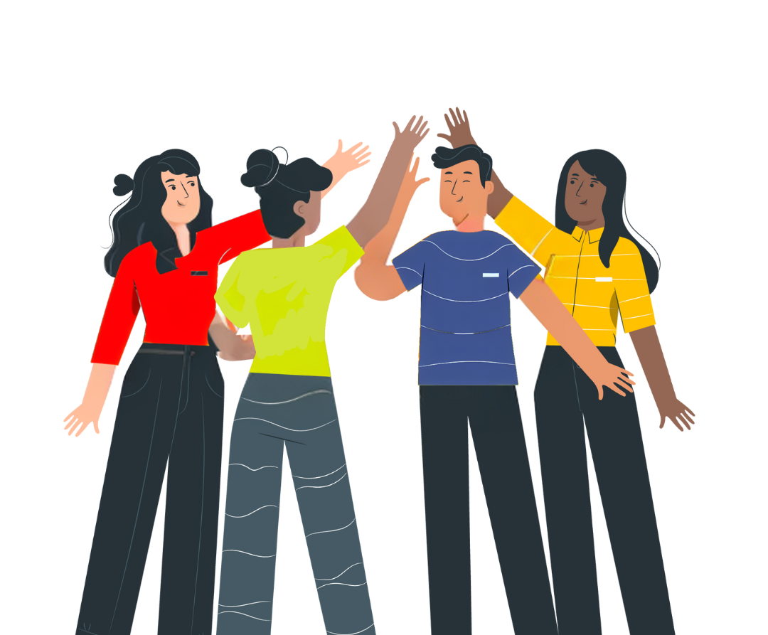


No Vote,
No Voice!
Registering to Vote and Understanding Civic and Democratic Participation
Funded by the Greater London Authority, City Hall, Kamal Chunchie Way, London, E16 1ZE
Notes:
Slide:
Opening slide
Speaker notes:
Welcome students and introduce the topic of political literacy. Contextualise the session in terms of the election landscape i.e. is this being delivered after an election? When will your students be old enough to register to vote, and to vote?

Slide 2
In this session we will explore the following questions:
What is civic and democratic participation, and how can I get involved?
What elections are there in London and how do I vote in them?
How can I use verified sources to find reliable information on democracy, elections, and voting?
Notes:
Slide:
Session aims
Speaker notes:
Go through the session aims and learning questions you will explore.

Slide 3
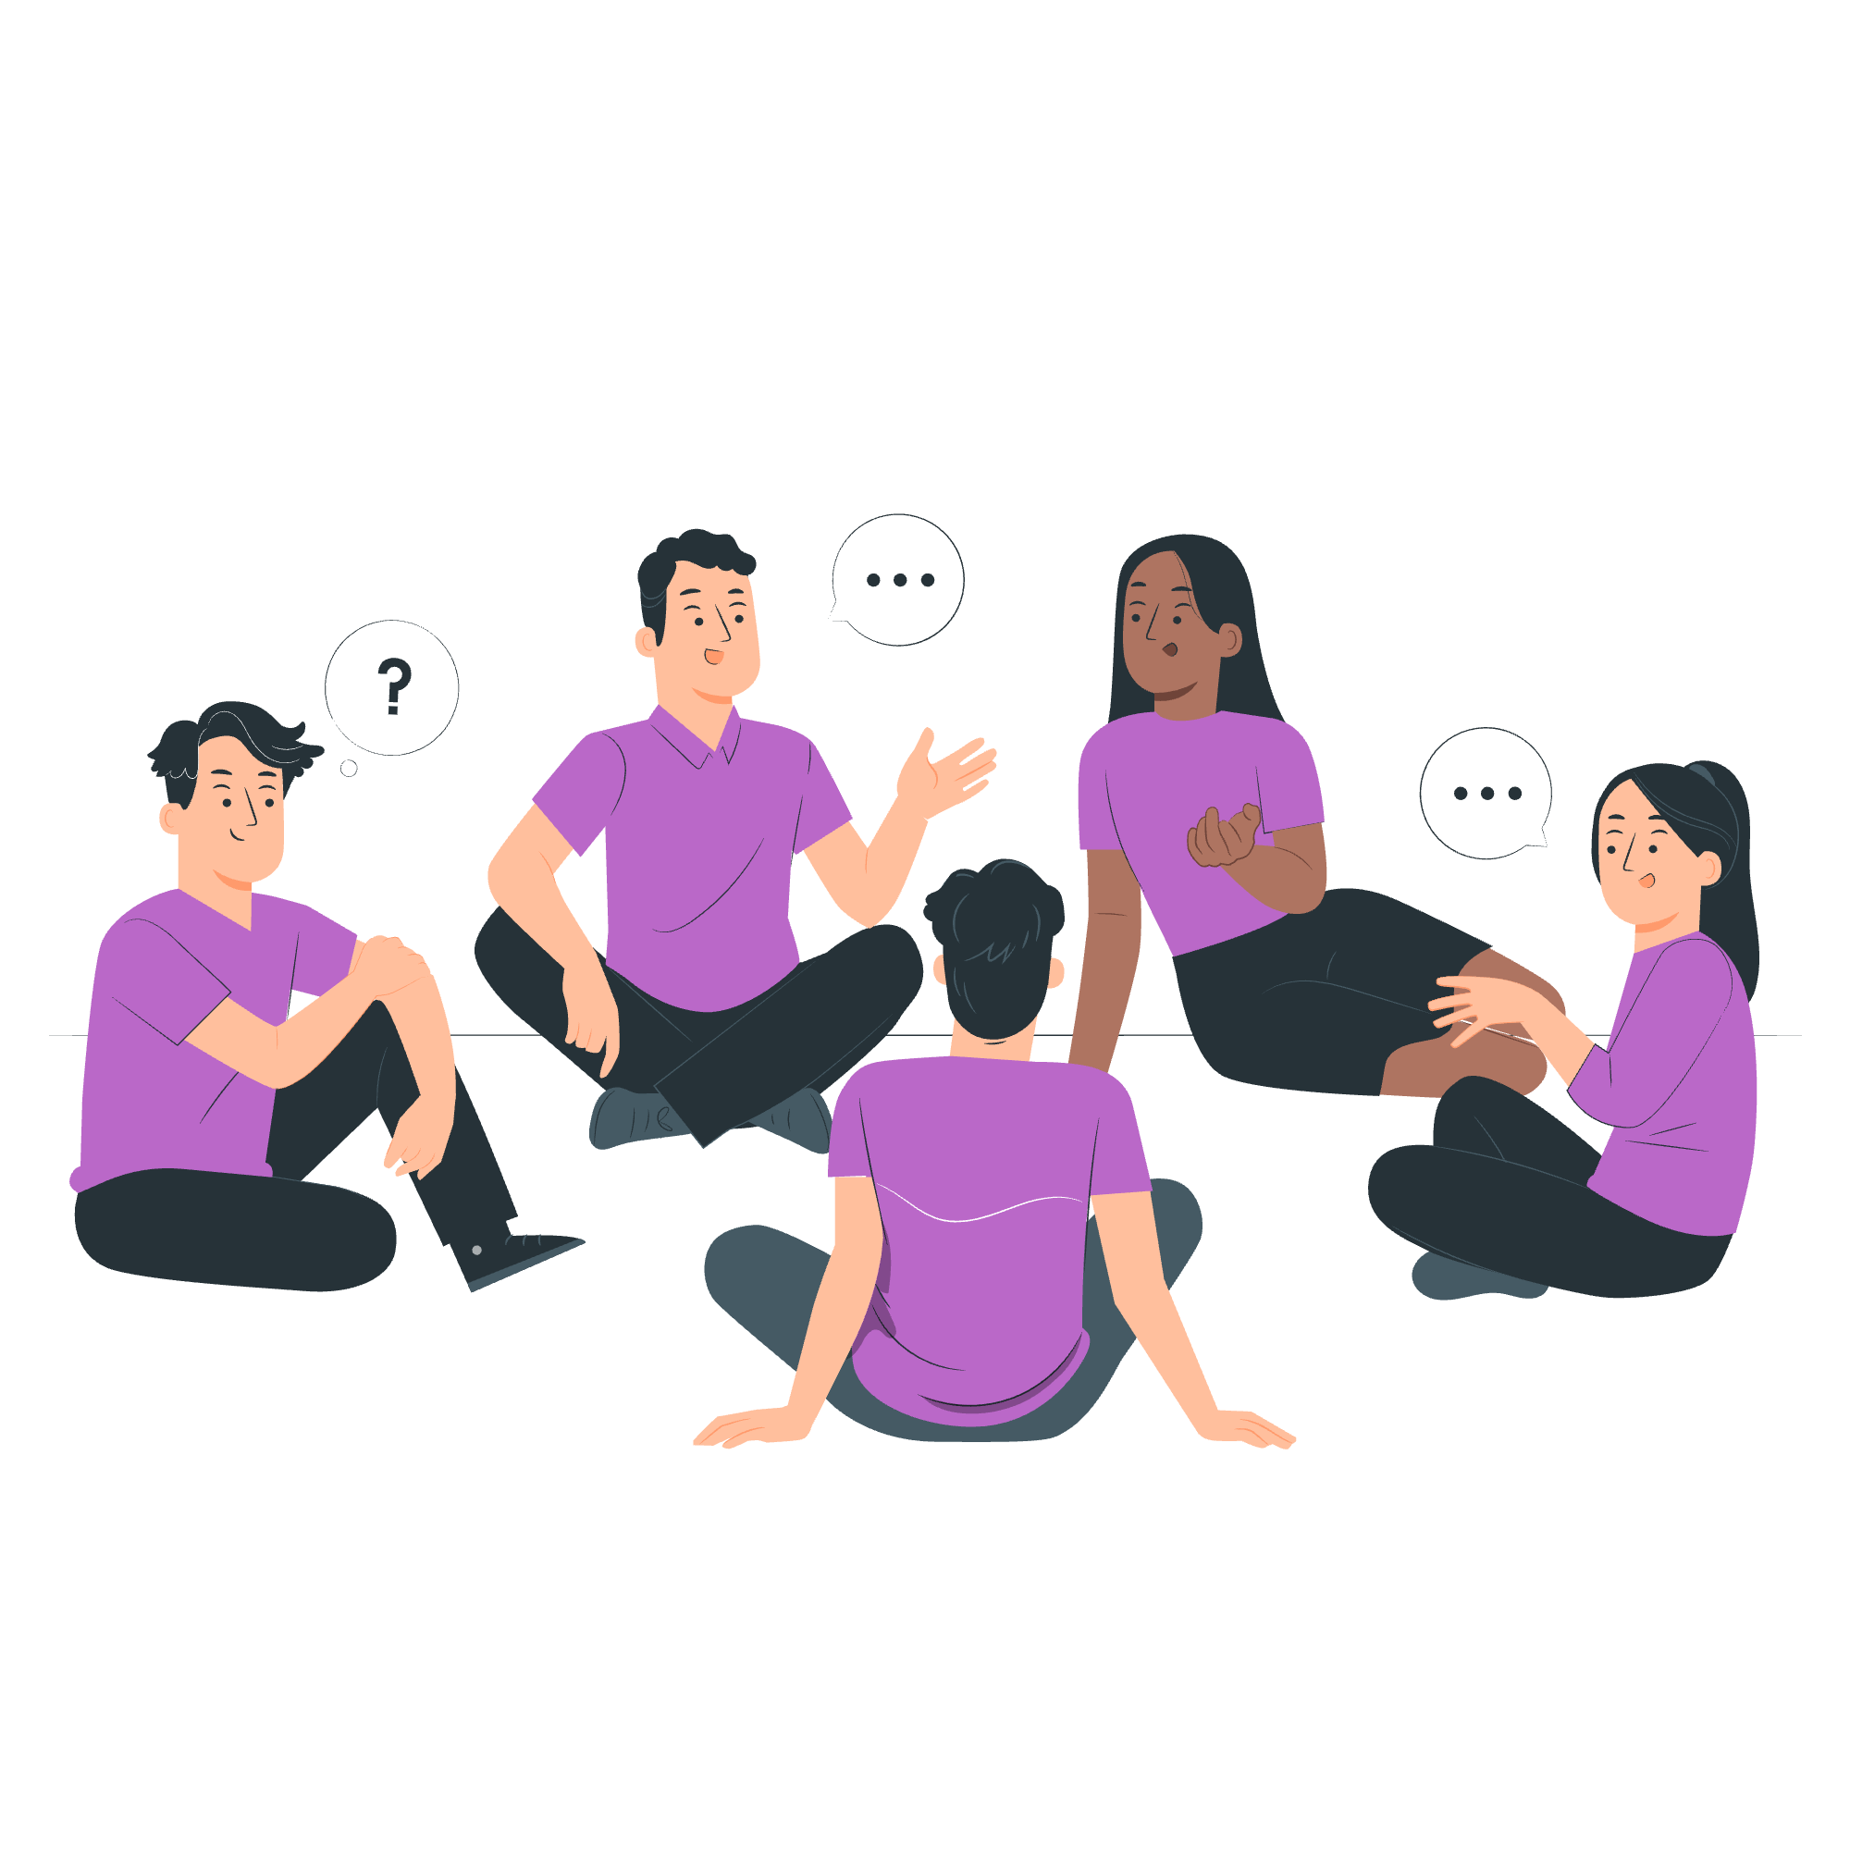
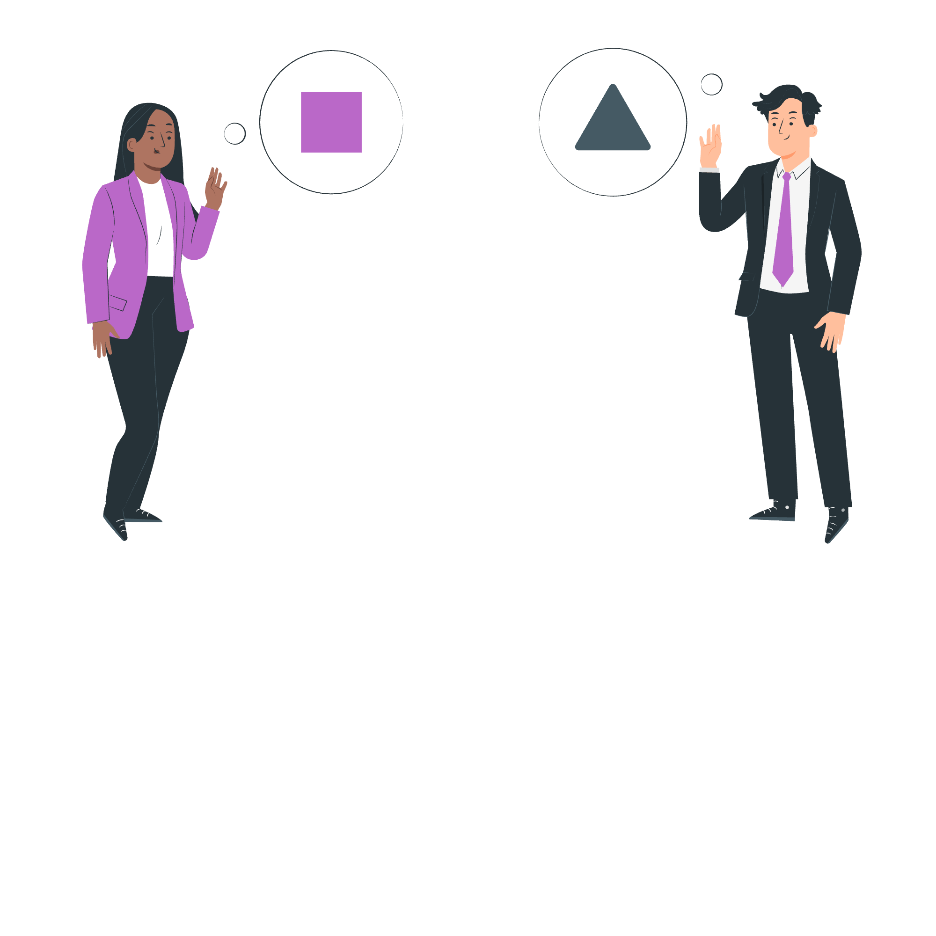
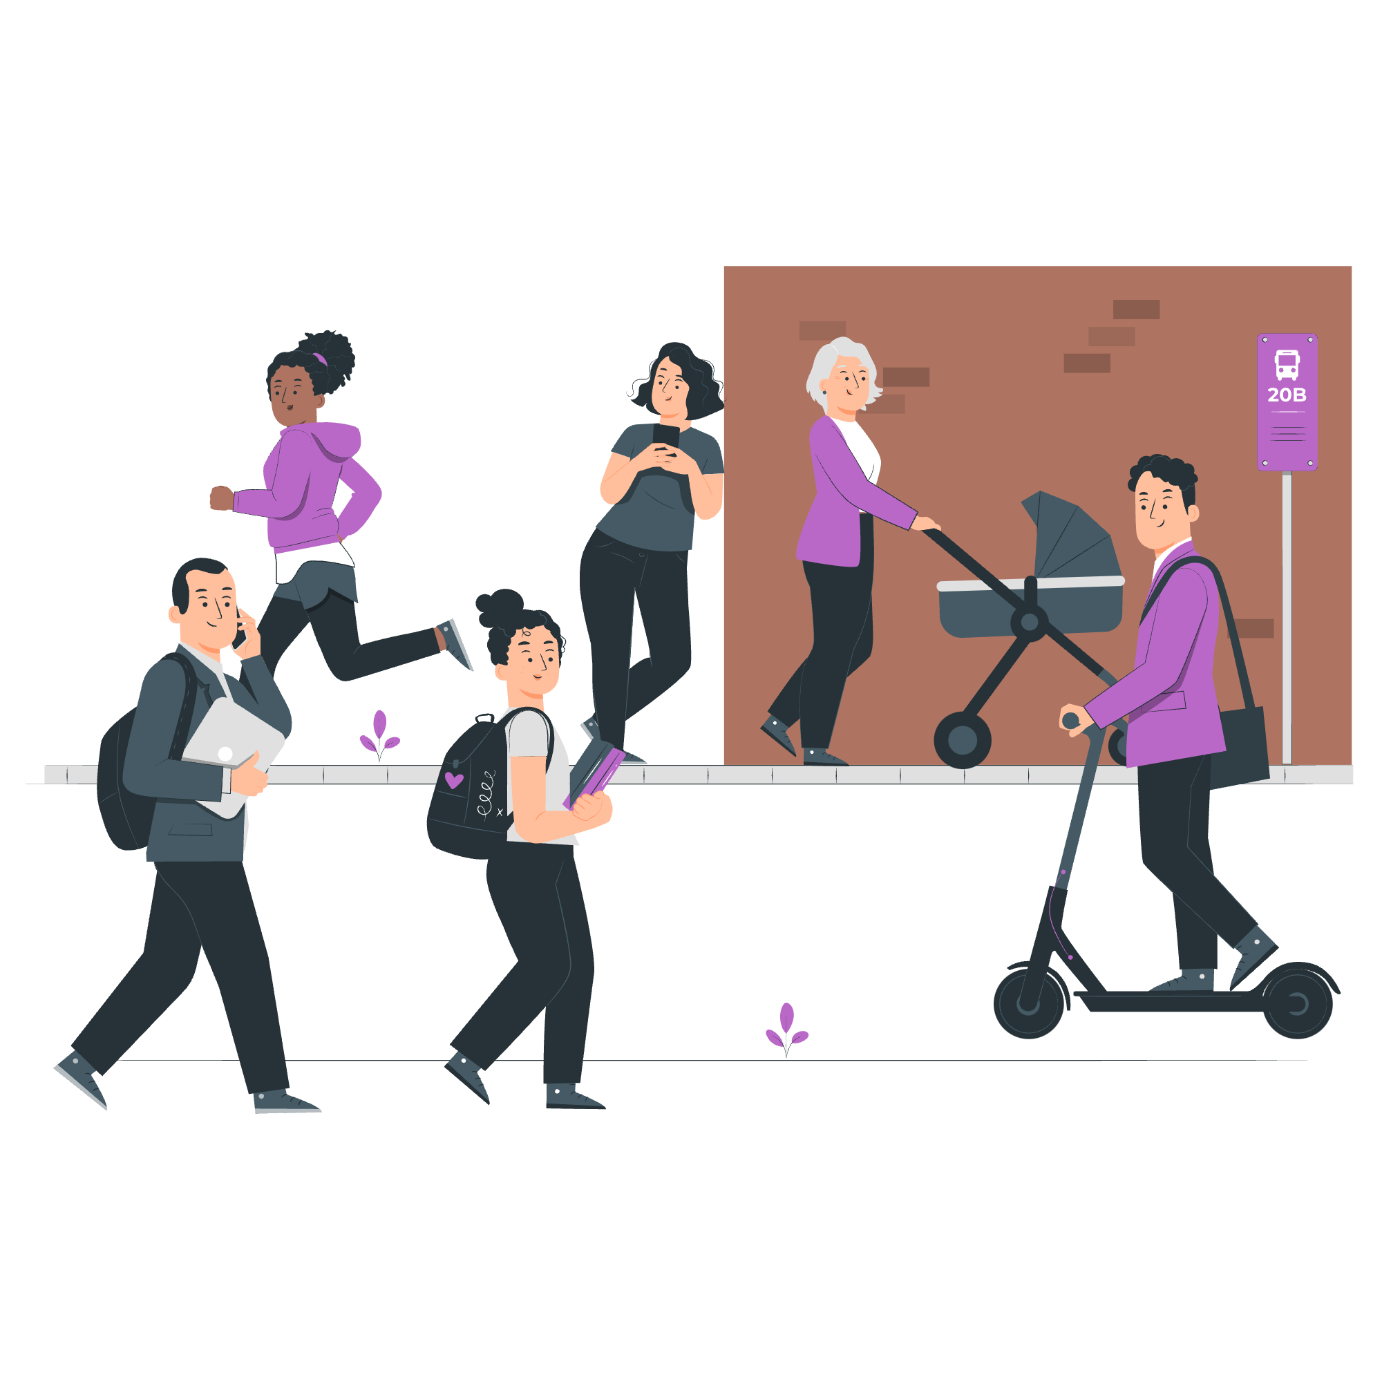

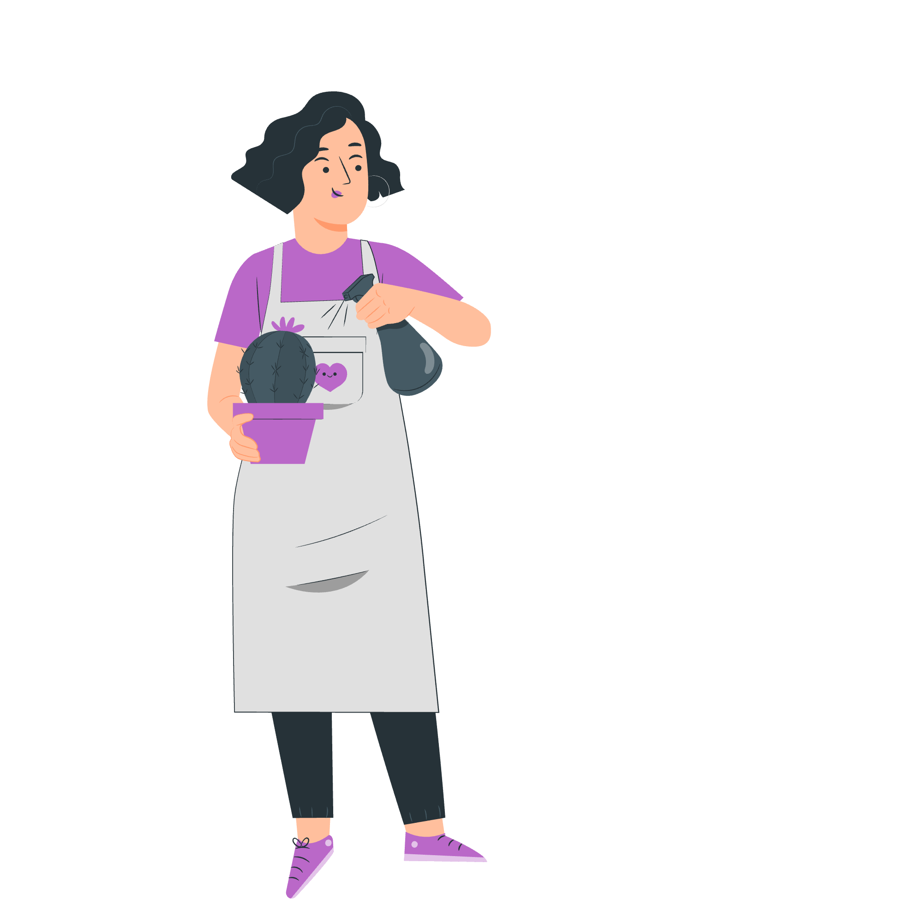

To have a voice
To build stronger communities
To engage with your representatives
Why participate in democracy and civic life?
To gain knowledge and skills
To support equality and justice
To make a difference on issues you care about
Notes:
Slide:
Why participate in democracy and civic life?
Speaker notes:
Display the mind map showing reasons people participate in democracy and civic life.
Discussion opportunity: Have students discuss other reasons for civic and democratic participation and ask for volunteers to share their ideas.

Slide 4
What is the difference between civic and democratic participation?
Civic participation includes:
Starting or signing petitions
Taking part in peaceful, legal protest
Being involved in community organising
Volunteering
Democratic participation includes:
Contacting your elected representatives
Registering to vote, if eligible
Voting in elections (local/borough council, Mayor of London, London Assembly, general elections)
Standing for elected office (e.g. as an MP or local councillor)
Notes:
Slide:
Civic and democratic participation
Speaker notes:
Explain the differences between democratic and civic participation using the table. These are examples, rather than a comprehensive list.

Slide 5
Civic participation
Starting or signing petitions
Official petitions appear on petition.parliament.uk. If a petition reaches 10,000 signatures, the government will respond. If it reaches 100,000 signatures, it may be debated in Parliament.
Taking part in peaceful, legal protest
Everyone has the right to protest in a peaceful and legal way. If you’re organising a protest, you may need to notify the police in advance.
Community organising and volunteering
Community organising brings local people together to create the change they want to see. Volunteering helps you gain skills, meet new people, and make a difference.
Notes:
Slide:
Civic participation
Speaker notes:
Explain civic participation and how it empowers people to take action on issues they care about. Points to note:
You don't have to wait until you're 18 to do these things.
British citizens or UK residents of any age can create petitions on gov.uk.
Community organising could include things like community clean-up days, fundraising for a local cause, donating for food banks, setting up an informal support group, or organising a clothes-swap event.
You could direct students to these sites for volunteering opportunities in London:
Simply Volunteer London | Discover Volunteering Opportunities Across The Borough/City
Flexible Volunteering Opportunities with Charities | GoVo

Slide 6
Democratic participation
Contacting your elected representatives
At any age, you can contact your MP, London Assembly member or local councillors to share your views, raise concerns or ask for help. You can write to them, email them or attend one of their local meetings or surgeries.
Registering to vote and voting, if eligible
If you are eligible to vote, you can currently register at 16, and vote at 18. Your vote will help choose the candidate(s) that will represent you.
Standing for elected office
If eligible, at 18, you can also become a candidate for Mayor of London, London Assembly member, Member of Parliament (MP), local councillor.
Notes:
Slide:
Democratic participation
Speaker notes:
Highlight examples of democratic participation and its importance. Please note that the activities featured in this are in the order that your students will be able to access them as they get older.
Discussion opportunity: Ask students if they’ve done any of the things mentioned on these last two slides.

Slide 7
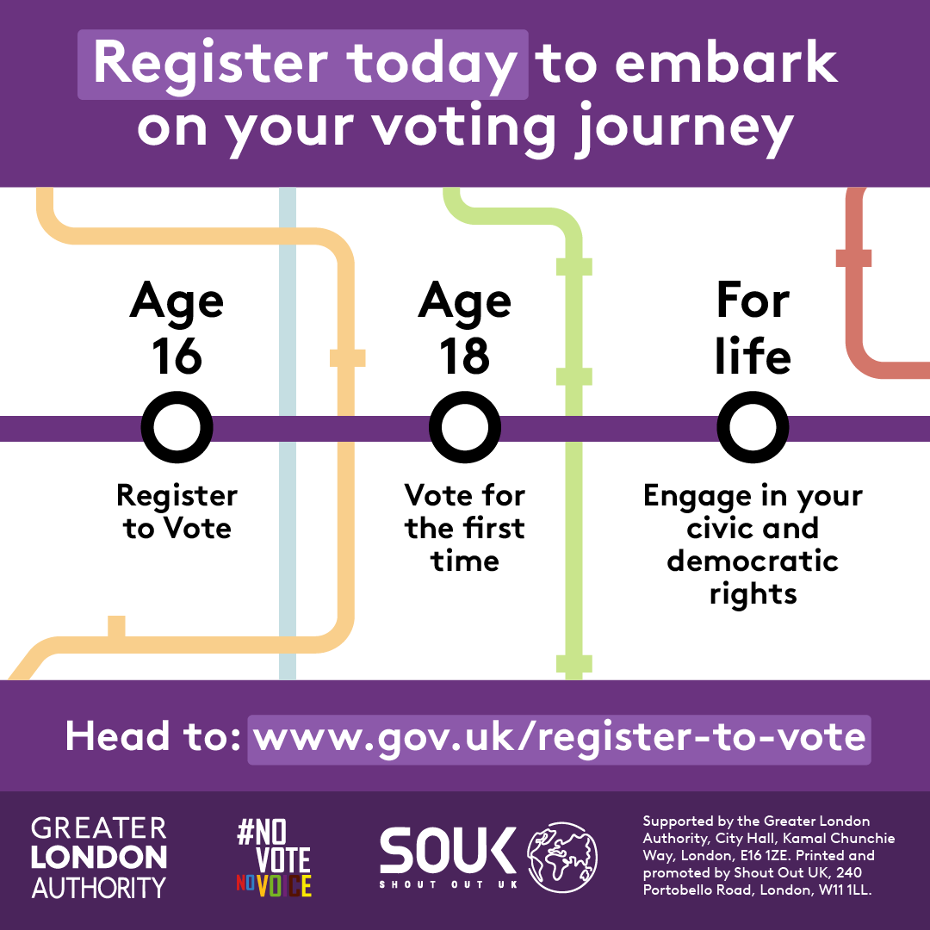
What key milestones do you have on the horizon?
Do you know how these milestones might change in the future?
There’s a bill currently going through Parliament called the Representation of the People Bill. A bill is a proposed new law or a change to an existing law that is debated in Parliament.
If this bill passes and becomes law, young people will be able to register to vote from 14 years old, and vote in all elections from age 16.
Check www.gov.uk/register-to-vote for the latest news and updates on voting rules.
Notes:
Slide:
Representation of the People Bill
Speaker notes:
Show the milestones graphic and ask students to discuss which milestones, if any, they have already reached.
Explain the Representation of the People Bill and that, if it passes, it will allow young people to register to vote from 14 years old and vote from 16.
Further information on the Representation of the People Bill - Representation of the People Bill - Parliamentary Bills - UK Parliament

Slide 8
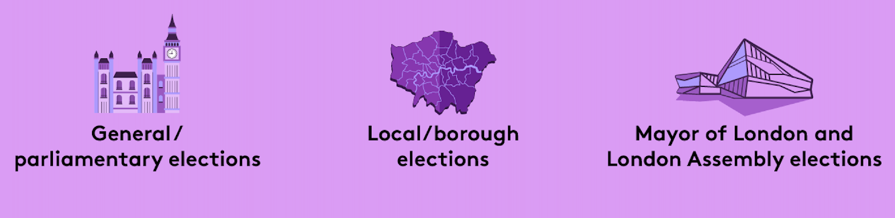
Who can you vote for?
There are three types of election in London:
Notes:
Slide:
Who can you vote for?
Speaker notes:
Present the three different structures that Londoners vote in. This is also an opportunity to discuss previous elections. For example, “in May 2024, Londoners voted for the Mayor of London and London Assembly members. In July 2024, Londoners voted in the General Election”.
Discussion opportunity: Discuss what different things you think these levels of government might be responsible for.

Slide 9

What is the Greater London Authority?
Mayor of London
The Mayor of London is elected to set city-wide/ regional priorities:
Transport for London
Mayor’s Office for Policing and Crime
London Fire Brigade
Housing
Environment
Culture and arts
London Assembly
The London Assembly holds the Mayor to account.
It is elected by Londoners, at the same time as the Mayor.
It is composed of 25 Assembly Members: 14 represent geographic areas (2 or 3 London boroughs) and 11 work pan-London.
Notes:
Slide:
What is the GLA?
Speaker notes:
Explain who the GLA is and the two parts it is made up of. This is a good opportunity to explain the structure of GLA including the roles and responsibilities of the Mayor of London, as well as the London Assembly. GLA officers are impartial and deliver the programmes and projects decided by the Mayor of London and scrutinised by the London Assembly.

Slide 10
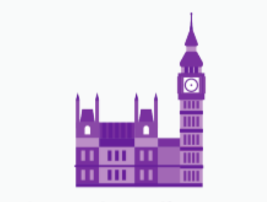
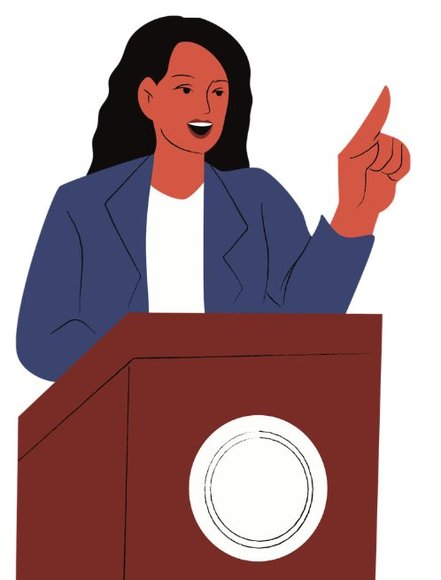
Who are Members of Parliament (MPs) and local councillors?
Member of Parliament (MP)
In a general election, you vote for the MP that you want to represent your constituency.
They can influence the decision-making in Parliament on things like:
The economy
Education
Healthcare
Housing
Environment
Councillor
Work in the borough council (the local authority), which oversees this and more:
Council tax collections
Rubbish and recycling
Arts and leisure services
Housing (borough)
Environment (borough)
Health and wellbeing
Notes:
Slide:
Who are MPs and local councillors?
Speaker notes:
Explain what an MP and local councillor is and the areas of policy they influence. Mention the name of the school’s local constituency MP, or look it up here: Find your MP - MPs and Lords - UK Parliament. Not all students will be from the same constituency as the school, so make this clear.

Slide 11
Which London residents are eligible to vote in these elections?
 | General/ parliamentary | Local/ borough | Mayor of London and London Assembly
Must be at least 18 years of age to vote (you can register from 16 years of age) | ✅ | ✅ | ✅
British or Irish citizens | ✅ | ✅ | ✅
Qualifying Commonwealth citizens | ✅ | ✅ | ✅
Qualifying EU citizens or EU citizens with retained rights | ❌ | ✅ | ✅
For further information on eligibility, head to electoralcommission.org.uk
Notes:
Slide:
Voter eligibility
Speaker notes:
Outline the eligibility requirements to vote in London elections.
For further definitions of eligible EU citizens and eligible Commonwealth citizens please click on the Electoral Commission links provided.

Slide 12



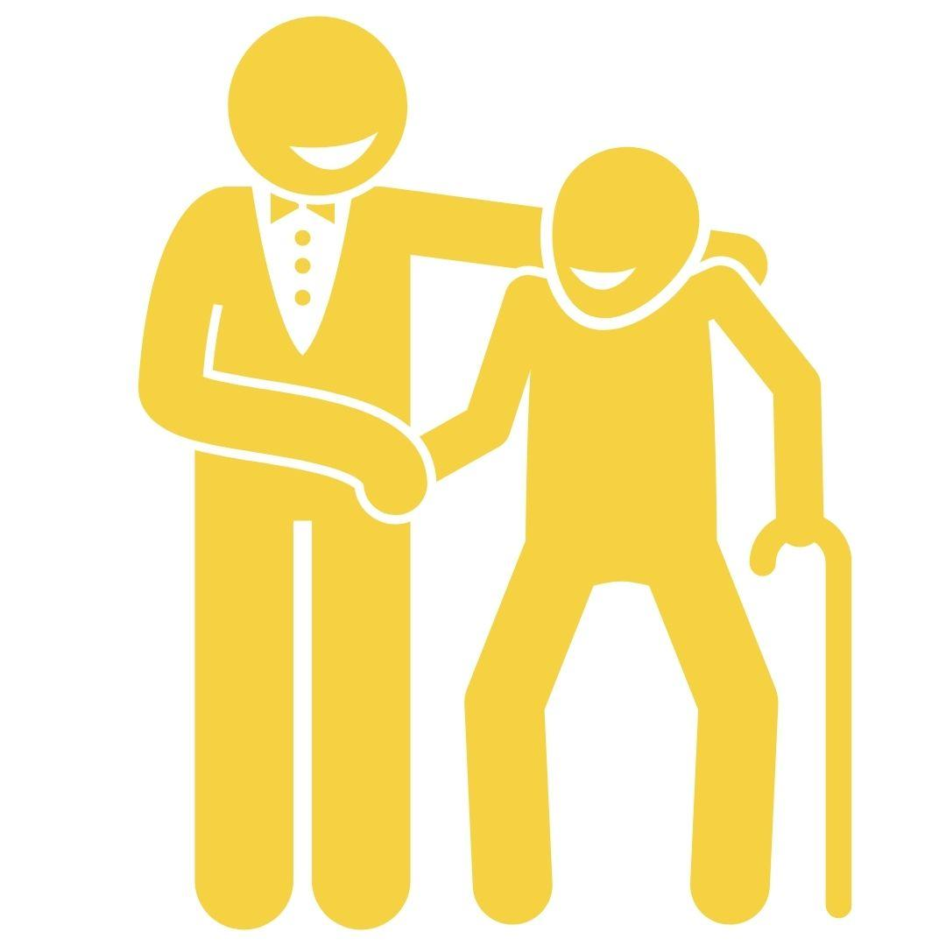
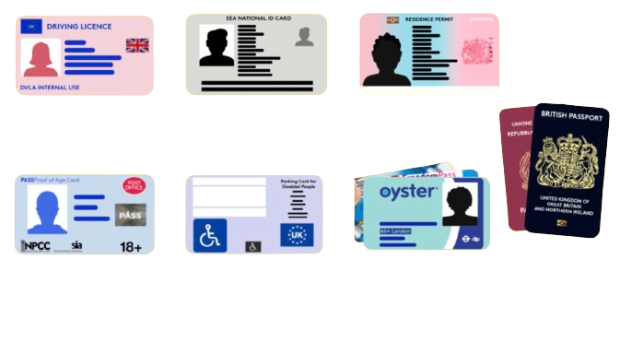
How can you have your voice heard in the voting system?
1
To register to vote, head to gov.uk/register-to-vote
2
You can vote in person, by post, or by proxy
UK, Channel Islands or EEA driving licence
3
You need an accepted form of photo ID to vote in person
These include, but are not limited to:
Blue Badge scheme card
UK, Commonwealth
or EEA passport
Notes:
Slide:
Voting basics
Speaker notes:
Present the 3 key points about voting. Highlight that student IDs and a young person’s Oyster card are not accepted forms of photo Voter ID.

Slide 13
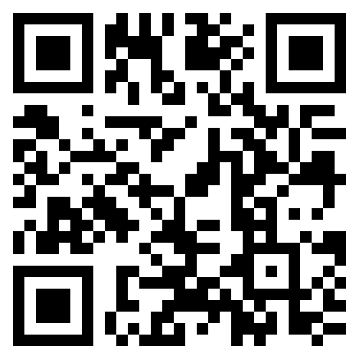
How can I register to vote?
Make sure you meet the eligibility criteria
Make sure you have the following information:
  Your name
  Your date of birth
  Your address
Go to gov.uk/register-to-vote or scan this QR code
Fill in the form: don't worry if you do not have a National Insurance number.
Notes:
Slide:
How to register to vote
Speaker notes:
Ask students to get out their devices and scan the QR code on the screen to register to vote.
Any students who do not have devices can observe how their classmates register now and register themselves later, at home.
Reassure students that they may still register to vote if they do not have their National Insurance Number with them. Circulate and help any students who need support.
After registering, students can keep their devices handy for the Scavenger Hunt activity.

Slide 14
Start or sign petitions!
Remember you can start a petition on an issue that matters to you.
petition.parliament.uk
london.gov.uk/london-assembly-petitions
Meet your MP!
Most MPs will have days and times that they are available, known as ‘surgeries’.
Attend a hustings event! This is a meeting where candidates from different parties debate. This is normally before an election.
How else can you connect with your representatives?
Follow what your representatives are saying! You can find transcripts and voting records on hansard.parliament.uk
Contact your representatives!
Anyone can email their MP, London Assembly member or local councillor. Find out how on WriteToThem.com
Take part in peaceful and legal protest!
Show up for issues that matter to you.
Notes:
Slide:
Connecting with your representatives outside of election times
Speaker notes:
Explain how students can engage with their representatives.
Highlight that everyone can do these actions; you do not need to be eligible to vote to do so.
Discussion opportunity: With your class, explore some of the links to find out information about your local area.
Discussion opportunity: Conduct a quick quiz to test knowledge about local representatives. Ask questions such as “Who knows the name of the MP for our constituency?” or “Who knows the name of the Mayor of London?”

Slide 15
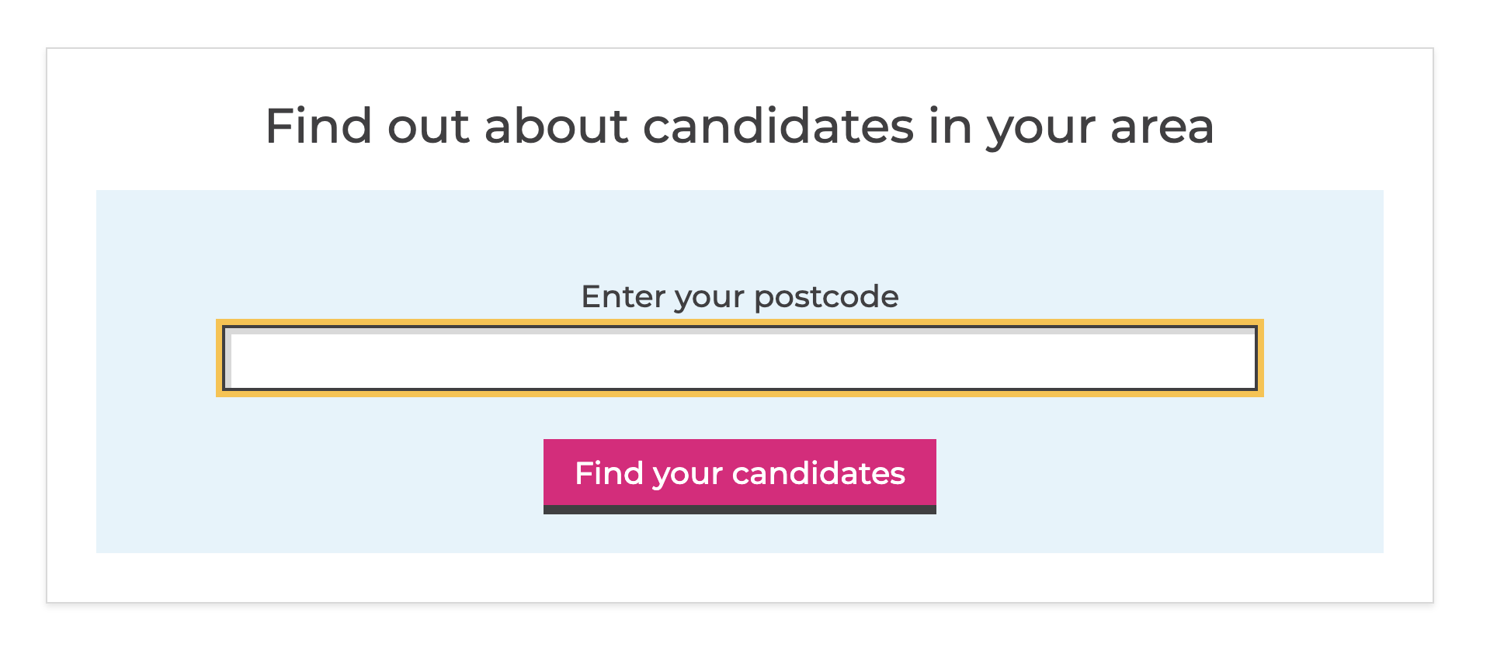

Where can I find more information?
GLA Democracy Hub
Provides resources and a comprehensive FAQ in both Easy Read and community languages. You can also use a WhatsApp chatbot (+44 7908820136) to answer questions you may have!
Who Can I Vote For?
Helps to find the candidates in your area, at various elections, based on publicly - available information.
TheyWorkForYou
Tells you the voting record on policy issues and public statements from Members of Parliaments and others.
Notes:
Slide:
Further information
Speaker notes:
Signpost to the websites provided. Please note these are linked so you can explore them as a class if you have time.

Slide 16
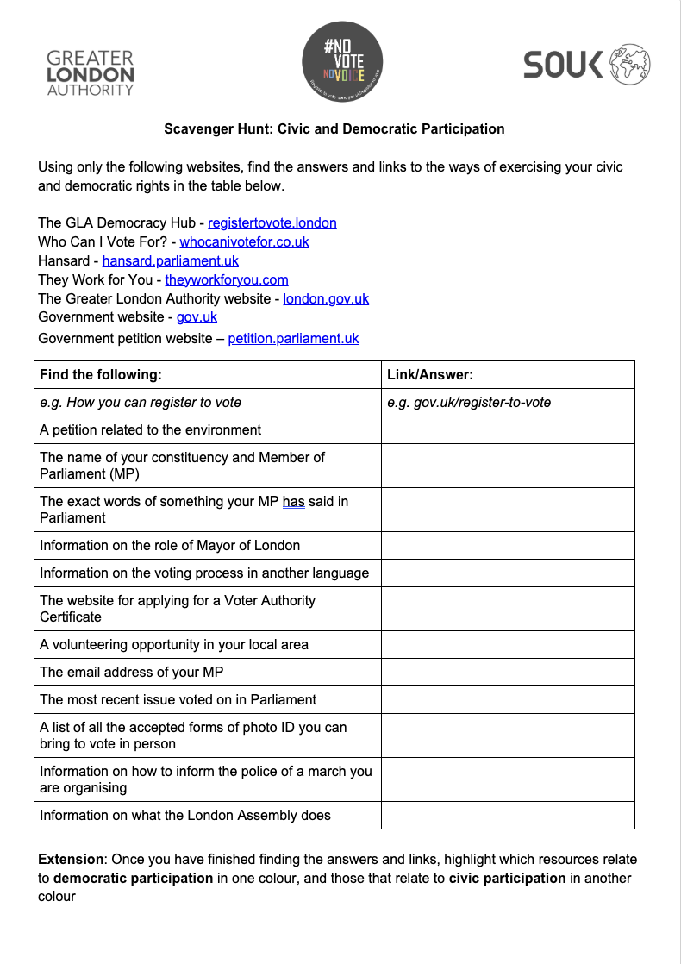
Digital democracy scavenger hunt!
You will need:
A device with internet connection
A pen
A copy of this worksheet →
Notes:
Slide:
Digital democracy scavenger hunt
Speaker notes:
If they are not already distributed, hand out the Scavenger Hunt worksheets, one per student.

Slide 17
Digital democracy scavenger hunt!
Get your worksheet ready!
Use only the websites on the worksheet to find answers. No search engines or AI are allowed.
How many answers can you find in 10 minutes?
Notes:
Slide:
Digital democracy scavenger hunt
Speaker notes:
Introduce the activity and read out the instructions. Give students ten minutes to complete the activity.
Circulate and support students in completing the activity.
If there is enough time, go through the questions and compare answers as a group.

Slide 18
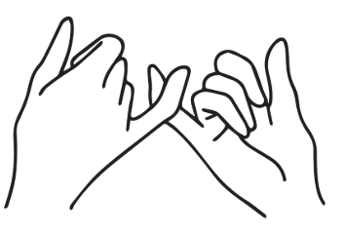
Democracy pledge
Can you talk to three people after this session about voting, civic and democratic participation, and getting your voice heard? ​
Notes:
Slide:
Pledge
Speaker notes:
Take a show of hands for students who pledge to talk to three people about civic and democratic participation this week.

Slide 19

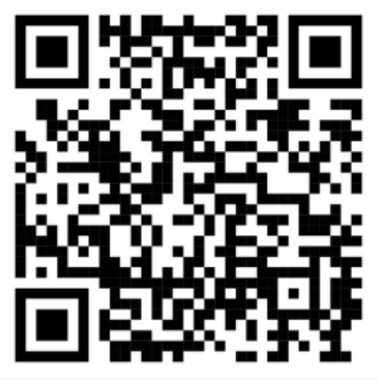
Your voice matters - make sure it gets heard!
Check out the GLA Democracy Hub registertovote.london to:
Find more information on your civic and democratic rights
Find comprehensive answers to FAQs
Check the Democracy WhatsApp chatbot (+44 7908820136) and #NoVoteNoVoice WhatsApp channel
Find accessible resources, including in different languages
Notes:
Slide:
GLA Democracy Hub
Speaker notes:
Signpost students to the GLA Democracy Hub for more information, highlighting the community language resources, WhatsApp channel, and chatbot.

Slide 20

Thank You!
For more information contact the
GLA Democratic Participation Team at: democracy@london.gov.uk
Funded by the Greater London Authority, City Hall, Kamal Chunchie Way, London, E16 1ZE
Notes:
Slide:
Conclusion
Speaker notes:
As a plenary, ask students to discuss what they learnt today that they didn’t know previously. Ask the students to feedback to the class. Wrap up the session by encouraging students to get their voices heard and emphasise that they are at the beginning of their relationship with democracy and civic life, but this is something that continues for the rest of their lives. It is in their hands to shape the future of London!

