Slide 1



No Vote, No Voice!
Masterclass:
How to Lead a Voter Registration Drive
Funded by the Greater London Authority, City Hall, Kamal Churchie Way, London, E16 1ZE
Notes:
Welcome students and introduce the GLA Voter Registration Toolkit, including the aims and objectives of this toolkit and why this is important. Contextualise this in terms of the current landscape, with votes at 16 being on the horizon and the importance of young people getting their voice heard.

Slide 2
In this session we will:
Explore ways of running a voter registration drive.
Understand key information about eligibility, voting rights, and ways of voting for Londoners.
Be able to answer basic questions on elections in London in an impartial way.
Create an action plan to run a voter registration drive.
Notes:
Walk through the aims briefly. Emphasise that the session is practical, not just theory. Let participants know they will leave with knowledge, confidence, and a clear action plan to run a voter registration drive.

Slide 3
Activity: One word
Three prompts will appear one by one; you need to give a one-word response that explains how you feel towards that prompt.
There are no right or wrong answers – just honest reactions!
Community
Power
Young People
Icebreaker adapted from The Politics Project’s At the Table Toolkit
Notes:
This is an icebreaker activity designed to spark thinking and discussion. Explain the rules clearly and emphasise that there are no right or wrong answers. The aim is open, honest discussion. Encourage quick responses and reassure participants that they only need to explain their word if they choose to.

Slide 4
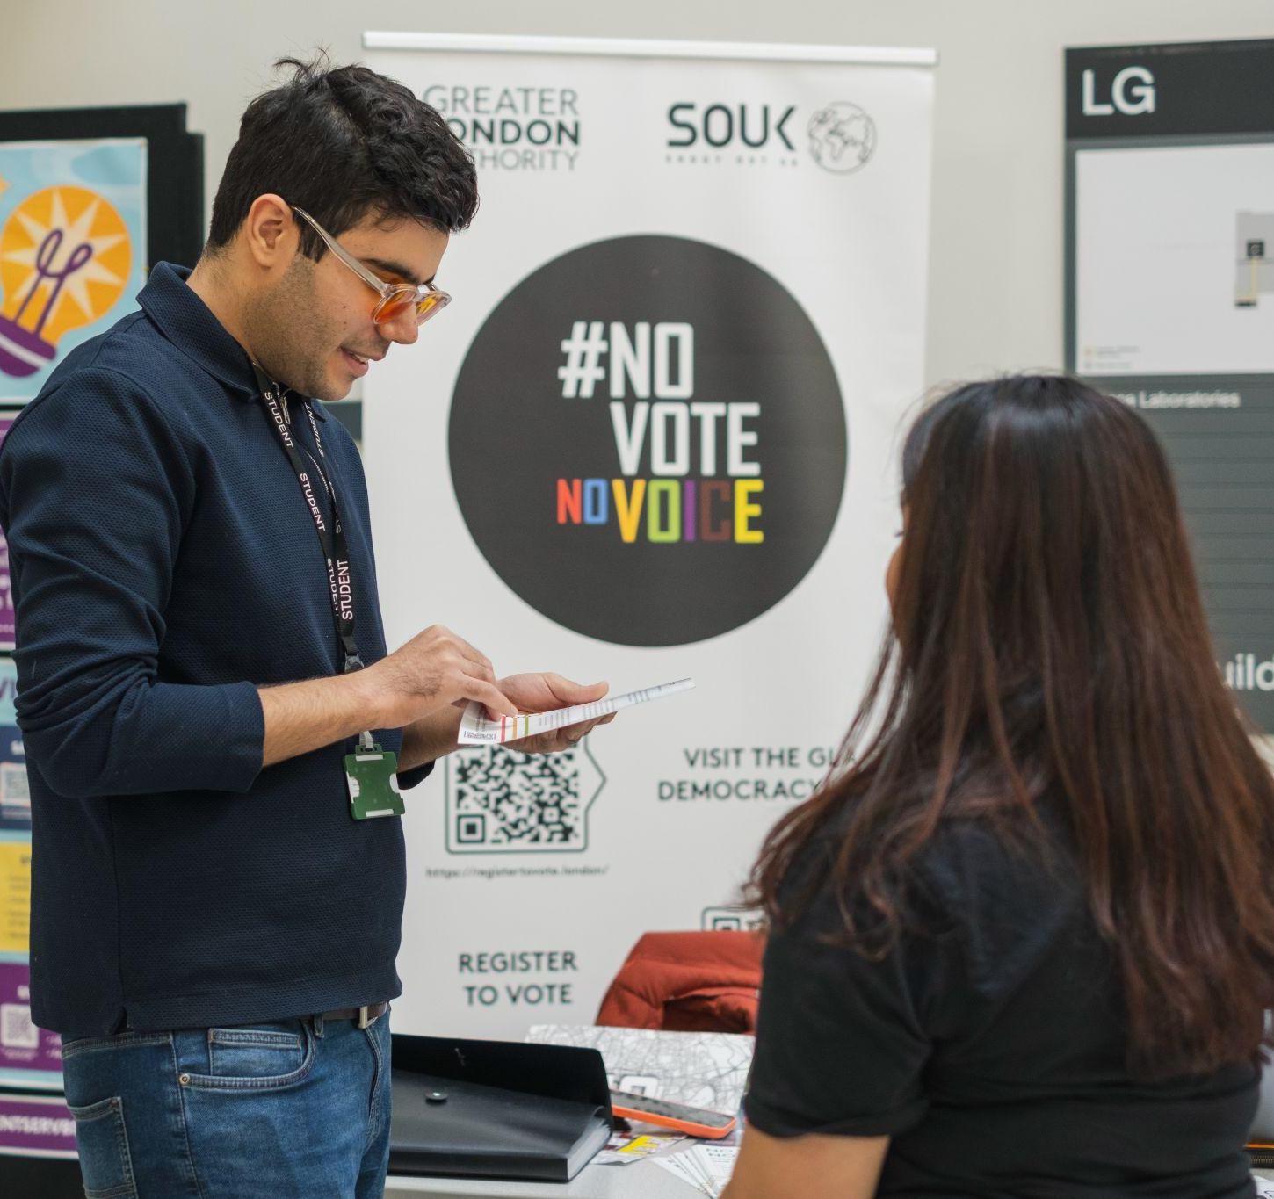
What is the GLA’s Civic and Democratic Participation Programme?
The GLA and Shout Out UK run events and create resources across the year as part of our Civic and Democratic Participation programme. This programme aims to help people in London:
Register to vote
Know what elections they can vote in
Understand how all Londoners can get their voice heard and help shape their city
By running your own voter registration drive, you can be part of this important work!
Notes:
Explain what the GLA Civic and Democratic Participation Programme is and how this activity fits in with shaping London together.

Slide 5
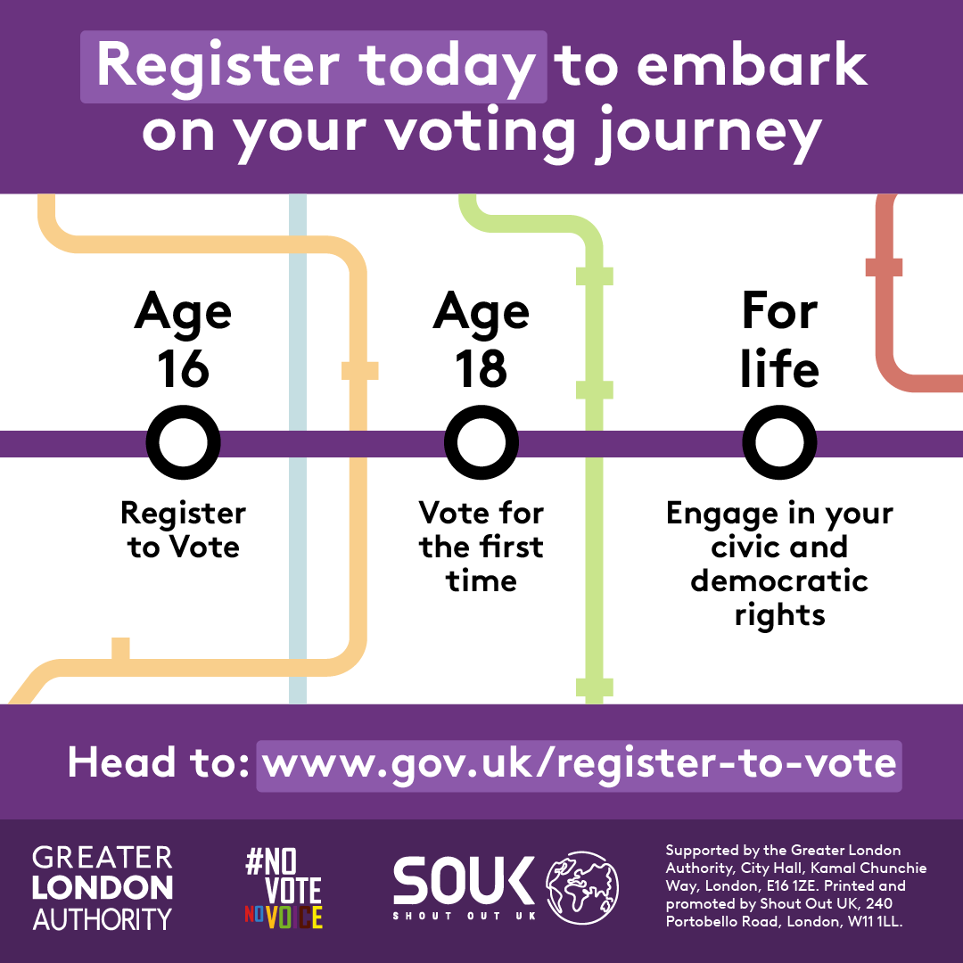
What voting milestones do young people have on the horizon?
Do you know how these milestones might change in the future?
There’s a bill currently going through Parliament called the Representation of the People Bill. A bill is a proposed new law or a change to an existing law that is debated in Parliament.
If this bill passes and becomes law, young people will be able to register to vote from 14 years old, and vote in general elections from age 16. Check www.gov.uk/register-to-vote for the latest news and updates on voting rules.
Notes:
Explain the “Young Londoners - key dates” asset to the audience and highlight the importance of registering to vote and making note of the key dates for their own reference, and to also share it with their friends, family and wider community.
Explain the significance of the Representation of the People Bill and what it would mean for voter registration and voting age. Further information on the Representation of the People Bill - Representation of the People Bill - Parliamentary Bills - UK Parliament.

Slide 6
True or False? Young Londoners (aged 16-25) are less likely to be registered to vote than older Londoners.
TRUE
TRUE
FALSE
70% of Londoners aged 16-24 are registered to vote, compared with 96% of Londoners aged 65 and over.
Source: GLA Survey of Londoners 21-22
Notes:
Emphasise the importance of young people getting registered to vote, through existing stats. Young people are currently disproportionately under-registered, therefore they are currently less likely to have their voices heard in decision-making.

Slide 7
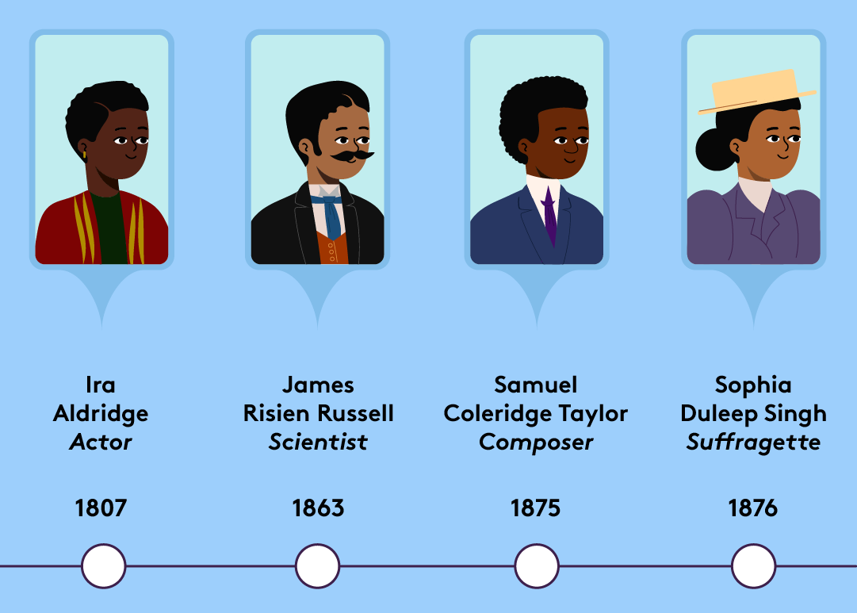
Many voices have shaped London’s history.
What do you already know about:
Who is eligible to vote?
How voting rights have changed over the years?
How else can you have your voice heard beyond voting?
Notes:
To be delivered in the following format: Think, pair, share.
Following on from the previous slide, emphasise the history and significance of making your voice heard in London’s democracy by showcasing the "Diverse Voices" asset. Encourage discussion around the questions above to stimulate conversation about students’ existing knowledge of their civic and democratic rights.

Slide 8
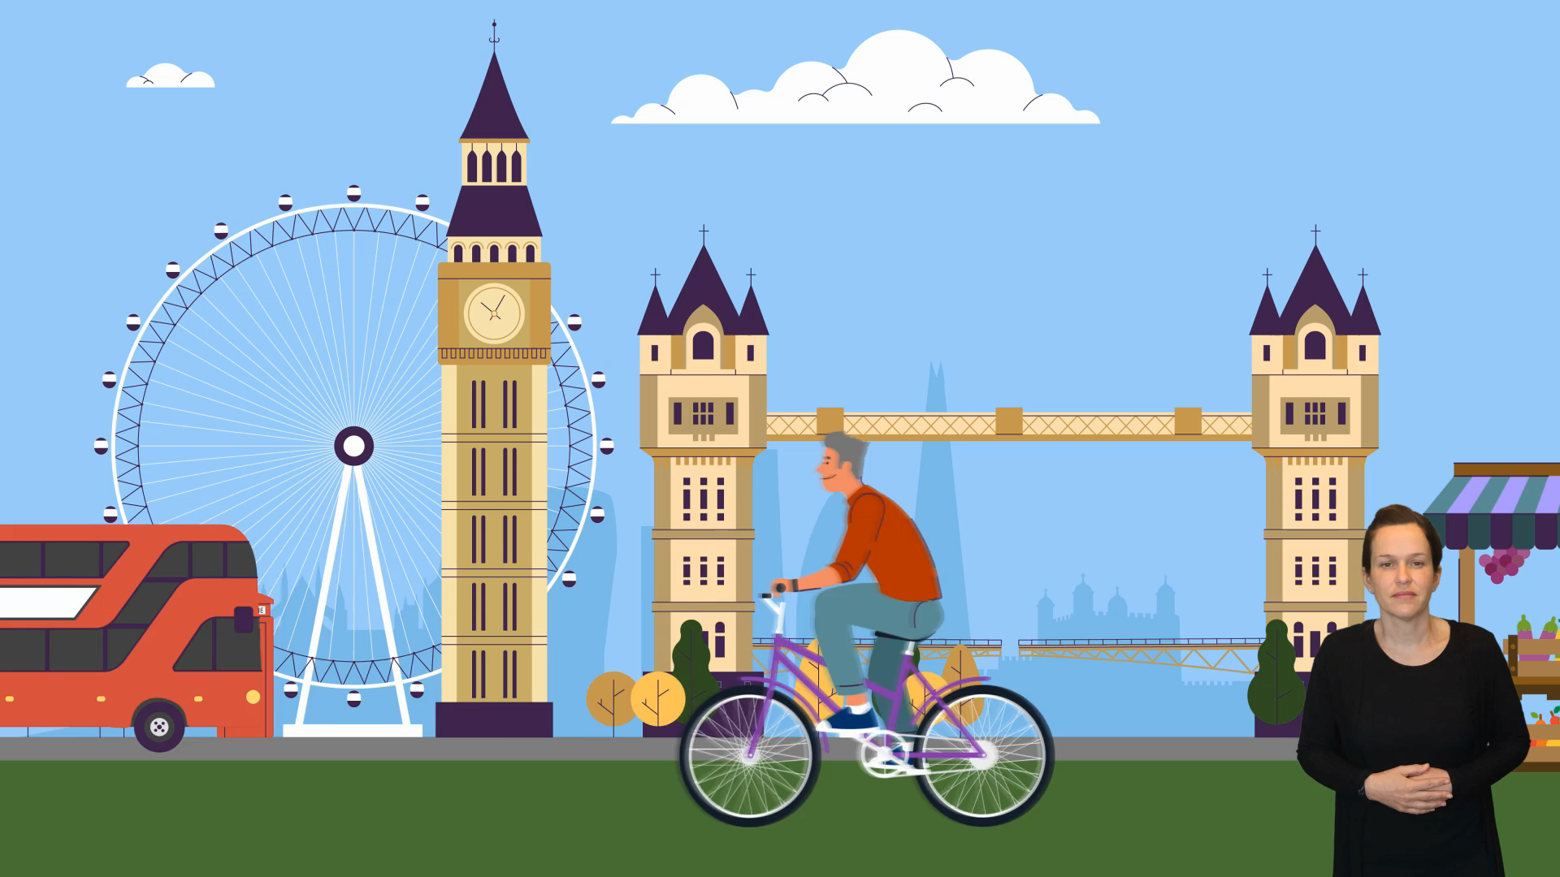
Notes:
Play the animation to introduce voting in London, including essential information on how to register to vote, key dates, eligibility etc

Slide 9
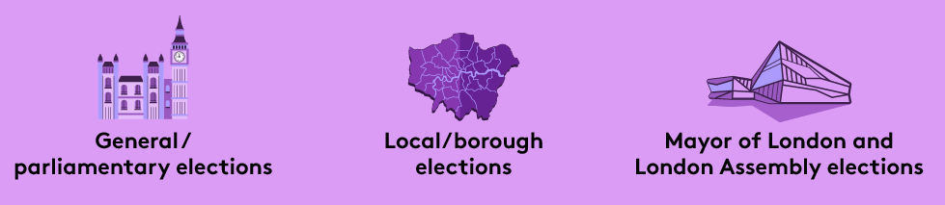
Who can you vote for?
What are the three elections in London?
Notes:
Introduce the various types of elections in London. Ask the students first to elicit answers and see which ones they already know. Highlight how some of them can have different names.

Slide 10
Which London residents are eligible to vote in these elections?
 | Mayor of London and London Assembly | Local/borough | General
Must be at least 18 years of age to vote (you can register from 16 years of age) | ✅ | ✅ | ✅
British or Irish citizens | ✅ | ✅ | ✅
Qualifying Commonwealth citizens | ✅ | ✅ | ✅
Qualifying EU citizens or EU citizens with retained rights | ✅ | ✅ | ❌
For more information on eligibility, let’s check out the Voter Eligibility Flow Charts…
Notes:
This slide uses content from the Introduction to voting in London FAQs section. It gives a short overview of who can register to vote in London and how the registration process works.
Explain that someone can register if they live in London, are aged sixteen or over, and are a British, Irish, qualifying Commonwealth or EU citizen, or an EU citizen with retained rights. The FAQs also outline which groups can vote in different elections. Finish by signposting students to the voter eligibility flow charts.

Slide 11

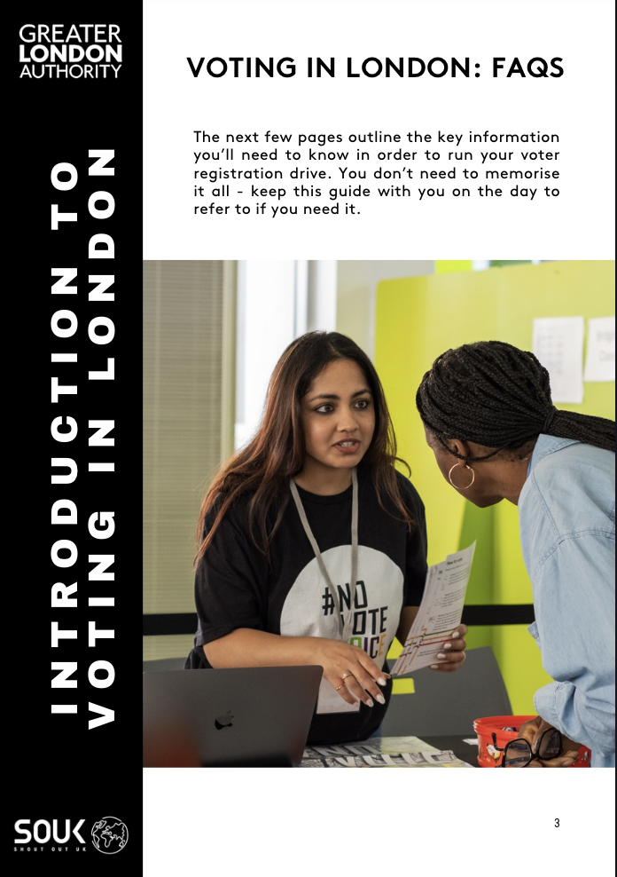
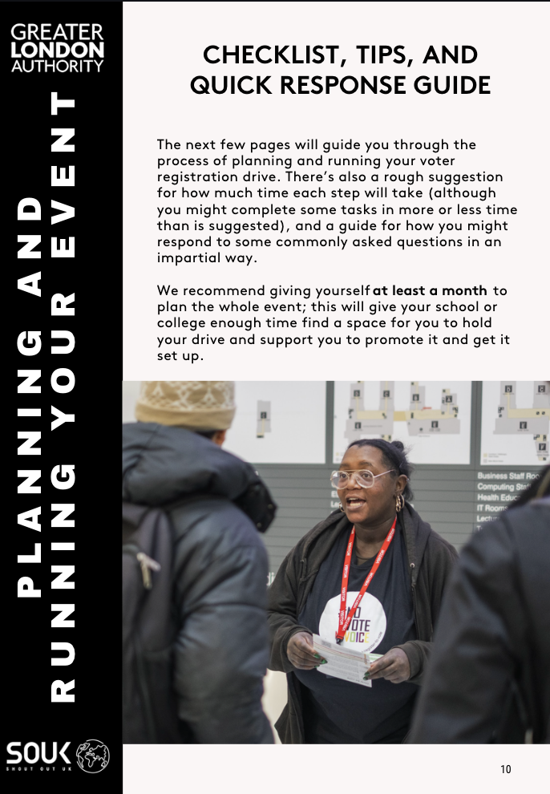
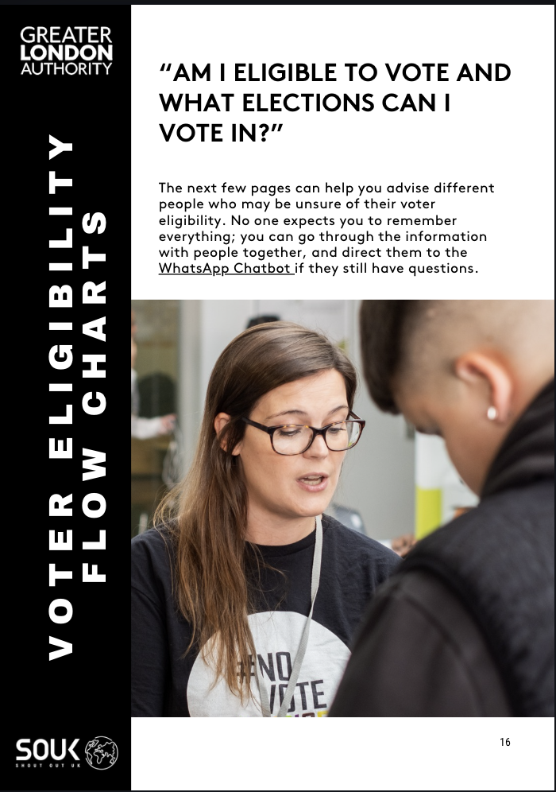
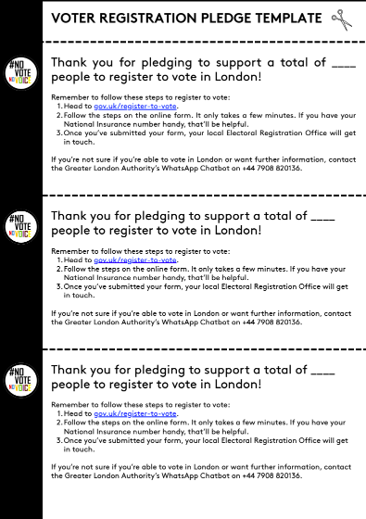
What is included in the Voter Registration Toolkit?
Support with planning and preparation:
Resources for on the day:
Certificate of completion:
Notes:
This slide introduces all the components/sections of the voter registration toolkit, including a checklist and top tips for running an impartial voter registration drive, a flow chart to check if you are eligible to vote, a printable pledge template, some political literacy resources and a skills-building certificate for facilitators.
These key documents chould be printed out for the session so that they can be used throughout the exercises.

Slide 12

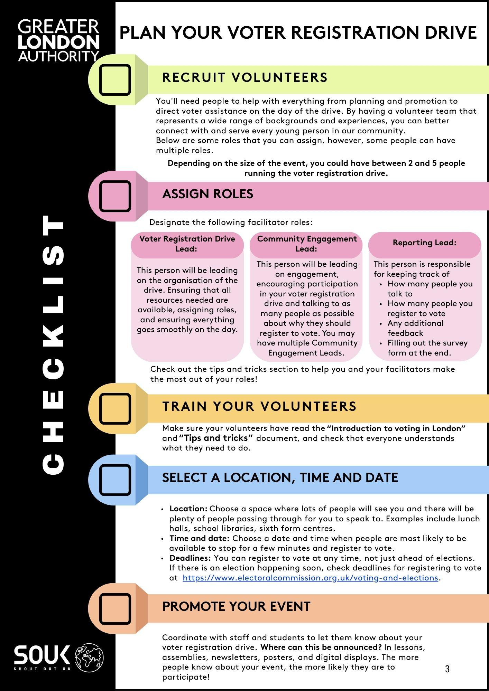
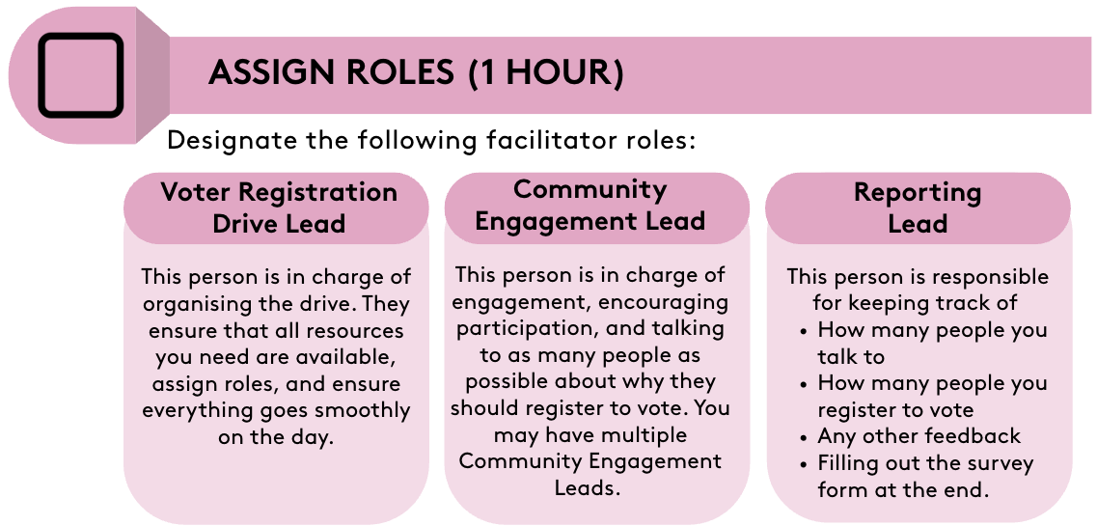
Getting started: Using the Voter Registration Toolkit
What do you think you should consider when recruiting volunteers?
Notes:
Explain that we are going to look at the practical side of running a voter registration drive first and then move into what kind of knowledge we need to support Londoners.
This slide introduces the organiser checklist, which is the backbone of the entire voter registration drive. Explain that the checklist walks students through every step they need to take, starting with recruiting volunteers and assigning roles, through to choosing a location and promoting the event. Emphasise that the checklist helps students stay organised and ensures that nothing important is missed. Point out that this structure gives them confidence and clarity, especially if it is their first time running a civic activity.
Discuss the different volunteer roles included in the toolkit. Describe the three key roles in a clear and friendly way. The Drive Lead is responsible for coordinating the event and making sure everything runs smoothly. The Community Engagement Leads are the people who speak to students and staff, answer questions and encourage participation. The Reporting Lead keeps track of conversations, registrations and pledges so the team can evaluate the impact of the drive. Make clear that the roles help split responsibilities, but that they can be combined if the team is small. The goal is to show students that a well-organised team makes the entire event easier and more enjoyable.

Slide 13
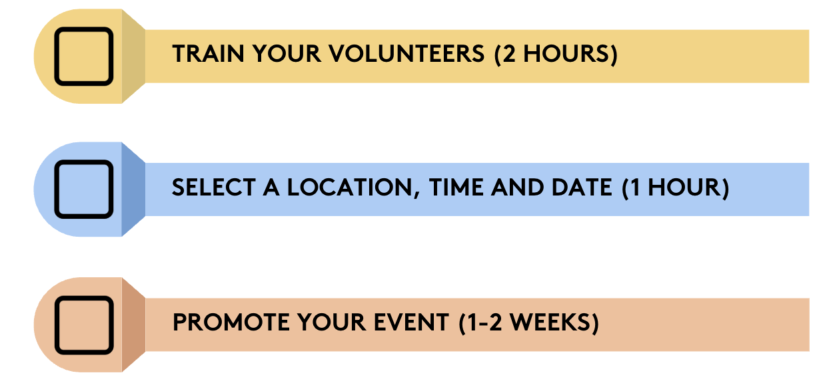
Getting started: Using the Voter Registration Toolkit
What resources do you have available to you in the toolkit?
What should you consider to maximise impact?
How can you best let people know about your event?
Notes:
This slide introduces the eligibility flowchart and the key resources included in the toolkit, as resources available for preparation. Explain that the flow chart helps volunteers quickly check whether someone can register to vote by guiding them through simple questions about age, nationality and residency. Reassure students that they do not need to memorise anything because the flow chart does the work for them. Encourage students to print these posters and place them somewhere visible during the drive so people can register instantly using their phones. Mention that having a laptop or tablet available makes the process even more accessible.
Introduce the logistics of organising a voter registration drive. Explain that the toolkit provides a clear step-by-step structure that makes the planning process manageable for any group of students. Reiterate how the team should begin by recruiting volunteers and assigning the main roles. Encourage students to think about the best location for their drive and to choose a space with regular footfall, such as a canteen or sixth form centre. Mention the importance of selecting a time when students are likely to be available and more willing to stop for a conversation. Remind them that all planning should remain impartial and focused on making information accessible rather than influencing anyone’s political choices. Encourage creative promotion through posters, announcements, social media, and peer-to-peer conversations. Stress that preparation makes the day smoother.

Slide 14
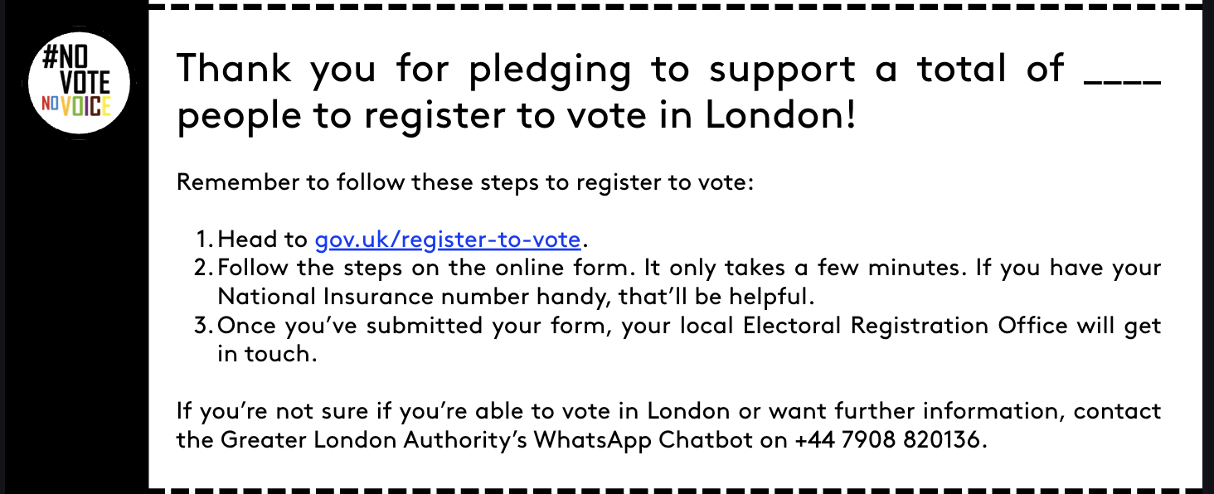
How can we increase our impact beyond the day?
Notes:
Introduce the pledge cards, which encourage students to spread the message beyond the event by talking to friends and family.
Explain that we are now going to look into what we need to know to successfully run the drive.

Slide 15
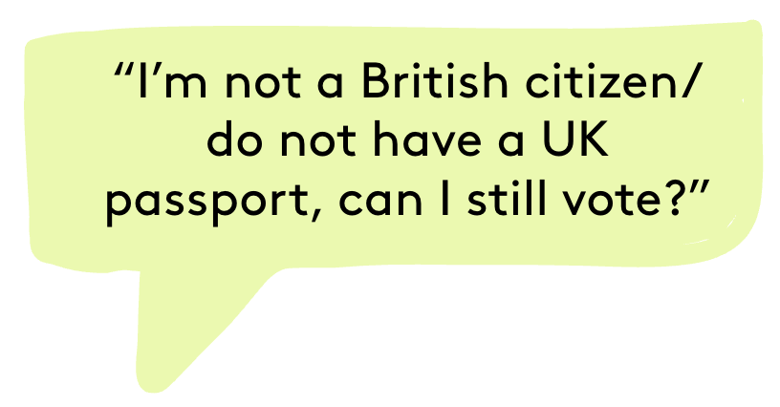
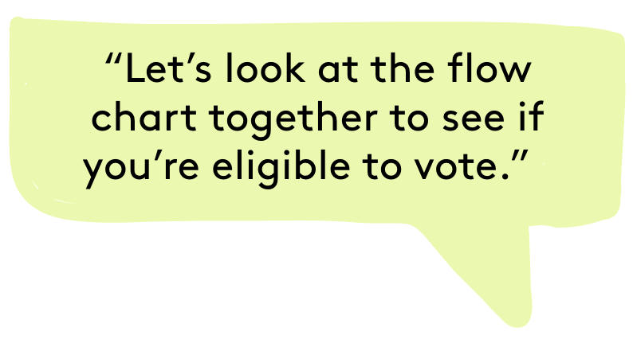
Notes:
The next few slides focus on some common eligibility questions and how to find their answers using the eligibility flowcharts. If you are 16 and a qualifying Commonwealth and EU citizen, as well as an EU citizens with retained rights you are eligible to register to vote and can vote from 18.
In the next section, use a printed version of the Eligibility Flow Charts to model how to use the flow charts to answer specific questions on eligibility.

Slide 16
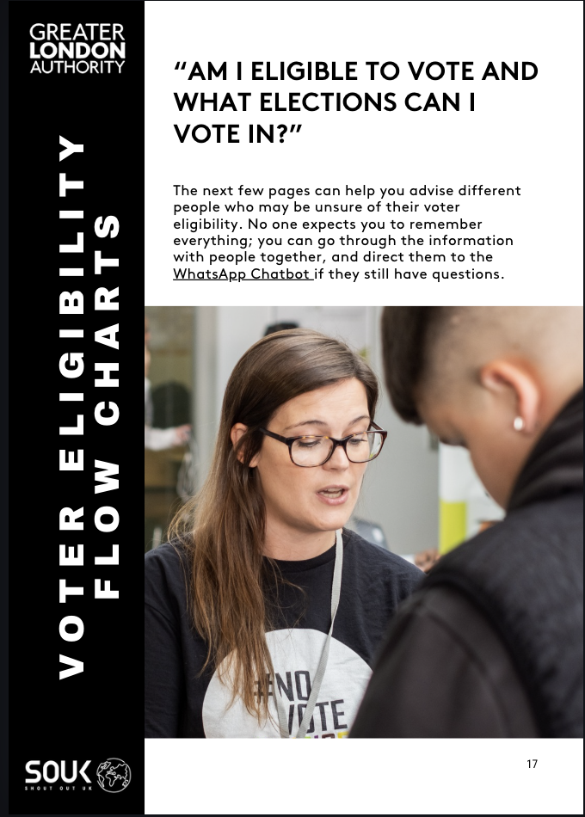
Using the Voter Eligibility flow charts, find out which elections (if any) these people can vote in:
A 19 year old Irish citizen
An 18 year old Indian citizen
An 18 year old Italian citizen who has lived in the UK for the last 8 years
A 17 year old Cypriot citizen
A 16 year old Polish citizen
Notes:
In this activity, model the use of the voter eligibility flow charts. The first couple can be done together and the last few could be done independently. To highlight that these people will still need to register to vote, if eligible.

Slide 17
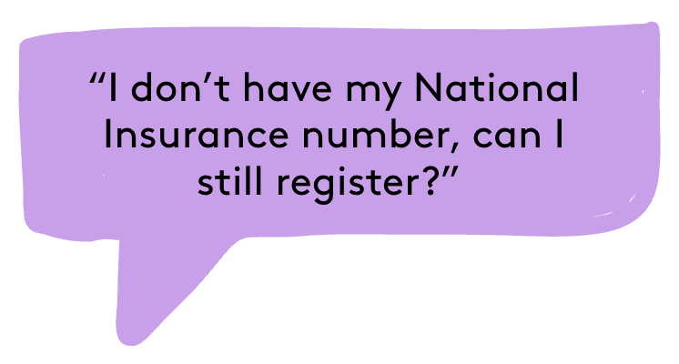
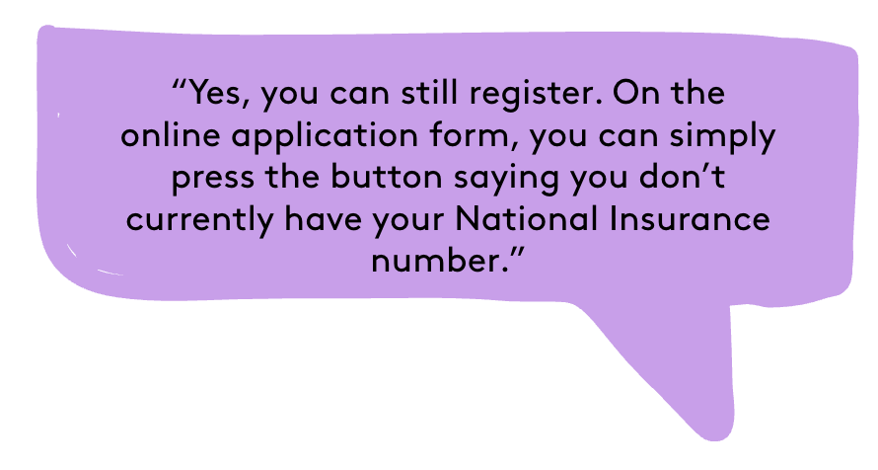
Notes:
The next 3 slides focus on some common informational queries, beyond eligibility, that the students may receive when running their own voter registration drives.

Slide 18
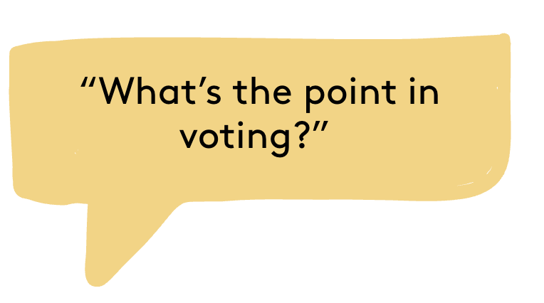
How many of these benefits did you mention?
Having your voice heard on issues that matter to you
Giving elected representatives a better idea of how to advocate for you
Representing your community’s/young people’s interests
Registering to vote can improve your credit score
Being on the electoral register is how juries are chosen
Notes:
To give an opportunity to students to craft their own impartial response to this question.

Slide 19
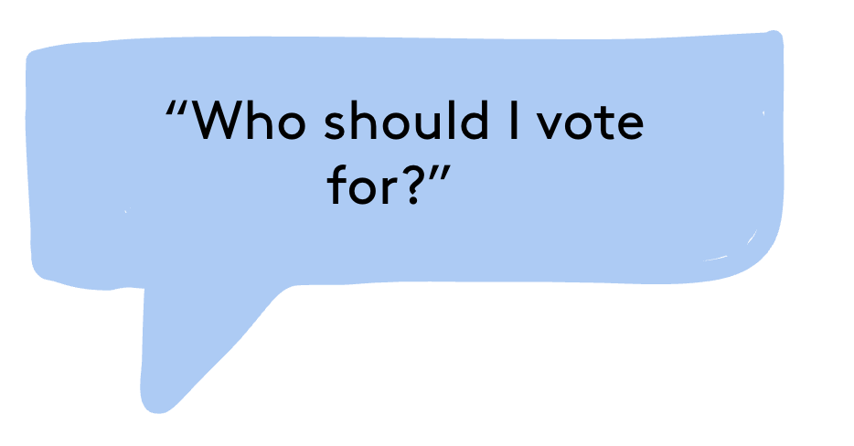
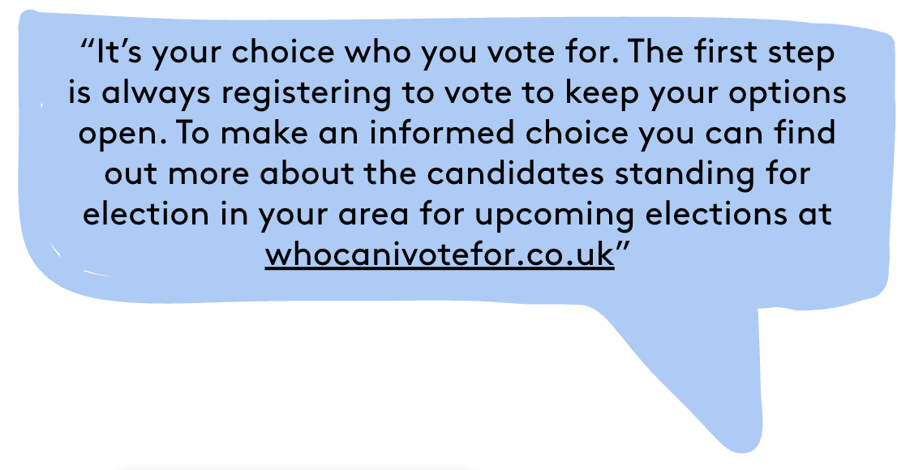
For more FAQs, check out the Voter Registration Toolkit!
Notes:
www.electoralcommission.org.uk/i-am-a/voter/your-election-information

Slide 20
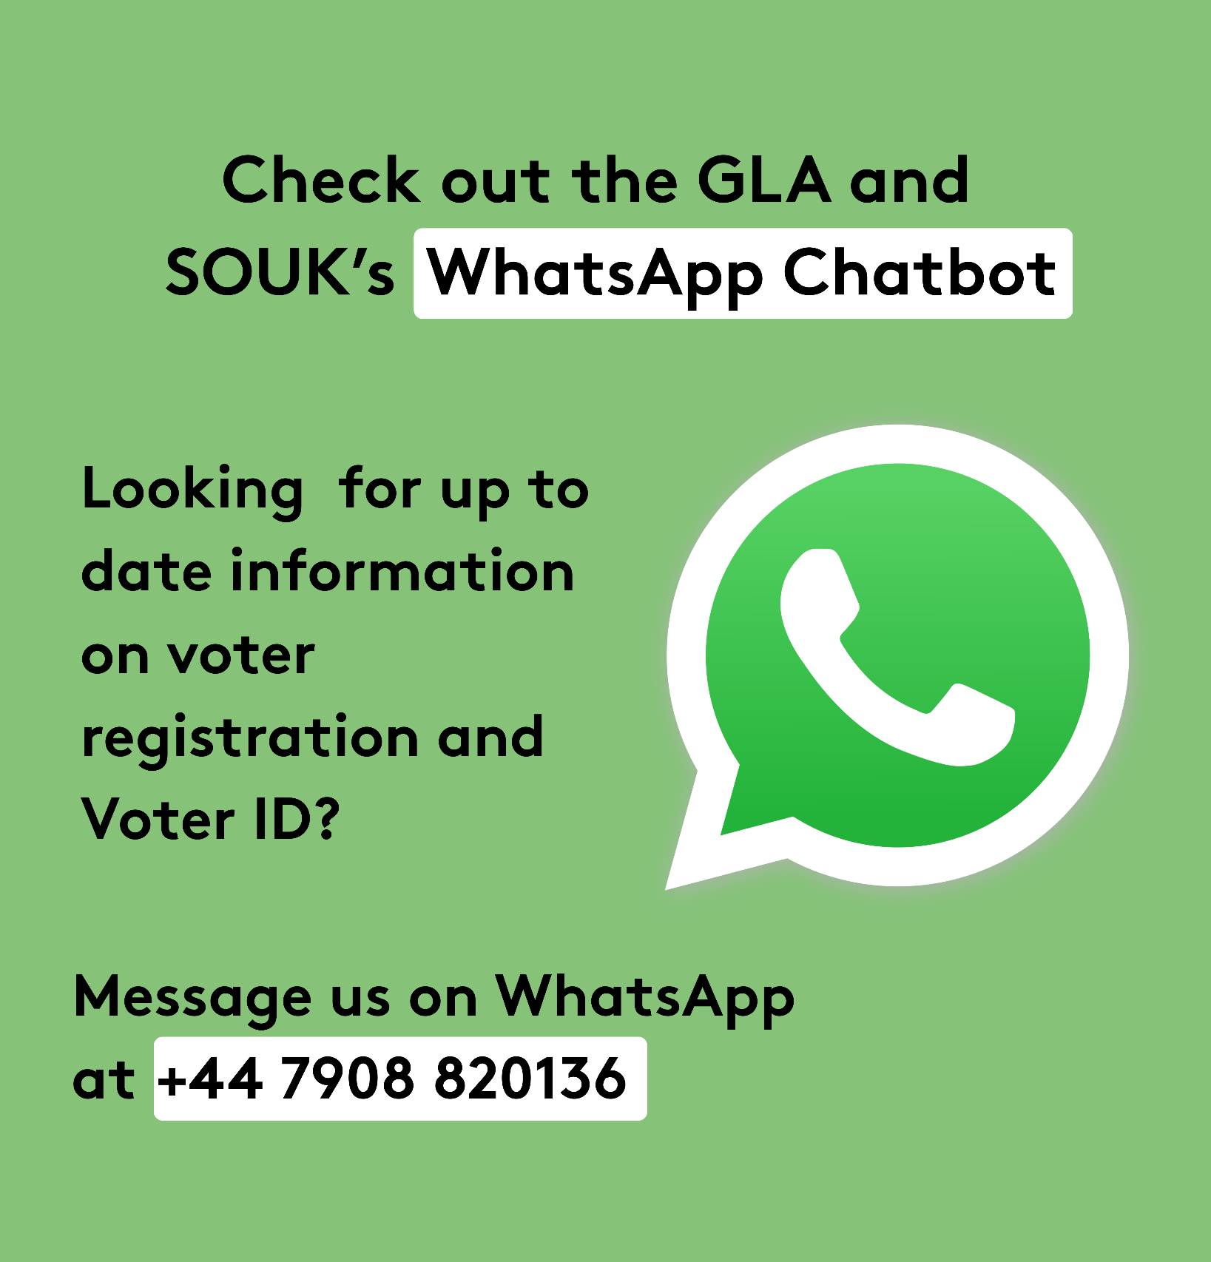
Top Tip:
If you’re not sure how to answer a question, the GLA and SOUK’s WhatsApp Chatbot can be a great way to:
Answer questions on eligibility and voting
Share FAQ docs in 16 community languages
Give further information on voting in London elections
Notes:
Explain to the students that they do not need to have all the right answers but can signpost people to the appropriate resources to get support.

Slide 21
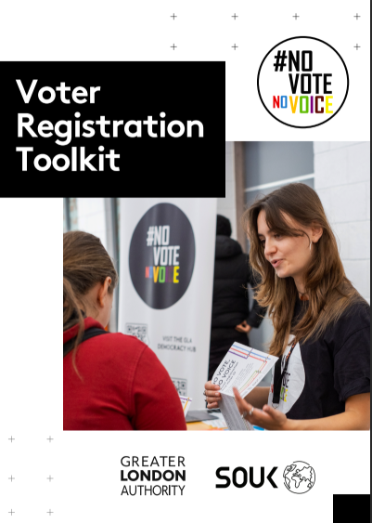
Let’s create an action plan for your voter registration drive!
Have a look at the following sections and we'll start planning together:
What do we need to do to prepare for the voter registration drive?
What do we need on the day?
What do we need to do after the day?
Notes:
This activity will entail students making a brief action plan on how they will run their own voter registration drive, and how they will organise and execute it. 10 mins for the activity. The discussion should focus on the practicalities of the day itself and the steps that follow once the drive is complete. Explain that on the day, volunteers should stay friendly, approachable and confident when speaking to people, just as they have practiced. They can use the QR code posters to help students register quickly or give them the tools to register later.
Remind students that the Reporting Lead will keep track of the number of conversations, registrations and pledges, which helps the team understand its impact. Describe the importance of ending the drive with a short debrief so the group can reflect on what went well, what challenges they faced and what they might improve next time. Finish by noting that the feedback survey included in the toolkit allows the GLA and SOUK to learn from their experience and support future events. Teachers to add in closing comments and encourage uptake from students.

Slide 22
How can you engage with London’s democracy beyond voting?
Contacting your elected representatives including your MPs, Local councillors and London Assembly members.
Taking part in citizens’ assemblies, or other forms of deliberative or participatory democracy.
Standing for elected office.
The ability to start or sign petitions.
Taking part in peaceful, legal protest.
Being involved in community organising.
Volunteering (including volunteering as a magistrate https://magistrates.judiciary.uk/)
Notes:
This slide focuses on wider civic and democratic rights, and how students can remain engaged beyond the ballot box.
This is also an opportunity to showcase how you do not need to be eligible to vote to take part in London’s civic and democratic life.

Slide 23
How can you continue to have your voice heard by representatives beyond an election?
Engage with them by:
Writing to them – the emails and addresses are publicly available
Talking to them - MPs often have surgery hours where you can meet them and discuss issues that matter to you
Following their record – the voting records of your representatives are publicly available
Find out who represents you and how to contact them (Local councillor, MP, London Assembly):
www.writetothem.com
Follow what is being said & voted for in parliament:
hansard.parliament.uk
Notes:
This slide focuses on how you can engage with your representatives heard beyond elections. Go through all the different forms of engagement, emphasising that you do not need to be eligible to register.

Slide 24
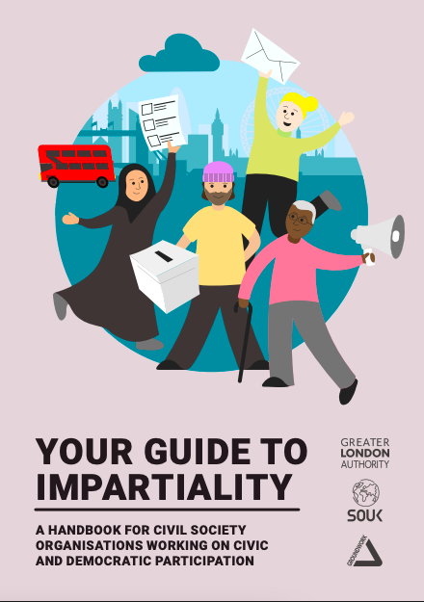
What is impartiality and why is it important?
This programme is impartial. This means that it does not promote, praise or criticise any political party or opinion. Running a voter registration drive is about giving people access to register to vote and answer questions about the voting process.
For our Impartiality Toolkit, head to registertovote.london
Why is impartiality important?
We want people to form their own opinions and vote however they wish, this is key to our democracy.
We want people to trust that the information they are receiving is accurate and not biased or attempting to persuade people to vote in a particular way.
We want to promote informed decision-making, showing people where they can access verified and accurate information.
How might we make sure we’re keeping conversations impartial?
Notes:
Explain what impartiality is, why it’s important to the campaign generally and how it will be important for this campaign. Tease out some conversation about what might be some Do’s and Don’ts.

Slide 25
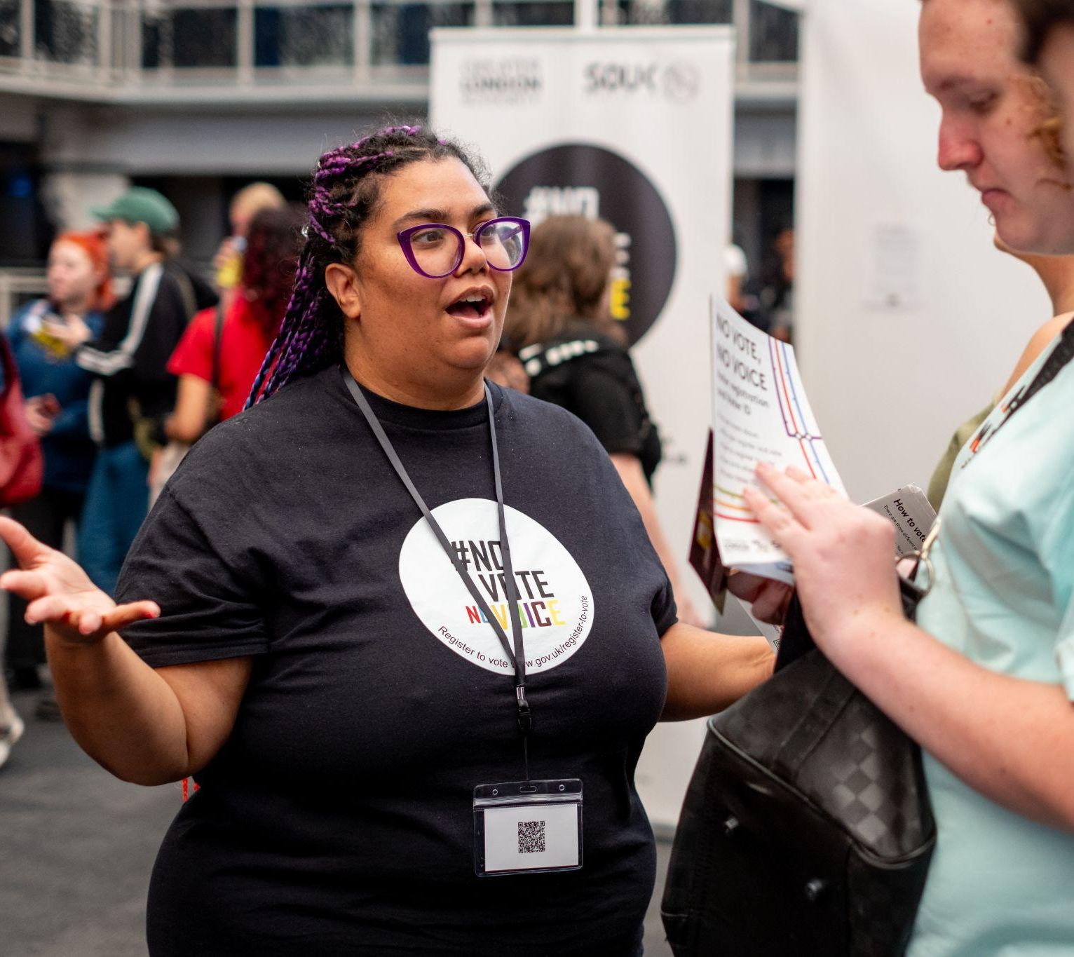
Let’s practise for the day!
We're going to role-play the voter registration drive (10 minutes). How might you support the following people?
A 16-year-old who is eligible to but hasn’t registered to vote yet
An 18-year-old who is eligible to vote, hasn’t voted before and is not particularly interested
Someone who is eligible to vote, wants to vote and has just changed address
An 18-year-old who is a French national and came to the UK a year ago
Notes:
Activity time! Explain that the purpose of the role-play is to practice empathy, clear thinking, and impartial decision-making. Encourage participants to step into the scenario fully and consider different perspectives. Remind them that if they find any questions challenging, they can refer to the toolkit and flow charts for guidance.

Slide 26

Do you have any questions?
Notes:
Invite the young people to ask any questions, comments or concerns they may have.

Slide 27

Your voice matters - make sure it gets heard!
Check out the GLA Democracy Hub registertovote.london to:
Find more information on your civic and democratic rights
Find comprehensive answers to FAQs
Check the Democracy WhatsApp chatbot (+44 7908820136) and #NoVoteNoVoice WhatsApp channel
Find accessible resources, including in 16 different languages
Notes:
Remind the young people that they can stay engaged and find further resources on the GLA Democracy Hub, WhatsApp Chatbot and channel. Explain the difference between the Chatbot and channel.

Slide 28

Thank You!
For more information contact the
GLA Democratic Participation Team at: democracy@london.gov.uk
Funded by the Greater London Authority, City Hall, Kamal Chunchie Way, London, E16 1ZE
Notes:
As a plenary, ask students to discuss what they learnt today that they didn’t know previously. Ask the students to provide feedback to the class. Wrap up the session by encouraging students to get their voices heard and emphasise that they are at the beginning of their relationship with democracy and civic life, but this is something that continues for the rest of their lives. It is in their hands to shape the future of London!
Teachers should be invited once again to provide closing comments and encourage student engagement and uptake of the voter registration toolkit. Further feedback can be requested to be shared over email after the session.

