Slide 1
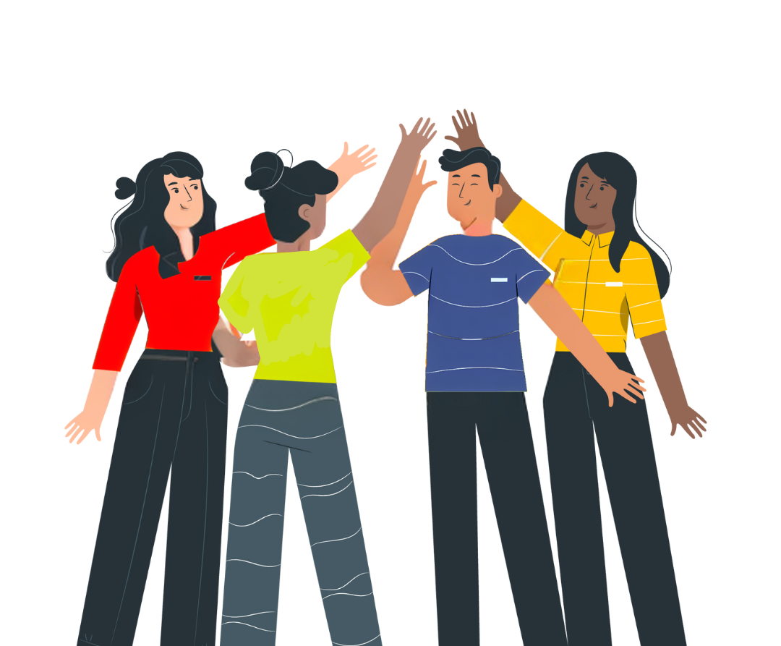


No Vote,
No Voice!
Democracy doesn’t end at the ballot box - it starts there.
Funded by the Greater London Authority, City Hall, Kamal Chunchie Way, London, E16 1ZE
Notes:
Slide:
Opening slide
Speaker notes:
Welcome students and introduce the topic of political literacy. Contextualise the session in terms of the election landscape i.e. is this being delivered after an election? When will your students be old enough to register to vote, and to vote?

Slide 2
By the end of this session, you’ll be able to answer these questions:
What is the difference between civic and democratic participation, and how can you take part?
Who is eligible to vote, who can Londoners vote for, and how does the voting process work?
How can you make your voice heard outside election times?
Notes:
Slide:
Session aims
Speaker notes:
Go through the session aims and learning questions you will explore.

Slide 3
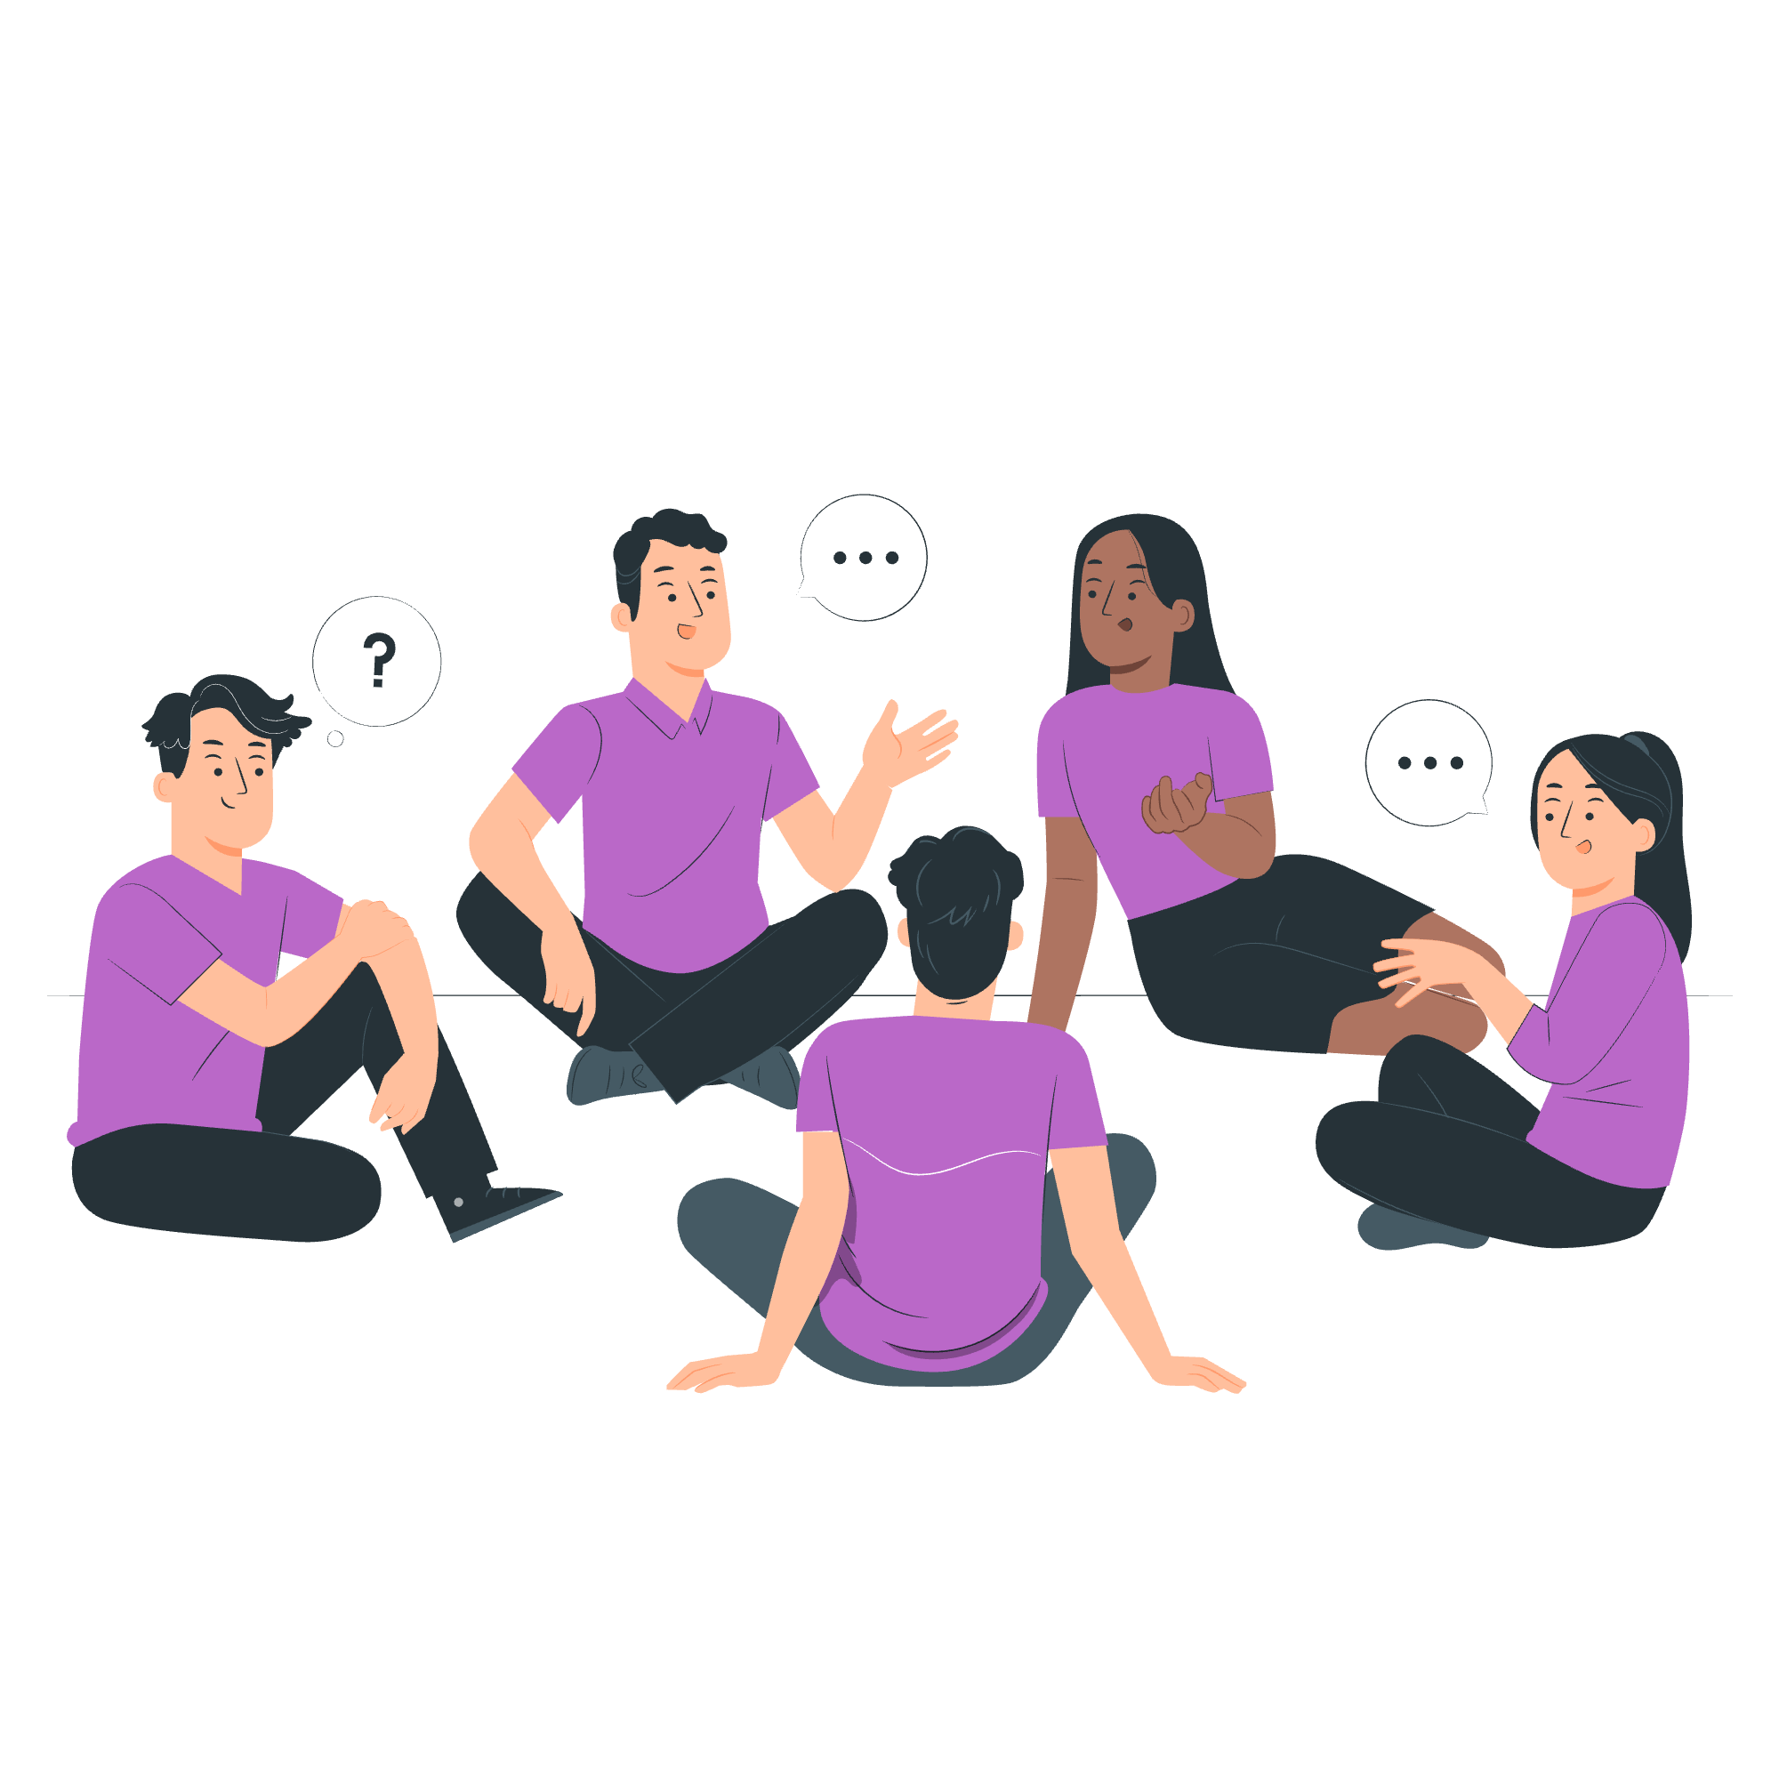
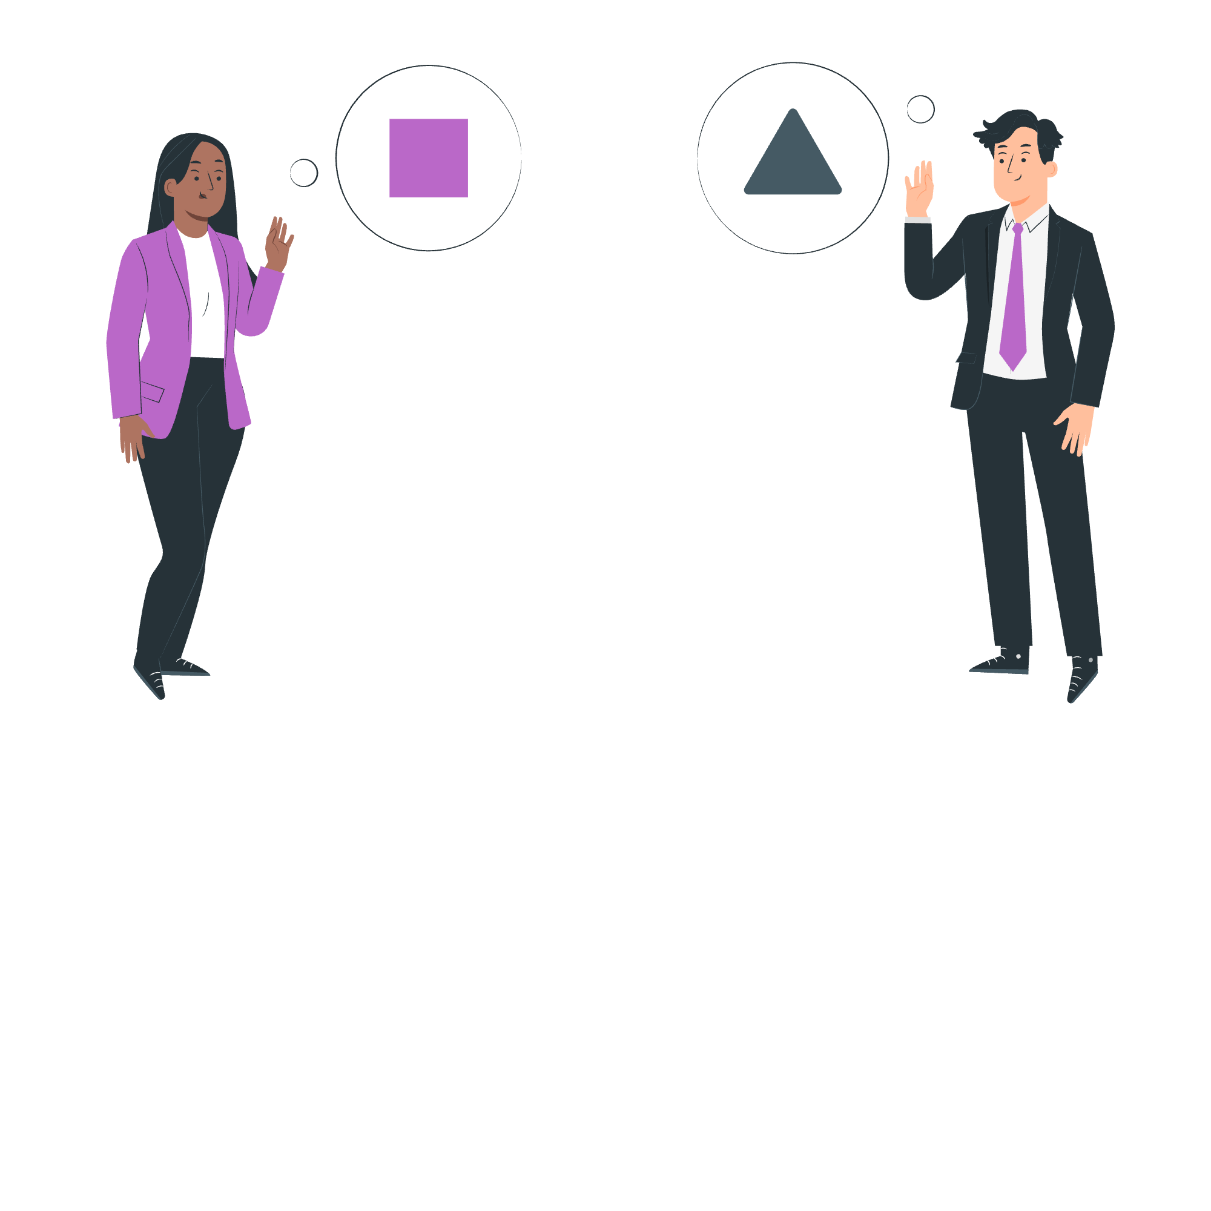
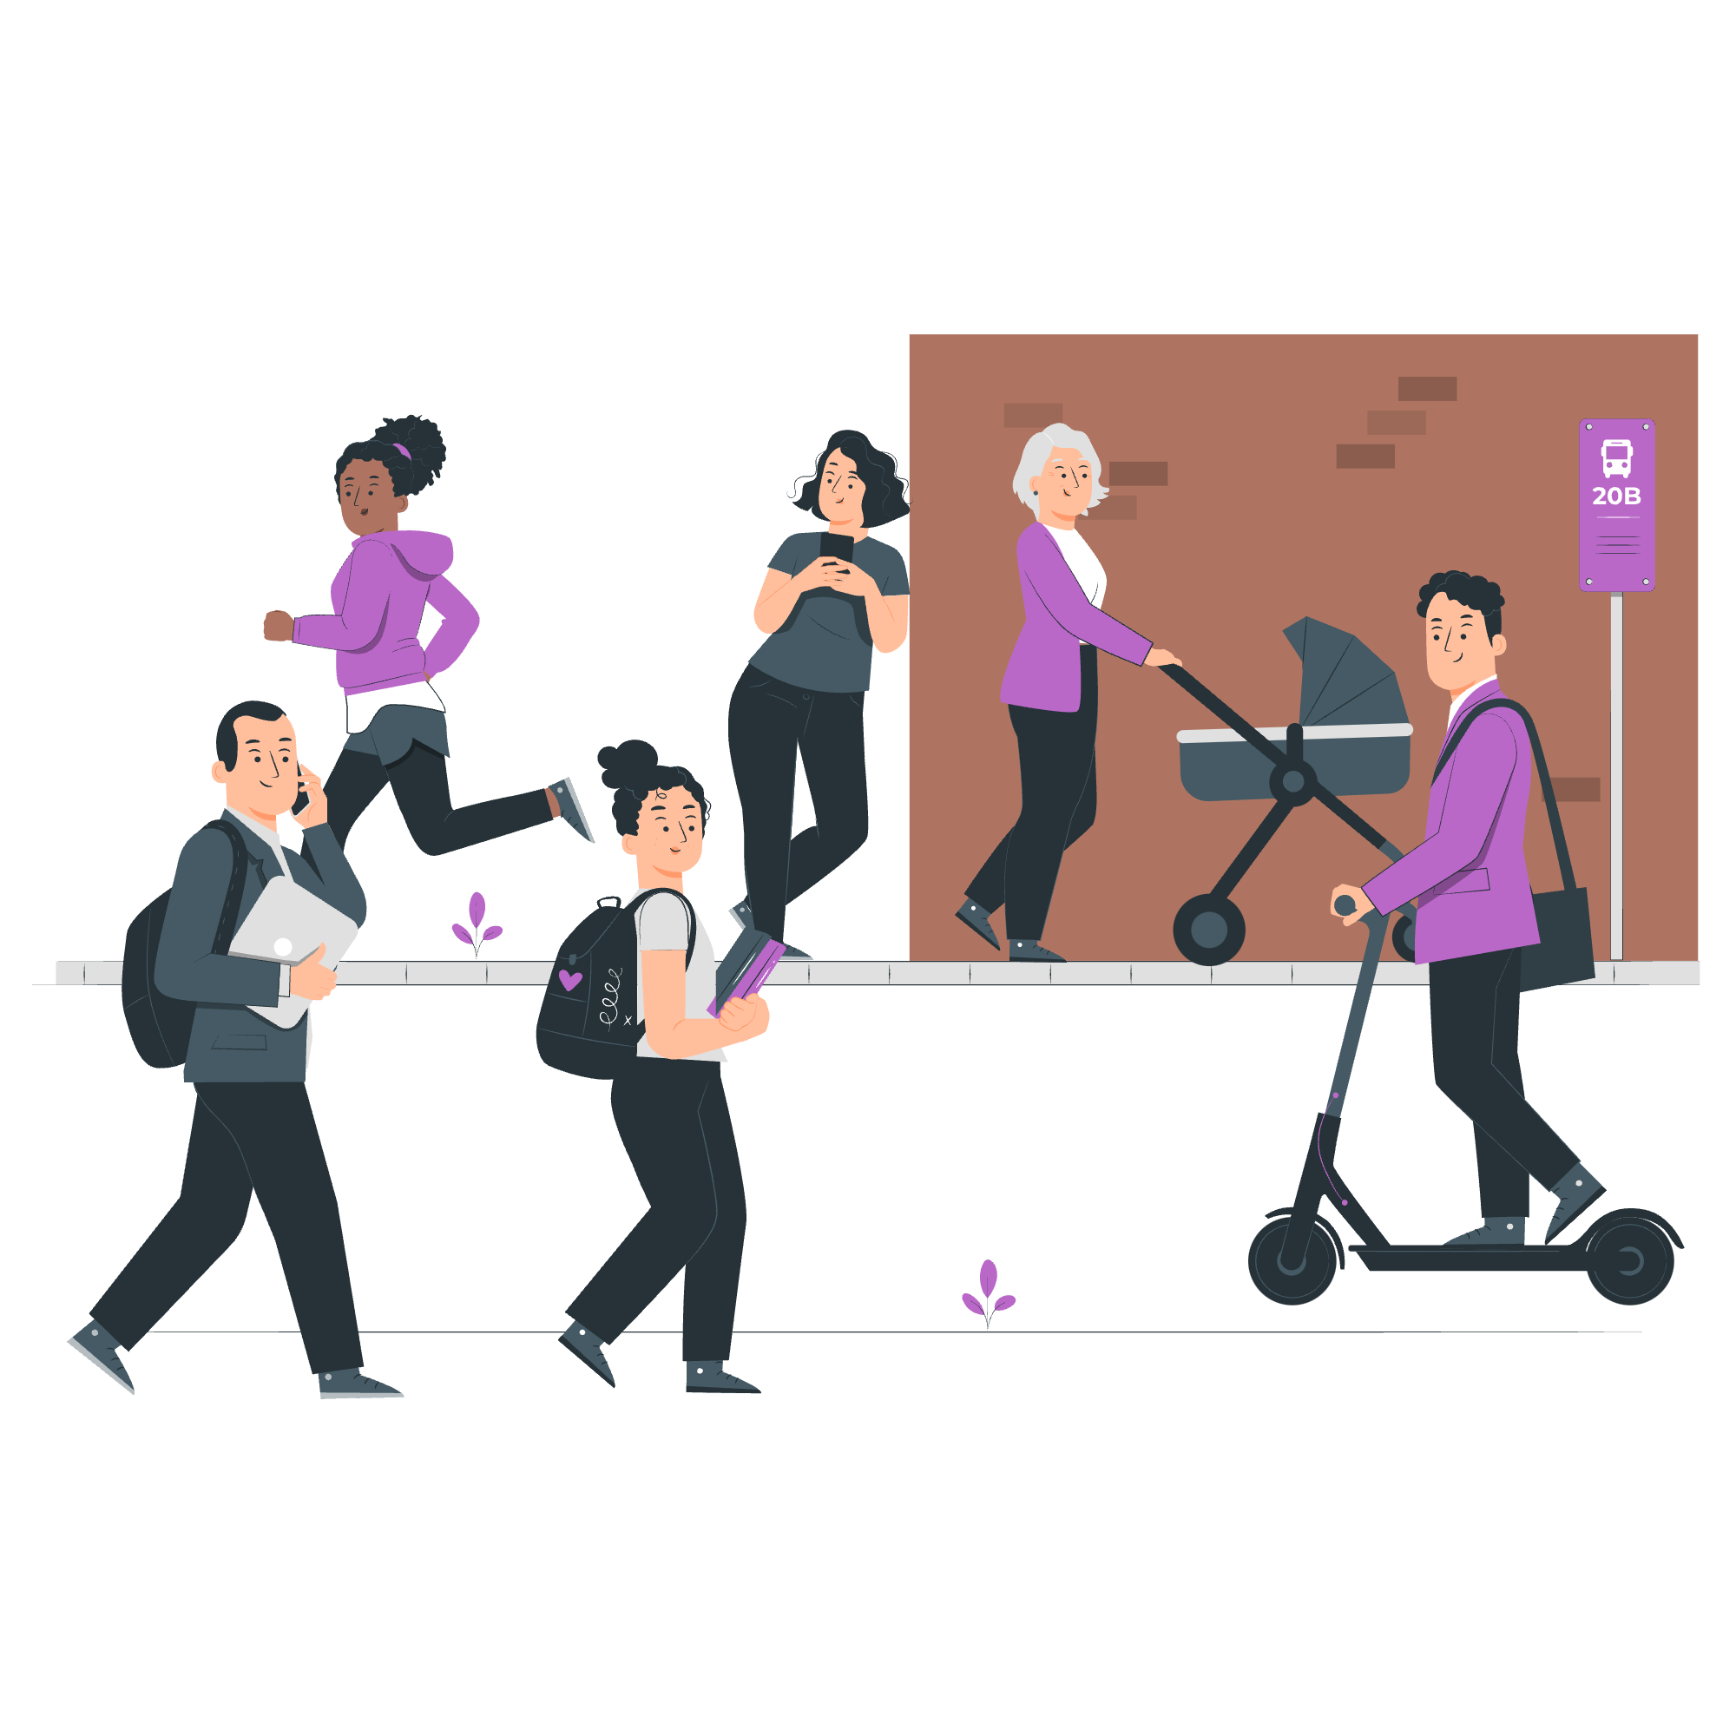

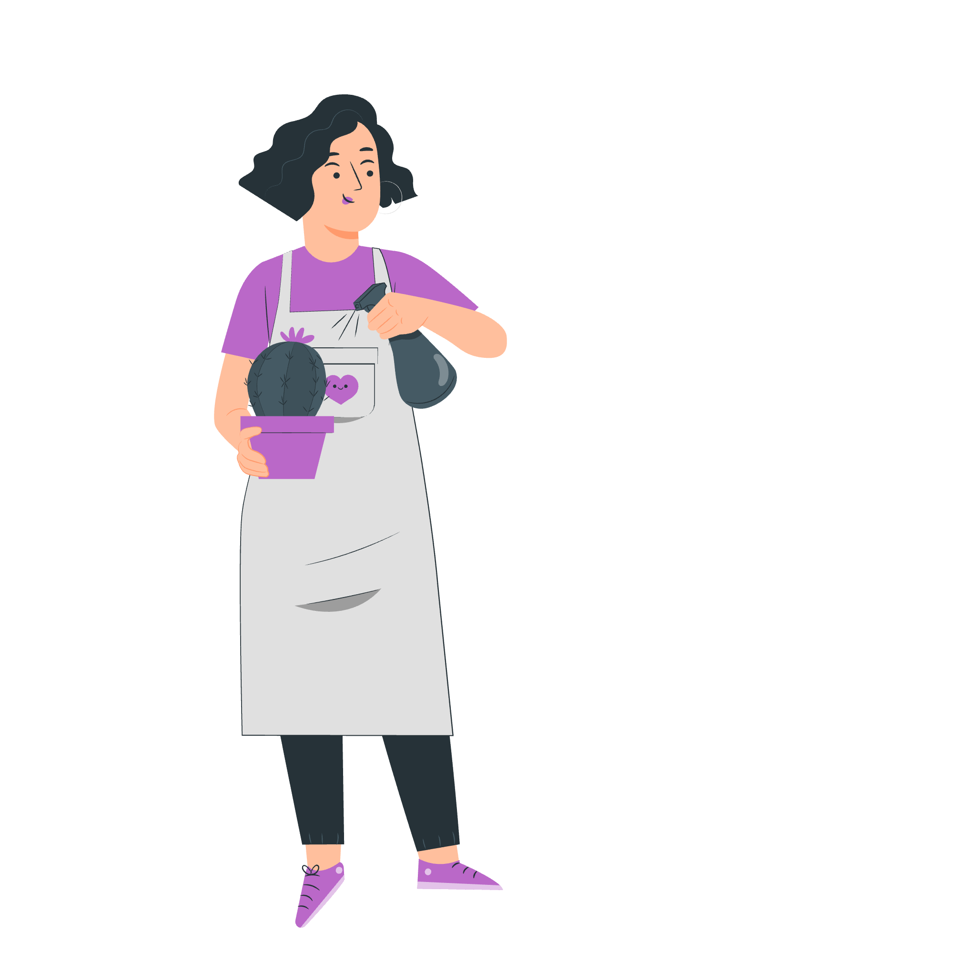

To have a voice
To build stronger communities
To engage with your representatives
Why participate in democracy and civic life?
To gain knowledge and skills
To support equality and justice
To make a difference on issues you care about
Notes:
Slide:
Why participate in democracy and civic life?
Speaker notes:
Display the mind map showing reasons people participate in democracy and civic life.
Discussion opportunity: Have students discuss other reasons for civic and democratic participation and ask for volunteers to share their ideas.

Slide 4
What is the difference between civic and democratic participation?
Civic participation includes:
Starting or signing petitions
Taking part in peaceful, legal protest
Being involved in community organising
Volunteering
Democratic participation includes:
Contacting your elected representatives
Registering to vote, if eligible
Voting in elections (local/borough council, Mayor of London, London Assembly, general elections)
Standing for elected office (e.g. as an MP or local councillor)
Notes:
Slide:
Civic and democratic participation
Speaker notes:
Explain the differences between democratic and civic participation using the table.

Slide 5
Civic participation
Starting or signing petitions
Official petitions appear on petition.parliament.uk. If a petition reaches 10,000 signatures, the government will respond. If it reaches 100,000 signatures, it may be debated in Parliament.
Taking part in peaceful, legal protest
Everyone has the right to protest in a peaceful and legal way. If you’re organising a protest, you may need to notify the police in advance.
Community organising and volunteering
Community organising brings local people together to create the change they want to see. Volunteering helps you gain skills, meet new people, and make a difference.
Notes:
Slide:
Civic participation
Speaker notes:
Explain civic participation and how it empowers citizens. Points to note:
You don't have to wait until you're 18 to do these things.
British citizens or UK residents of any age can create petitions on gov.uk.
Community organising could include things like community clean-up days, fundraising for a local cause, donating for food banks, setting up an informal support group, or organising a clothes-swap event.
You could direct students to these sites for volunteering opportunities in London:
Simply Volunteer London | Discover Volunteering Opportunities Across The Borough/City
Flexible Volunteering Opportunities with Charities | GoVo

Slide 6
Democratic participation
Contacting your elected representatives
At any age, you can contact your MP, London Assembly member or local councillors to share your views, raise concerns or ask for help. You can write to them, email them or attend one of their local meetings or surgeries.
Registering to vote and voting, if eligible
If you are eligible to vote, you can currently register at 16, and vote at 18. Your vote will help choose the candidate(s) that will represent you.
Standing for elected office
If eligible, at 18, you can also become a candidate for Mayor of London, London Assembly member, Member of Parliament (MP), local councillor.
Notes:
Slide:
Democratic participation
Speaker notes:
Highlight examples of democratic participation and its importance. Please note that the activities featured in this are in the order that your students will be able to access them as they get older. Discussion opportunity: Ask students if they’ve done any of the things mentioned on these last two slides.

Slide 7
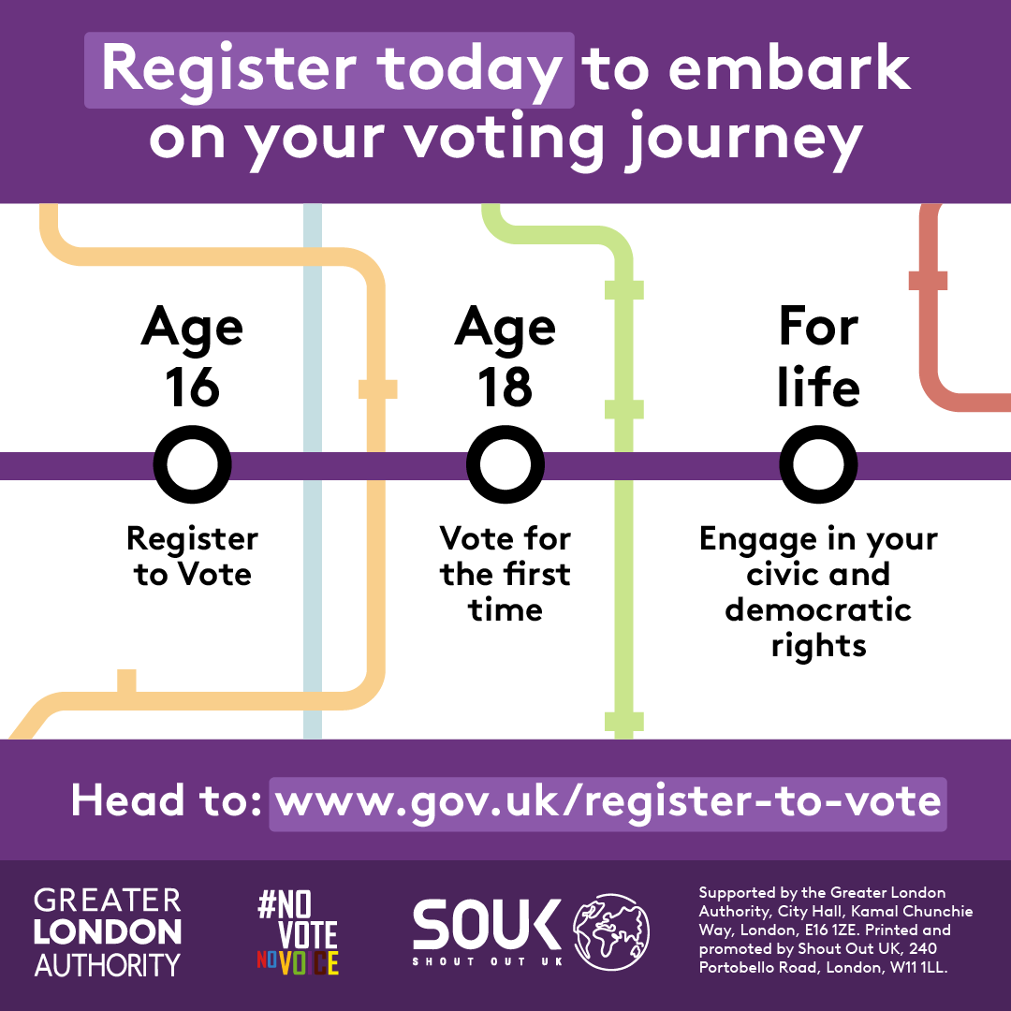
What key milestones do you have on the horizon?
Do you know how these milestones might change in the future?
There’s a bill currently going through Parliament called the Representation of the People Bill. A bill is a proposed new law or a change to an existing law that is debated in Parliament.
If this bill passes and becomes law, young people will be able to register to vote from 14 years old, and vote in all elections from age 16.
Check www.gov.uk/register-to-vote for the latest news and updates on voting rules.
Notes:
Slide:
Representation of the People Bill
Speaker notes:
Show the milestones graphic and ask students to discuss which milestones, if any, they have already reached.
Explain the Representation of the People Bill and that, if it passes, it will allow young people to register to vote from 14 years old and vote from 16.
Further information on the Representation of the People Bill - Representation of the People Bill - Parliamentary Bills - UK Parliament

Slide 8

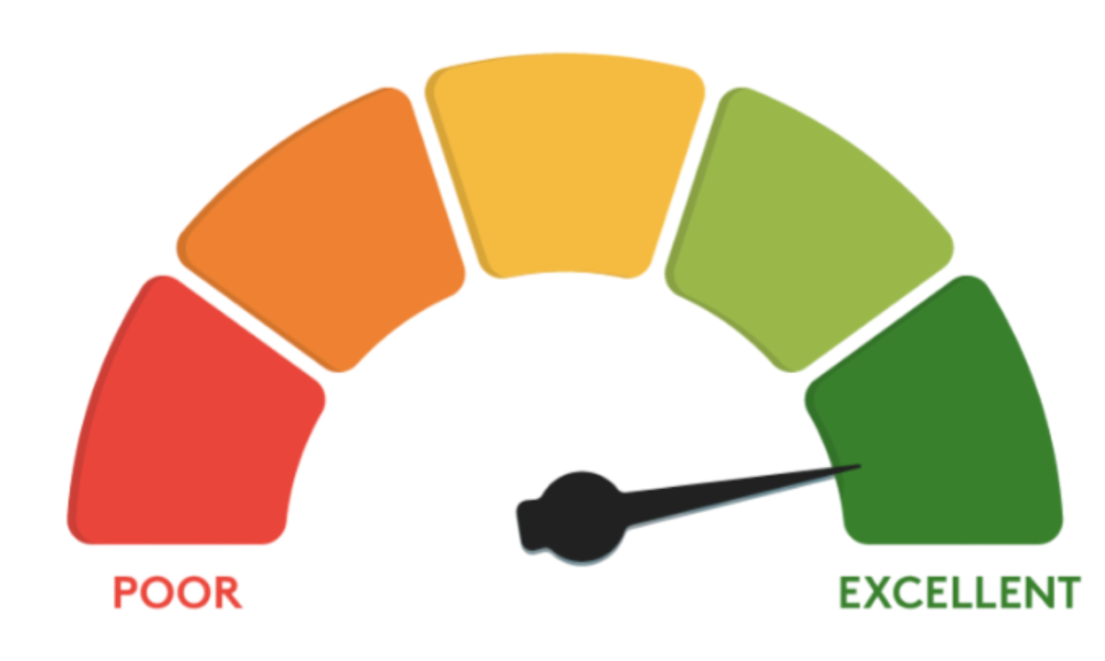


To get your voice heard about issues that matter
In a democracy, voting is a key way to contribute to the decisions that shape your local area, your community, and the UK.
To improve your credit score
Being on the electoral register helps lenders confirm your name and address, so your credit score can improve. A higher score can increase your chances of getting phone contract or a loan.
What are the benefits of registering to vote?
To contribute to a fair criminal justice system
Courts use the electoral register to select people for jury service. If you’re registered, you can be called to be on a jury. More representative juries mean fairer verdicts.
To exercise a fundamental – and hard-won – right
Before 1832, less than 3% of people in England and Wales could vote. British women have been able to vote for less than 100 years.
Notes:
Slide:
What are the benefits of registering to vote?
Speaker notes:
Ask students if they know of some of the benefits of registering to vote, and go through the points on the slide.

Slide 9
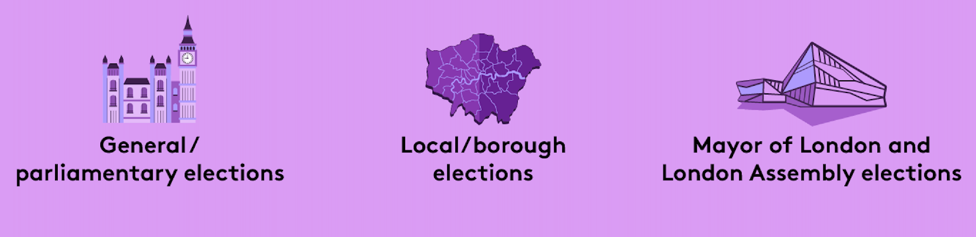
Who can you vote for?
There are three types of election in London:
Notes:
Slide:
Who can you vote for?
Speaker notes:
Present the three different structures that Londoners vote in. General elections take place at least every five years, while local elections, Mayor of London, and London Assembly elections take place at least every four years.
Discussion opportunity: Tell students that the last general election was 4th July 2024, the last local elections were on 7th May 2026 and the last Mayor of London and London Assembly elections were on 2nd May 2024. Discuss with students how old they will be when the next elections of each type come around.

Slide 10

What is the Greater London Authority?
Mayor of London
The Mayor of London is elected to set city-wide/ regional priorities:
Transport for London
Mayor’s Office for Policing and Crime
London Fire Brigade
Housing
Environment
Culture and arts
London Assembly
The London Assembly holds the Mayor to account.
It is elected by Londoners, at the same time as the Mayor.
It is composed of 25 Assembly Members: 14 represent geographic areas (2 or 3 London boroughs) and 11 work pan-London.
Notes:
Slide:
What is the GLA?
Speaker notes:
Explain who the GLA is and the two parts it is made up of. This is a good opportunity to explain the structure of GLA including the roles and responsibilities of the Mayor of London, as well as the London Assembly. GLA officers are impartial and deliver the programmes and projects decided by the Mayor of London and London Assembly.

Slide 11
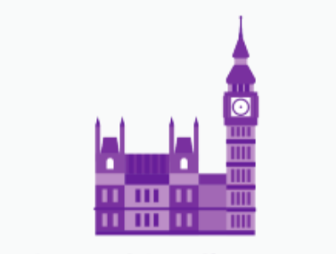
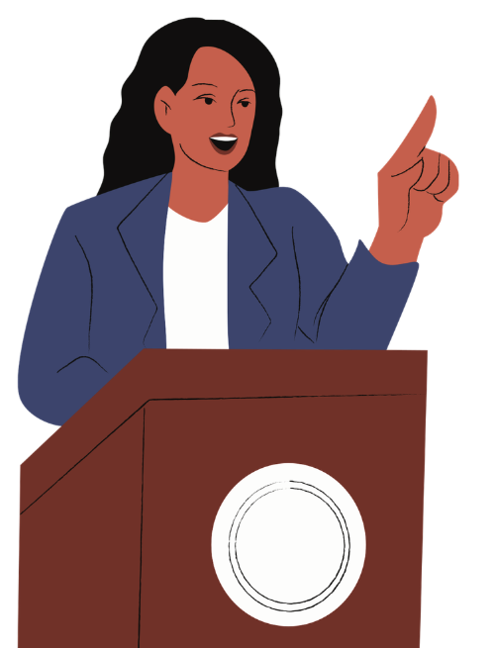
Who are Members of Parliament (MPs) and local councillors?
Member of Parliament (MP)
In a general election, you vote for the MP that you want to represent your constituency.
They can influence the decision-making in Parliament on things like:
The economy
Education
Healthcare
Housing
Environment
Councillor
Work in the borough council (the local authority), which oversees this and more:
Council tax collections
Rubbish and recycling
Arts and leisure services
Housing (borough)
Environment (borough)
Health and wellbeing
Notes:
Slide:
Who are MPs and local councillors?
Speaker notes:
Explain what an MP and local councillor is and the areas of policy they influence. This would be a good opportunity to explain who the local MP is, if you are unsure, you have a link on the next slide to check who they are. Mention the name of the school’s local constituency MP, or look it up here: Find your MP - MPs and Lords - UK Parliament

Slide 12
Which London residents are eligible to vote in these elections?
 | Mayor of London and London Assembly | Local/borough | General
Must be at least 18 years of age to vote (you can register from 16 years of age) | ✅ | ✅ | ✅
British or Irish citizens | ✅ | ✅ | ✅
Qualifying Commonwealth citizens | ✅ | ✅ | ✅
Qualifying EU citizens or EU citizens with retained rights | ✅ | ✅ | ❌
For further information on eligibility, head to electoralcommission.org.uk
Notes:
Slide:
Voter eligibility
Speaker notes:
Outline the eligibility requirements to vote in London elections.
For further definitions of eligible EU citizens and eligible Commonwealth citizens please click on the Electoral Commission links provided.

Slide 13



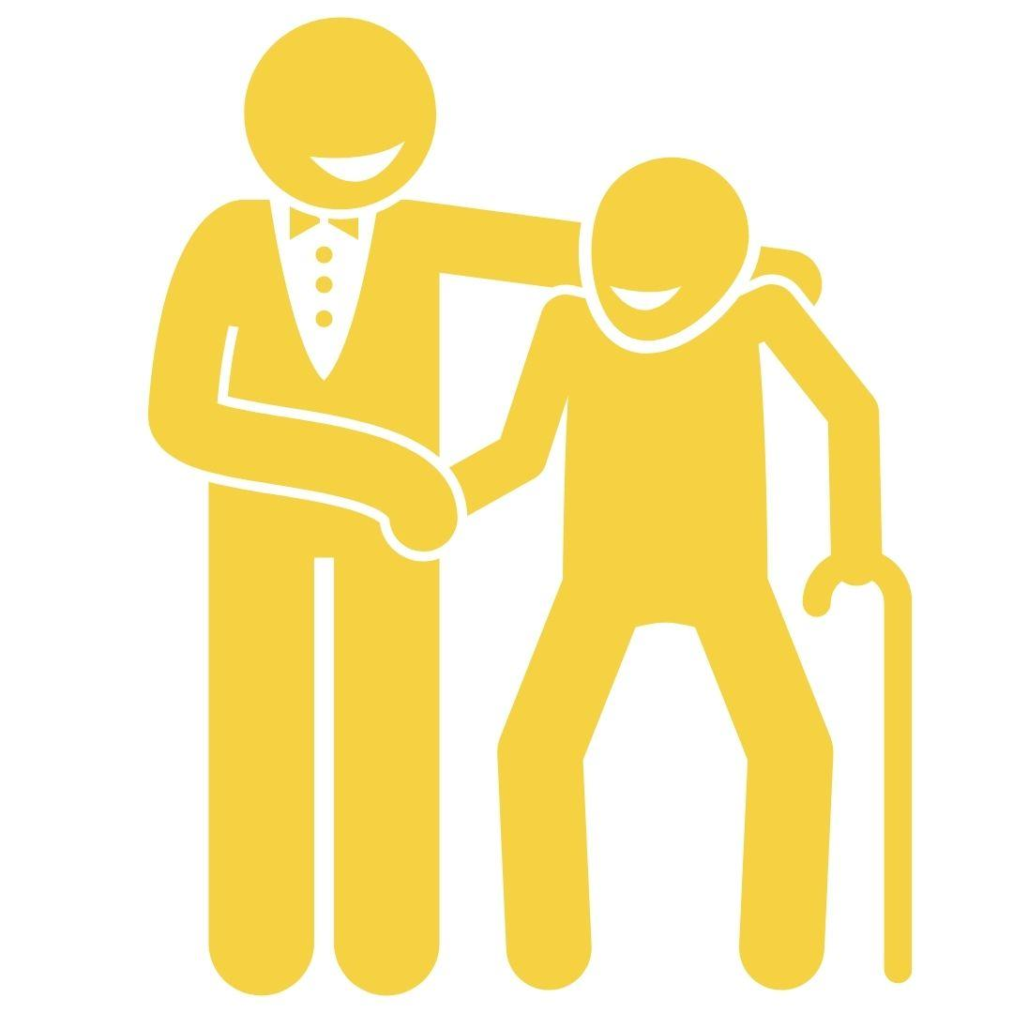
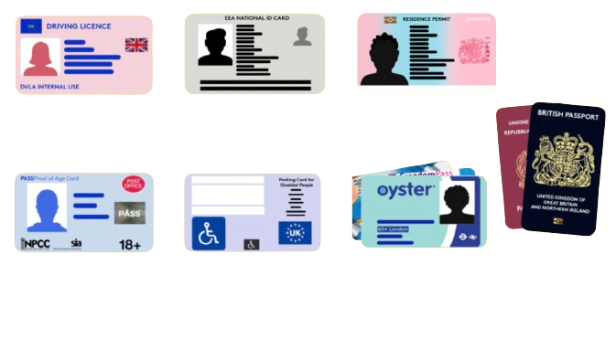
How can you have your voice heard in the voting system?
1
To register to vote, head to gov.uk/register-to-vote
2
You can vote in person, by post, or by proxy
3
You need an accepted form of photo ID to vote in person
Notes:
Slide:
Voting basics
Speaker notes:
Present the 3 key points about voting. Highlight that student IDs and a young person’s Oyster card are not accepted forms of photo Voter ID.

Slide 14
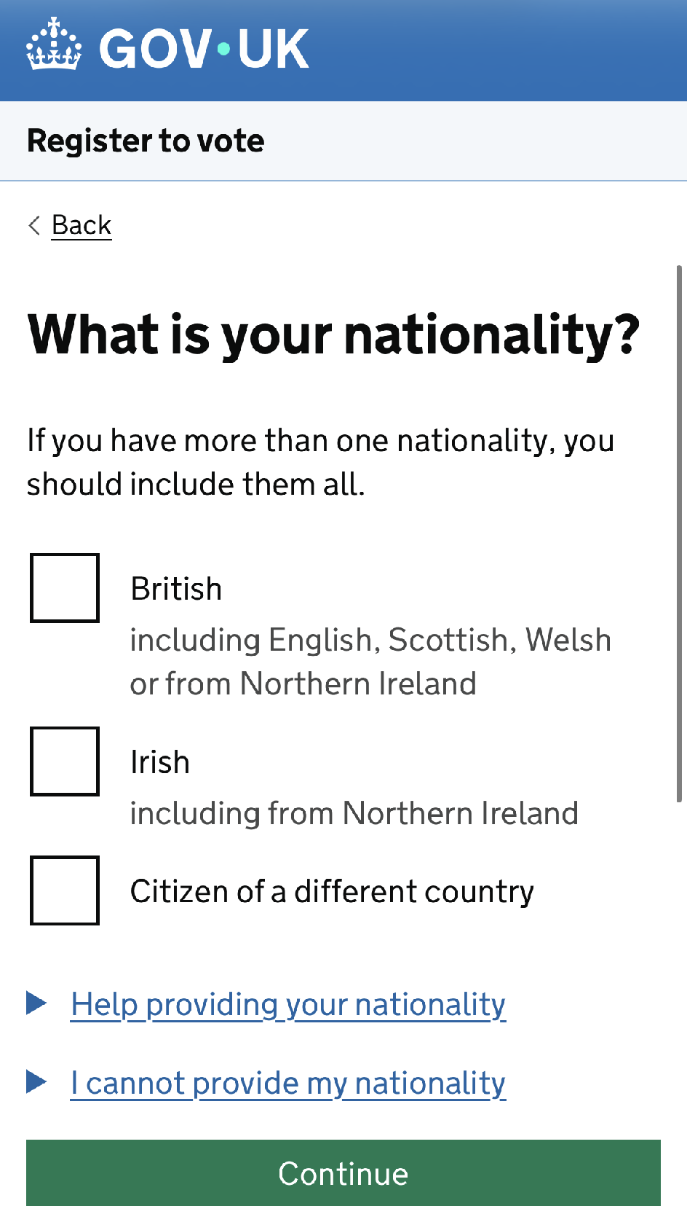
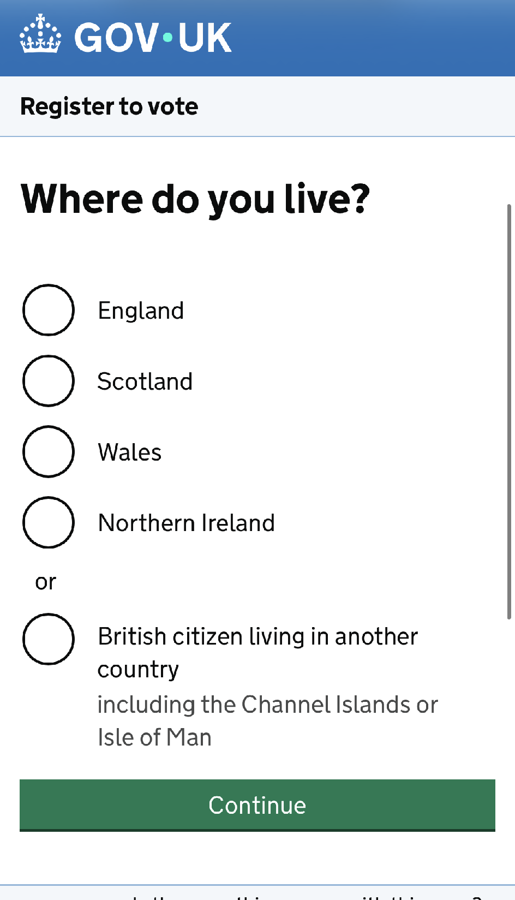
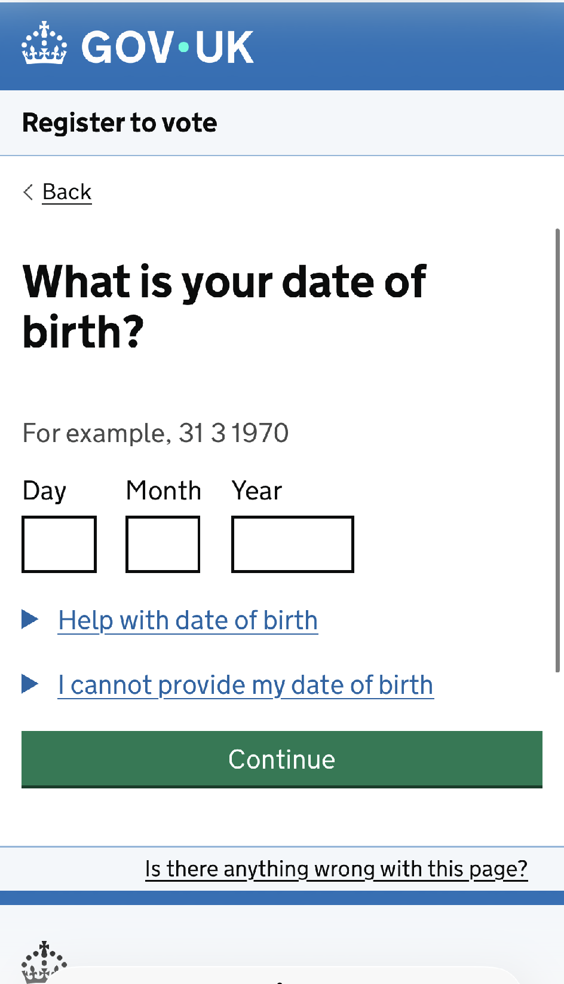
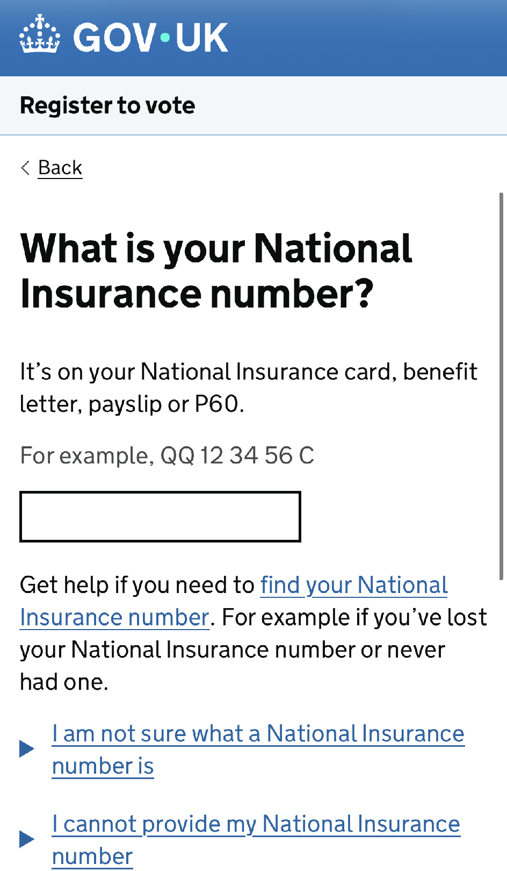
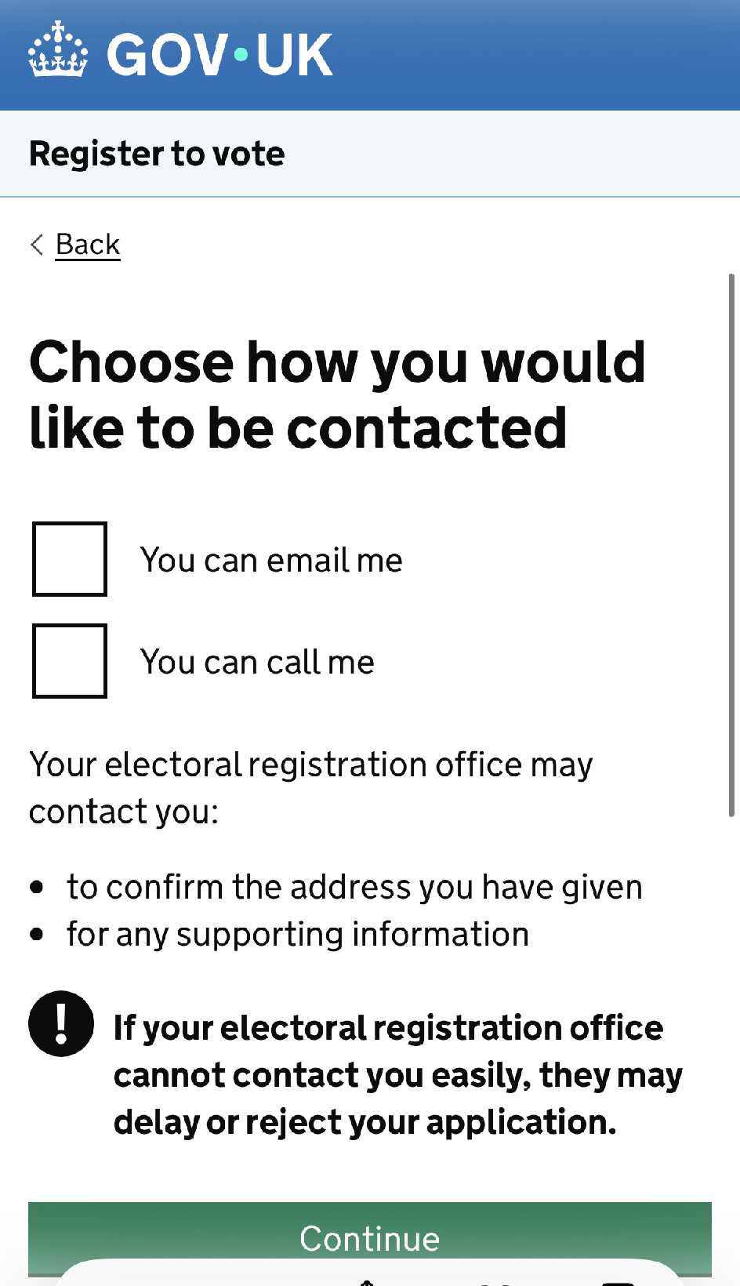
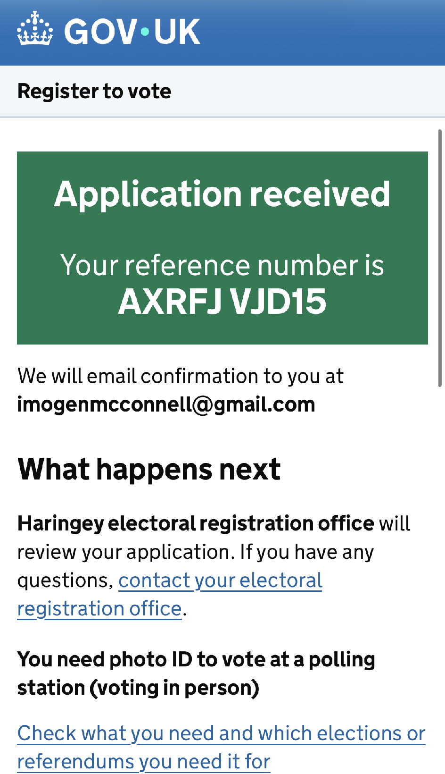
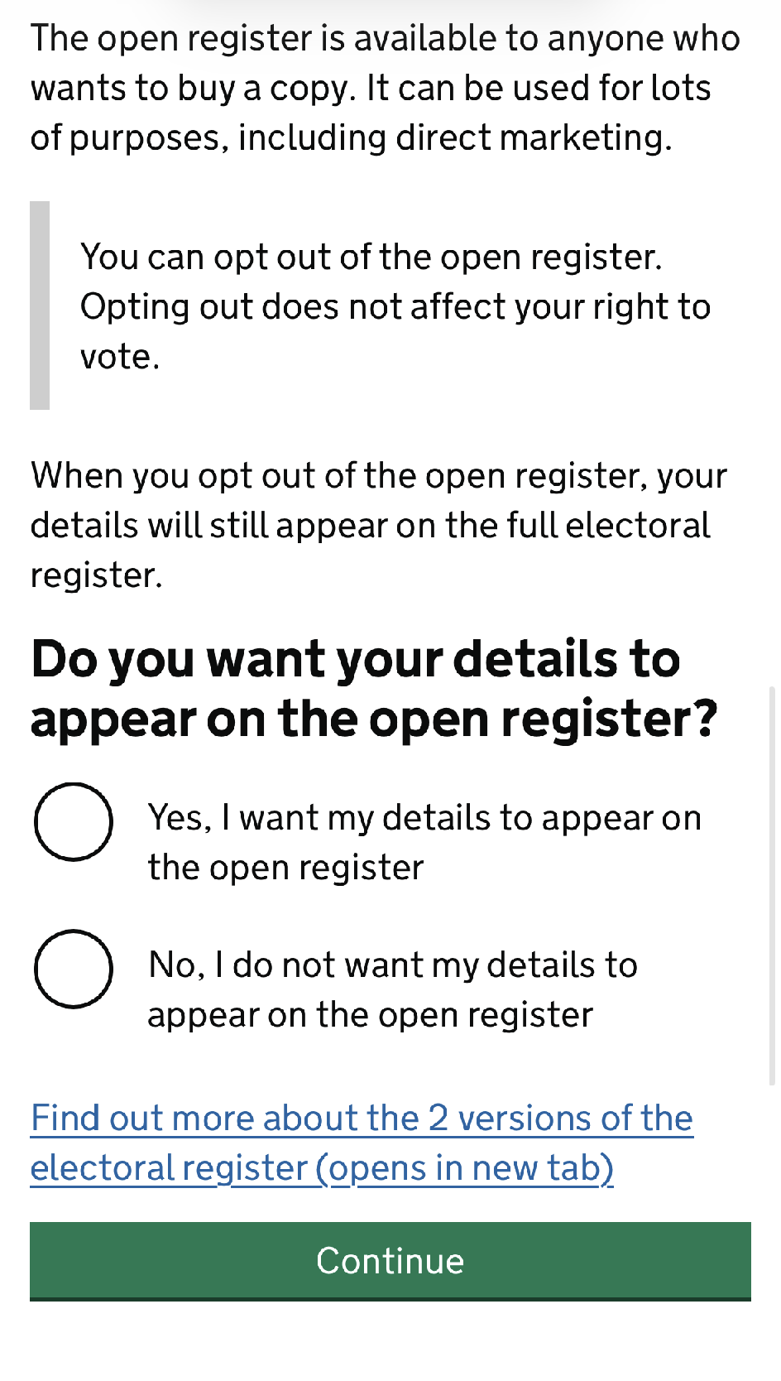
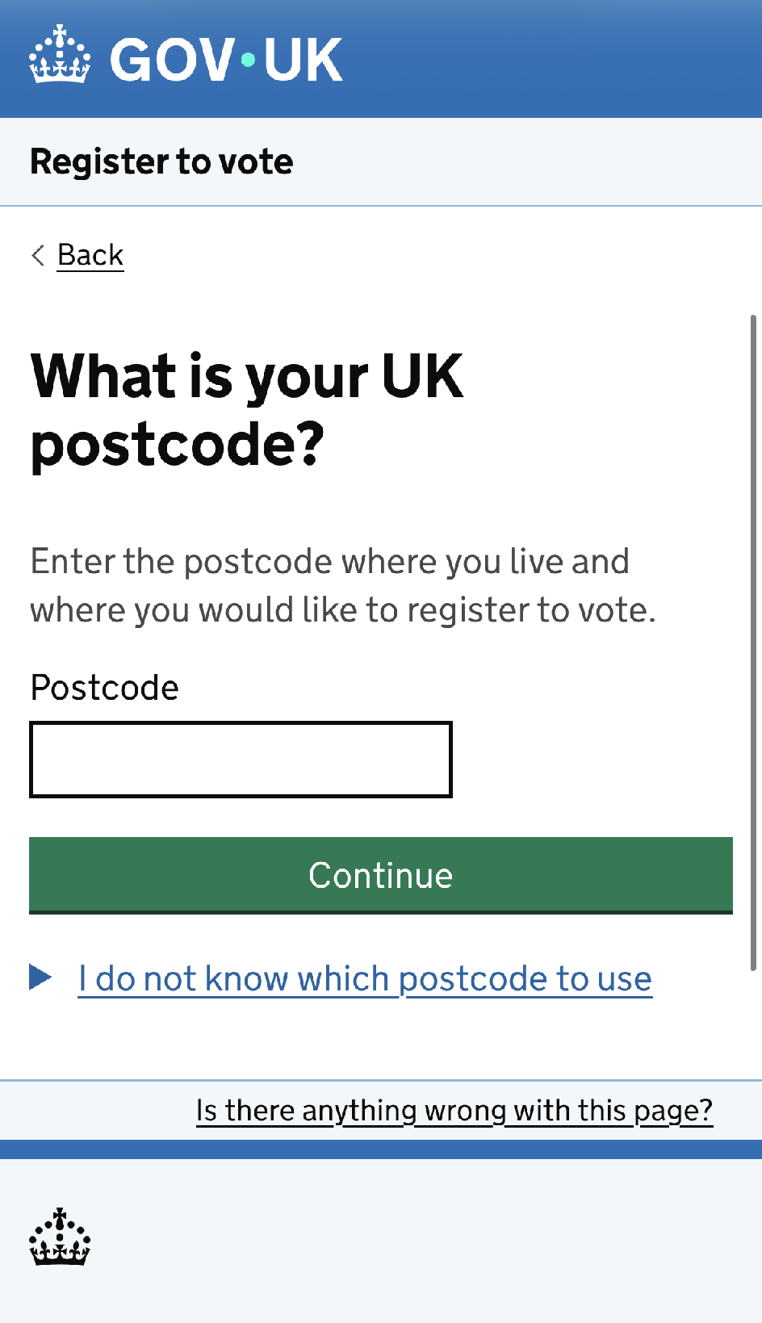
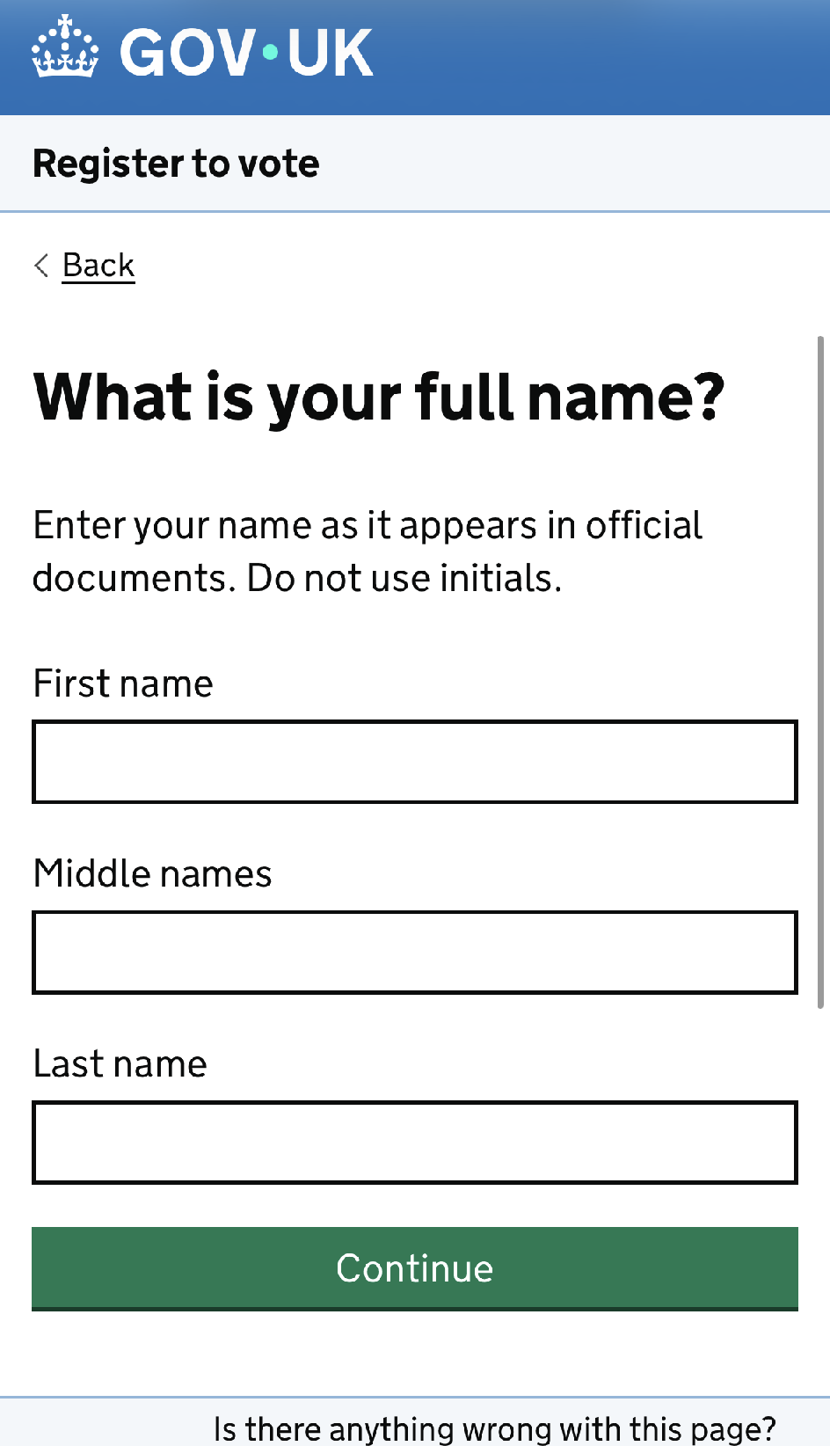
How can I register to vote?
Make sure you meet the eligibility criteria
Make sure you have the following information:
  Your name
  Your date of birth
  Your address
Go to gov.uk/register-to-vote
Fill in the form - don't worry if you do not have a National Insurance number.
Notes:
Slide:
How to register
Speaker notes:
Model the voter registration process by explaining the process and showing the screenshots of the gov.uk website.

Slide 15
What are the 3 different ways you can vote?
By proxy
In person
By post
Notes:
Slide:
Ways of voting
Speaker notes:
Explain the different ways students can vote, highlighting that they would need to apply for postal or proxy voting after they have registered to vote.

Slide 16

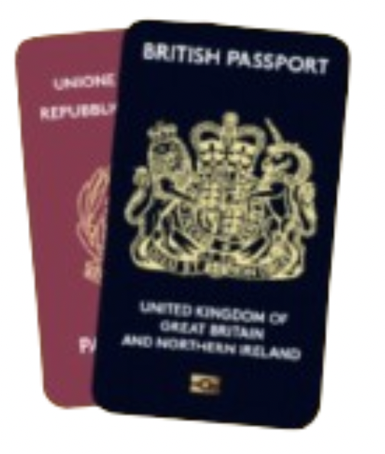
What are some accepted forms of photo ID to vote in person?
UK, Channel Islands or EEA driving licence
National identity card issued by an EEA state
Biometric immigration document (including e-VISA)
PASS card issued by the National Proof of Age Standards Scheme with the PASS hologram
Blue Badge scheme card
UK, Commonwealth,
or EEA passport
Notes:
Slide:
Accepted forms of ID
Speaker notes:
Present some of the forms of accepted photo Voter ID, highlight that student IDs and Young Person’s Oyster card are not accepted.
A couple of things to note:
Even if your form of ID is out of date, you can still use it for voting, as long as it still looks like you and has the same name that you registered to vote with.
Also, polling staff are only checking that you look like your photo and your name matches - they do not check gender markers.

Slide 17

What if I don’t have an accepted form of photo ID?
You can apply for a free Voter Authority Certificate (VAC) if:
You do not have an accepted form of photo ID
You no longer look like the photo on your ID
The name on your photo ID is different to the name on the electoral register
Notes:
Slide:
Voter Authority Certificate
Speaker notes:
Explain what a Voter Authority Certificate is and that it’s valid for 10 years. Highlight that it is only for voting; it cannot be used as a proof-of-age ID at a shop or venue.

Slide 18
Start or sign petitions!
Remember you can start a petition on an issue that matters to you.
petition.parliament.uk
london.gov.uk/london-assembly-petitions
Meet your MP!
Most MPs will have days and times that they are available, known as ‘surgeries’.
Attend a hustings event! This is a meeting where candidates from different parties debate. This is normally before an election.
How else can you connect with your representatives?
Follow what your representatives are saying! You can find transcripts and voting records on hansard.parliament.uk
Contact your representatives!
Anyone can email their MP, London Assembly member or local councillor. Find out how on WriteToThem.com
Take part in peaceful and legal protest!
Show up for issues that matter to you.
Notes:
Slide:
Engaging with representatives
Speaker notes:
Explain how students can engage with their representatives, even when there's no election coming up.
Highlight that everyone can do these actions; you do not need to be eligible to vote to do so.
Discussion opportunity: With your class, explore some of the links to find out information about your local area.
Discussion opportunity: Conduct a quick quiz to test knowledge about local representatives. Ask questions such as “Who knows the name of the MP for our constituency?” or “Who knows the name of the Mayor of London?”

Slide 19
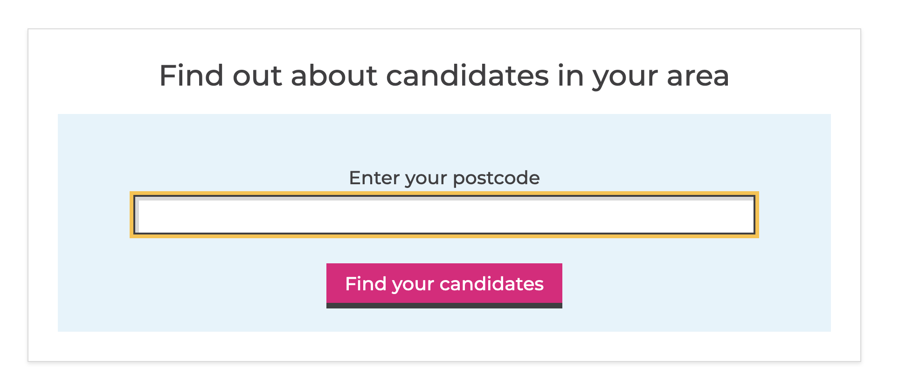

Where can I find more information?
GLA Democracy Hub
Provides resources and a comprehensive FAQ in both Easy Read and community languages. You can also use a WhatsApp chatbot (+44 7908820136) to answer questions you may have!
Who Can I Vote For?
Helps to find the candidates in your area, at various elections, based on publicly - available information.
TheyWorkForYou
Tells you the voting record on policy issues and public statements from Members of Parliaments and others.
Notes:
Slide:
Further information
Speaker notes:
Signpost to the websites provided. Please note these are linked so you can explore them as a class if you have time.

Slide 20
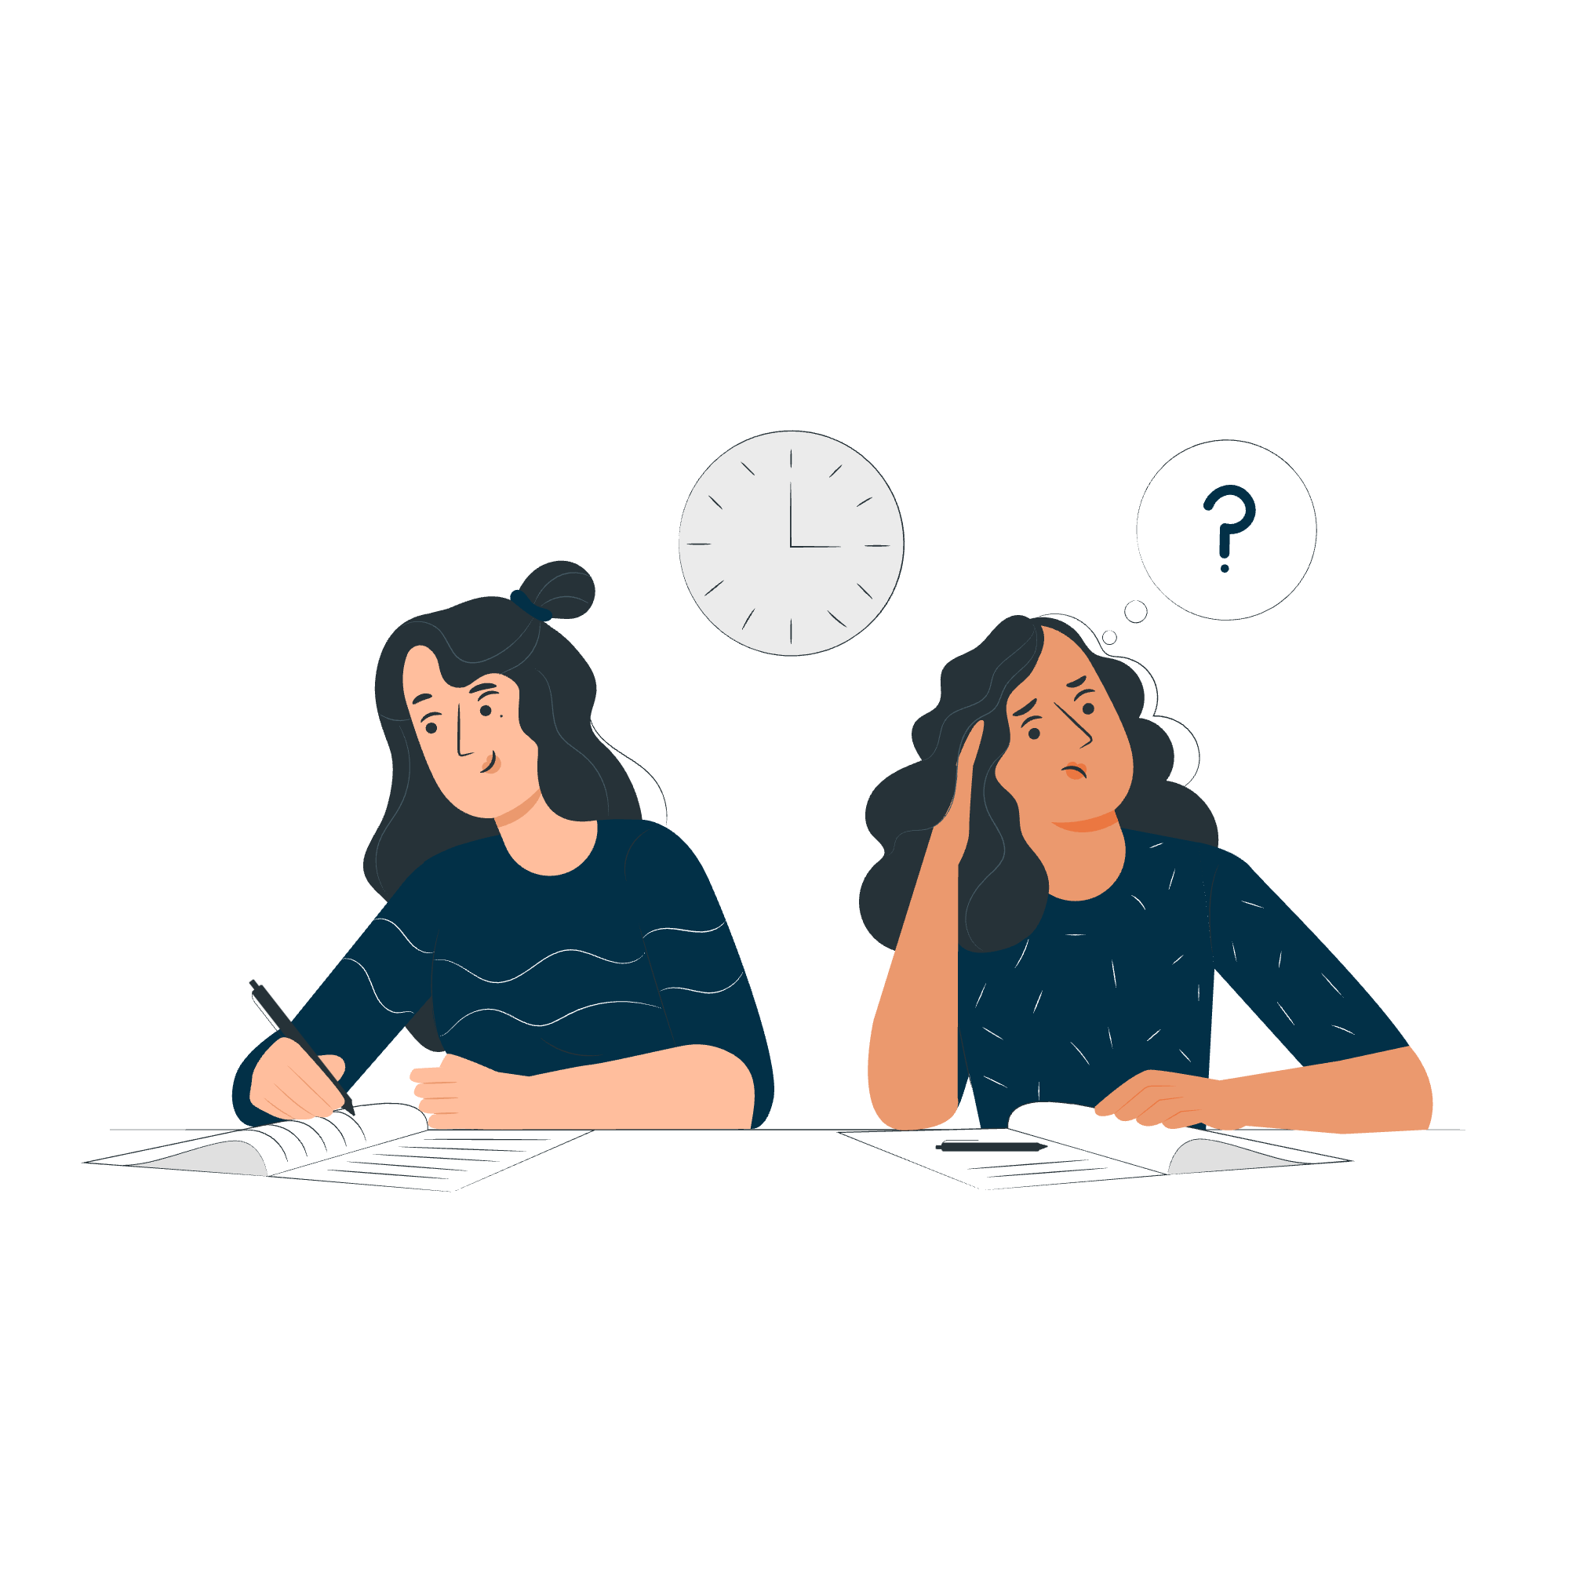
Democracy Mini Quiz!
Notes:
Slide:
Mini quiz
Speaker notes:
Guide students through the quiz. This can be completed as a class or in groups! The answers provide follow-up information.

Slide 21
True or false: You can find reliable information on WhatsApp about voting in London.
True
False
In fact, there are two ways to get information from us on WhatsApp!
For personalised support on voting and translated guidance, you can use the GLA’s Whatsapp Chatbot. Just send a message to +44 7908 820136.
To get general updates and resources related to civic and democratic rights, follow the GLA and SOUK’s #NoVoteNoVoice Whatsapp Channel.
Notes:
Slide:
Mini quiz
Speaker notes:
Read out the statement and reveal the correct answer and explanation.

Slide 22
True or false: The email address of your MP is publicly available.
True
False
Yes! You can find the email address of your MP, and any representative on WriteToThem.com
Notes:
Slide:
Mini quiz
Speaker notes:
Read out the statement and reveal the correct answer and explanation.

Slide 23
True or false: The debates in parliament are private.
True
False
They are publicly available and are broadcast through Parliamentlive.tv - Commons.
You can find transcripts and voting records from Parliament on Hansard.
Notes:
Slide:
Mini quiz
Speaker notes:
Read out the statement and reveal the correct answer and explanation.

Slide 24
True or False: You need to apply to register to vote by post or by proxy if you wish to vote in this way.
True
False
You need to register to vote first, at www.gov.uk/register-to-vote .
Once you have registered, you need to apply to register to vote by post or proxy on the following links:
gov.uk/apply-proxy-vote
gov.uk/apply-postal-vote
Notes:
Slide:
Mini quiz
Speaker notes:
Read out the statement and reveal the correct answer and explanation.

Slide 25
True or False: the only way to find out who your candidates are for upcoming elections is through leaflets delivered to your address.
True
False
You can find out which candidates are standing in your area at any time by checking WhoCanIVoteFor
Notes:
Slide:
Mini quiz
Speaker notes:
Read out the statement and reveal the correct answer and explanation.

Slide 26
True or false: If you don’t own an accepted form of photo ID you can’t vote in person.
True
False
If you don’t have an accepted form of photo ID, you can apply for a Voter Authority Certificate! These are free, valid for 10 years, and have no gender marker.
Apply here: gov.uk/apply-for-photo-id-voter-authority-certificate
Notes:
Slide:
Mini quiz
Speaker notes:
Read out the statement and reveal the correct answer and explanation.

Slide 27
True or False: You can follow how your MP votes in parliament on specific issues.
True
False
You can find transcripts and voting records from parliament on Hansard.
Remember you can write to your MP to ask them to vote a certain way.
Notes:
Slide:
Mini quiz
Speaker notes:
Read out the statement and reveal the correct answer and explanation.

Slide 28
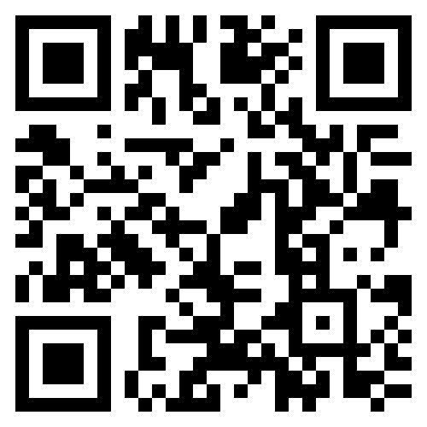
Can you pledge to do two things following this session?
1
Register to vote!​
Talk to 3 other people about registering to vote and how they can have their say in London's democracy. ​
2
Notes:
Slide:
Pledge
Speaker notes:
Take a show of hands for students who pledge to do each activity on the screen. If the school permits student device use, allow students to register to vote now.

Slide 29

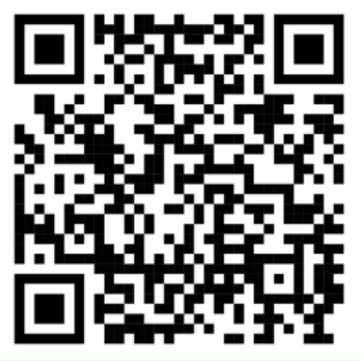
Your voice matters, make sure it gets heard!
Check out the GLA Democracy Hub registertovote.london to:
Find more information on your civic and democratic rights
Find comprehensive answers to FAQs
Check the Democracy WhatsApp chatbot (+44 7908820136) and #NoVoteNoVoice WhatsApp channel
Find accessible resources, including in different languages
Notes:
Slide:
GLA Democracy Hub
Speaker notes:
Signpost students to the GLA Democracy Hub for more information, highlighting the community language resources, WhatsApp channel, and chatbot.

Slide 30

Thank You!
For more information, contact the
GLA Democratic Participation Team at: democracy@london.gov.uk
Funded by the Greater London Authority, City Hall, Kamal Chunchie Way, London, E16 1ZE
Notes:
Slide:
Conclusion
Speaker notes:
As a plenary, ask students to reflect on what they learnt today that they didn’t know previously. Wrap up the session by encouraging students to get their voices heard and emphasise that they are at the beginning of their relationship with democracy and civic life, but this is something that continues for the rest of their lives. It is in their hands to shape the future of London!

