Slide 1
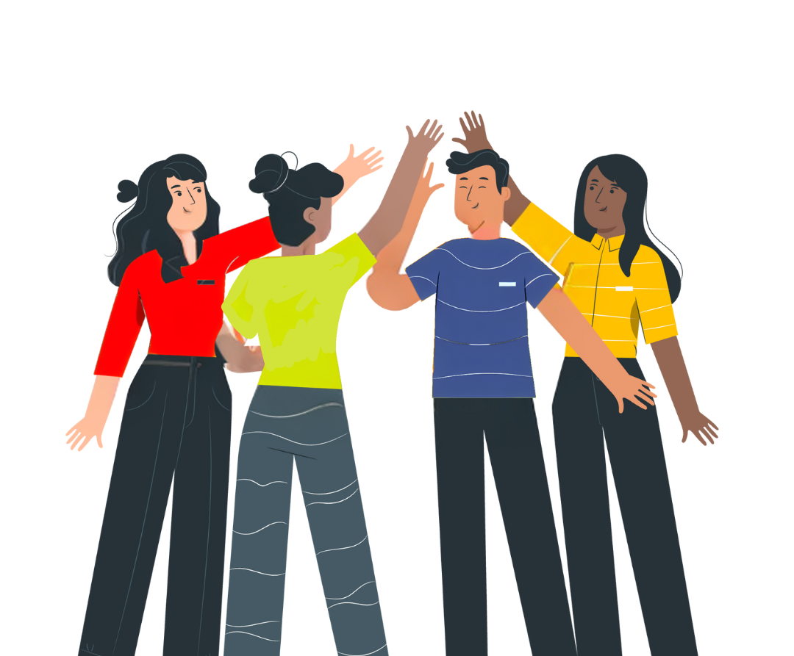


No Vote,
No Voice!
How can you register to vote?
Funded by the Greater London Authority, City Hall, Kamal Chunchie Way, London, E16 1ZE
Notes:
Slide:
Opening slide
Speaker notes:
Welcome students and introduce the topic of rights - discuss some rights that students have as they get older. Explain that we will look at some specific rights about how we improve our community. Contextualise the session in terms of the election landscape i.e. is this being delivered after an election? When will your students be old enough to register to vote, and to vote?

Slide 2
By the end of this session, you’ll be able to answer these questions:
How can I register to vote?
How can I vote in elections in London?
Where can I find information on voting in London that I can trust?
Notes:
Slide:
Session aims
Speaker notes:
Go through the session aims and learning questions you will explore.

Slide 3
Let’s look at some activities!
Put your hand up if you, or someone you know, has done this...
Notes:
Slide:
Civic and democratic participation intro
Speaker notes:
Explain that we will be looking at some different activities together and to put their hands up if they have taken part in this or if they know someone who has.
Discussion opportunity: When students put their hands up you can prompt a longer discussion and share experiences of these rights.

Slide 4


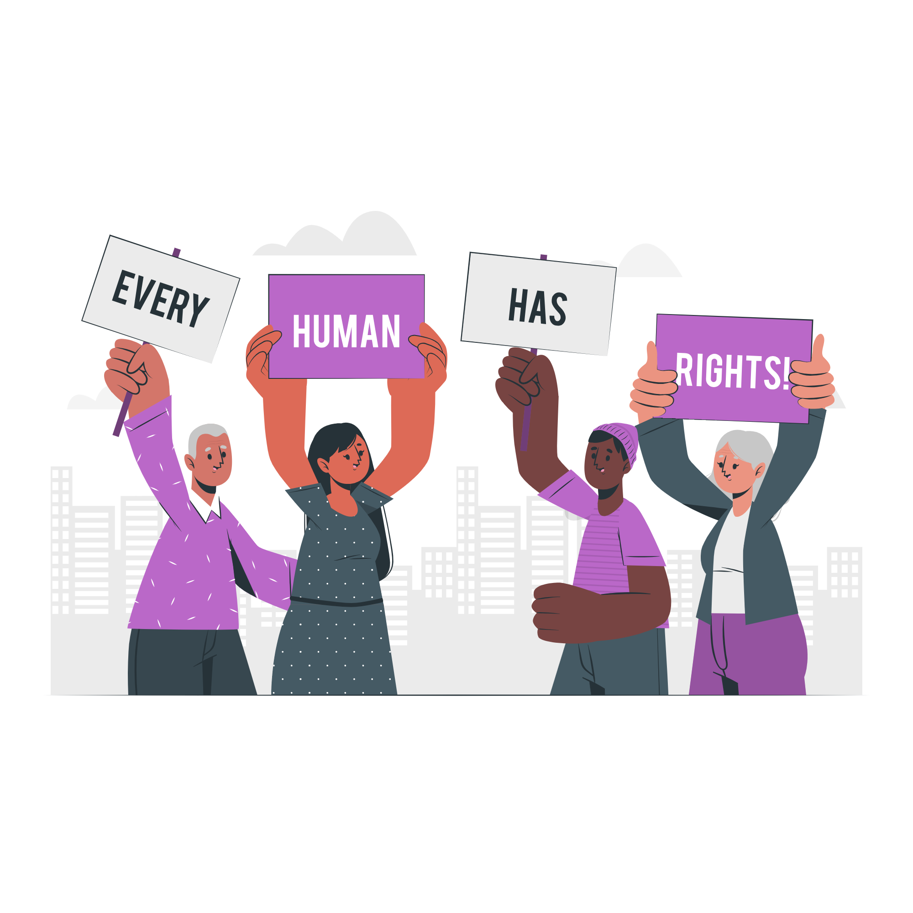
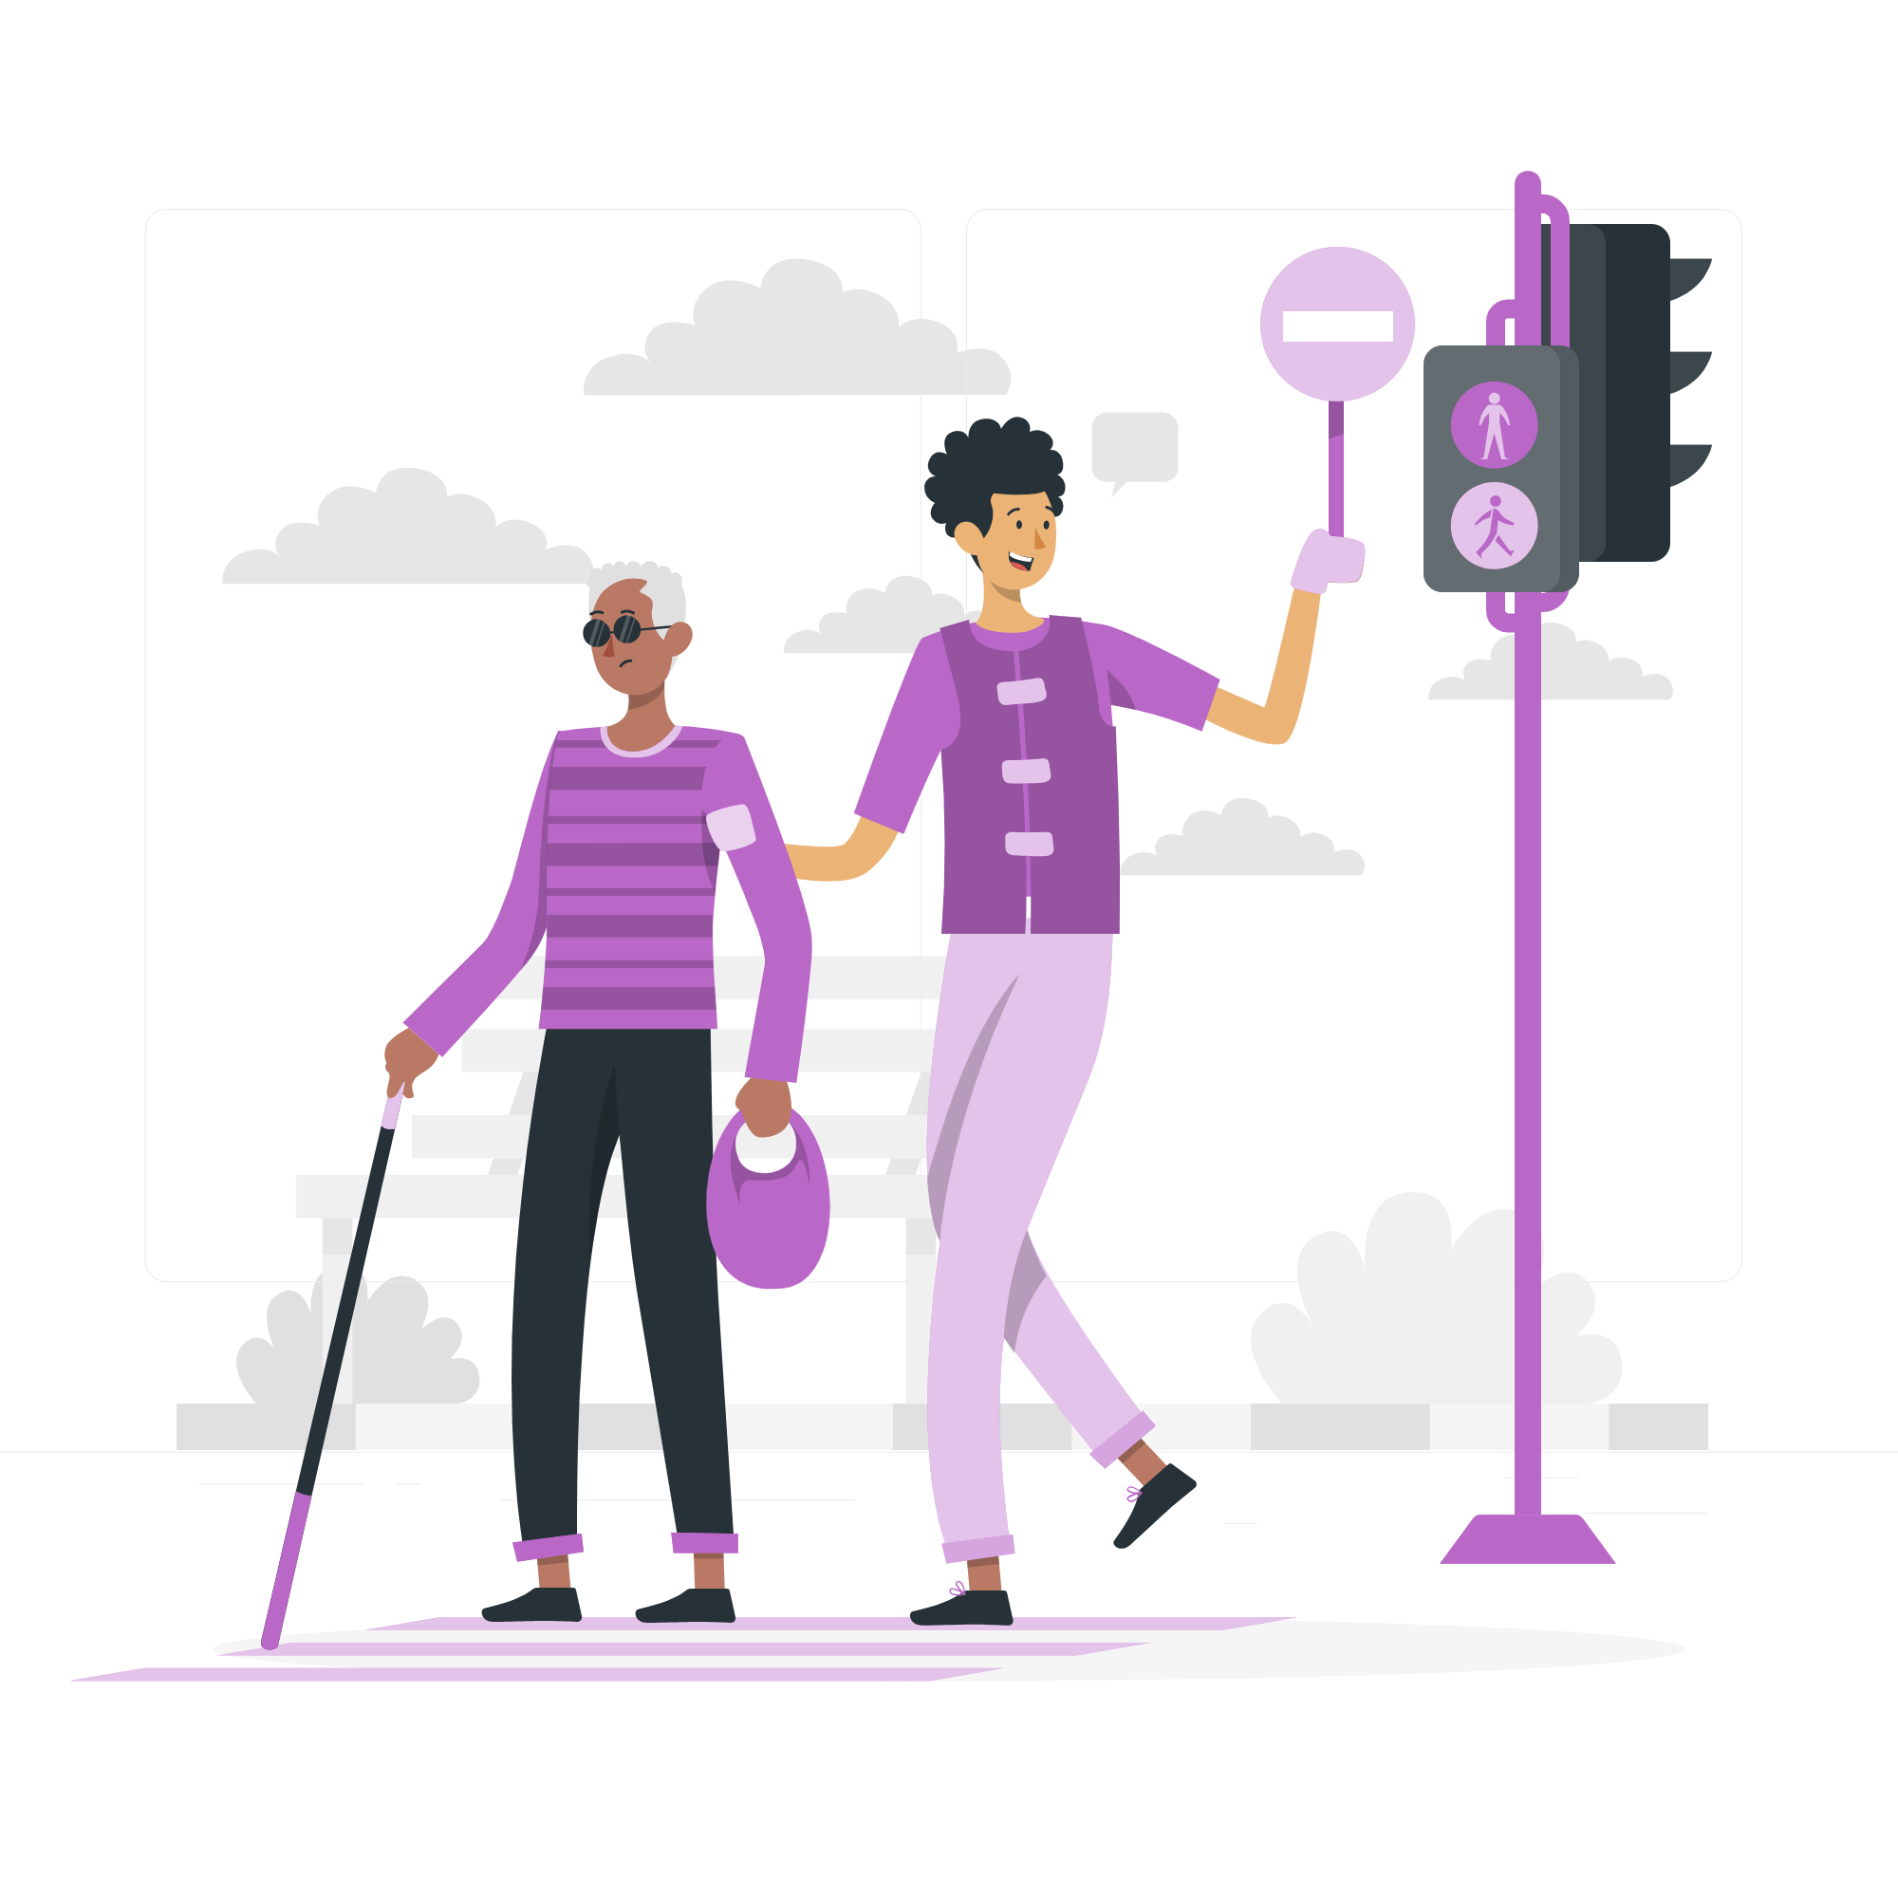
These activities are called civic participation:
Starting or signing petitions
Organising things in your local community
Taking part in peaceful, legal protest
Volunteering
Notes:
Slide:
Civic participation
Speaker notes:
Explore the different examples of civic participation activities and clarify any gaps in knowledge.

Slide 5

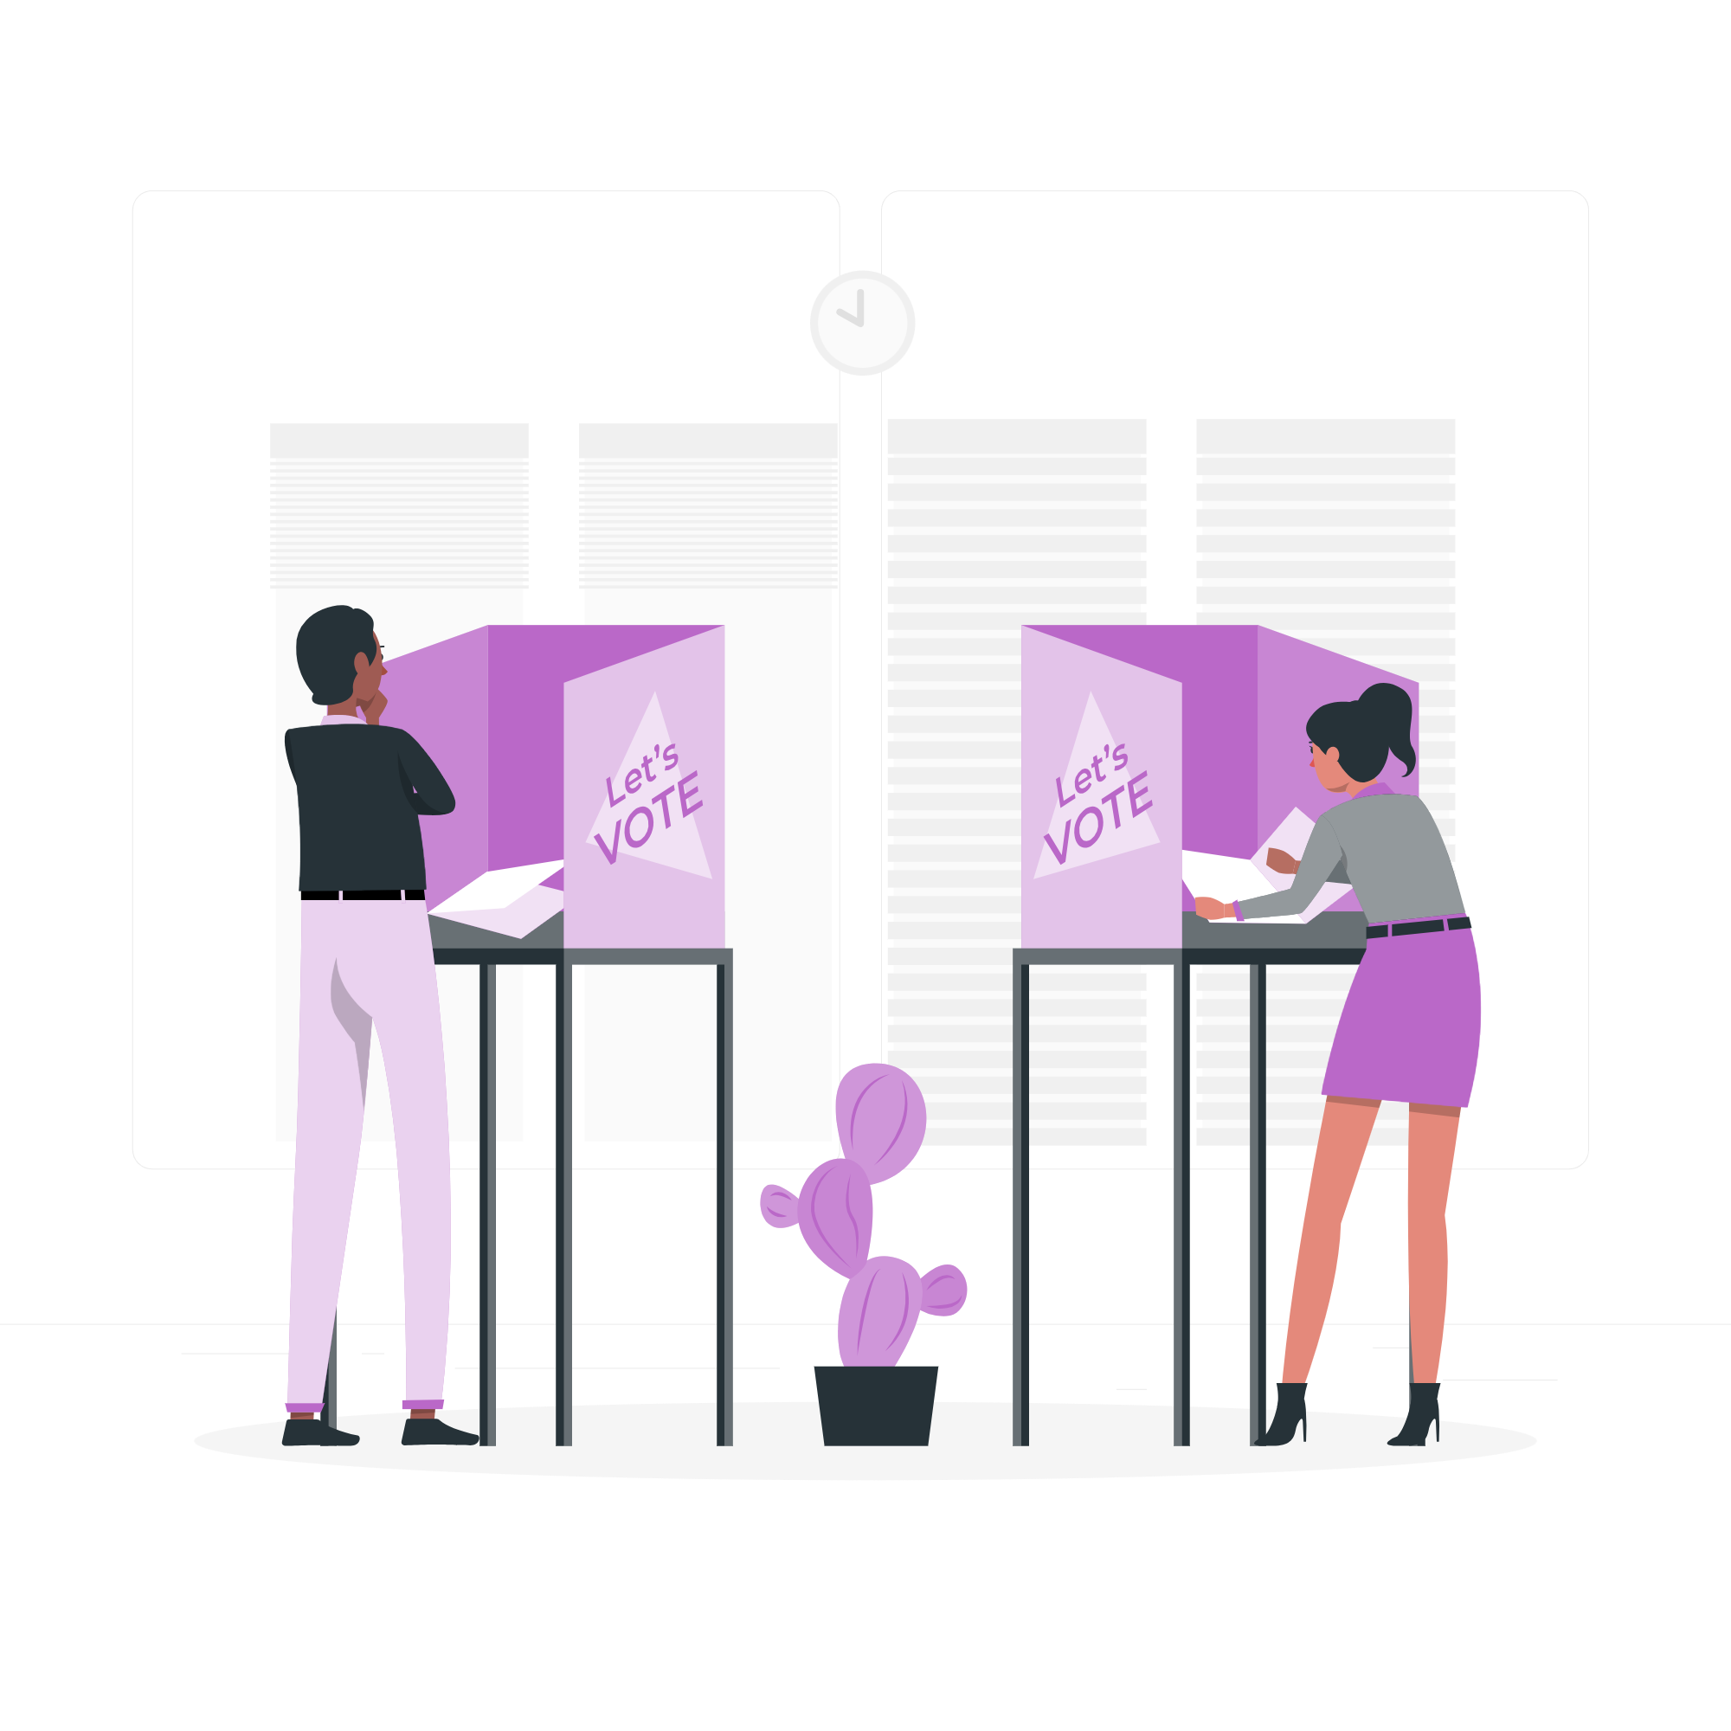
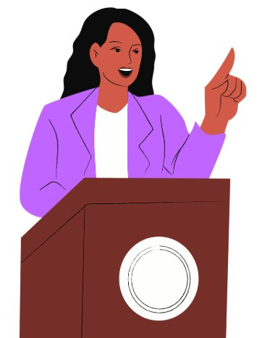

These activities are called democratic participation:
Registering to vote
Contacting the person who represents you
Voting in elections
Standing for election
Notes:
Slide:
Democratic participation
Speaker notes:
Explore the different examples of democratic participation activities and clarify any gaps in knowledge.

Slide 6

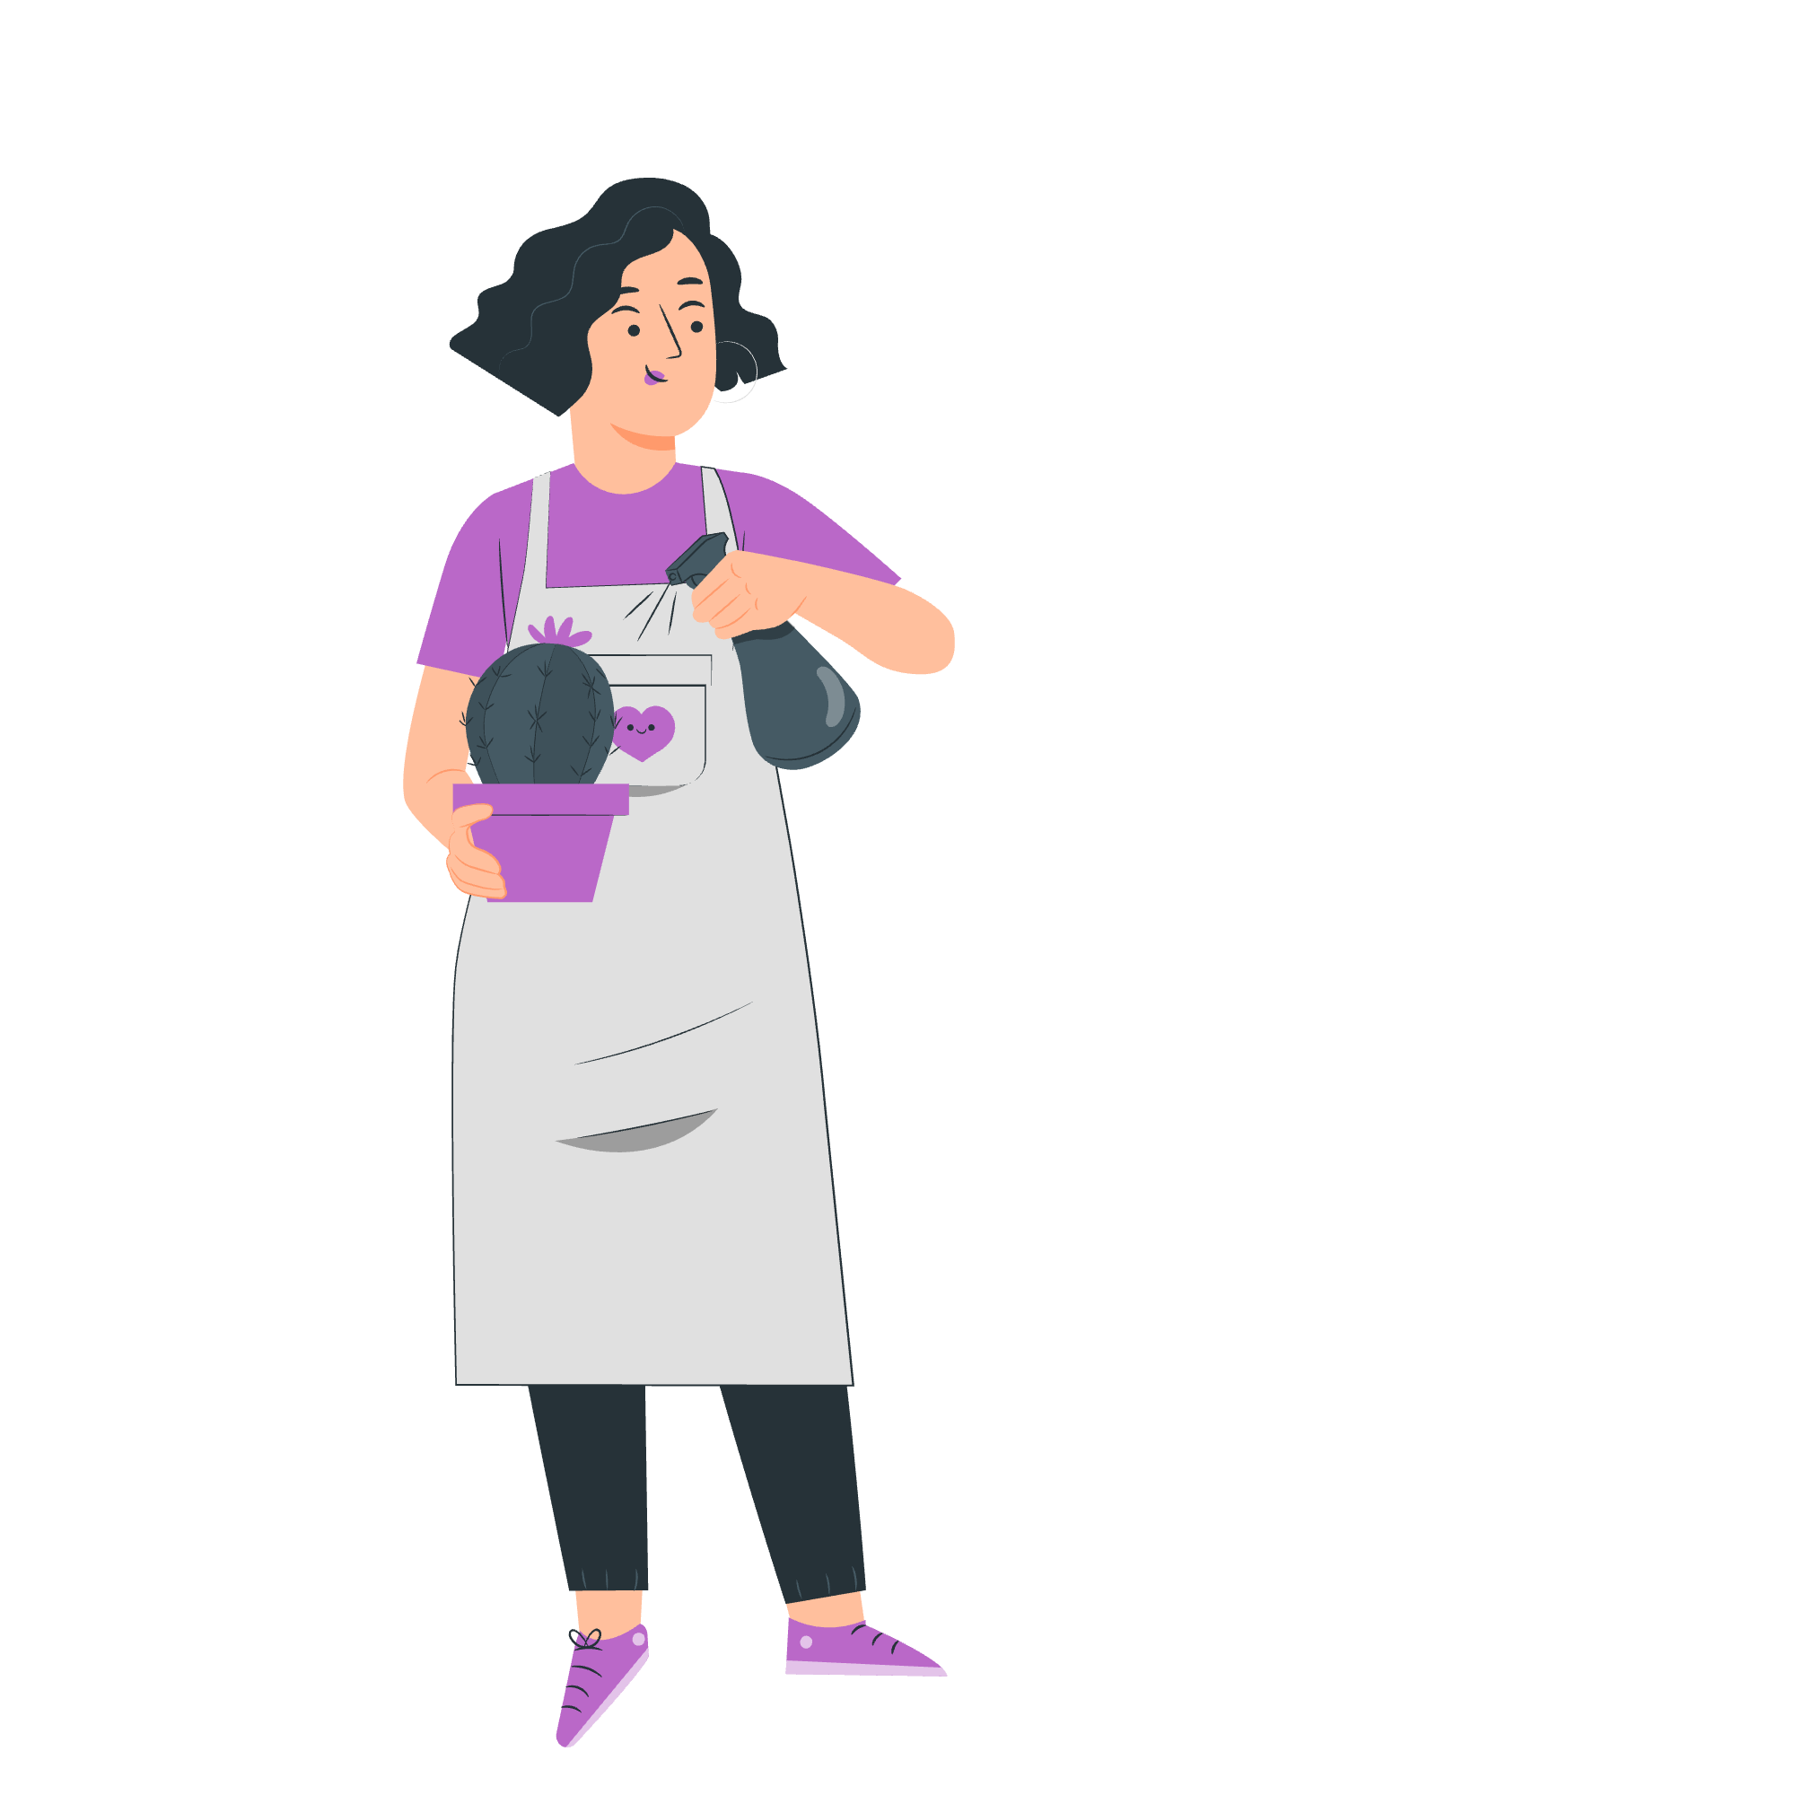
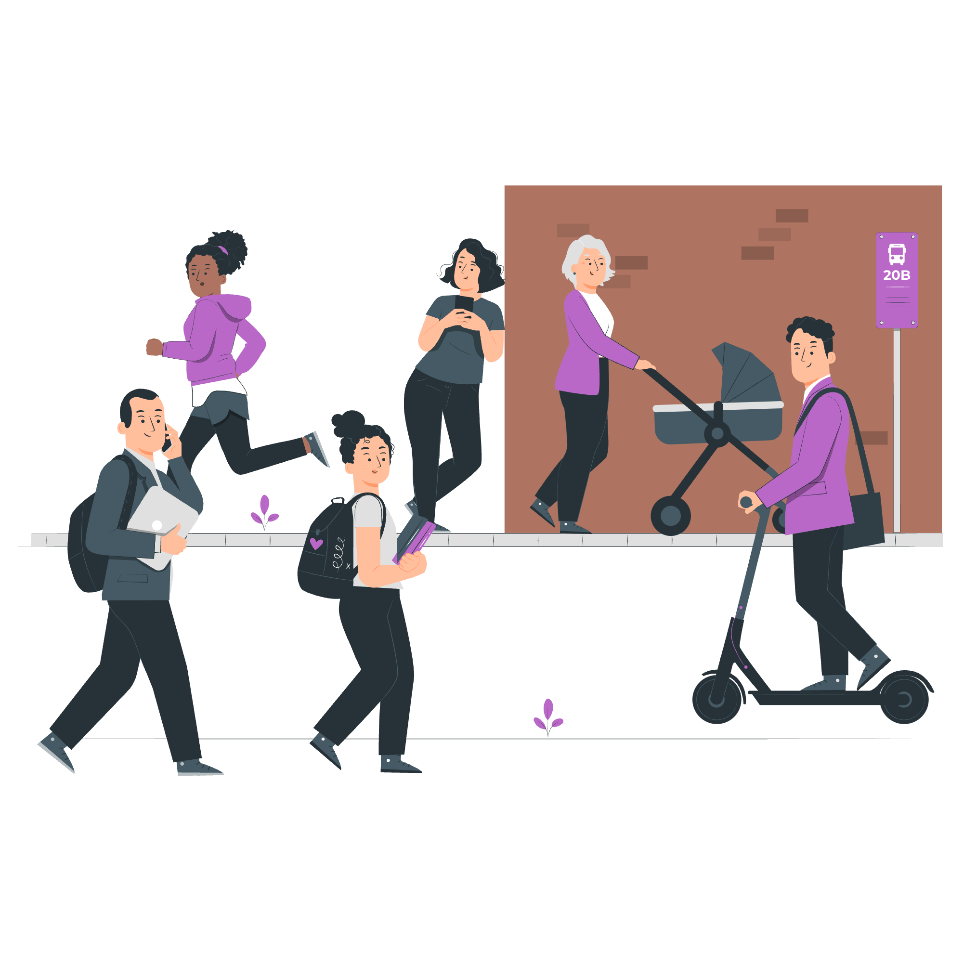
Why do people do these activities?
To gain knowledge and skills
To make a difference
To build stronger communities
Notes:
Slide:
Why participate in democracy and civic life?
Speaker notes:
Elicit some responses from the students first, encouraging them to recall the different rights they have explored. Afterwards, show them some of the reasons people do these activities

Slide 7
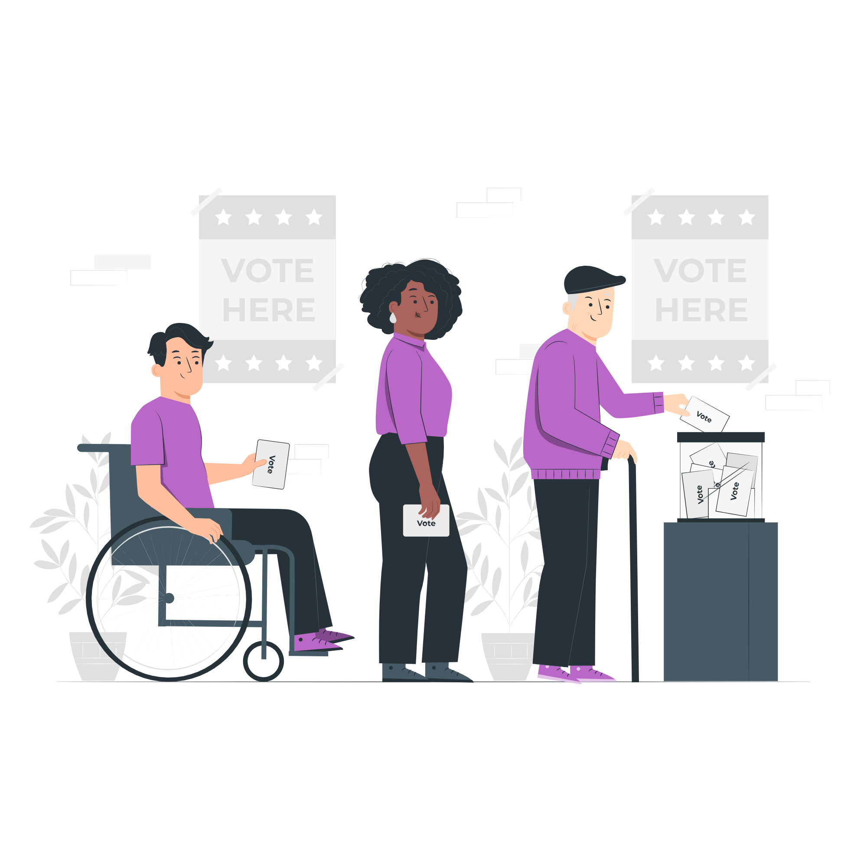
What do you know about voting?
Notes:
Slide:
Introduction to voting
Speaker notes:
Use this slide to prompt discussions about any recent elections that might have happened. Use the images to discuss what happens on voting day.

Slide 8
Which Londoners can vote in elections?
 | General (UK) | Local (borough) | Mayor of London and London Assembly
Must be at least 18 years of age to vote (you can register from 16 years of age) | ✅ | ✅ | ✅
British or Irish citizens | ✅ | ✅ | ✅
Qualifying Commonwealth citizens | ✅ | ✅ | ✅
Qualifying EU citizens or EU citizens with retained rights | ❌ | ✅ | ✅
For more information on if you can vote, head to electoralcommission.org.uk
Notes:
Slide:
Voter eligibility
Speaker notes:
Show which Londoners can vote in elections. You may want to explain the word ‘eligible’ to them.
Discussion opportunity: allow students an opportunity to ask about their eligibility. This will set them up for registration. Remind students that there are other ways to engage in their civic and democratic rights (slides 5 & 6).
Additional visuals that may be useful: Who Can Register to Vote and How | Democracy Hub, Bitesize Video: Eligibility to Register to Vote in London | Democracy Hub

Slide 9
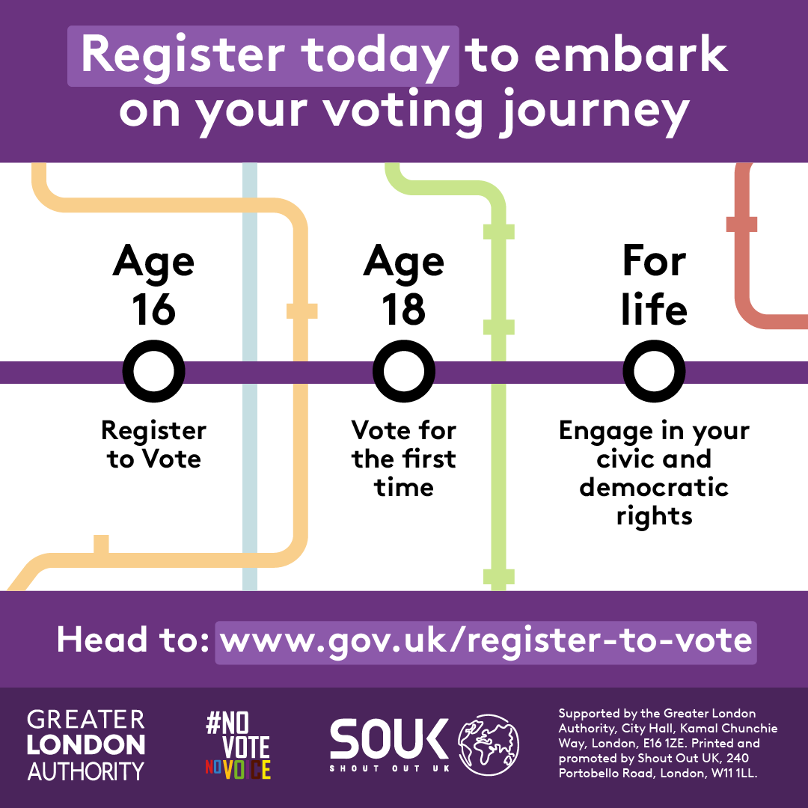
Look at the picture. What can you do already? What have you got coming up in the future?
Do you know how this information might change in the future?
In Parliament, they are having discussions changing the law, to allow people to register to vote from 14 years old, and vote in all elections from age 16.
Check www.gov.uk/register-to-vote for the latest news and updates on voting rules.
Notes:
Slide:
Potential future changes to voting age
Speaker notes:
Show the milestones graphic and ask students to discuss which things they can already do at their age.
Explain that there are discussions about a change in the law that would mean young people could to register to vote from 14 years old and vote from 16.
Further information on the Representation of the People Bill - Representation of the People Bill - Parliamentary Bills - UK Parliament

Slide 10



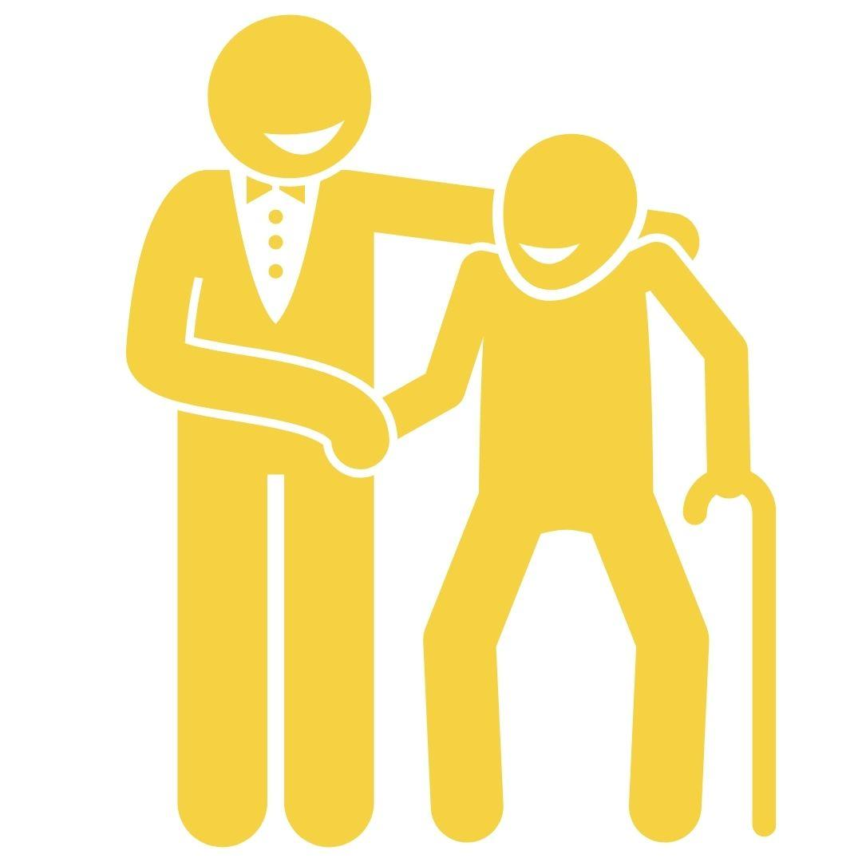
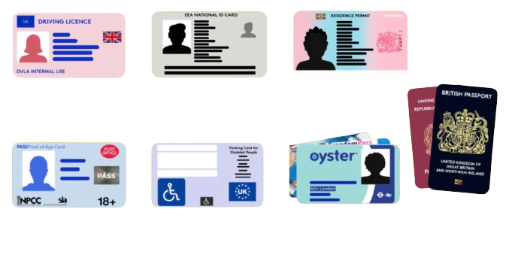
How does voting work?
1
To register to vote, head to gov.uk/register-to-vote
2
You can vote in person, by post, or by proxy
3
You need an accepted form of photo ID to vote in person
Notes:
Slide:
How does voting work?
Speaker notes:
Explain that there are different ways of voting and that we will explore these in more detail. You can elicit knowledge from students that they might already have on this topic.

Slide 11
How can you vote?
1
To register to vote, head to gov.uk/register-to-vote
Notes:
Slide:
How to vote - step 1
Speaker notes:
Explain the process of registering to vote, that it is completed on the gov.uk website and usually doesn't take long.

Slide 12
How can you vote?
2
You can vote in three different ways
In person
By post
By proxy
This means on election (voting) day you go to your local polling station, show your photo Voter ID and vote for the person you choose.
This means before election (voting) day you are sent papers to your home. To vote, you must follow the instructions and post your papers before the deadline.
This means before election (voting) day, you have choose someone you trust to vote for you because you cannot go yourself. They will vote for the candidate you choose.
Notes:
Slide:
How to vote - step 2
Speaker notes:
Explain the three different ways to vote: in person, by post, and by proxy.

Slide 13
How can you vote?
3
You need an accepted form of ID to vote in person.
These include:
UK, Channel Islands or EEA driving licence
UK, Commonwealth
or EEA passport
Blue Badge scheme card
Notes:
Slide:
How to vote - step 3
Speaker notes:
Discuss different forms of ID. Highlight that student IDs and a young person’s Oyster card are not accepted forms of photo Voter ID.

Slide 14
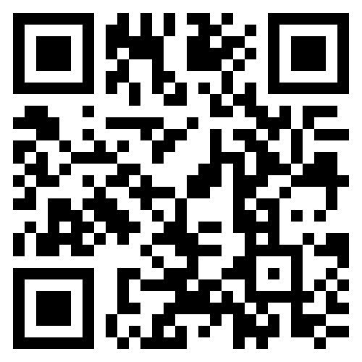
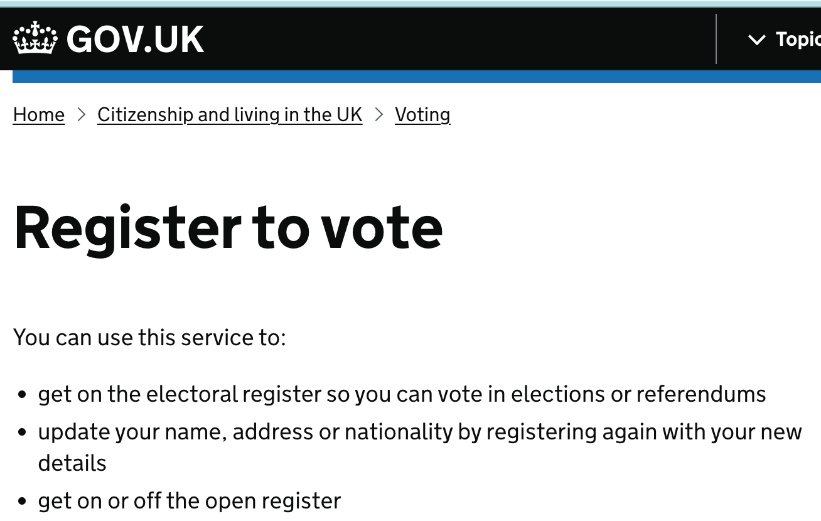
Time to register!
STEP 1:
Scan the code or go to www.gov.uk/register-to-vote
(Don't worry if you don't have your National Insurance number)
Notes:
Slide:
Voter registration
Speaker notes:
Ask students to get out their devices and scan the QR code on the screen to register to vote.
Any students who do not have devices can observe how their classmates register now and register themselves later, at home.
Reassure students that they may still register to vote if they do not have their National Insurance Number with them.

Slide 15
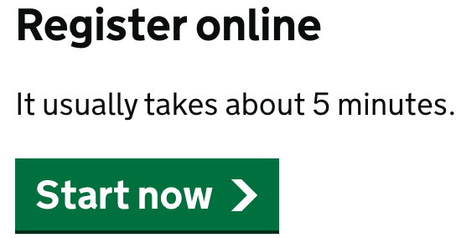
Time to register!
STEP 2:
Click the 'Start now' button and answer the questions!
Notes:
Slide:
Voter registration
Speaker notes:
Circulate and help any students who need support.
After registering, students can keep their devices handy for the Scavenger Hunt activity.

Slide 16
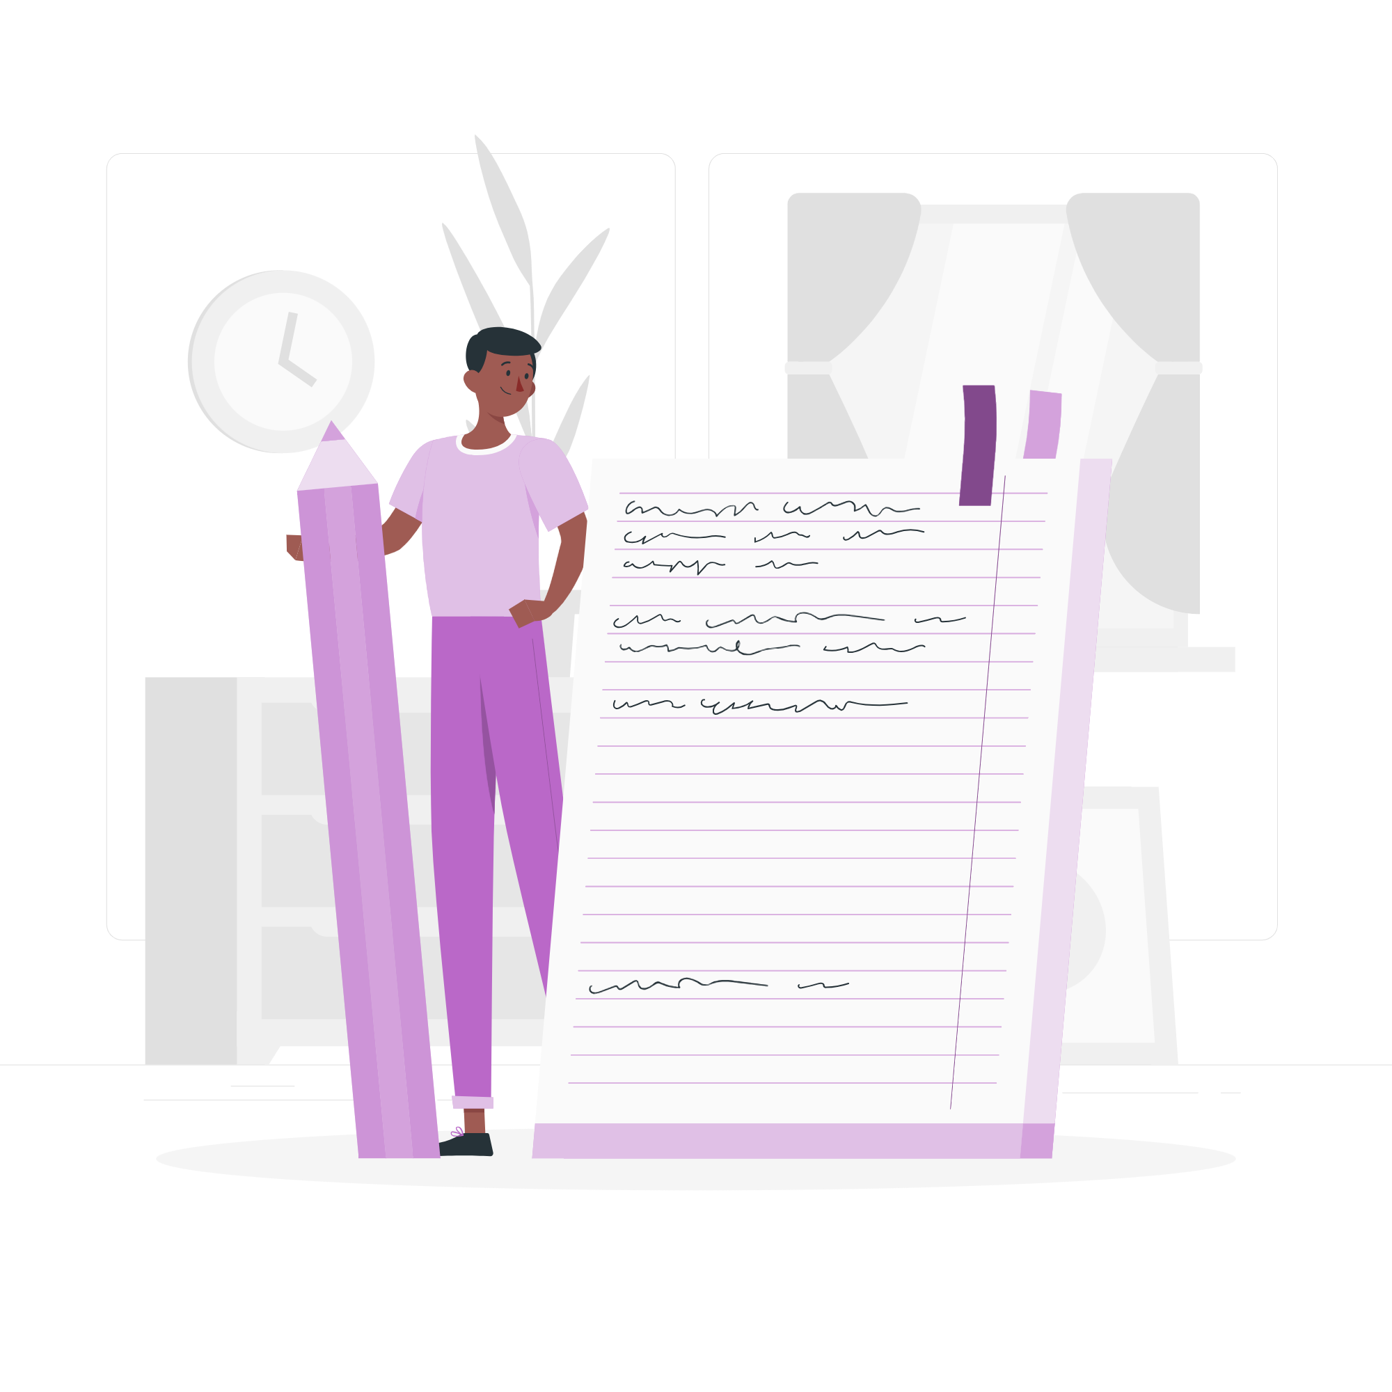
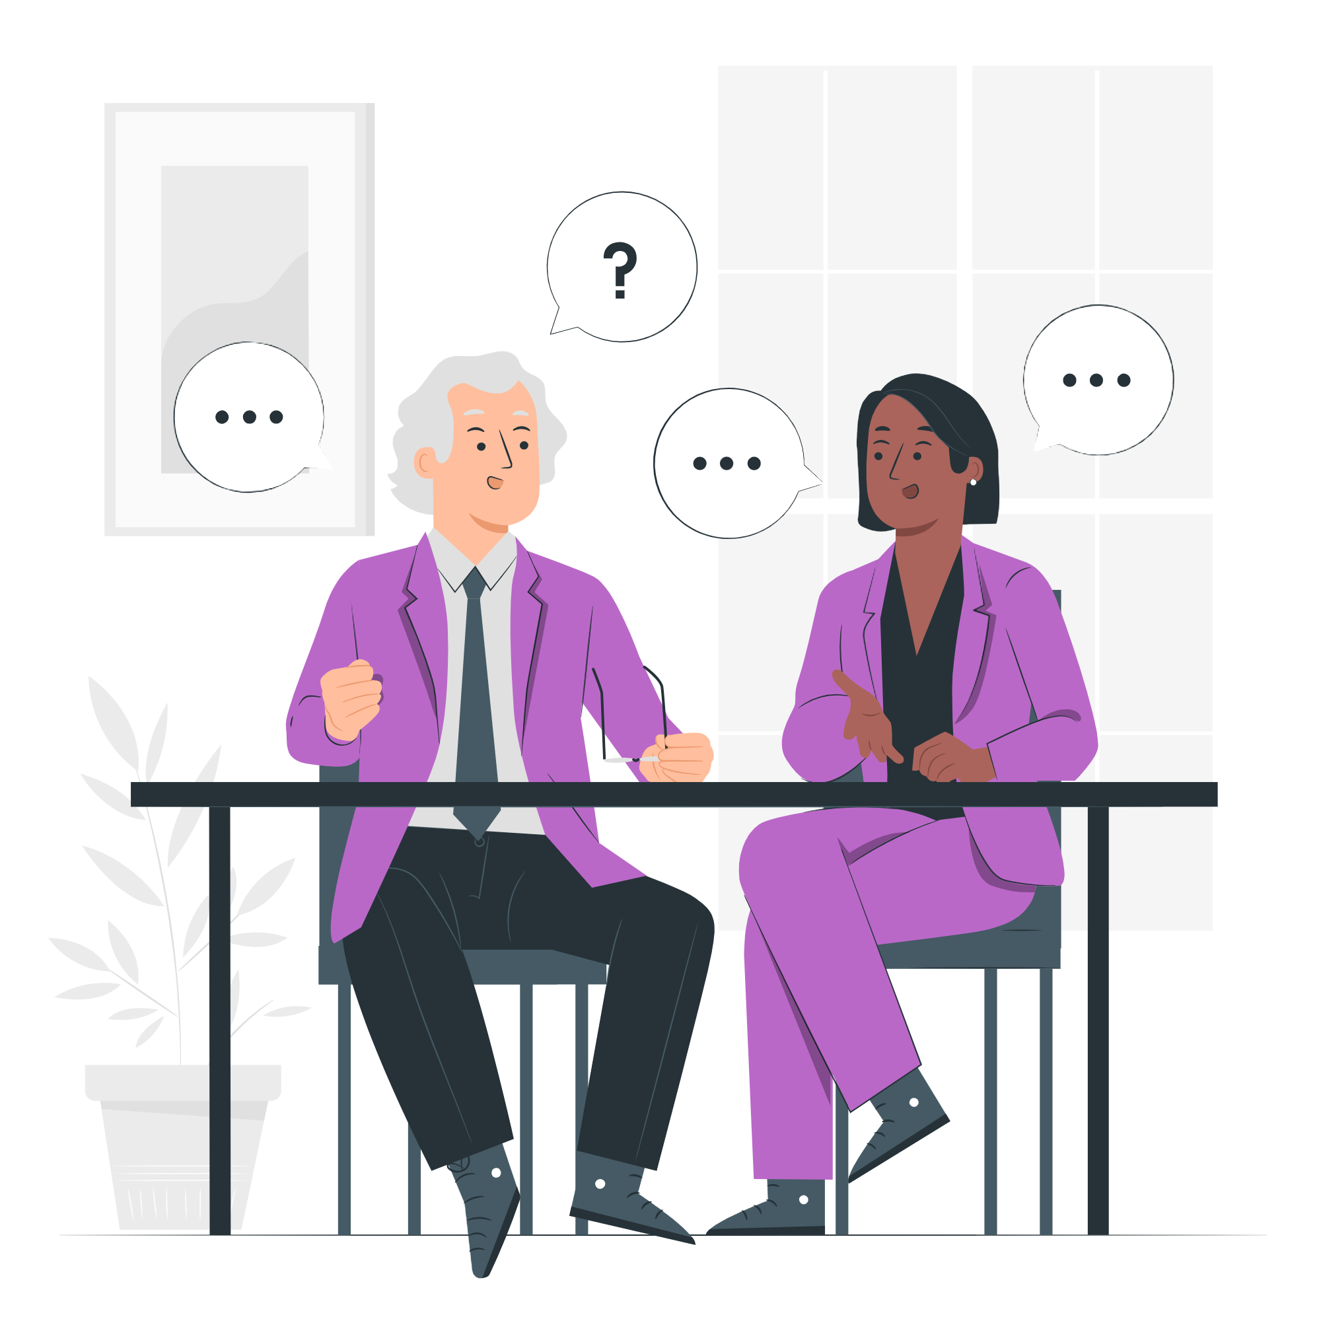

How can I find out more about the elected person who represents me? How can I contact them?
Follow what they say and how they vote!
Write to them!
Talk to them!
This link shows you what representatives say/vote for: Hansard
This link shows you how: WriteToThem
Some representatives have days and times you can visit!
Notes:
Slide:
Engaging with representatives
Speaker notes:
Discuss the different ways you can engage with your representatives. There might be discussions about other ways of engaging, for example through social media.
Discussion opportunity: Discuss the way students would prefer to have their voice heard.

Slide 17

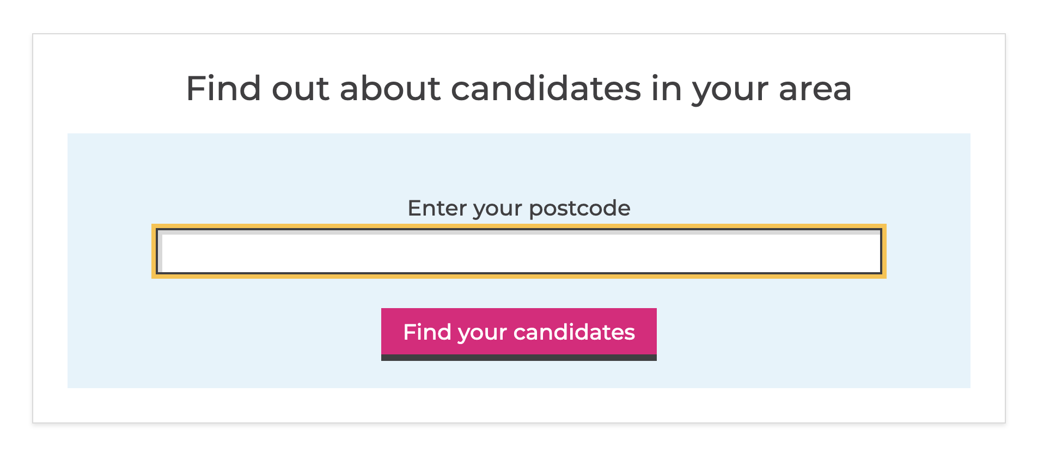
Where can I find more information?
GLA Democracy Hub
This link has:
Frequently asked questions
Information in other languages
A WhatsApp Chatbot you can ask questions to!
Who Can I Vote For?
This link has:
Information on opportunities to vote and who you can vote for
TheyWorkForYou
This link has:
Information about the people who have been voted in (representatives)
Notes:
Slide:
Further information
Speaker notes:
Signpost to the websites provided. Please note these are linked so you can explore them as a class if you have time.

Slide 18
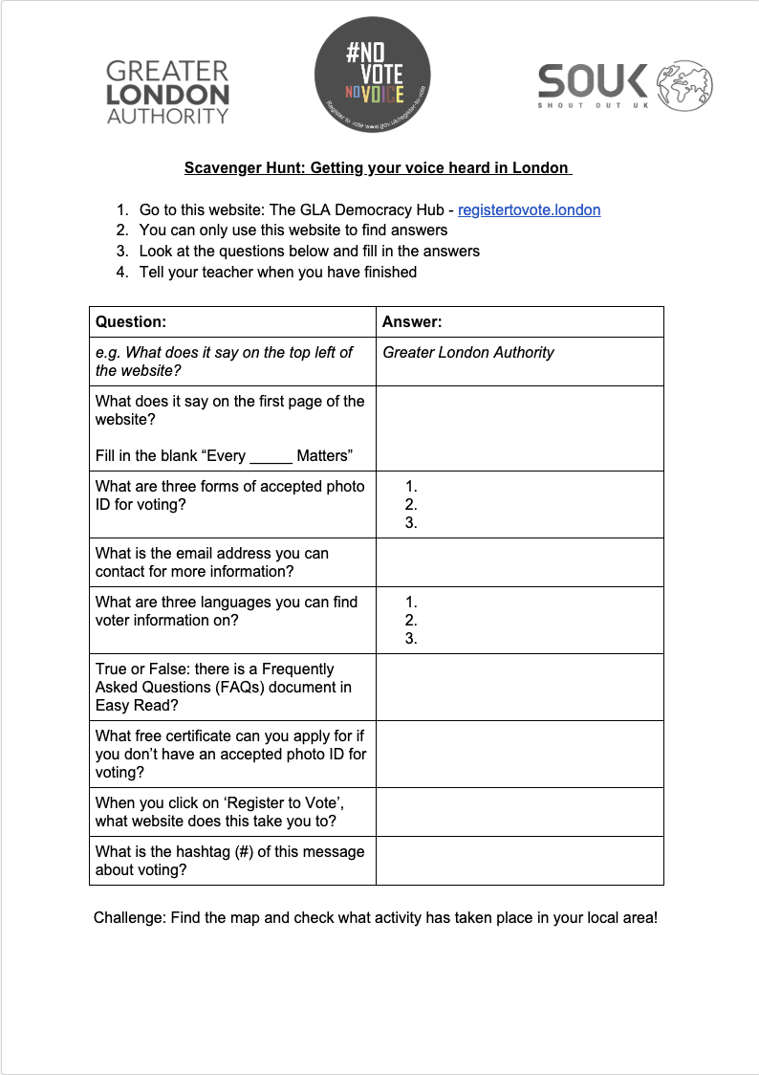
Online treasure hunt!
You will need:
A phone or laptop
A pen
A copy of this worksheet →
Notes:
Slide:
Digital democracy scavenger hunt
Speaker notes:
If they are not already distributed, hand out the Scavenger Hunt worksheets, one per student.

Slide 19
Online treasure hunt!
Get your worksheet ready!
Only use this website to find answers: The GLA Democracy Hub - registertovote.london. No Google – or AI! -is allowed!
How many answers can you find in 10 minutes?
Notes:
Slide:
Digital democracy scavenger hunt
Speaker notes:
Introduce the activity and read out the instructions. Give students ten minutes to complete the activity.
Circulate and support students in completing the activity.
If there is enough time, go through the questions and compare answers as a group.

Slide 20
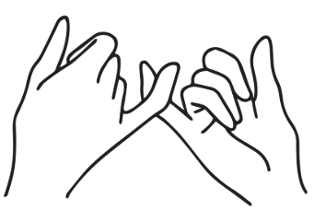
Challenge!
Can you to talk to three people about voting this week?
Notes:
Slide:
Pledge
Speaker notes:
Take a show of hands for students who pledge to talk to three people about voting this week.

Slide 21

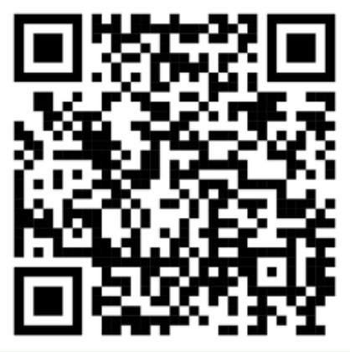
Your voice matters - make sure it gets heard!
Check out the GLA democracy Hub registertovote.london to:
Find more information on voting and your rights
Find the answers to common questions and use our WhatsApp chatbot (+44 7908820136)
Find information in different languages
Notes:
Slide:
Conclusion
Speaker notes:
Remind students of the GLA Democracy Hub, WhatsApp Channel, and Chatbot.

Slide 22

Thank You!
For more information: democracy@london.gov.uk
Funded by the Greater London Authority, City Hall, Kamal Churchie Way, London, E16 1ZE
Notes:
Slide:
Conclusion
Speaker notes:
As a plenary, ask students to discuss what they learnt today that they didn’t know previously. Ask the students to feedback to the class. Wrap up the session by encouraging students to get their voices heard and emphasise that they are at the beginning of their relationship with democracy and civic life, but this is something that continues for the rest of their lives. It is in their hands to shape the future of London!

