Slide 1
No vote, no voice!
ACTIVITY | Register to vote

Slide 2
What are the aims of this activity?
After this 10 – 15 minutes activity you will:
Understand who can register to vote
Understand the different ways of voting
Register to vote yourself
Notes:
Relevant technology will be required for this activity. Such as a functioning ipad, phone or computer with internet connection, that the students can use. We suggest setting up the students in a computer room at the school, with the web browsers open to https://www.gov.uk/register-to-vote so that they can immediately access the Government registration website.

Slide 3

By registering to vote you can:
get on the electoral register and vote in local or national elections
have a voice and a vote in decisions impacting you, your community and our great city
We’re going to go through the steps you need to know so you can register to vote.
But first, do you know who can register?

Slide 4

You can register to vote in London at www.gov.uk/register-to-vote. You must be:
aged 16 or over
a London resident
You must also be one of the following:
a British or Irish citizen
a qualifying EU citizen or an EU citizen with retained rights
a Commonwealth citizen who has permission to enter or stay in the UK, or who does not need permission
Notes:
List of eligible Commonwealth and EU citizens who can register to vote in London: https://www.electoralcommission.org.uk/sites/default/files/2021-10/List%20of%20eligible%20countries.pdf

Slide 5



There are 3 different ways to vote:
In person: You will receive a polling card/letter telling you where your polling station is. You will need to show an original accepted form of photo ID to receive ballot paper/s in the polling station.
By post: If you are not able to vote in person, you can apply to vote by post. There is no requirement for you to provide photo ID. The council’s Returning Officer will undertake security checks of your signature and date of birth when you return your postal vote pack. You can apply to vote by post at www.gov.uk/apply-postal-vote
By proxy: If you cannot vote in person, you can nominate someone to vote on your behalf. An appointed proxy can attend the polling station and will be required to provide their own photo ID or they can apply to vote by post. You can apply to vote by proxy at www.gov.uk/apply-proxy-vote
Notes:
Link to postal vote information: https://www.gov.uk/how-to-vote/postal-voting
Link to proxy vote information: https://www.gov.uk/how-to-vote/voting-by-proxy and the application form - https://www.gov.uk/government/collections/proxy-voting-application-forms

Slide 6

The benefits of voter registration
There are various benefits to registering to vote:
You could pass credit checks more easily and improve your credit score (this is because lenders often use the electoral register to check your identify)
Being eligible to be called up for jury service (jury members are drawn randomly from the electoral register)
Being a key part in decision-making by electing local and national representatives!

Slide 7
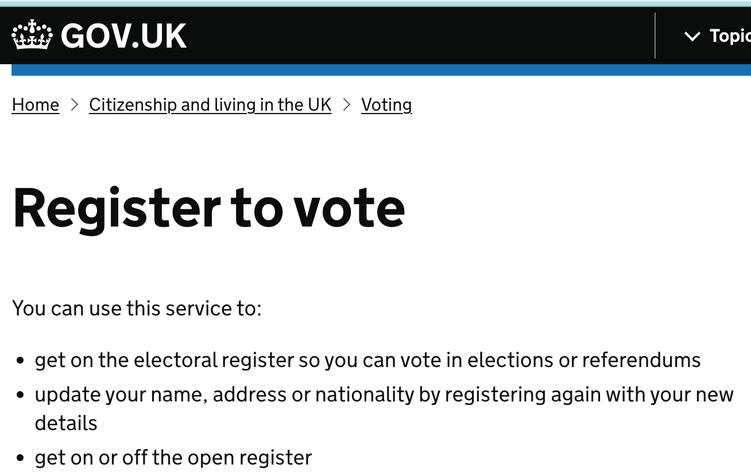
Time to register!
STEP 1: Go to www.gov.uk/register-to-vote
[Try to have your National Insurance number handy]

Slide 8
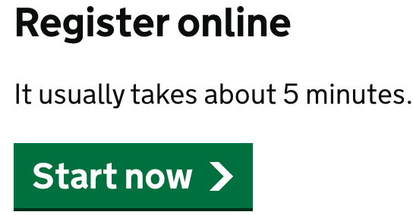
STEP 2:
Click the Start now button and complete the registration process

Slide 9

STEP 3: Register to vote!
Remember that, if you move address, change your name or nationality, you will have to re-register – your vote does not move with you!
Don’t worry if you do not have or cannot remember any information requested, such as your National Insurance number. When asked during the registration process, leave your email or other contact details, and your local Electoral Registration Office will get in touch to support.
Also don’t worry if you don’t have a fixed or permanent address, you can still register.
Let family members and friends known that you’ve registered and that No Vote = No Voice !

Slide 10

Types of Registers:
The Electoral Register
This lists the names and addresses of everyone who is registered to vote in local/ borough or parliamentary/ general elections. It is used for electoral purposes and for jury selection.
The Open Register
This is an extract of the electoral register, but it is not used for elections. Any person, company or organisation can buy this information. As an elector, you can opt out of the open register.
Anonymous Register
If you think your name and address being on the electoral register could affect your safety, or the safety or someone in your household, you can register anonymously.
This means you will still be able to vote, but your name and address will not be on the electoral register.
Notes:
More info and the form for anonymous voter registration - https://www.electoralcommission.org.uk/i-am-a/voter/register-vote/register-vote-anonymously

Slide 11

Links for further information:
Register to vote website:
https://www.gov.uk/register-to-vote
Link to postal vote information:
https://www.gov.uk/how-to-vote/postal-voting
Link to proxy vote information:
https://www.gov.uk/how-to-vote/voting-by-proxy
Link to anonymous voter registration: https://www.electoralcommission.org.uk/i-am-a/voter/register-vote/register-vote-anonymously
Register to vote if you haven't got a fixed or permanent address: https://www.gov.uk/government/publications/register-to-vote-if-you-havent-got-a-fixed-or-permanent-address

Slide 12

Thank you
For more information contact the
GLA Civic and Democratic Participation Team
democracy@london.gov.uk
london.gov.uk

