Slide 1
No vote, No voice!
ACTIVITY | Voter registration and photo Voter ID

Slide 2
What are the aims of this activity?
After this 30 minute activity you will:
Understand who can register to vote
Understand the different ways of voting
Understand the changes to voting
Be able to register to vote yourself
Notes:
Relevant technology will be required for this activity. Such as a functioning ipad, phone or computer with internet connection, that the students can use. We suggest setting up the students in a computer room at the school, with the web browsers open to https://www.gov.uk/register-to-vote so that they can immediately access the Government registration website.

Slide 3

By registering to vote you can:
Get on the electoral register and vote in local or national elections
Use your voice to vote on decisions impacting you, your community and our great city
We’re going to go through the steps you need to know so you can register to vote.
But first, do you know who can register?

Slide 4

You can register to vote in London at www.gov.uk/register-to-vote
You must be:
Aged 16 or over
A London resident
You must also be one of the following:
A British or Irish citizen
A qualifying EU citizen or an EU citizen with retained rights
A Commonwealth citizen who has permission to enter or stay in the UK, or who does not need permission
Notes:
List of eligible Commonwealth and EU citizens who can register to vote in London: https://www.electoralcommission.org.uk/sites/default/files/2021-10/List%20of%20eligible%20countries.pdf

Slide 5
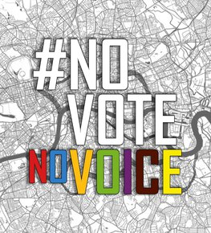
The benefits of voter registration
There are various benefits to registering to vote:
You could pass credit checks more easily and improve your credit score (this is because lenders often use the electoral register to check your identity)
You are eligible to be called up for jury service (jury members are drawn randomly from the electoral register)
You are a key part in decision-making by electing local and national representatives!

Slide 6
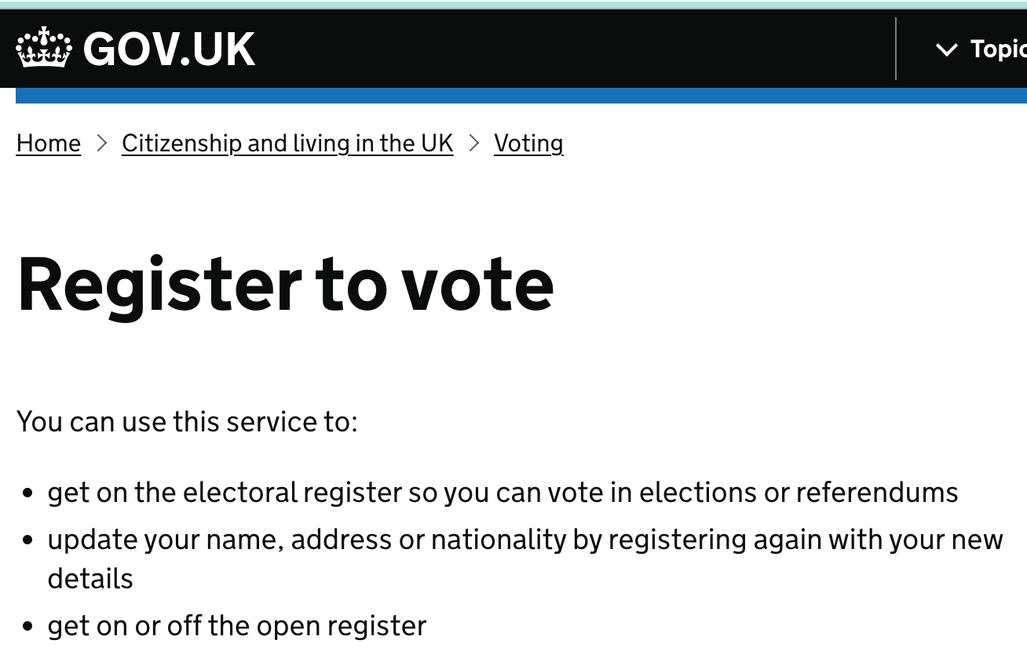
Time to register!
STEP 1: Go to www.gov.uk/register-to-vote
[Try to have your National Insurance number handy]

Slide 7
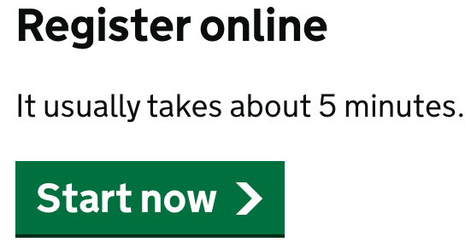
STEP 2:
Click the Start now button and complete the registration process

Slide 8

STEP 3: Register to vote!
Remember that, if you move address, change your name or nationality, you will have to re-register – your vote does not move with you!
Don’t worry if you do not have or cannot remember any information requested, such as your National Insurance number. When asked during the registration process, leave your email or other contact details, and your local Electoral Registration Office will get in touch to support.
Also don’t worry if you don’t have a fixed or permanent address, you can still register.
Let family members and friends known that you’ve registered and that No Vote = No Voice !

Slide 9

Types of Registers:
The Electoral Register
This lists the names and addresses of everyone who is registered to vote in local/ borough or parliamentary/ general elections. It is used for electoral purposes and for jury selection.
The Open Register
This is an extract of the electoral register, but it is not used for elections. Any person, company or organisation can buy this information. As an elector, you can opt out of the open register.
Anonymous Register
If you think your name and address being on the electoral register could affect your safety, or the safety or someone in your household, you can register anonymously.
This means you will still be able to vote, but your name and address will not be on the electoral register.
Notes:
More info and the form for anonymous voter registration - https://www.electoralcommission.org.uk/i-am-a/voter/register-vote/register-vote-anonymously

Slide 10
Voter Identification:
Elections Act (2022)
From this year, voters will have their identity checked by showing a form of photographic identification, before being given their ballot paper in a polling station.
You will need to show an accepted photo Voter ID if you vote in person at:
Mayor of London and London Assembly elections
Borough/ local elections
Parliamentary/ General elections
Notes:
https://www.gov.uk/government/news/voter-identification-faqs
FAQs – GLA Democracy Hub (registertovote.london)

Slide 11

When will photo Voter ID become applicable?
The requirement to show photo ID to vote in person has been applicable at local elections in England from May 2023.
The first time it applied in pan - London elections was the 2 May 2024 Mayor of London and London Assembly elections. The requirement for the UK Parliamentary/ General elections took effect for elections after 5 October 2023, and in any individual parliamentary by-elections after May 2023.

Slide 12

What counts as accepted photo ID to vote?
Accepted photo ID to vote cannot be any form of ID.
What ID do you think will be an accepted form of ID? Discuss with your partner next to you and make a list!
5 minutes.

Slide 13
Accepted forms of photo ID
A United Kingdom passport
A passport issued by an EEA state or a Commonwealth country
A national identity card issued by an EEA state
A UK driving licence
A driving licence issued by the Channel Islands, the Isle of Man or an EEA state
A Biometric Immigration Document, including eVisas
PASS card issued by the National Proof of Age Standards scheme bearing the Proof of Age Standards Scheme hologram
A Ministry of Defence Form 90 (Defence Identity Card)
A Ministry of Defence Form 100 (HM Armed Forces Veteran Card)
60+ Oyster photocard or a Freedom Pass
A Blue Badge
A free Voter Authority Certificate
Notes:
If they are not in this list, other photo IDs issued by third parties will not be accepted as proof of identity in order to be able to vote.
Please note that you need to take the original form of photo ID with you to the polling station. Photocopies of documents and photos on your phone will not be accepted.
People will be able to use expired photo ID if they are still recognisable from the photo. There is more information on the Electoral Commission’s website on all the accepted types of photo ID at https://www.electoralcommission.org.uk/i-am-a/voter/voter-id.

Slide 14

Voter Authority Certificate
If you do not have one of the accepted forms of photo ID, you can apply for a free Voter Authority Certificate.
All you need is:
a recent, digital passport style photograph of yourself
your date of birth
your National Insurance Number
If you don't know your NI Number, or dont have one, you can still apply. Your council will contact you to request an alternative proof of identity.

Slide 15
Is there a deadline to apply for a free Voter Authority Certificate?
Yes, you can apply for Voter Authority Certificate or Anonymous Elector’s Document at any time.
The deadline for applications for a particular election is 5pm, 6 working days before polling day. However, it’s best to apply as soon as possible to be prepared and avoid disappointment!

Slide 16
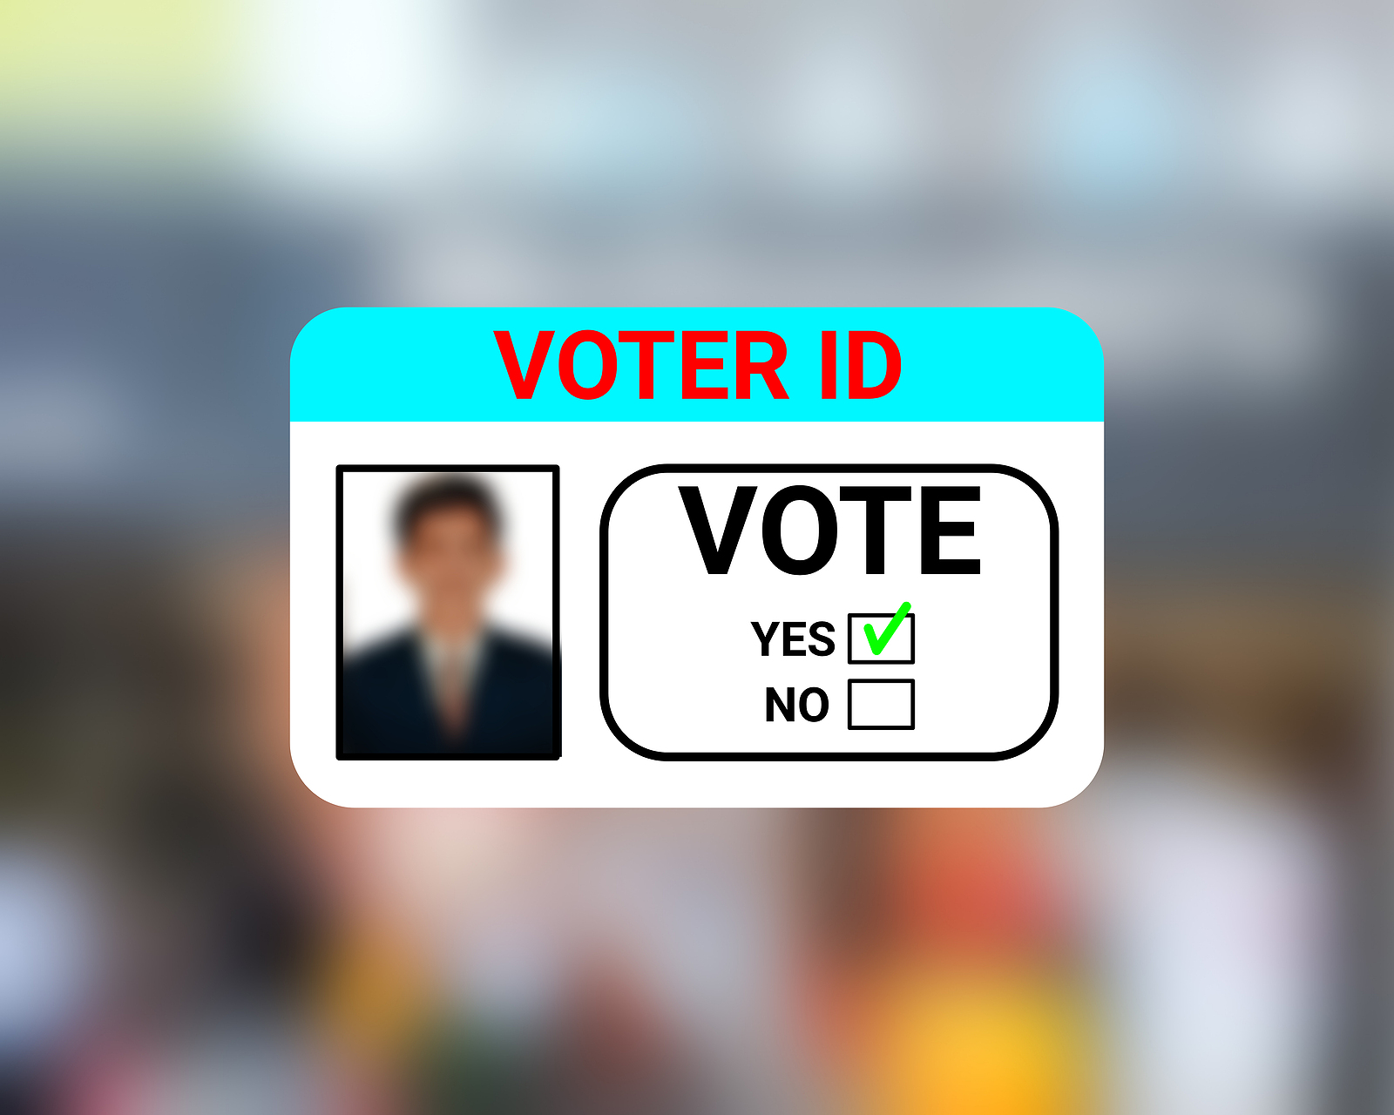
Can I use the Voter Authority Certificate as photo ID for other things?
No, the Voter Authority Certificate is for voting purposes only and cannot be used as proof of identification for any other reason.
It will not be accepted as a proof of age or proof of address document.

Slide 17
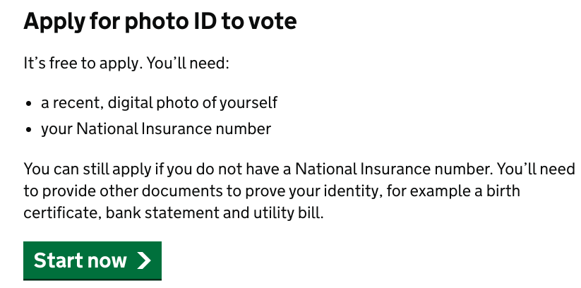
Get your free Voter Authority Certificate!
You can apply online at:
https://www.gov.uk/apply-for-photo-id-voter-authority-certificate.
Or you can fill out a paper application form and send this to your local council. You can request the instructions in Large Print, Braille or Easy Read.

Slide 18



There are 3 different ways to vote:
In person: You will receive a polling card/letter telling you where your polling station is. You will need to show an original accepted form of photo ID to receive ballot paper/s in the polling station.
By post: If you are not able to vote in person, you can apply to vote by post. There is no requirement for you to provide photo ID. The council’s Returning Officer will undertake security checks of your signature and date of birth when you return your postal vote pack. You can apply to vote by post at www.gov.uk/apply-postal-vote
By proxy: If you cannot vote in person, you can nominate someone to vote on your behalf. An appointed proxy can attend the polling station and will be required to provide their own photo ID or they can apply to vote by post. You can apply to vote by proxy at www.gov.uk/apply-proxy-vote
Notes:
Link to postal vote information: https://www.gov.uk/how-to-vote/postal-voting
Link to proxy vote information: https://www.gov.uk/how-to-vote/voting-by-proxy and the application form - https://www.gov.uk/government/collections/proxy-voting-application-forms

Slide 19

Links for further information:
GLA Democracy Hub - info and resources
https://registertovote.london/
Register to vote website:
https://www.gov.uk/register-to-vote
Link to postal vote information:
https://www.gov.uk/how-to-vote/postal-voting
Link to proxy vote information:
https://www.gov.uk/how-to-vote/voting-by-proxy
Link to anonymous voter registration:
https://www.electoralcommission.org.uk/voting-and-elections/register-vote/register-vote-anonymously
Register to vote if you haven't got a fixed or permanent address:
https://www.gov.uk/government/publications/register-to-vote-if-you-havent-got-a-fixed-or-permanent-address

Slide 20
Find out more information about accepted photo ID to vote:
The Electoral Commission is publishing national guidance on https://www.electoralcommission.org.uk/
You can apply for, renew or update your licence, view or share your driving licence at https://www.gov.uk/browse/driving/driving-licences .
You can apply online for a British passport at https://www.gov.uk/apply-renew-passport. You can pick up passport application forms from your local Post Office and apply by post, or use the Post Office Check and Send service.
You can apply for or renew a Blue Badge at https://www.gov.uk/apply-blue-badge .
Your local Citizens Advice might also be able to support. Find your local branch at https://www.citizensadvice.org.uk/

Slide 21
For more information contact the
GLA Civic andDemocratic Participation Team at
democracy@london.gov.uk
Thank you

