Slide 1

Your City
Lesson 3 | Voting and Elections

Slide 2
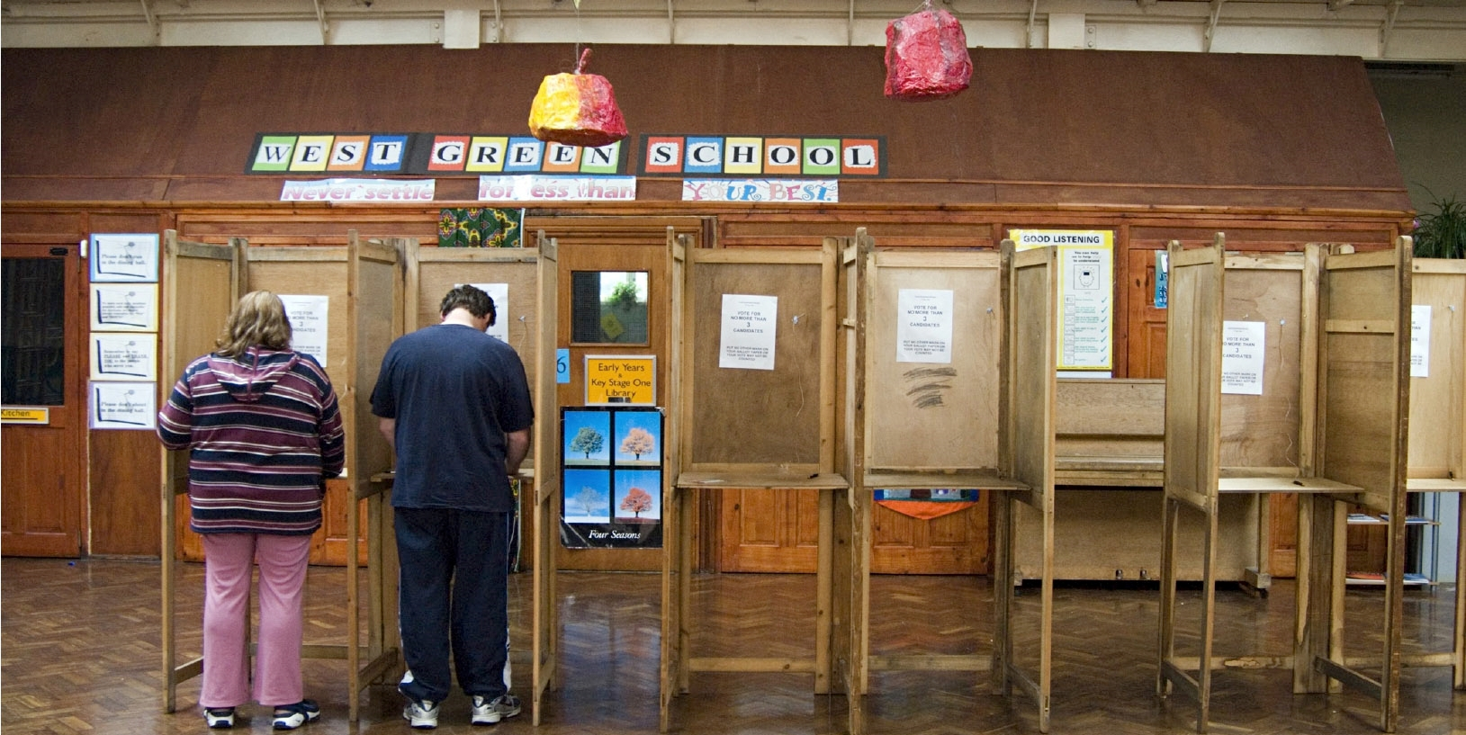

Slide 3
ACTIVITY
Vote with your feet

Slide 4
DISCUSS
Why is voting important?

Slide 5
Types of
electoral systems
The main types of election
systems used in the UK are:
First Past the Post (FPTP)
Alternative Vote (AV)
Proportional Representation (PR)

Slide 6
First Past the Post
Voters put a cross next to one or more candidates (one in general elections, multiple in some local elections).
Where is it used? In the UK, the US and India.
The Mayor of London election uses the first-past-the-post system. This means that voters put a cross next to the one candidate and the candidate who receives the most votes becomes the next Mayor of London.
The London Assembly is made of 25 Assembly Members who keep a check on what the Mayor is doing, publish findings and recommendations to investigations and make proposals to the Mayor. 14 London Assembly Members - who represent a constituency made of two or more London boroughs - are elected using FPTP. The other 11 represent London as a whole and are elected through the additional member system.
Pro | Cons
Usually allows parties to form a government on their own | The number of votes cast for a party in general elections is not accurately reflected in the number of seats won
Fringe parties unlikely to get elected | Hard for small parties to gain seats
 | Can encourage tactical voting

Slide 7
Proportional
Representation (PR)
Pro | Cons
The number of seats directly reflects the number of votes cast for each party | Consensus politics isn’t always what voters want
Every vote counts | Gridlock - It can take longer for coalitions and minority governments to reach decisions.
Less tactical voting | Politicians could prioritise local issues, to get re-elected, over national compromise
Voters put a cross next to their chosen party. Votes are counted in each region and seats
are given to parties in direct proportion to
their vote share. So, if a party gets 40% of
the vote in a region, they will have 40% of
the available seats.
Where is it used? It is used for electing the UK’s Members of the European Parliament (MEPs) and in other European countries for their national parliaments, such as Denmark, Austria and Spain.

Slide 8
Alternative Vote (AV)
Pro | Cons
The aim of securing more than 50% of the local vote means MPs work harder to earn and keep voter support. | AV is a "losers' charter" where the candidate who comes second or third in first preferences can actually be elected.
No wasted votes | Some votes count more than others - If you give your first preference to a mainstream party, your other choices might not be counted, but if you give first preference to a small party who gets knocked out, your other preferences will count.
Less tactical voting
Reduces negative campaigning
Voters rank candidates in order of preference. If more than half the voters have the same favourite candidate, that candidate wins. If nobody gets half of first preference votes, the candidate who came last is removed and their second choices are allocated. This is repeated until one candidate has over half the votes.
Where is it used? To elect the majority of chairs of select committees in the House of Commons and for the election of the Lord Speaker and in by-elections for hereditary Peers.

Slide 9
Registering to vote
In some countries, voter registration is an “automatic” system, meaning that everyone is automatically registered to vote, unless you specifically choose to un-register yourself.
To vote in the UK, you must be registered
You can register when you’re 16!
If you don’t register in advance of
the election, you cannot vote.
In some countries (like Belgium and Australia), it is a legal requirement to
vote – though you can mark on the ballot
that you abstain or spoil the ballot.

Slide 10
Registering to vote
You can register online:
www.gov.uk/register-to-vote
You can also register by post:
to find out how, get in touch with your local Electoral Registration Office via
https://www.gov.uk/get-on-electoral-register.
Voting is not obligatory in the UK.
It is a right but there is no punishment
if you do not vote.
But registering to vote is mandatory. You can be fined if you repeatedly refuse to register.
Remember, you need to register at your new address every time you move house.

Slide 11
To vote in the UK you must be registered and be:
18 years of age or over on polling day in England, Wales and Northern Ireland and 16 or older to vote in some Scottish and Welsh elections
a British or Irish citizen, or
  a qualifying Commonwealth citizen, or
  a qualifying EU citizen or an EU citizen with retained rights
a resident at an address in the UK (or a UK citizen living abroad who has previously
been registered to vote in the UK or have lived in the UK) and not be legally excluded from voting
Note: British, Irish and qualifying Commonwealth citizens can vote in all elections. Qualifying citizens and EU citizens with retained rights can vote in local and regional elections, but not general elections. For up to date info visit: https://www.electoralcommission.org.uk/voting-and-elections/register-vote

Slide 12
Types of elections
in the UK:
UK general election
Devolved Parliaments and
Assembly elections
Regional and Local elections

Slide 13
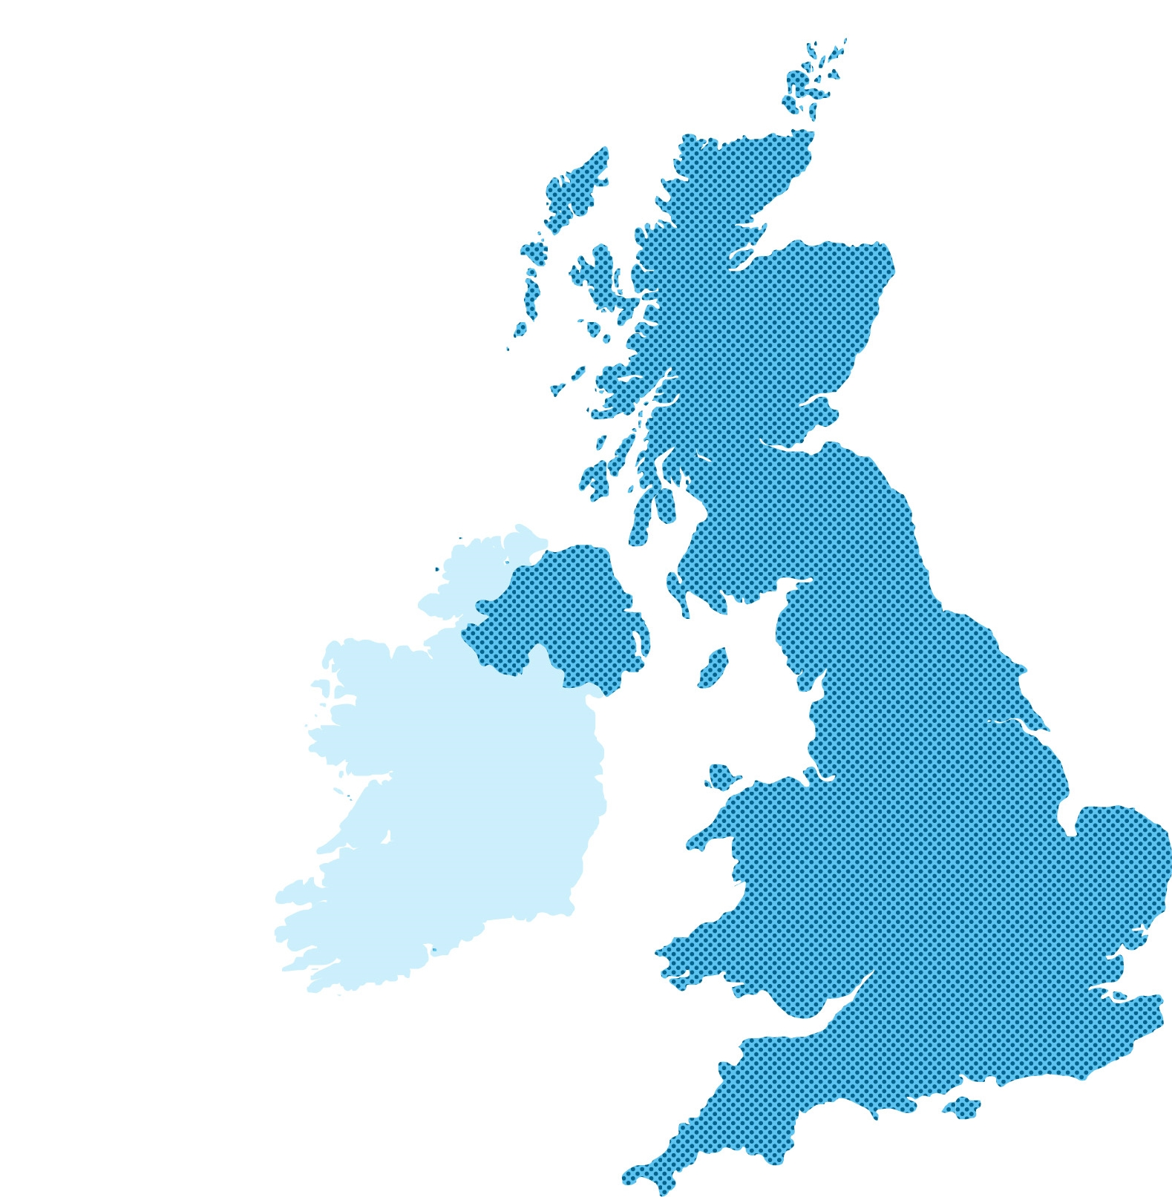
General Elections
In general elections, you vote for a Member of Parliament
(MP) to represent you in the House of Commons.
These elections are meant to take place every 5 years
You vote in your constituency (local area)
MPs are elected using the First Past the Post system.
You vote once for a candidate in your constituency and
the candidate with the most votes becomes your MP.
The party with the most MPs in Parliament forms the government and its leader becomes the Prime Minister.

Slide 14
Members of Parliament
Whilst Parliament is sitting, MPs:
– Raise issues affecting their constituents
– Debate, amend and vote on new laws
– Deal with national issues, such as: tax,
abortion laws, transport and housing
legislation, foreign policy.
Sit in the House of Commons
(the elected House in Parliament)
Split their time between working in Parliament
and in their constituency
Many MPs also sit on committees, which
analyse policy issues in depth, e.g. Education Committee, Defence Committee.

Slide 15
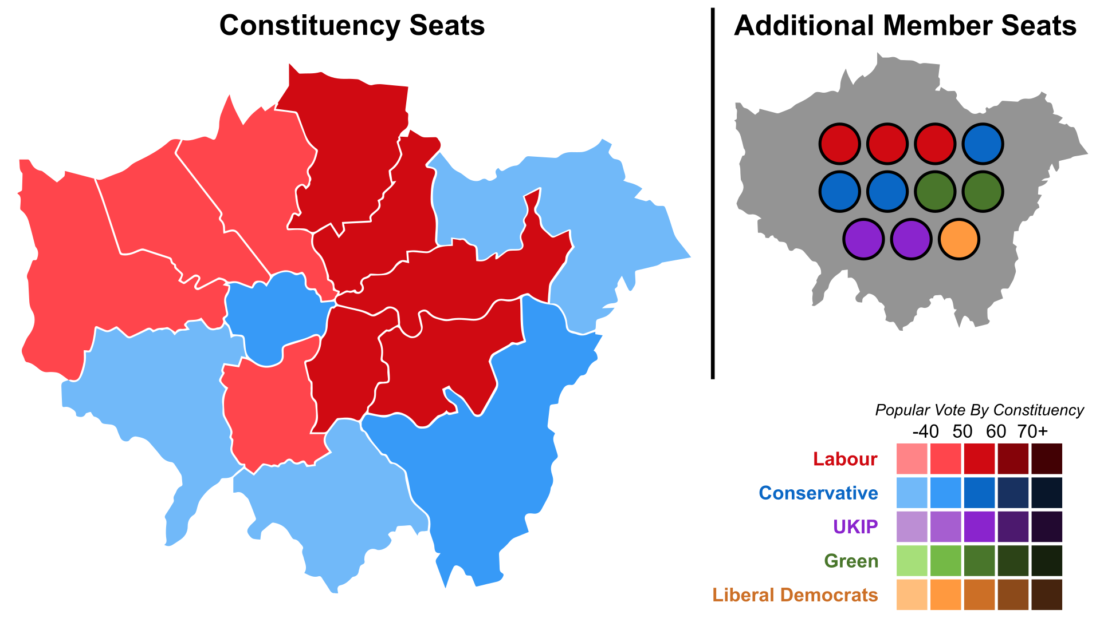
London elections
The London Assembly is London's local government.
It is made of 25 Assembly Members who hold the Mayor
and his team to account.
The Assembly Members are elected using the
additional members system of proportion
representation. This mixes first past the post and
proportional representation. Each voter casts two
votes. One for a candidate standing in a super –
constituency (covering 2 or more boroughs),
and a vote for a party list member standing for
the whole region.
14 Assembly constituency members are elected
via FPTP and 11 London-wide Members using
proportional representation.
This is the result of the 2016 London Assembly elections.

Slide 16
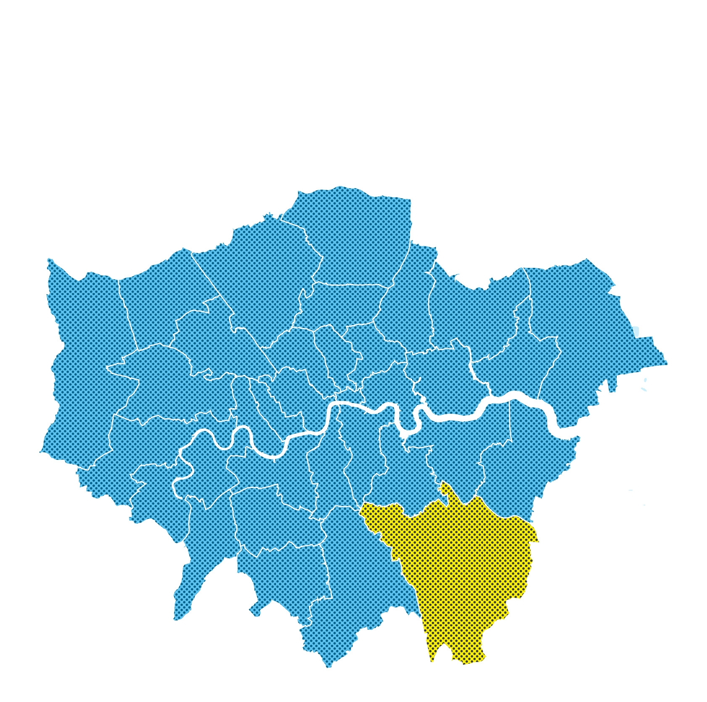
Local elections
In local elections, you vote for councillors –
the politicians who represent you in your local council.
Local government councillors are elected
using the First Past the Post system.
You vote for one or more candidates in your local area (ward) and the candidates with the most votes win. Often you will vote for around three councillors per ward.

Slide 17
Local councillors
Councillors are usually members of political parties, but can also run as independents
They represent people in their local
area (ward)
They debate local issues in council chambers
They act as a bridge between the community and local council
Councillors deal with local issues, including: libraries, youth services, council housing, rubbish collection, local environment, social care and public health.

Slide 18
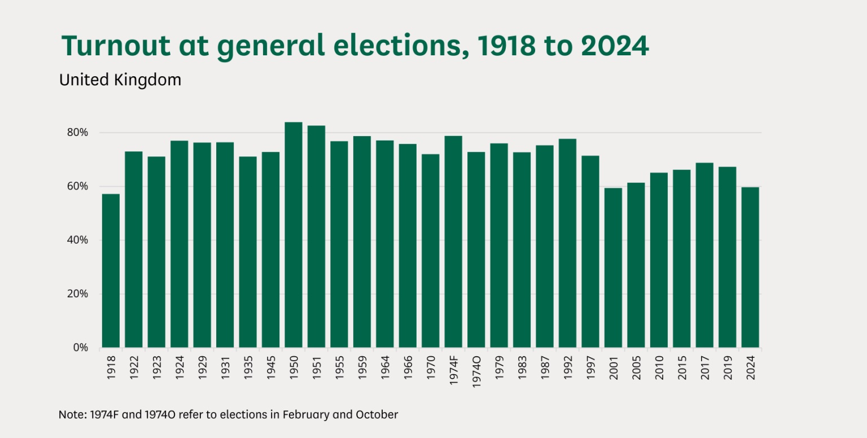
Voter turnout
Voter turnout in the UK is low and varies between general elections
In the 2024 general election, an estimated 60% of those who were registered to vote, voted
This is not the same as the total number
of people eligible to vote because some people don’t register
If you don’t vote, you can’t have a say and decide who will make decisions on your behalf
Source: UK Parliament

Slide 19
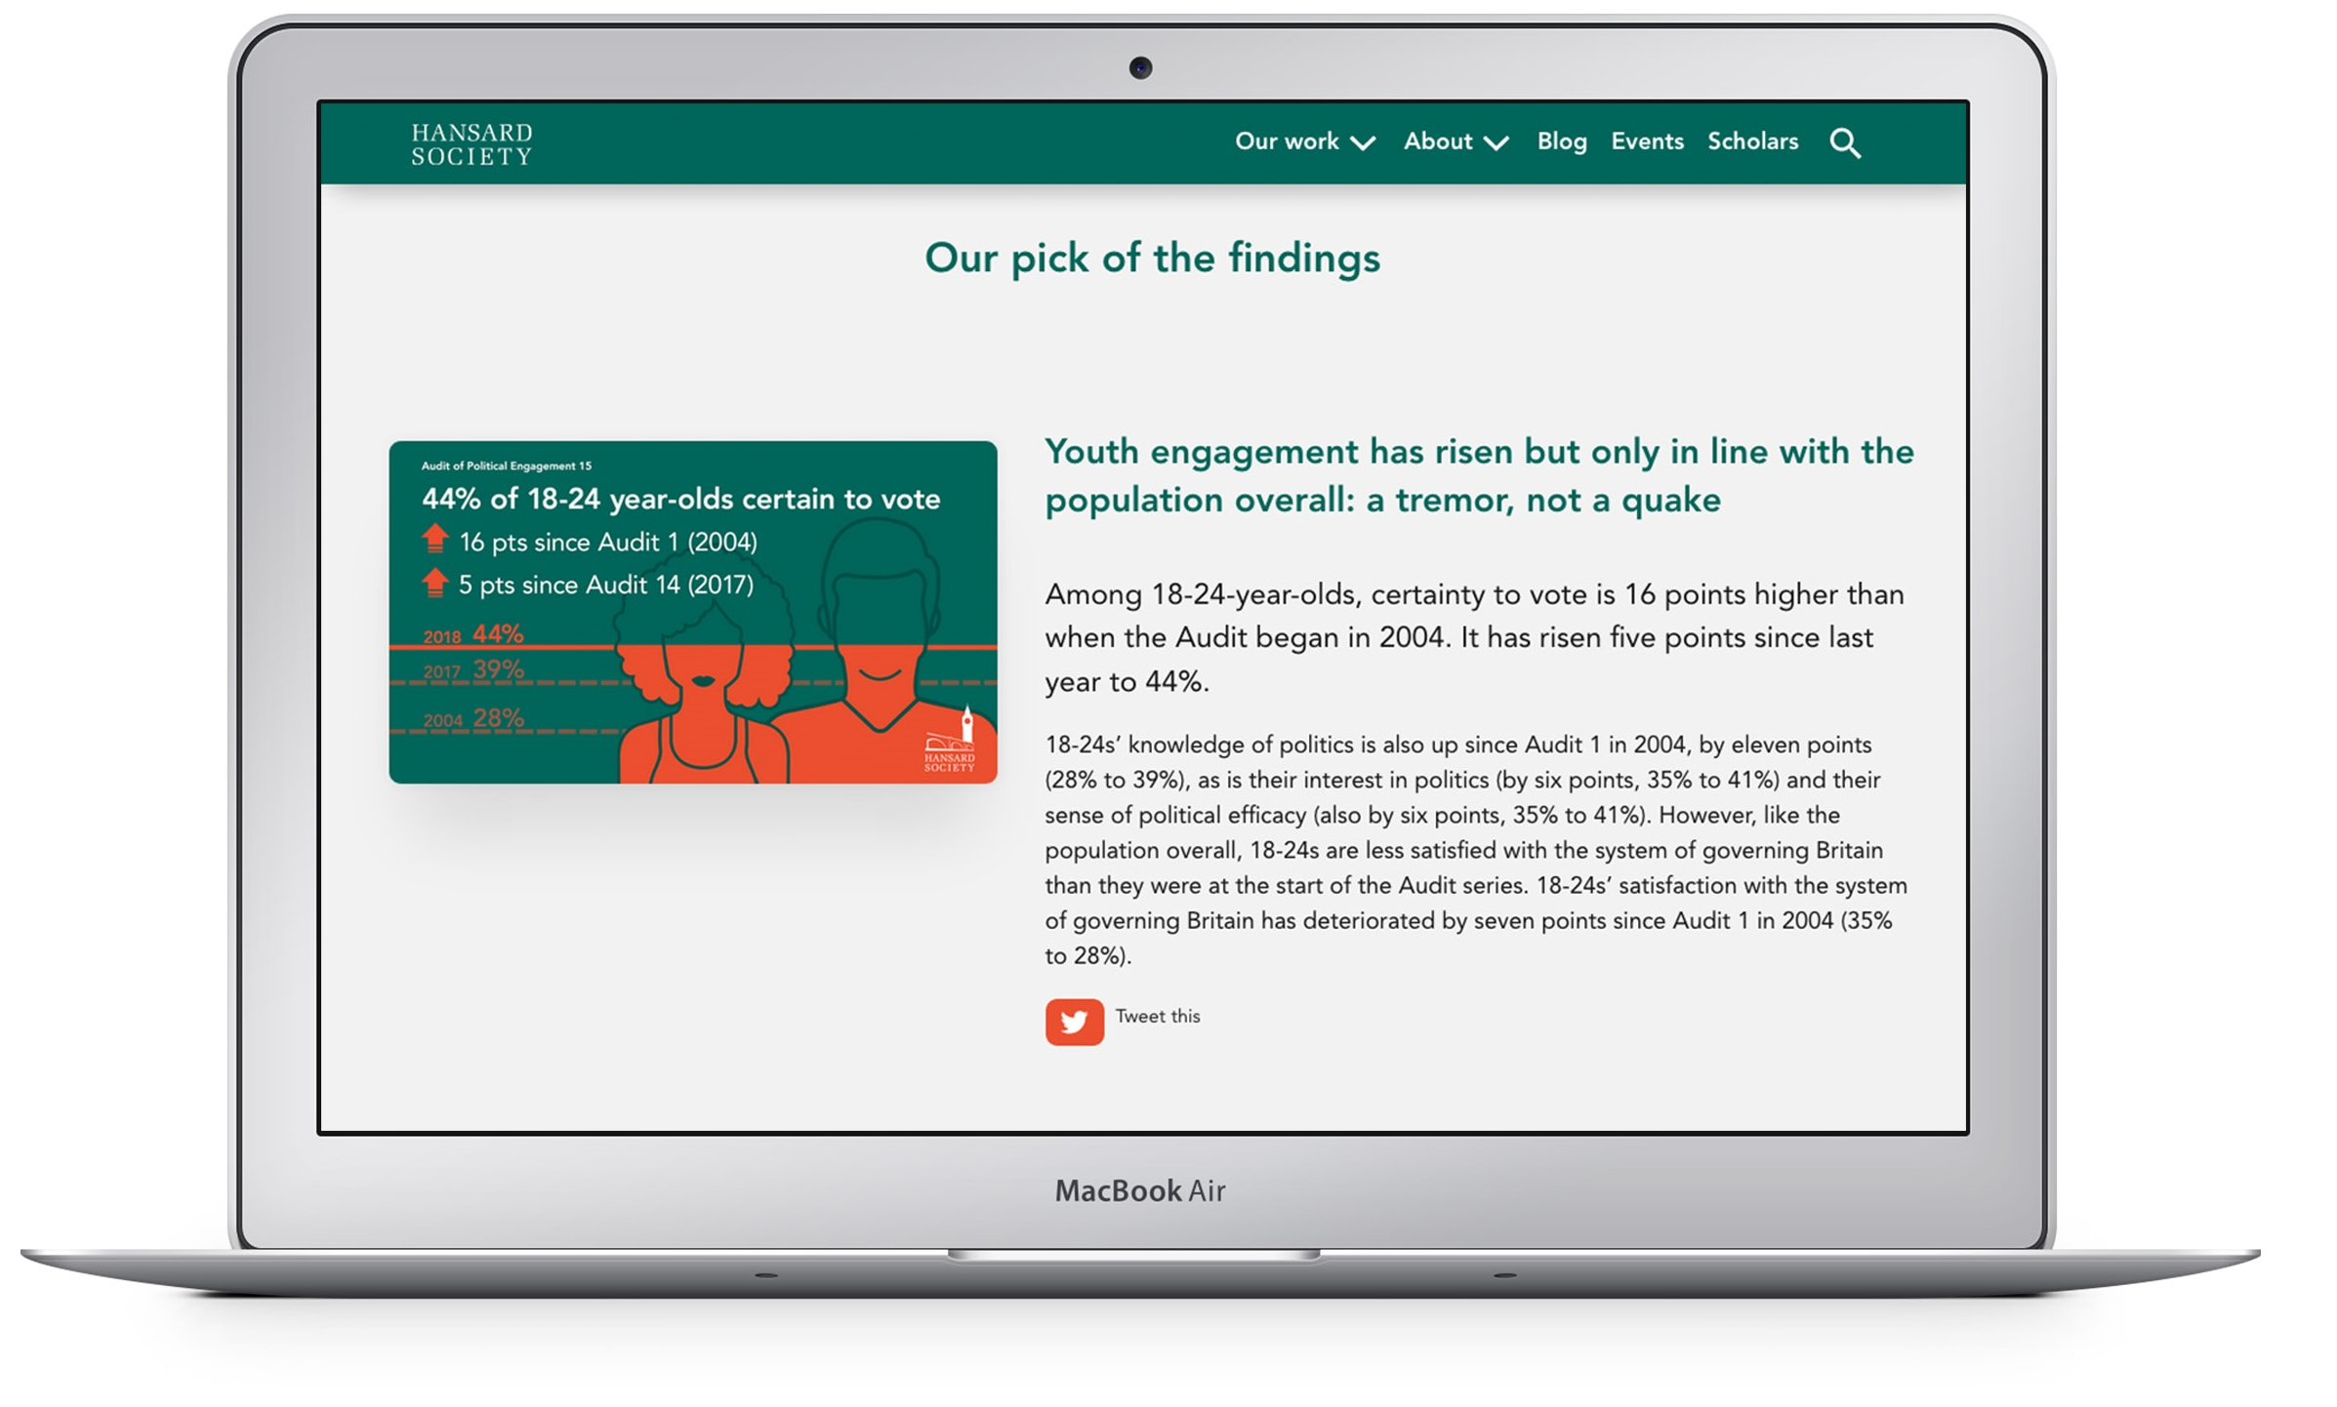
Do young people vote?

Slide 20
Thank you
For more information contact the
GLA Civic and Democratic Participation Team
democracy@london.gov.uk
london.gov.uk

