Slide 1


Your City
Lesson 2 | Political systems and
the British government

Slide 2

ACTIVITY
Quiz!
What is the minimum wage for people under the age of 18?
You can register to vote when you turn 16. Should we also
be able to vote at 16?
What is the age of criminal responsibility?
(And what does this mean?)

Slide 3
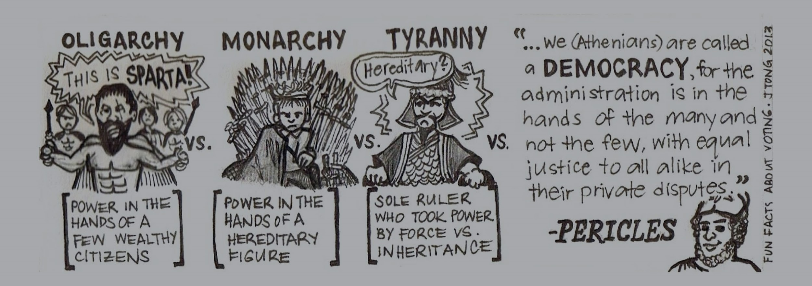


Types of government
Can you think of any other types of government?

Slide 4
1
2
3
Fill in the blanks
Dictatorship
Monarchy
Oligarchy
Can you think of any
examples of countries with these political systems?
One ruler with
complete autocratic
control power.
Rule by a royal who
has inherited power.
Rule by a small
group of wealthy
citizens.
4
5
6
7
Democracy
Theocracy
Anarchy
Tyranny
Citizens have a role
in decision making and usually mandate politicians to exercise
their power.
Religious leader rules
in the name of God.
No government,
no rules or laws.
One ruler who uses
power oppressively, illegitimately
and unjustly.

Slide 5
LOOK OUT
Charades!
Can we guess which type of political
system you are acting out?

Slide 6
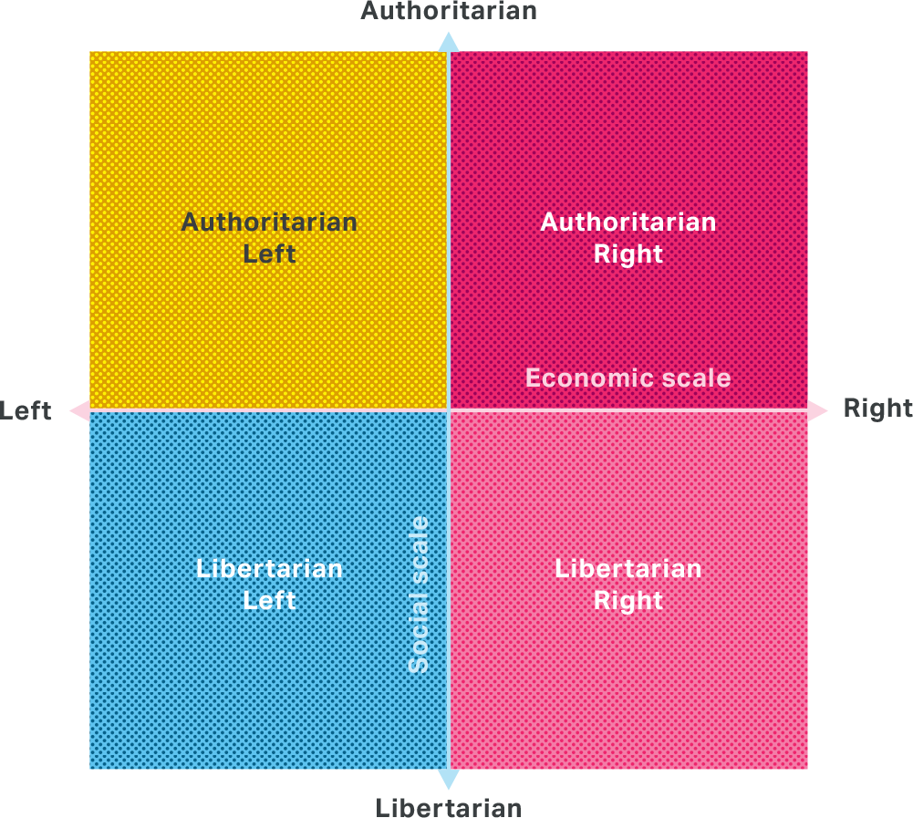
Left and Right
vs Libertarian and Authoritarian:
The economic (left-right) axis measures
one’s opinion on how the economy should
be run.
The social axis (authoritarian-libertarian) measures one’s political opinions in a
social sense.

Slide 7
Authoritarian | Libertarian
Strict on tradition | Believes in free will
Heavy authority over social action | Individual liberty of thought and action
Personal freedoms restricted | Free speech/free media
Increased police powers | Limit police powers
Increased surveillance | Privacy
The government regarded as interfering unduly with personal choice. | Freedom from government involvement in social life

Slide 8
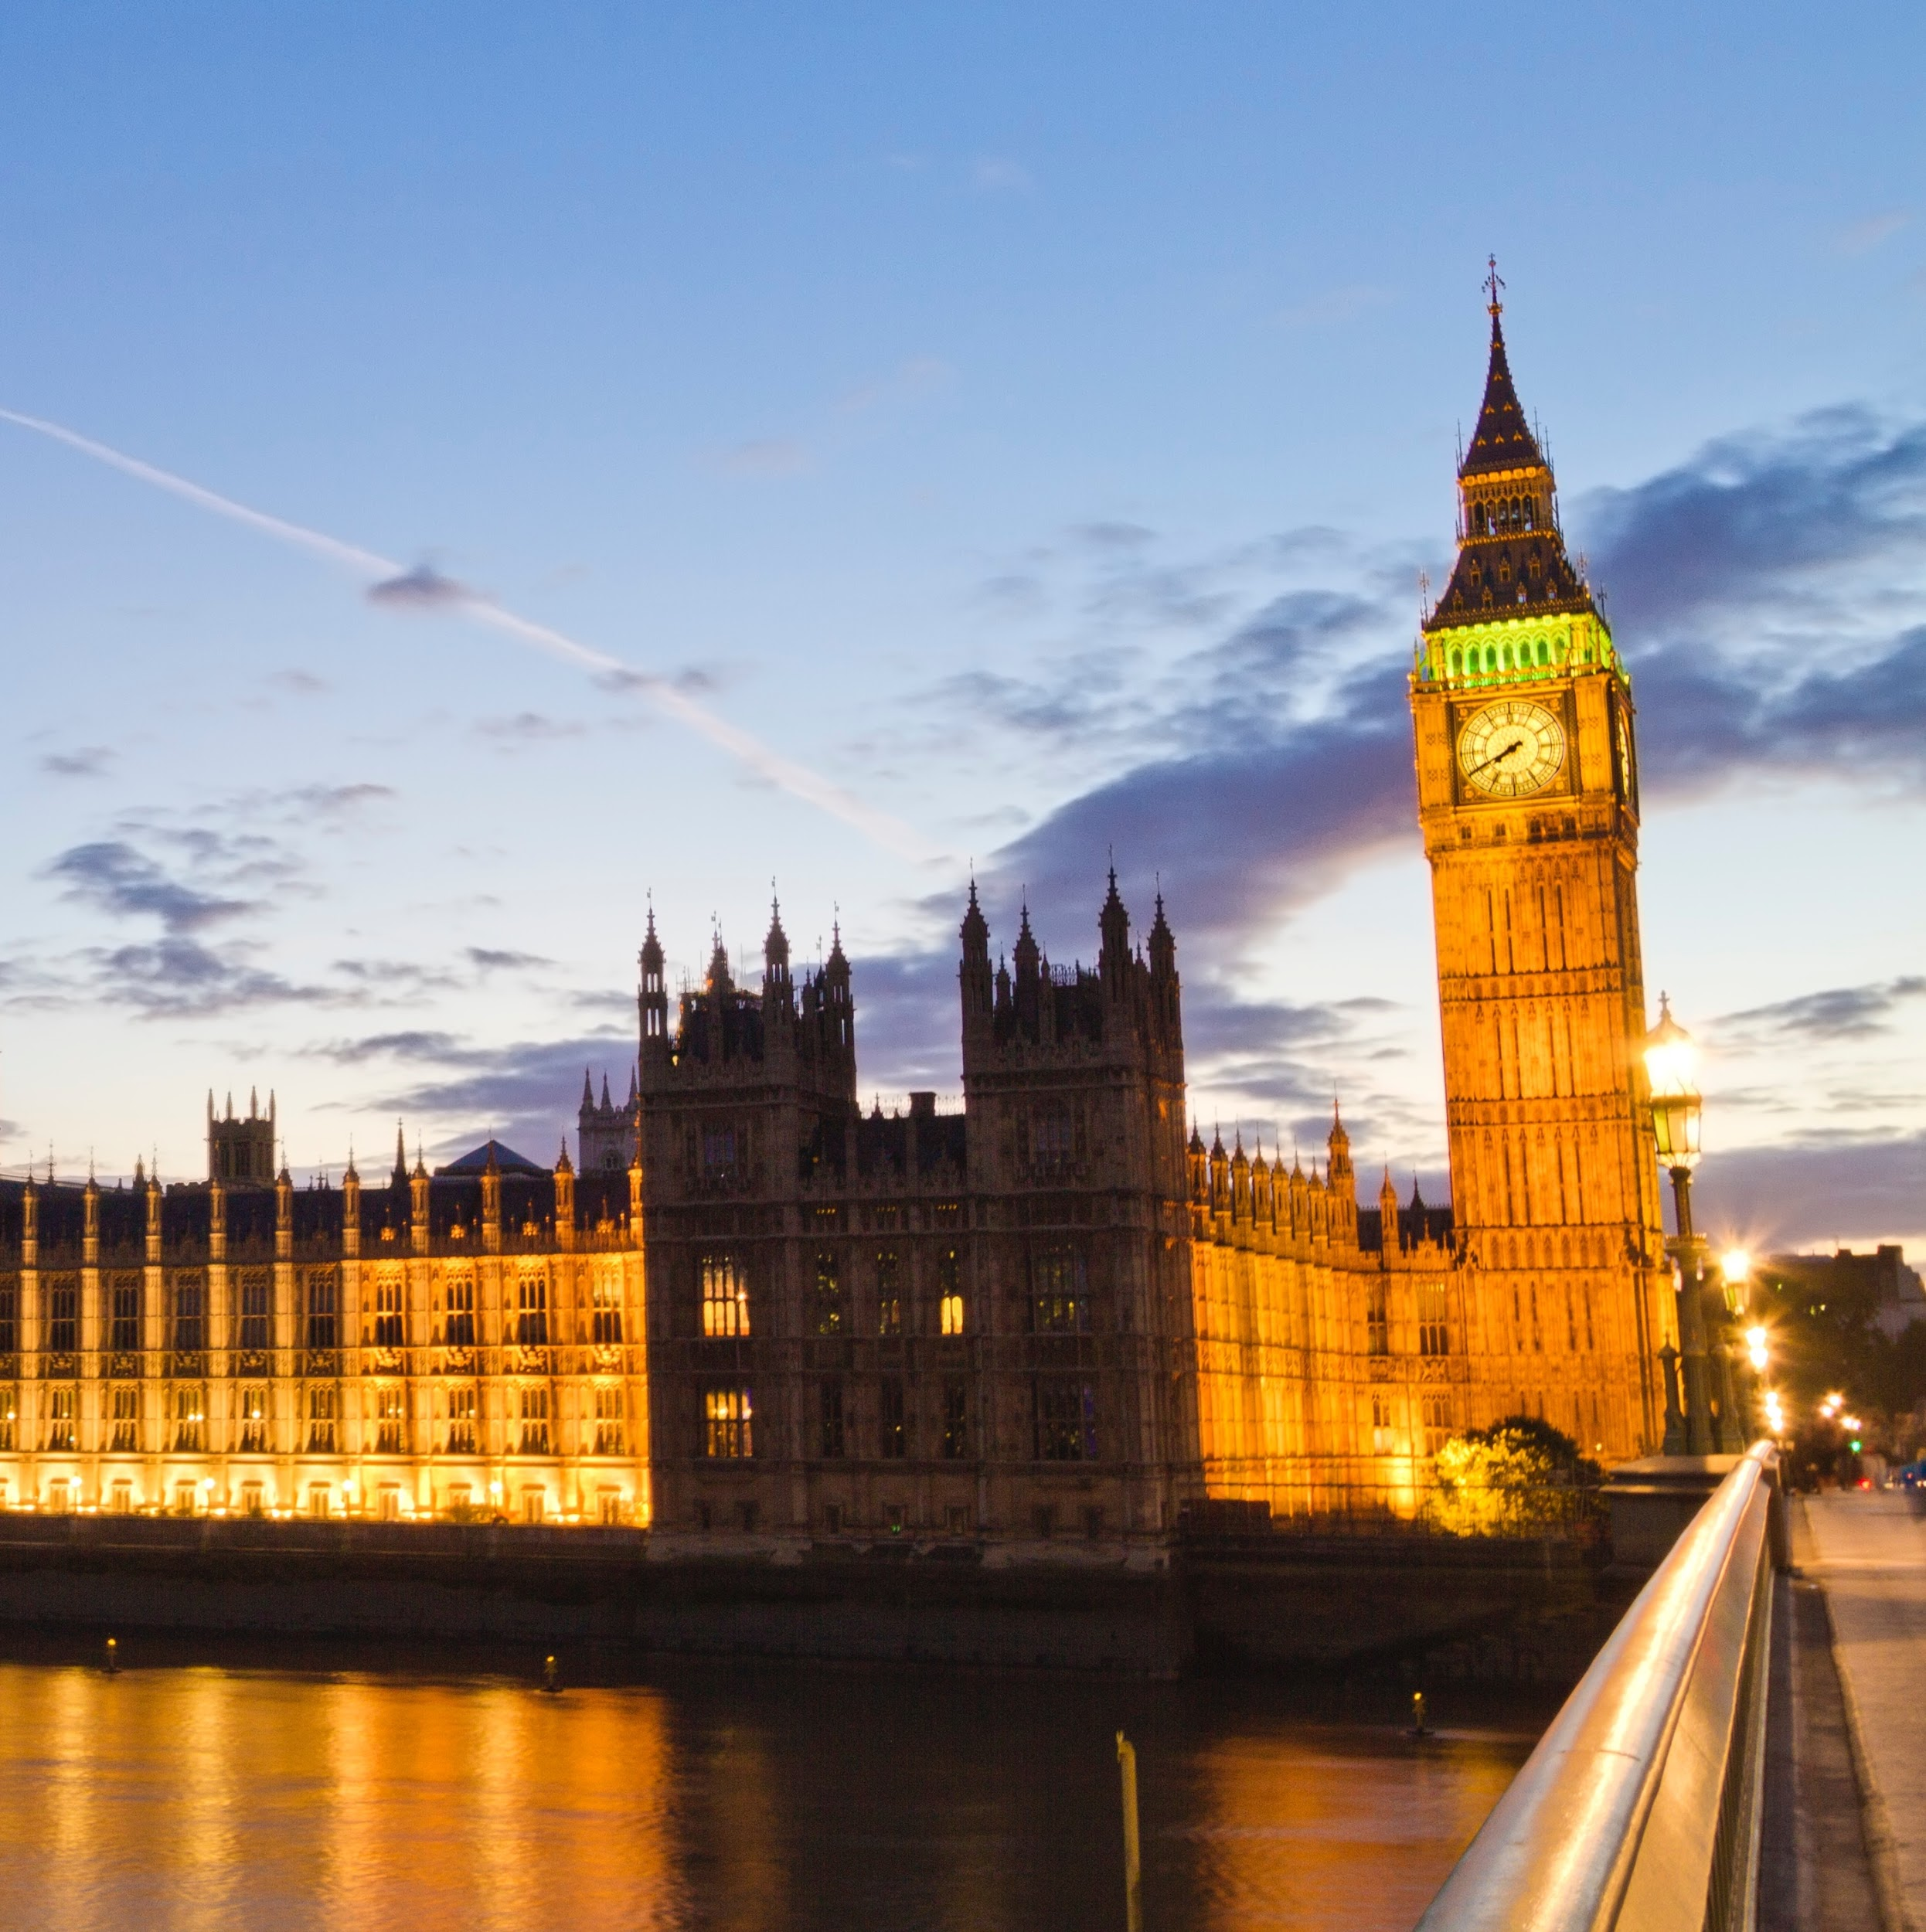
The British
Government

Slide 9

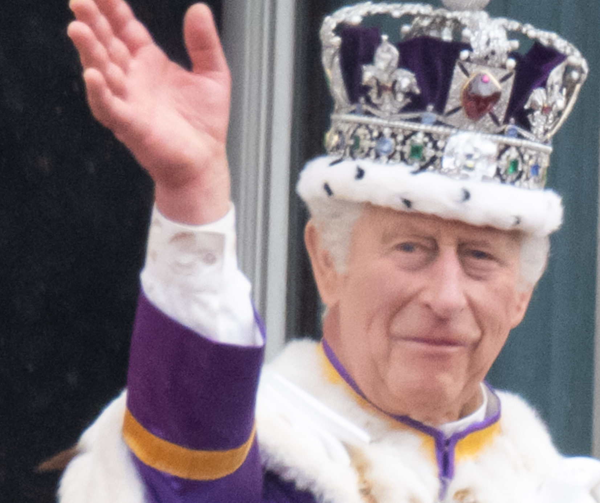
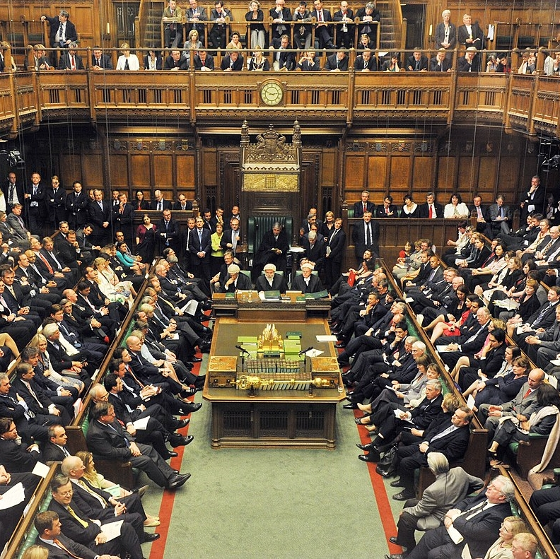
Who holds more power in the UK?
or

Slide 10

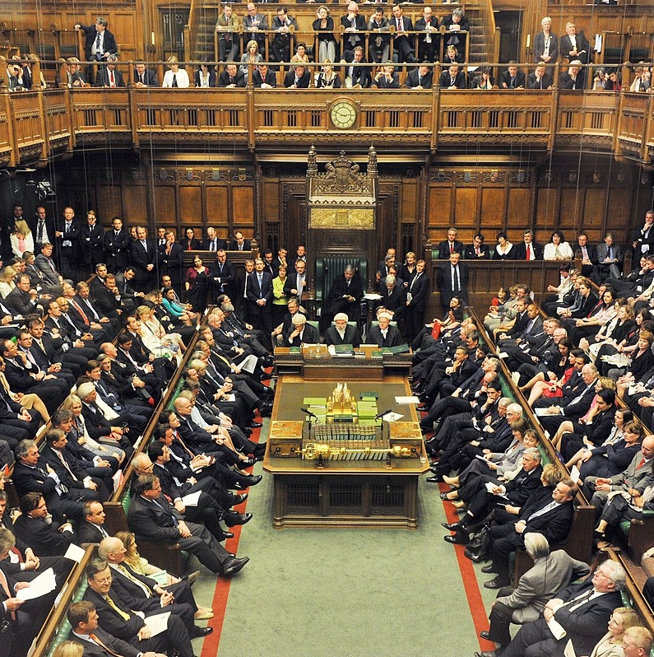
And the answer is…
We live in what is called a
Constitutional monarchy.
We have a monarch, but the main
decision making power, such as making
and passing laws and deciding the United Kingdom’s stance on international issues,
rests with parliament.

Slide 11

Constitutional
monarchy
Roles of the Monarch in politics…
Meeting the Prime Minister once a
week to discuss current business.
Formally opening Parliament and delivering ‘The King’s Speech’, which announces
the government’s plans for the year.
Formally agreeing new laws by giving
Royal Assent to Bills that have been
through both Houses of Parliament.
Discuss
What do you think would happen if
the King refused to sign off a
law or appoint a Prime Minister?

Slide 12
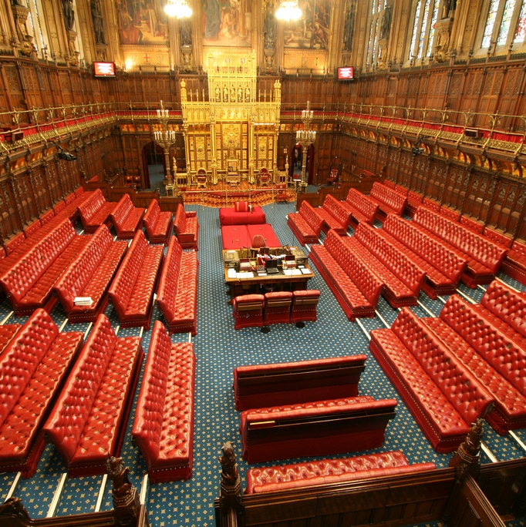
Legislature
House of Commons (MPs elected by us) and House of Lords (peers appointed by the King and through a nomination system by political parties and members of the public)
Design, debate, amend and pass laws

Slide 13
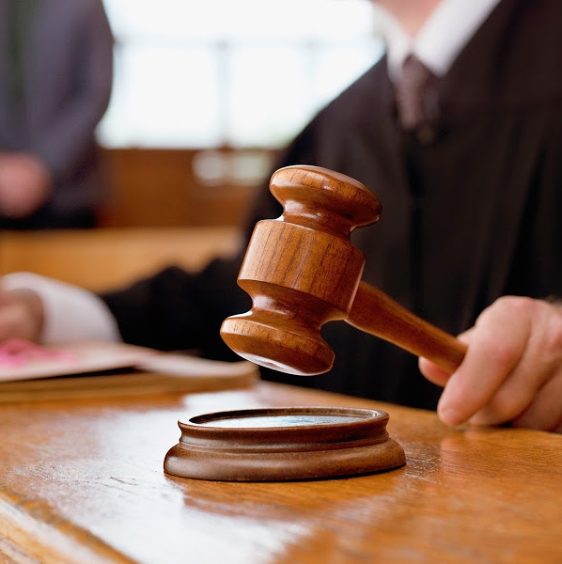
Judiciary
Judges, barristers, solicitors and courts
Uphold and implement laws

Slide 14
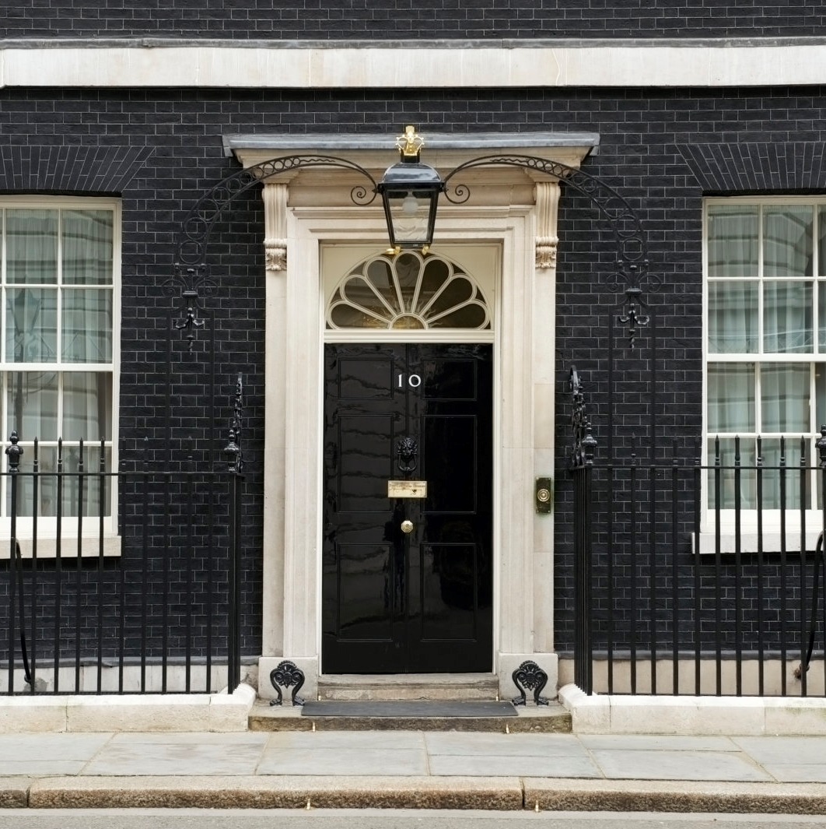
Executive
Prime Minister, Cabinet, ministers
(Heads of Departments), civil servants
Propose laws

Slide 15
In London, we also have the Mayor of London
and the London Assembly.
Established in 2000, the Greater London Authority (GLA) is headed by a directly elected executive Mayor of London.
Who is the current Mayor?
An elected 25-member London Assembly
has scrutiny powers to hold the Mayor
to account.
The Mayor of London has powers over transport, policing, economic development and fire & emergency planning.
Transport for London, the Mayor's Office
for Policing and Crime, and the London Fire Commissioner are all part of the GLA Group.
There is also now a London Youth Assembly to
bring together representatives from different youth forums across London to create positive change
for young people.
Discuss​
Do you agree that London should have its own devolved powers? Why?

Slide 16
DISCUSS
How democratic
is the UK?
Debate

Slide 17
ACTIVITY
Design your own island
Think about your:
Political system (democracy, dictatorship, communism, monarchy, oligarchy, anarchy)
Institutions (schools, hospitals and prisons)
Relations with other islands and islanders
Laws on issues
Money or trade system

Slide 18

You have a budget
of £10,000
How will you spend it?

Slide 19

An Earthquake has struck!
Make some changes. Do you…
Redistribute your budget?
Set up new institutions?
Make new laws or regulations?

Slide 20

A civil war has broken out on a neighbouring island
What will you do?
Take in people who are fleeing?
Give aid?
Provide medical help?
Provide weapons?
Join in?

Slide 21

What similarities and differences did your
islands have to London
and the UK?

Slide 22
Thank you
For more information contact the
GLA Civic and Democratic Participation Team
democracy@london.gov.uk
london.gov.uk

