Slide 1
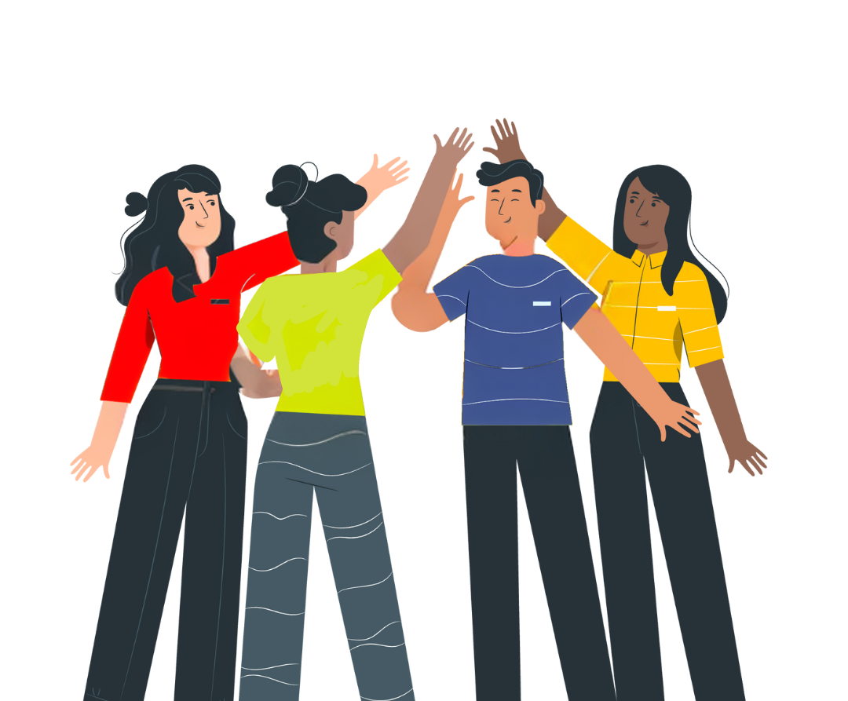


No Vote, No Voice!
Democracy doesn’t end at the ballot box, it starts there.
Funded by the Greater London Authority, City Hall, Kamal Churchie Way, London, E16 1ZE

Slide 2
In this session we will explore the following questions:
Why is it important to know your civic and democratic rights?
What is the difference between civic and democratic rights and how can you exercise those rights?
How can you have your voice heard in the voting system (if eligible)?
How can you continue to have your voice heard by your representatives beyond an election?

Slide 3
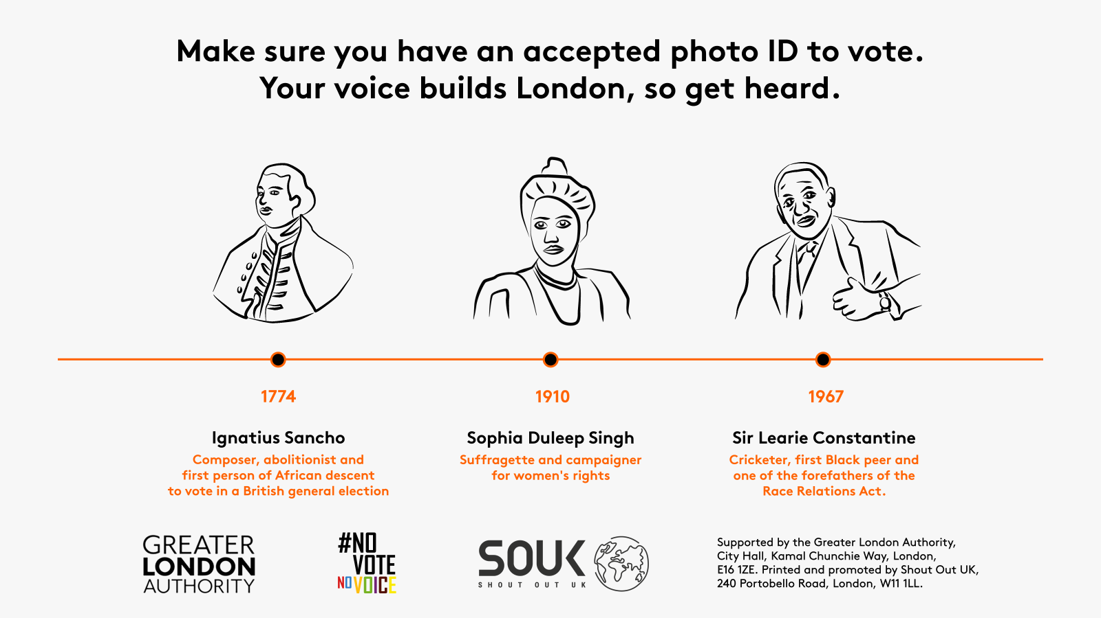
Why is it important to know your civic and democratic rights?

Slide 4
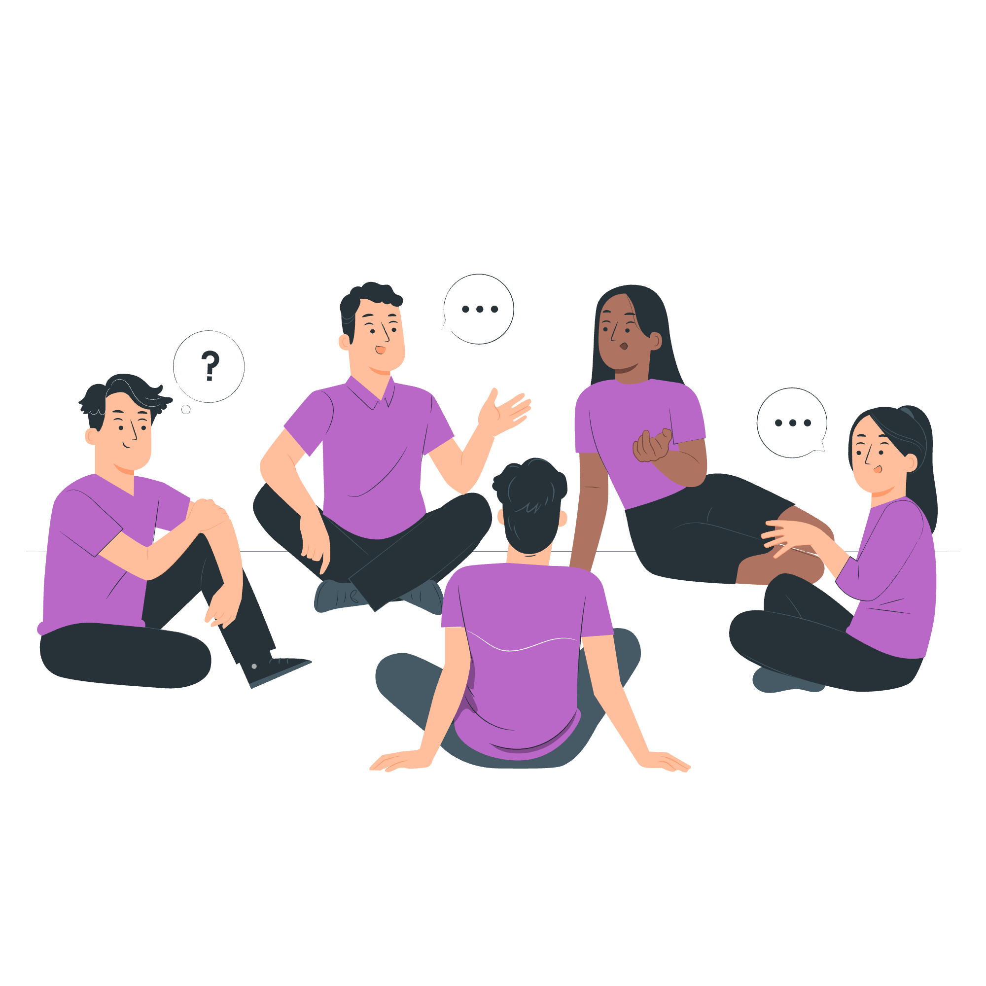
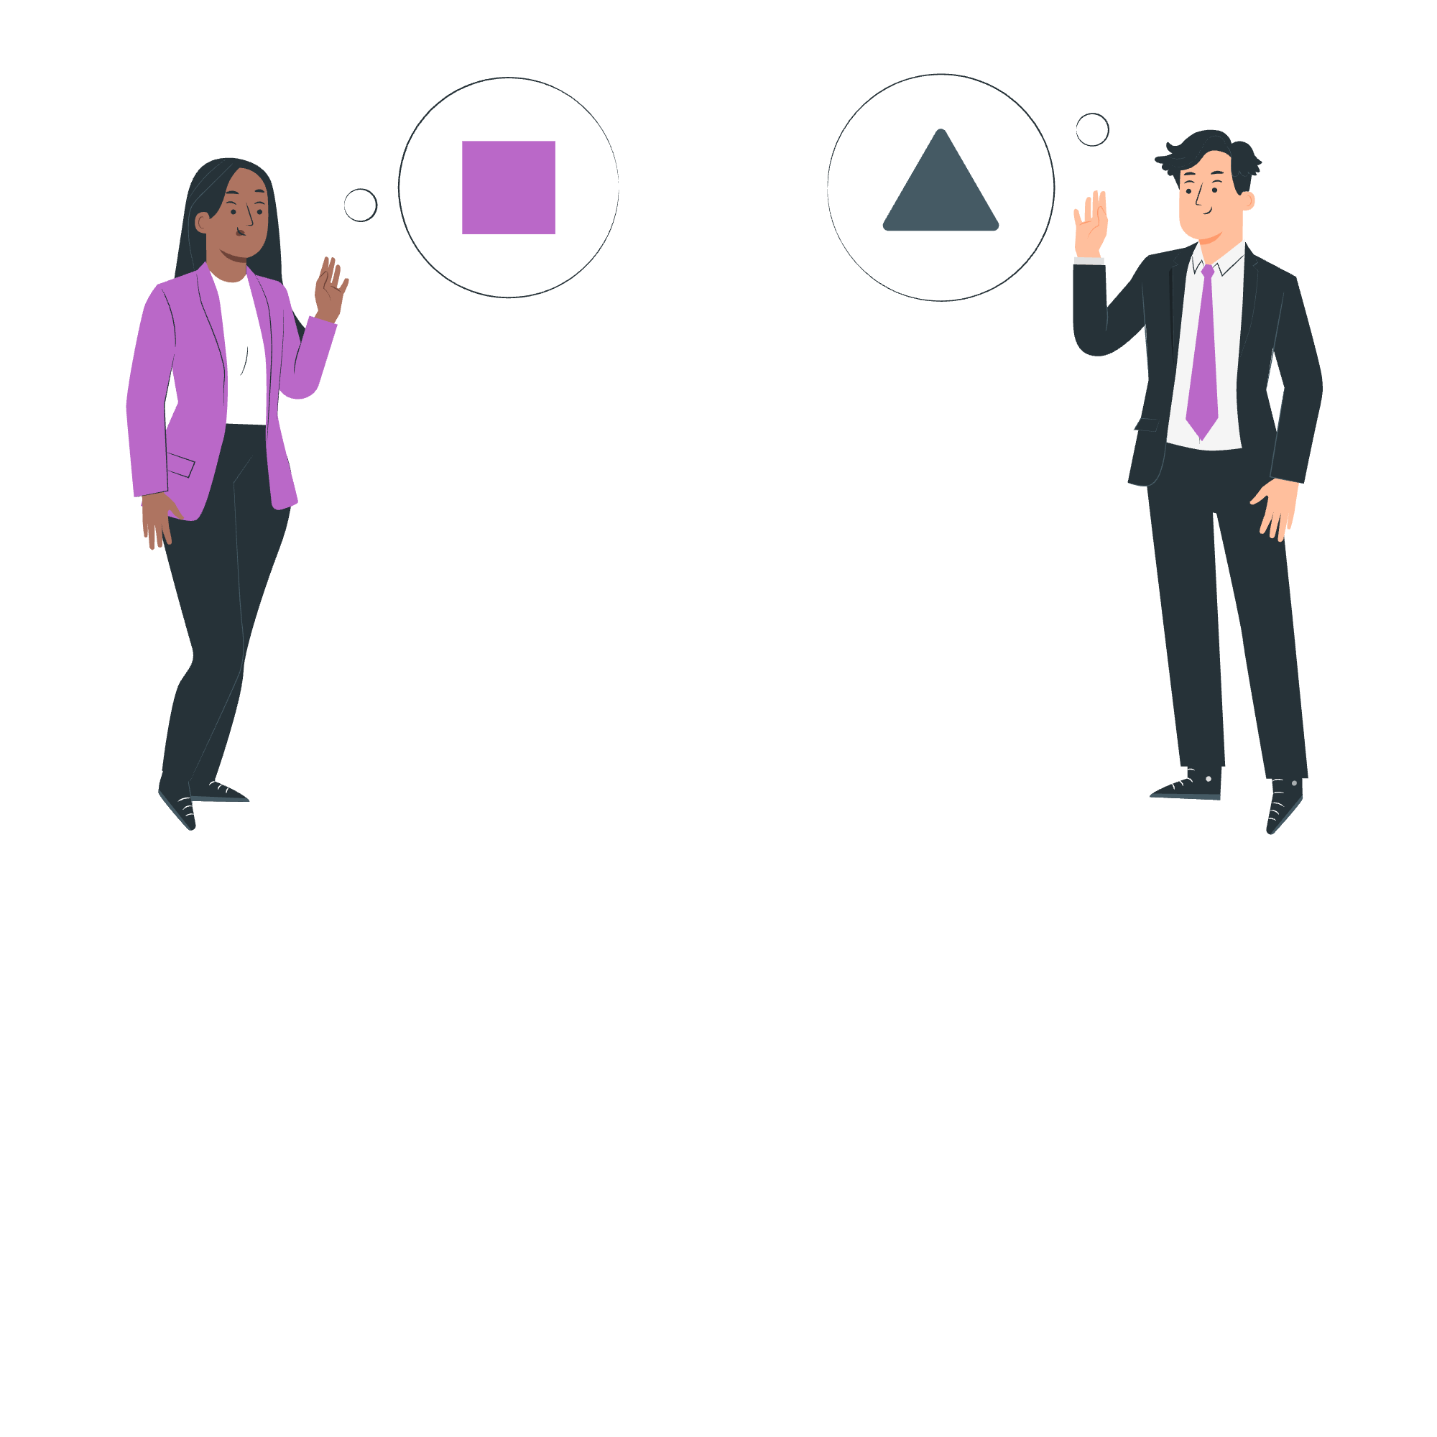
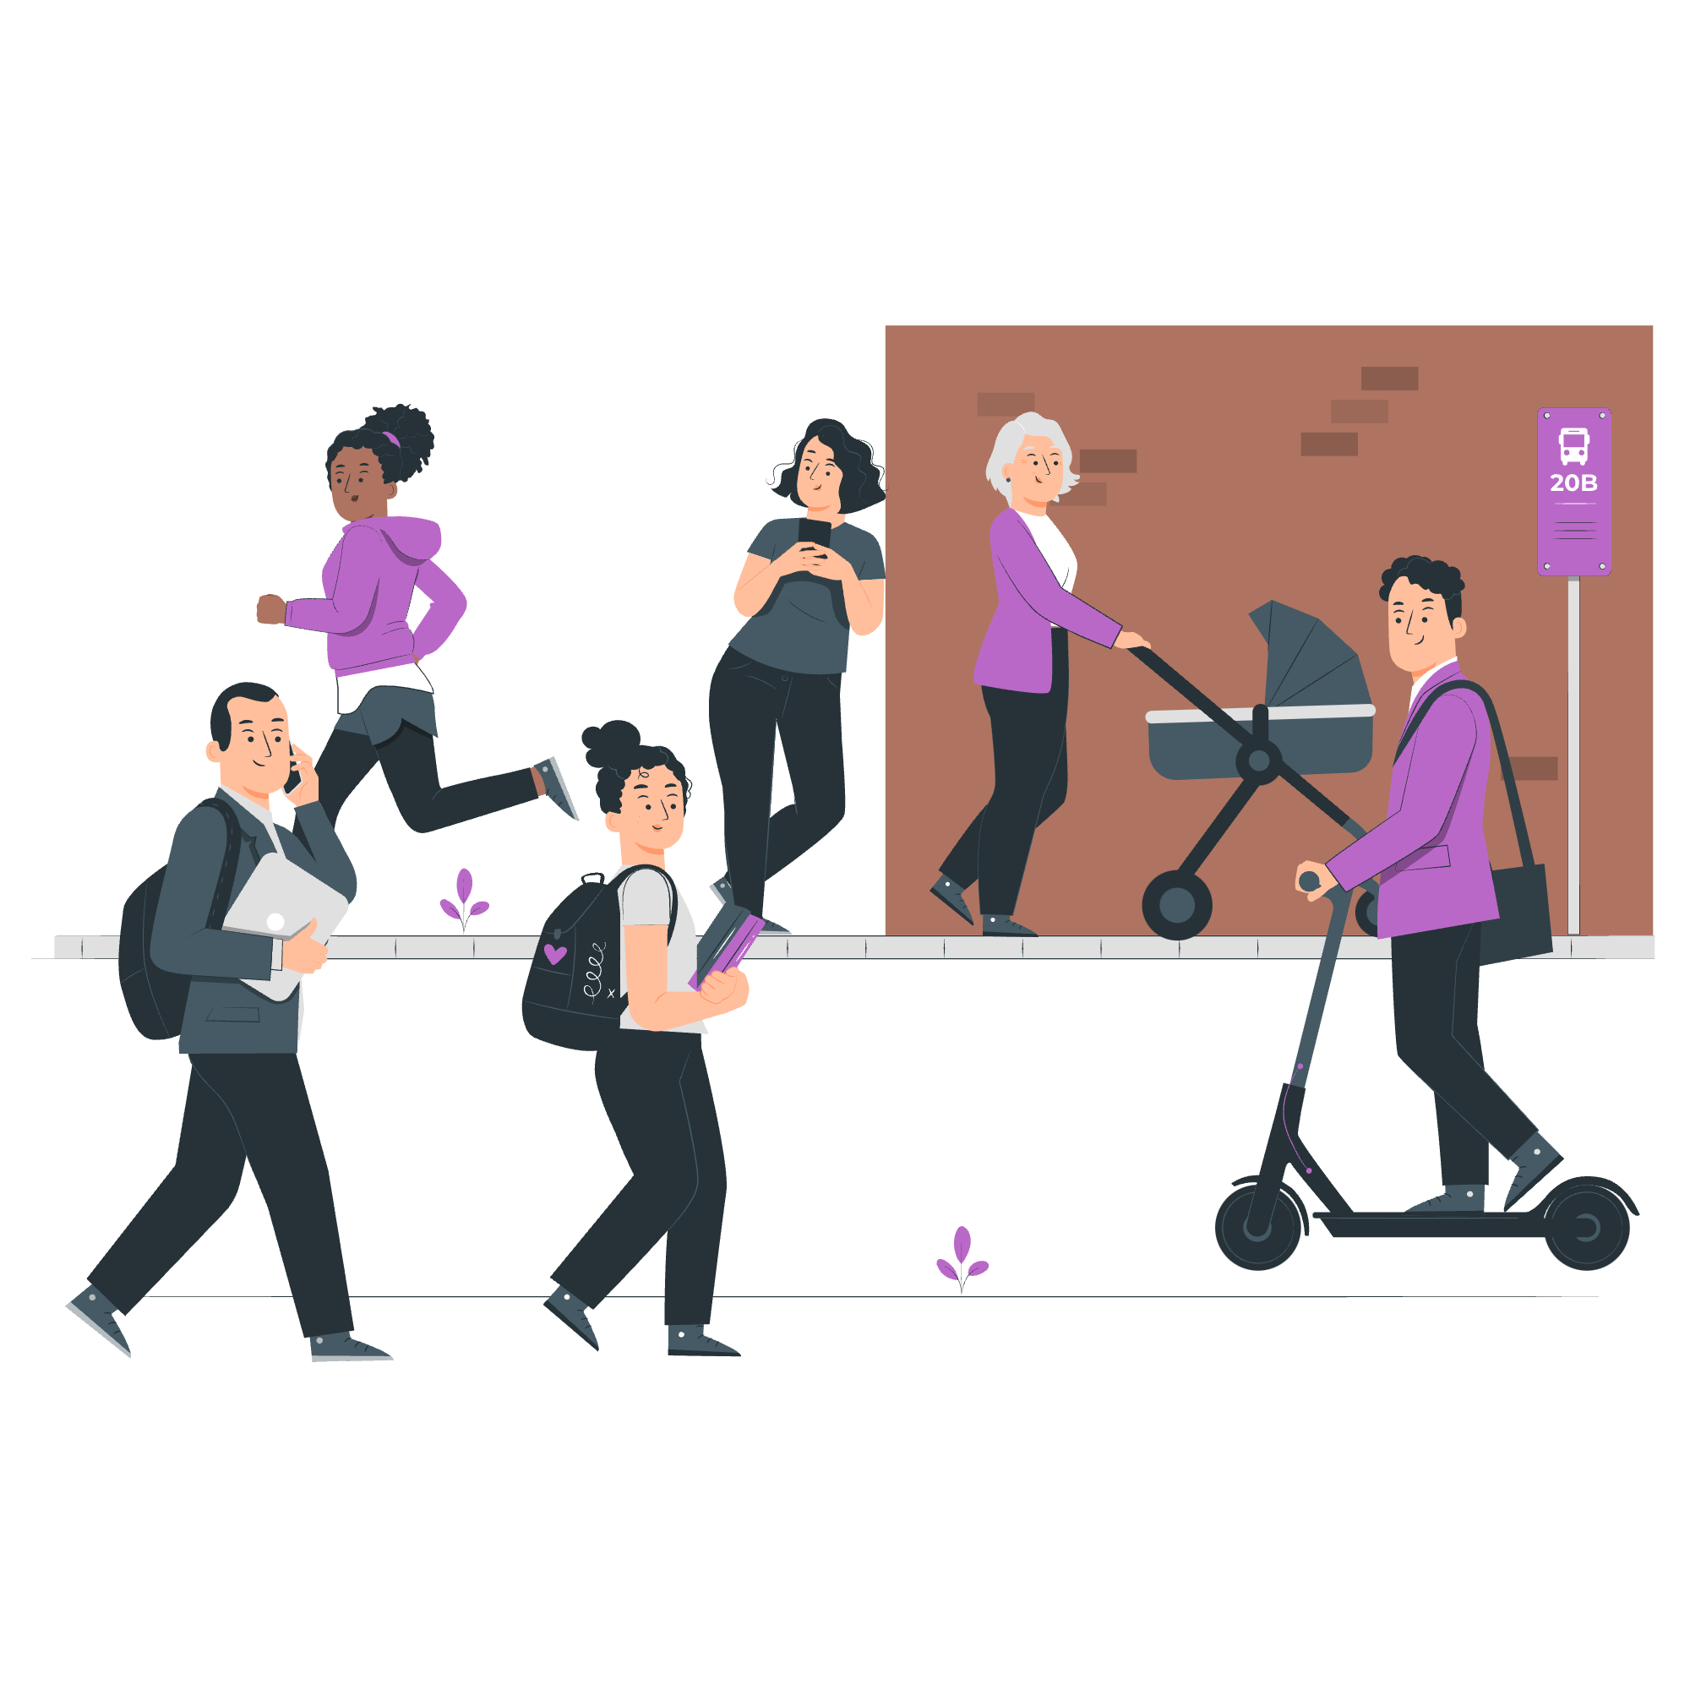

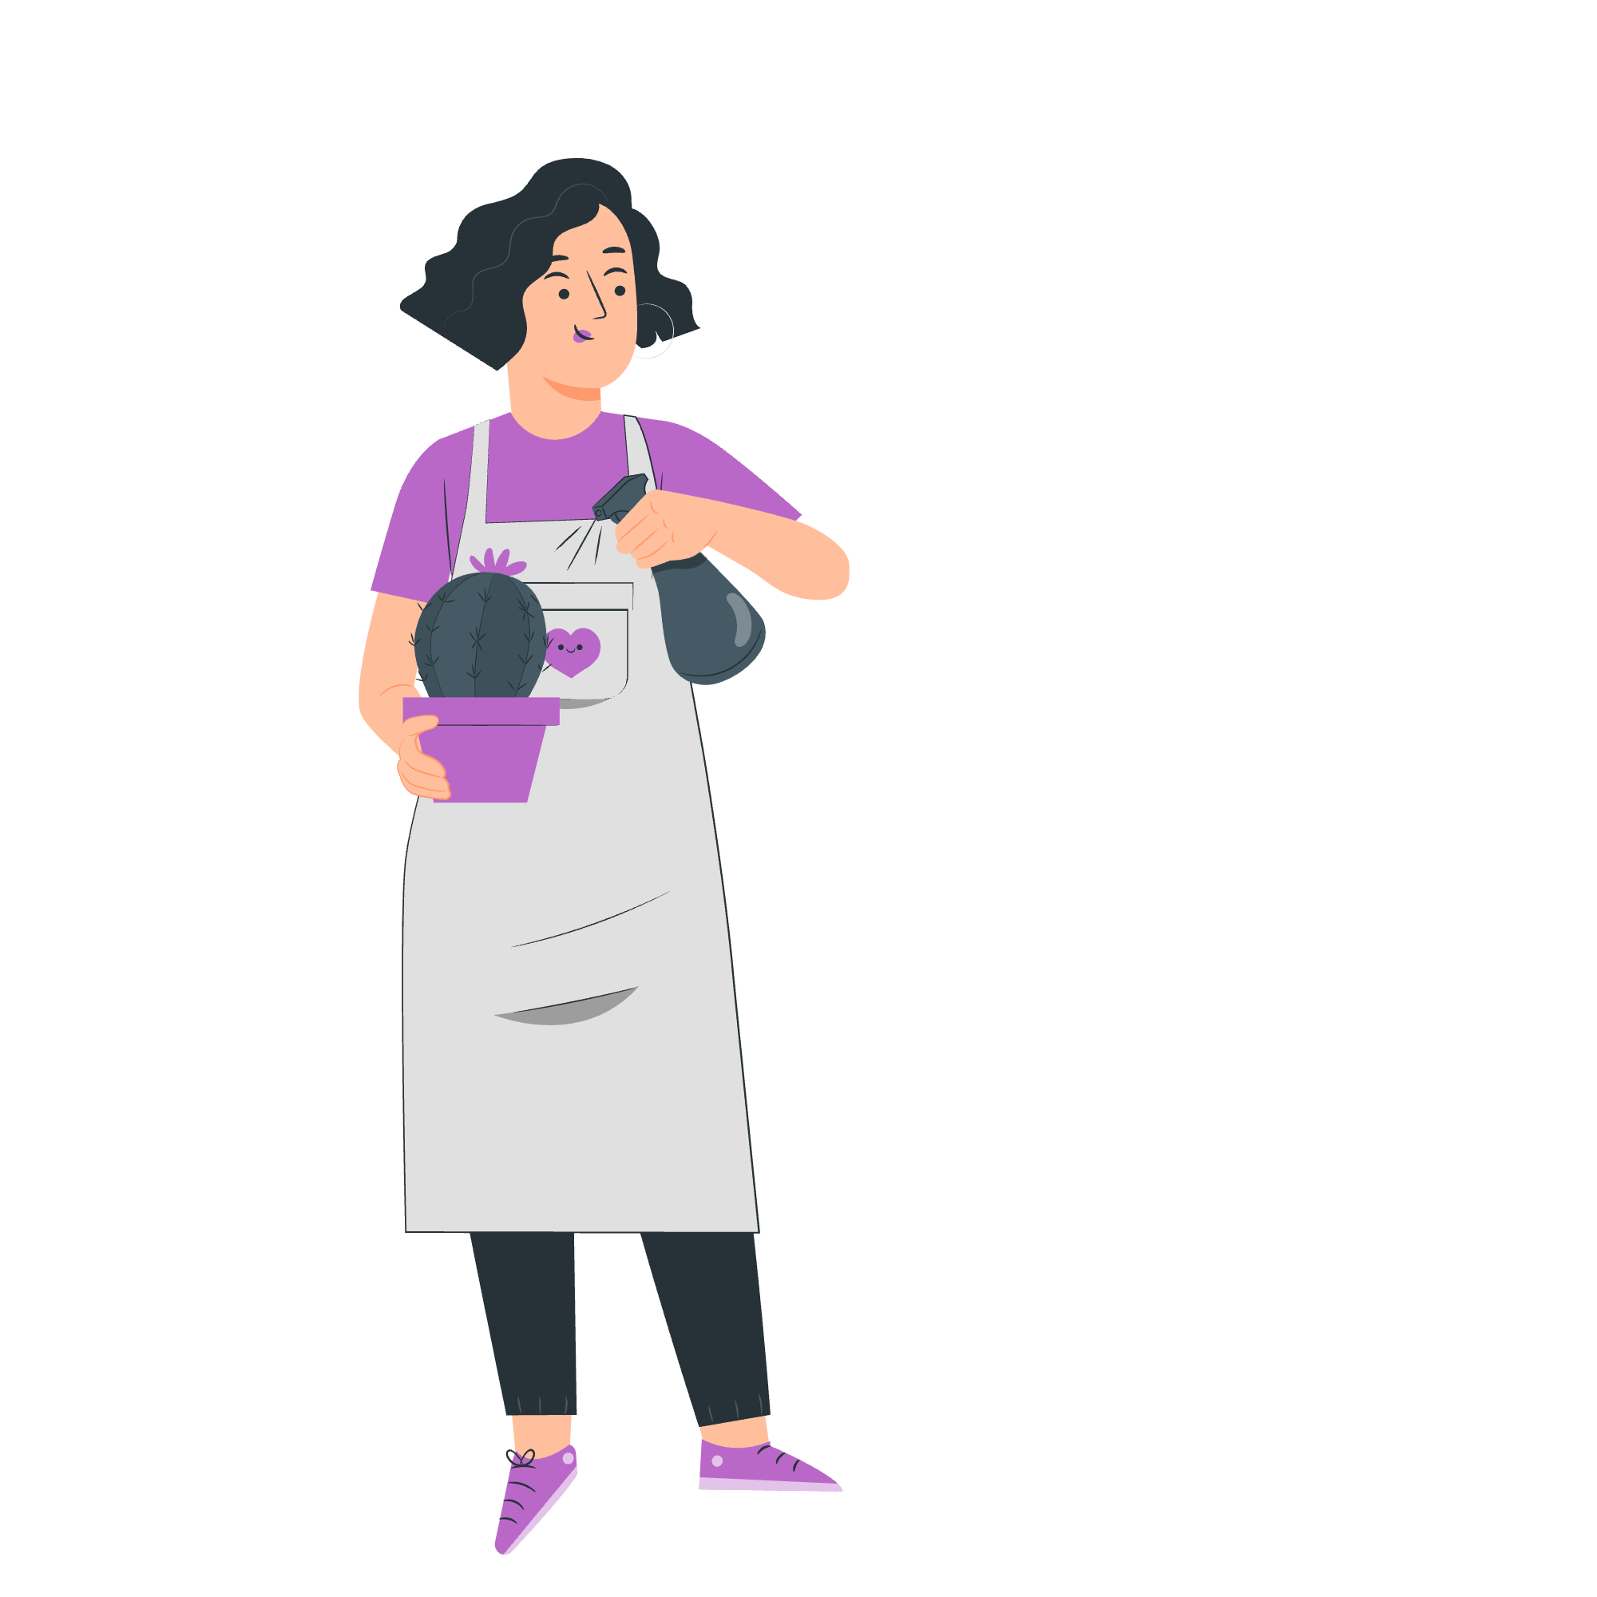

To have a voice
To build stronger communities
To engage with your representatives
Why participate in democracy and civic life?
To gain knowledge and skills
To support equality and justice
To make a difference on issues they care about

Slide 5
What is the difference between civic and democratic rights and
how can you exercise these rights?
Civic Rights include:
The ability to start or sign petitions
Taking part in peaceful, legal protest
Being involved in community organising
Volunteering
Democratic Rights include:
Registering to vote, if eligible
Voting in elections, such as local/ borough council, Mayor of London and London Assembly, general/ parliamentary elections
Taking part in citizens’ assemblies, or other forms of deliberative or participatory democracy
Standing for elected office

Slide 6
Civic rights:
Start or sign petitions
Official petitions appear on https://petition.parliament.uk/. If a petition reaches 10,000 signatures, the government will respond.
Take part in peaceful, legal protest
Everyone has the right to protest in a peaceful and legal way. If you’re planning a protest, you may need to notify the police in advance.
Community organising and volunteering
Community organising brings local people together to create the change you want to see. Volunteering helps you upskill, meet new people, and make a difference.

Slide 7
Democratic rights:
Register to vote and vote, if eligible
If you are eligible to vote, you can register at 16, and vote at 18. Your vote will help choose the candidate(s) that will represent you.
Stand for elected office
If eligible, at 18 you can also become a candidate for Mayor of London, London Assembly member, Member of Parliament (MP), local councillor.
Take part in Citizens’ Assemblies
A Citizens' Assembly is a randomly selected group of people who learn about and discuss specific issues, then make recommendations on related actions. You do not necessarily need to be eligible to vote to take part.

Slide 8
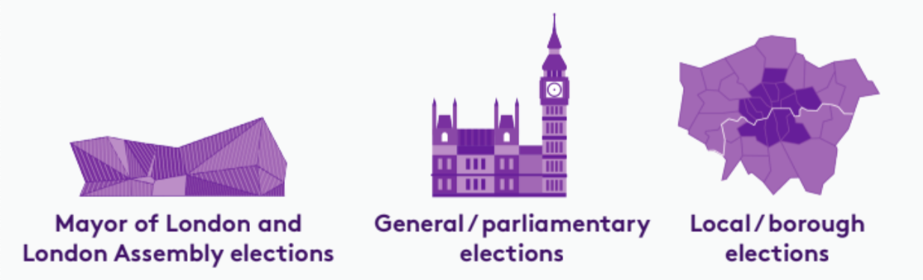
Who can you vote for?
There are three types of election in London:

Slide 9
Which London residents are eligible to vote in these elections?
 | Mayor of London and London Assembly | General / parliamentary | Local / borough
Must be at least 18 years of age | ✅ | ✅ | ✅
British or Irish citizens | ✅ | ✅ | ✅
Qualifying Commonwealth citizens | ✅ | ✅ | ✅
Qualifying EU citizens or EU citizens with retained rights | ✅ | ❌ | ✅
For further information on eligibility, head to electoralcommission.org.uk

Slide 10



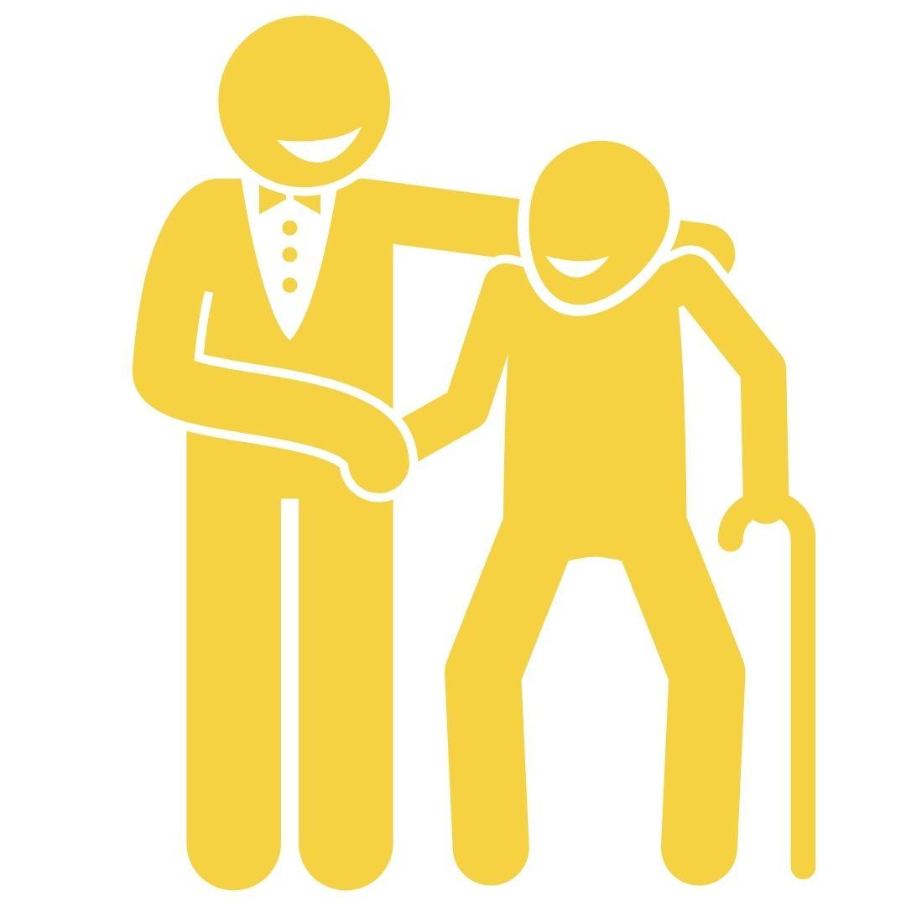
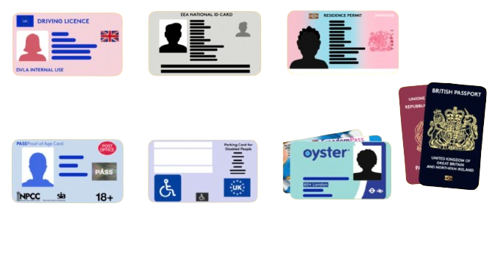
How can you have your voice heard in the voting system?
1
To register to vote, head to gov.uk/register-to-vote
2
You can vote in person, by post or by proxy
3
You need an accepted form of ID to vote in person
UK, Channel Islands or EEA driving licence
UK, commonwealth
or EEA passport
Blue Badge scheme card
These include, but are not limited to:
Notes:
Please note that a young person’s Oyster or student ID are NOT accepted forms of ID to vote in person.

Slide 11
Why should you engage with the Greater London Authority?
Mayor of London
The Mayor of London is elected to set city-wide/ regional priorities:
• Transport for London
• Mayor’s Office for Policing and Crime
• London Fire Brigade
• Housing
• Environment
• Culture and arts
The Greater London Authority (GLA) is made up of
London Assembly
The London Assembly holds the Mayor to account.
• It is elected by Londoners, at the same time as the Mayor.
• It is composed of 25 Assembly Members: 14 represent geographic areas (2 or 3 London boroughs) and 11 work pan-London.

Slide 12
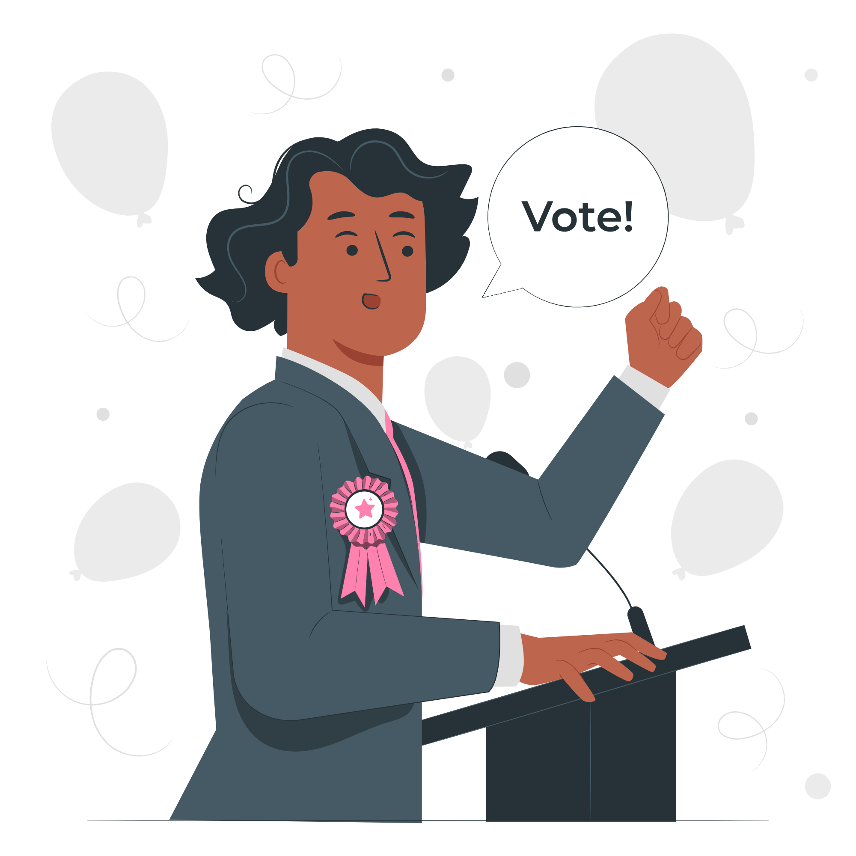
Why should you engage with your Member of Parliament (MP) or local councillor?
Member of Parliament (MP)
In a general election, you vote for the MP that you want to represent your constituency.
They can influence the decision-making in Parliament on:
The economy
Education
Healthcare
Housing
Environment
Councillor
Work in the borough council (the local authority), which oversees this and more:
Council tax collections
Rubbish and recycling
Arts and leisure services
Housing (borough)
Environment (borough)
Health and wellbeing

Slide 13
How can you continue to have your voice heard by representatives beyond an election?
Engage with them by:
Writing to them – the emails and addresses are publicly available
Talking to them – MPs and councillors often have surgery hours where you can meet them face-to-face and discuss issues that matter to you
Following their record – the voting records of your representatives are publicly available
Find out who represents you:
MP - members.parliament.uk
Mayor of London - london.gov.uk
London Assembly - london.gov.uk
Local councillor - gov.uk
Find your representatives’ contact details: www.writetothem.com
Follow what is being said & voted for in parliament:
hansard.parliament.uk
Notes:
Important to note that whether you are eligible to vote or not, you can participate in these ways of engagement.

Slide 14
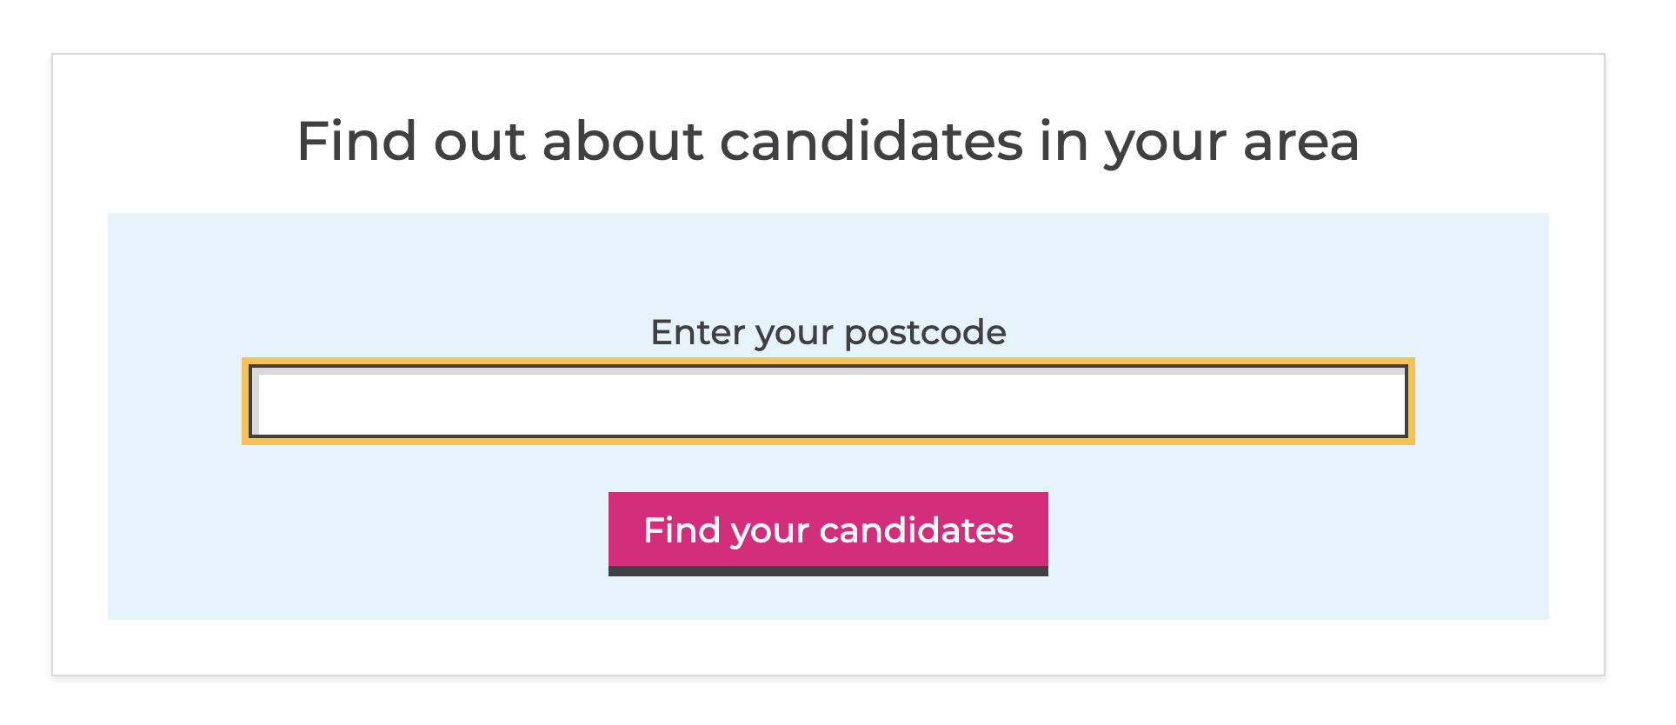

Where can I find more information?
GLA Democracy Hub
Provides resources and a comprehensive FAQ in both easy read and community languages. You can also use a WhatsApp chatbot (+44 7908820136)to answer questions you may have!
Who Can I Vote For?
Helps to find the candidates in your area, at various elections, based on publicly - available info.
TheyWorkForYou
Tells you the voting record on policy issues and public statements from Members of Parliaments and others.

Slide 15
Digital democracy scavenger hunt!
You will need:
A device with internet connection
A copy of this worksheet
Instructions are on the next slide.
Notes:
Important to note that whether you are eligible to vote or not, you can participate in these ways of engagement.

Slide 16
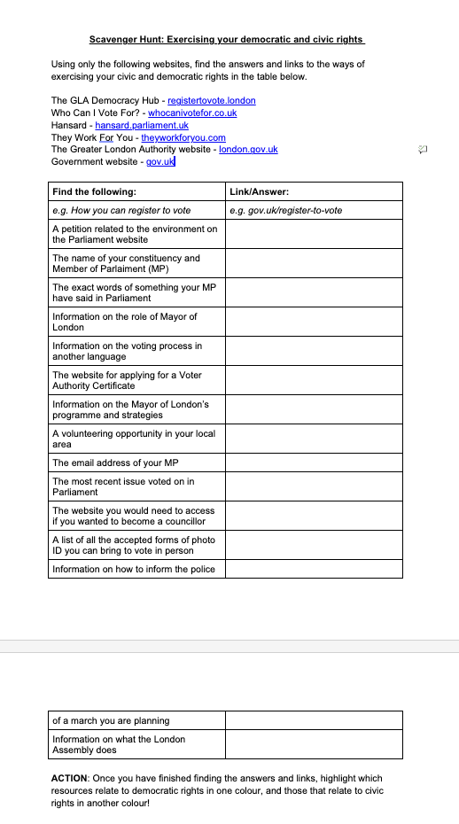
1. Get your worksheets ready!
2. Use only the websites on the worksheet to find answers. No search engines are allowed.
3. Once finished, highlight which resources relate to civic rights and which to democratic rights, using different colours.
4. Go through them as a class - do you all have the same answers?
Notes:
Slide 5 can help your class go through whether each answer relates to democratic or civic rights.

Slide 17

Your voice matters, make sure it gets heard!
Check out the GLA Democracy Hub registertovote.london to:
Find more information on your civic and democratic rights
Find comprehensive answers to FAQs
Check the Democracy WhatsApp chatbot (+44 7908820136) and #NoVoteNoVoice WhatsApp channel
Find accessible resources, including in different languages

Slide 18

Thank You!
For more information contact the
GLA Democratic Participation Team at: democracy@london.gov.uk
Funded by the Greater London Authority, City Hall, Kamal Churchie Way, London, E16 1ZE

