Slide 1

Media Literacy
Lesson: Science and misinformation

Slide 2


Media Literacy:
Why does it matter?
Being active in your local community; in decisions that impact you, your family and friends; being a part of civic life and democracy are all very important things. But so is the ability to know how politics works, what are the key issues facing London, Britain and the world, as well as developing the critical thinking necessary to evaluate different points of view and navigate the media.
You can find more education and social media resources on the London Voter Registration Hub.
>> https://registertovote.london/ <<

Slide 3
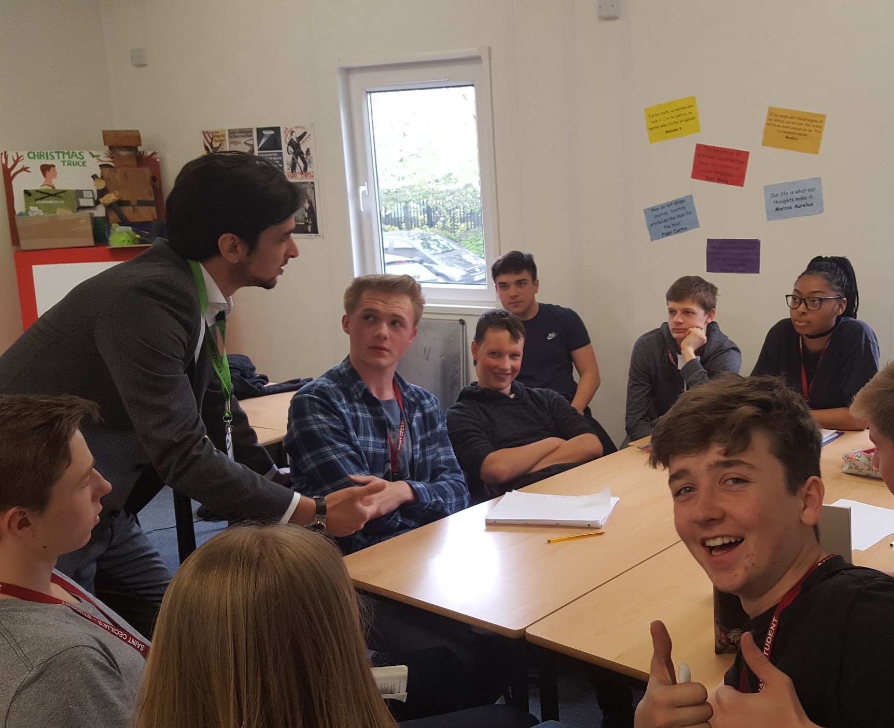
What are we going to do today?
Understand the current media landscape and how it has evolved.
Recognise different types of media content and different ways of conveying information, such as informing, misinformation and disinformation and advertising.
Determine the link between misinformation, voter registration and democratic participation.

Slide 4
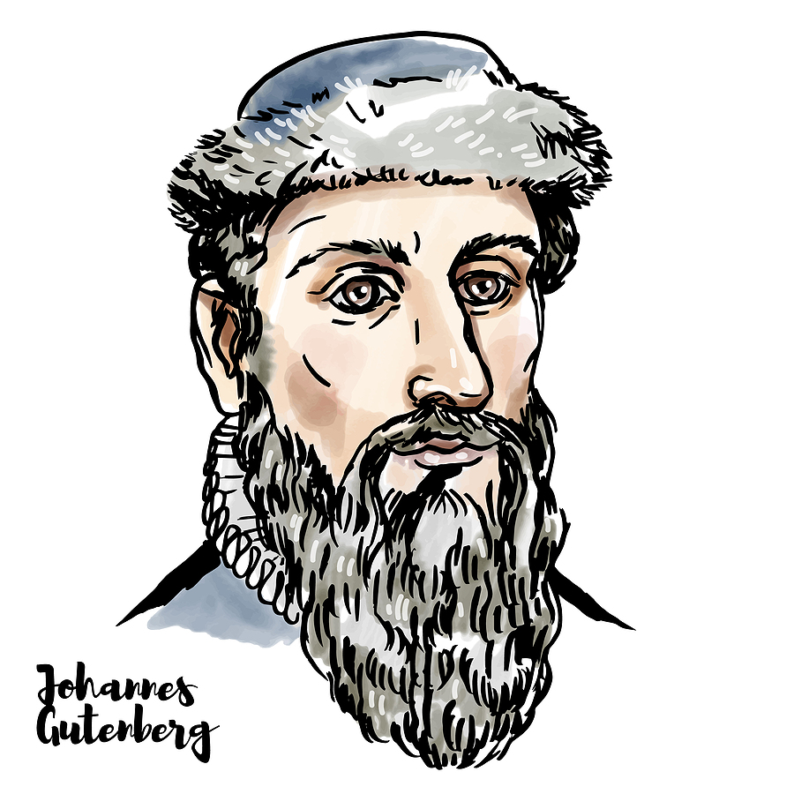
Starting from the beginning:
Gutenberg
You may not have heard about ‘Gutenberg’, but he was the Mark Zuckerberg of his time. In 1440, he created the means for mass communication through his invention of the printing press.
He paved the way for the Renaissance and the scientific revolution.
However, even Gutenberg could not have imagined the modern media landscape that we inhabit today.

Slide 5

Out with the old,
in with the WWW:
It was not until the 20th century when Tim Berners-Lee, a British scientist, invented the World Wide Web (WWW) in 1989.
If Gutenberg had made replication of content possible, Berners-Lee took one step further and ensured that all information was democratised and accessible to those who could navigate the internet.

Slide 6
Hands up:
Where do you get the majority
of your information from?
TV
RADIO
NEWSPAPERS
ONLINE ARTICLES
SOCIAL MEDIA

Slide 7
Discuss
Whilst there are clear positive aspects of the internet, there are also some worrying issues.
Can anyone name some of them?

Slide 8
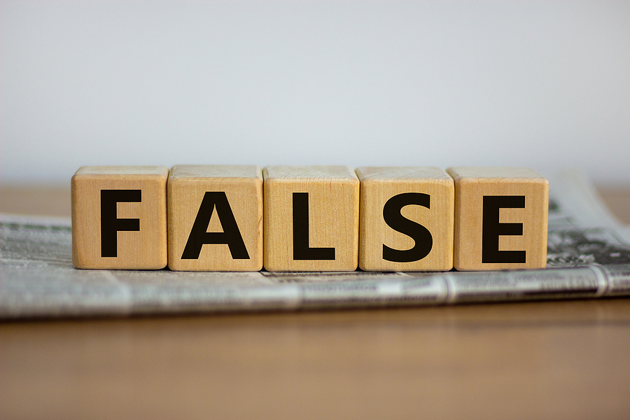
Big Problem: False News
Information, stories or hoaxes created to deliberately misinform or deceive readers/ viewers/ listeners.
Sometimes, the story itself might be fabricated, with no verifiable facts. Other times, some sources, quotes, some elements or facts might be accurate, but presented in a false or misleading way.

Slide 9
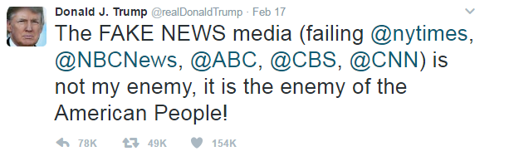
Use the correct terminology:
We no longer use the catch all term “Fake News” to explain false information spreading on the internet.
Some politicians, media outlets and other organisations have co-opted the term to mean news or information that criticises their actions, viewpoints or beliefs.

Slide 10
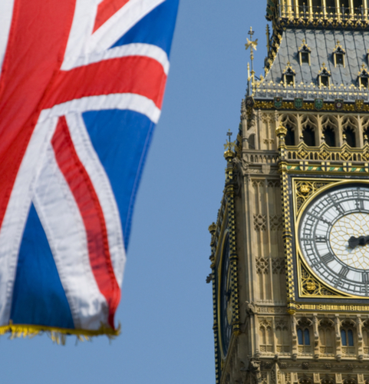
Advice from experts, civil society and academics:
“We recommend that the Government rejects the term ‘fake news’, and instead puts forward an agreed definition of the words ‘Misinformation’ and ‘Disinformation’.
With such a shared definition, and clear guidelines for companies, organisations, and the Government to follow, there will be a shared consistency of meaning across the platforms, which can be used as the basis of regulation and enforcement.”
Source: House of Commons Digital, Culture, Media and Sport Select Committee report, July 2018

Slide 11
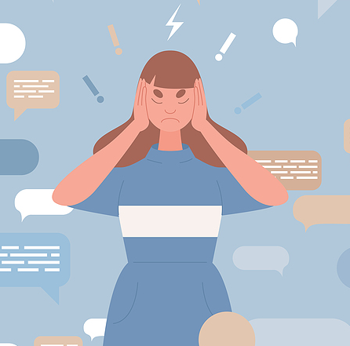
Defining words:
Disinformation is false information deliberately created to cause harm to a person, social group, organisation or country.
Misinformation is false information that is created and spread regardless of an intent to harm or deceive.
Both forms may be shared widely, regardless of whether or not the sharer knows the information is wrong.
11

Slide 12
Discuss
How can you recognise misinformation and disinformation?

Slide 13
Misinformation is false information that is created and spread without a deliberate intent
to harm or deceive.

Slide 14
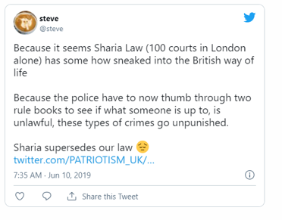
REVIEW your source
REPUTATION
INTENT
EVIDENCE
EMOTIONS
VERIFICATION
WEIGH IT UP

Slide 15
Hands up: Do you think this is misinformation or the truth?
MISINFORMATION
TRUTH

Slide 16
MISINFORMATION
Are there 'Sharia courts' in Britain?
While Sharia councils exist in London and the UK, they have no legal power. They are voluntary local associations of scholars who see themselves or are seen by their communities as authorised to offer advice on the Islamic religious law regulating public and private life, usually concerning religious marriage and divorce.
Source: The independent review into the application of sharia law in England and Wales, presented to Parliament in February 2018

Slide 17
Disinformation is false information deliberately created to cause harm to a person,
social group, organisation or country.

Slide 18
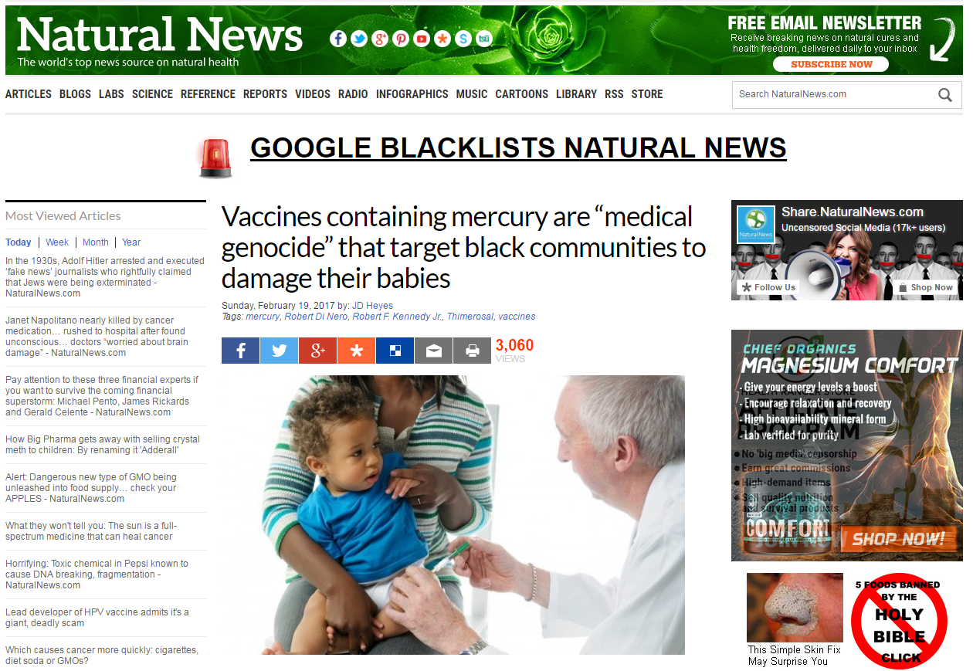

Slide 19
REVIEW your source
REPUTATION
INTENT
EVIDENCE
EMOTIONS
VERIFICATION
WEIGH IT UP

Slide 20
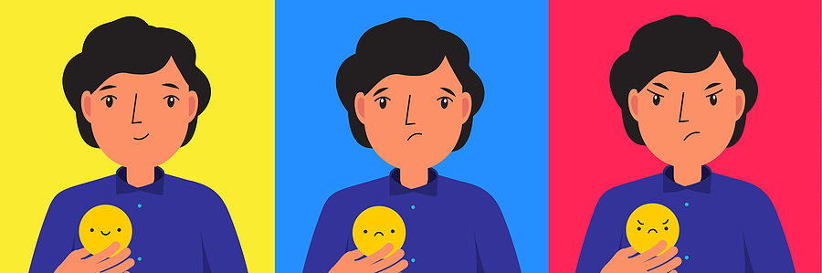
EMOTIONS:
What do you feel seeing that screenshot?
Happy, sad, angry?

Slide 21
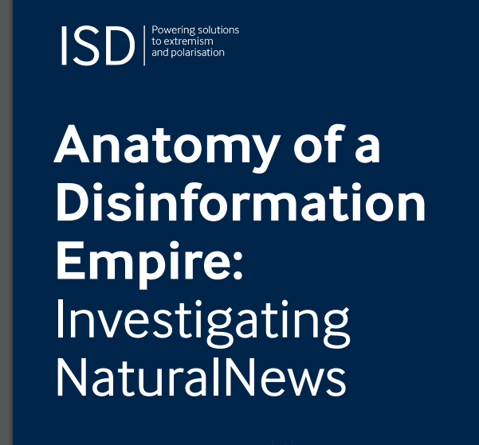
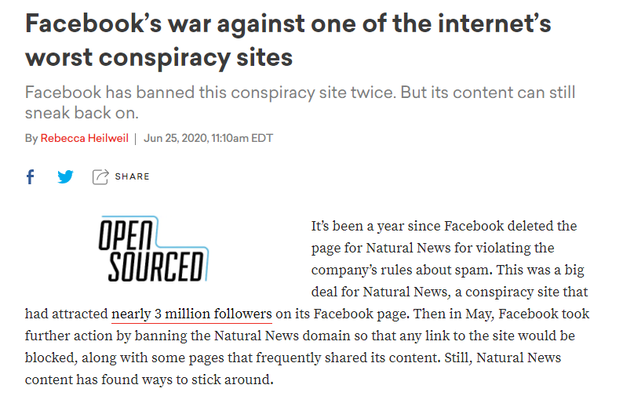
REPUTATION: Natural News
21

Slide 22
EVIDENCE: Mercury = Thiomersal
Thiomersal is a compound containing ethyl mercury used to prevent bacterial and fungal growth in inactivated (in which the virus has been killed) vaccines presented in multi-dose vials.
WHO (World Health Organisation) has closely monitored scientific evidence relating to the use of thiomersal as a vaccine preservative for over 10 years, in particular through its independent expert advisory group, the Global Advisory Committee on Vaccine Safety. The Committee has consistently reached the same conclusion: there is no evidence to suggest that the amount of thiomersal used in vaccines poses a health risk.
Source: https://www.who.int/news-room/q-a-detail/mercury-health

Slide 23
VERIFICATION
“It is the black neighborhoods that are getting the thimerosal vaccines,” Kennedy said at the press conference, held Feb. 15 at the National Press Club in Washington, D.C. “And it appears to be that African-Americans are much more susceptible to vaccine injury than other Americans.”
Quote from Natural News
Verify: Who is Kennedy?
Verify: The safety of vaccines for Black American children.

Slide 24
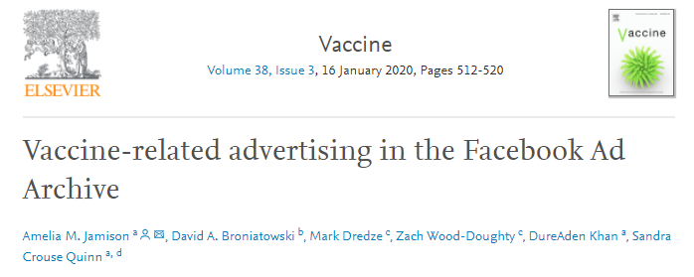
VERIFICATION: KENNEDY
The majority of Facebook ads spreading misinformation about vaccines are funded by two organizations run by well-known anti-vaccination activists, a new study in the journal Vaccine has found.
The World Mercury Project chaired by Robert F Kennedy Jr, and Stop Mandatory Vaccinations, a project of campaigner Larry Cook, bought 54% of the anti-vaccine ads shown on the platform during the study period.

Slide 25
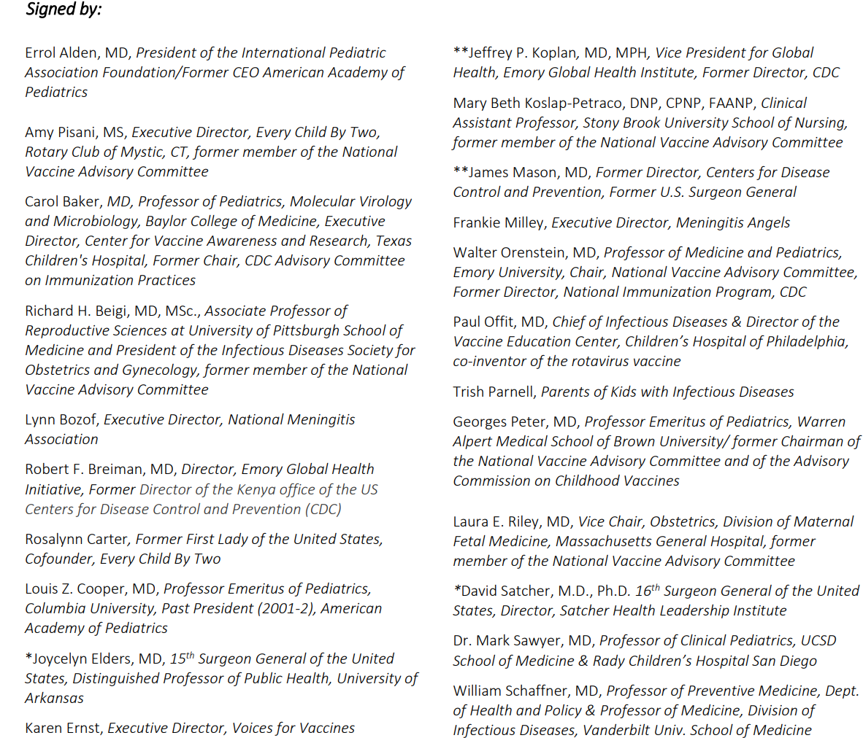

VERIFICATION: VACCINES FOR CHILDREN NOT SAFE
“Recently, a select few members of the African American community have become concerned that certain vaccines may not be safe for their children or that they may cause autism.
This is simply not true.”

Slide 26
INTENT:
Why did the author or publisher make this information available?
Is there obvious and/ or extreme bias or prejudice?
Are alternative points of view presented?
Does the author omit any important facts or data that might disprove their claim?
Does the author use strong emotional language?

Slide 27
INTENT:
Why did the author or publisher make this information available?
Is there obvious and/or extreme bias or prejudice? YES (Verified)
3. Are alternative points of view presented?
NO alternative points of view (Verified)
Does the author omit any important facts or data that might disprove their claim? YES (Verified)
5. Does the author use strong emotional
language?
YES, starting with the headline

Slide 28
INTENT:
Why did the author or publisher make this information available?
What do you think?
Talk with the person sitting next to you about the intent of Natural News.

Slide 29
“Competition for social media’s large supply of willing eyeballs is fierce, and a number of frequent offenders regularly fabricate salacious and attention-grabbing tales simply to drive traffic (and revenue) to their sites.”
Source: Snopes (fact checking guide)

Slide 30
WEIGH IT UP:
Once you have checked the reputation of the site, took stock of your emotions, verified the evidence and tried to figure out the intent, the final step is to weigh everything up and come to a conclusion:
This is disinformation.
DISINFORMATION: NOT TRUSTWORTHY

Slide 31
Looking to the future:
Disinformation is deliberately created with the intent to cause harm, while misinformation is incorrect information shared by people who believe it to be true.
Be aware that misinformation and disinformation are created and centered on big issues such as:
people's identities
climate change denial
voting and elections
Most fabricated content usually tries to play to your emotions. Always double-check images, social media posts and news articles before you react or share them.
When in doubt, remember to REVIEW.

Slide 32

The facts about WHO can and
HOW to register to vote:
1 in 3 young Londoners (16 to 25 year olds)
are not registered to vote
Black, Asian, ethnic minority and migrant
Londoners, private and social renters are
less likely to be registered to vote and, hence,
less likely to be heard
To register to vote in London, you must
be aged 16 or over (you can vote at 18),
be a British, Irish, EU or Commonwealth
citizen, have a London address
Now that you know the facts, get heard!

Slide 33
LONDON WON’T BE THE SAME WITHOUT YOUR VOICE.
Register to vote at:
www.gov.uk/register-to-vote
You can find more education and social media resources on the London Voter Registration Week Hub:
https://registertovote.london/
Thank you

