Slide 1
Media Literacy
Lesson | Critically Engaging with Media

Slide 2
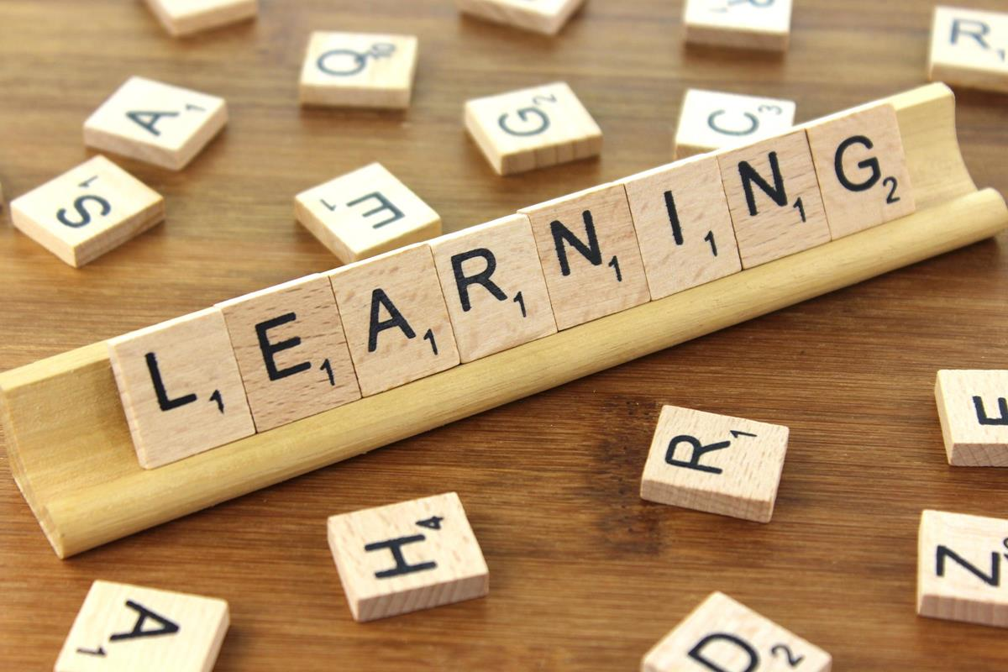
What are the aims of this session?
Today we will:
Critically evaluate a range of media
Identify the difference between misinformation, disinformation and mal-information
Explain why it is important to be able to identify these different types of information

Slide 3
Media Literacy: Why does it matter?
Being active in your local community; in decisions that impact you, your family and friends; being a part of civic life and democracy are all very important things. But so is the ability to know how politics works, what are the key issues facing London, Britain and the world, as well as developing the critical thinking necessary to evaluate different points of view and navigate the media.

Slide 4
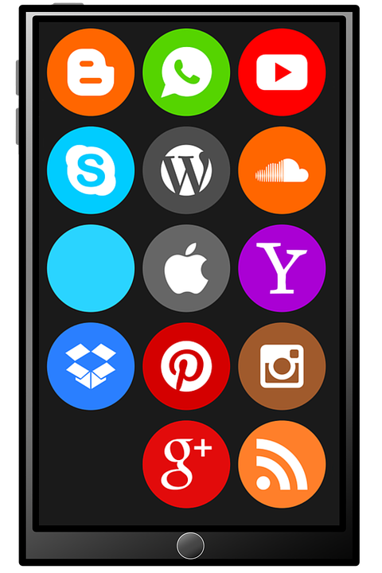
Spotting false news: Disinformation, Misinformation and Mal-information
In an age of limitless information at your fingertips, now more than ever, we need to be able to spot news, videos and stories that are simply incorrect.
We need to know how to identify the different types of information that are out there and be able to debunk false information.
We need to know why people create and disseminate false information and why/ how it can be harmful. This is where Media Literacy comes in.

Slide 5
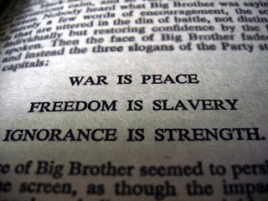
This is a quote from Orwell’s 1984. What do you think it means?
How can these slogans relate to the spread of false information online today?
George Orwell, 1984

Slide 6
Hands up: Where do you get the majority
of your information from?
TV
RADIO
NEWSPAPERS
ONLINE ARTICLES
SOCIAL MEDIA

Slide 7
What problems, if any, have you encountered when trying to find information on these platforms?
Notes:
Prompt suggestion: Clickbait - (on the internet) content which has the main purpose to attract attention and encourage visitors to click on a link to a particular web page.

Slide 8
Defining terms: Disinformation, Misinformation and Mal-information
Disinformation
Misinformation
Mal-information
information which is deliberately created to harm a person, group or organisation
information shared without knowing it is false; not created to cause harm
truthful information which is shared to deliberately harm a person or group
Definitions adapted from “Information Disorder”, Council of Europe report
Notes:
Source: https://www.coe.int/en/web/freedom-expression/information-disorder

Slide 9
How to understand Misinformation, Disinformation and Mal-information:
You might be familiar with the term ‘fake’ news, however, this term can be quite misleading. ‘Fake’ news has been adopted by some public figures to dismiss news that they personally disagree with.
False information is a better term and this can be broken down into the categories of misinformation, disinformation and mal-information.
Animation link: http://www.youtube.com/watch?v=HD5MmuLDeFE

Slide 10
REPUTATION
EVIDENCE
REVIEW your source
VERIFICATION
INTENT
EMOTIONS
WEIGH IT UP

Slide 11
Mis-, Dis- or Mal-information?
You are about to see three examples and you must decide whether each one is an example of misinformation, disinformation or mal-information.
Write down what you think and give at least one reason why you have chosen that type of information.

Slide 12
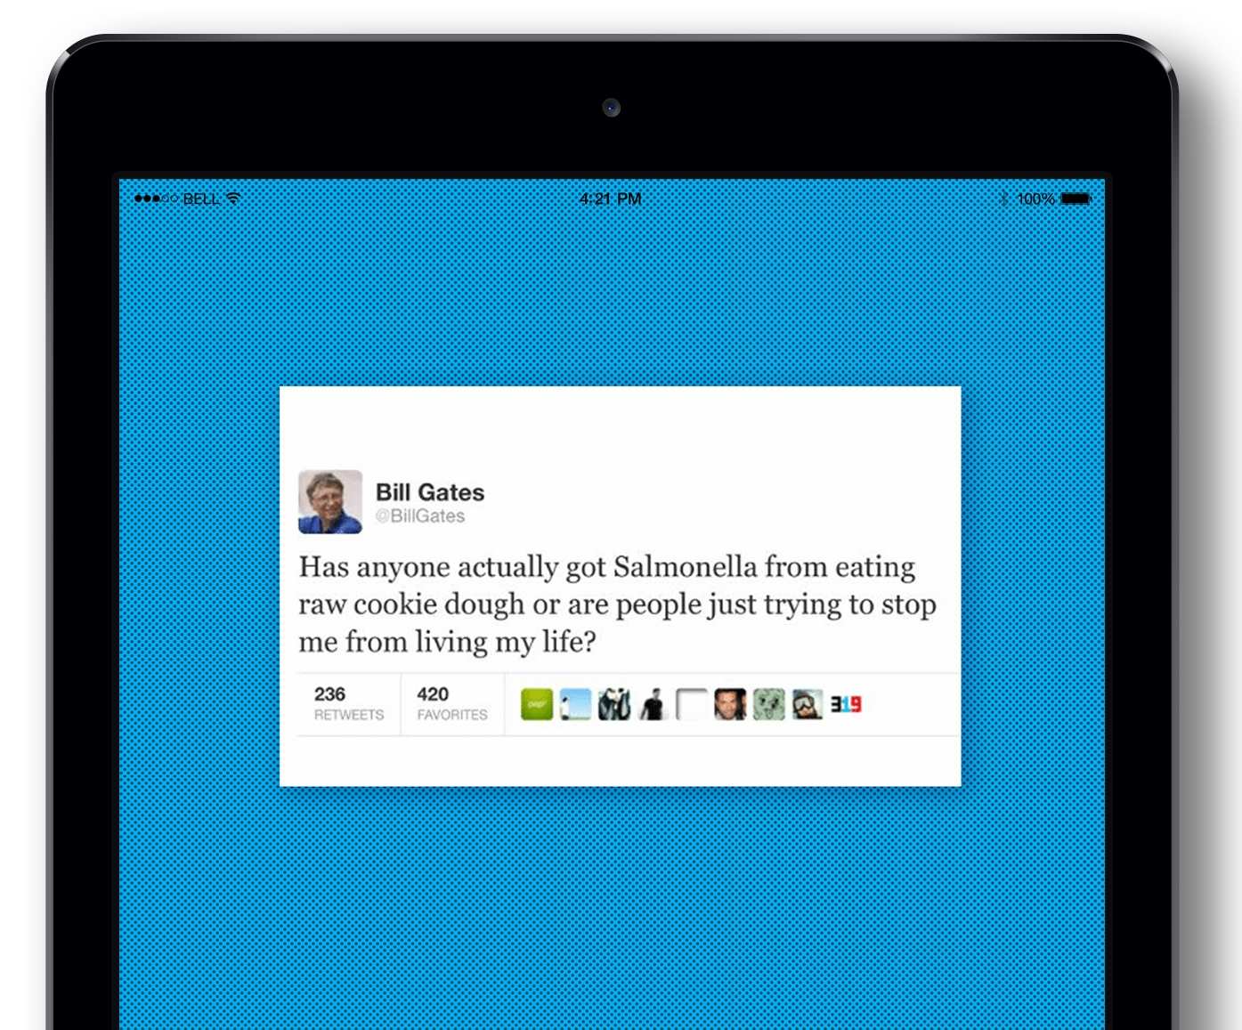
Misinformation
Disinformation
Mal-information
1
Is this an example of disinformation, misinformation or mal-information?

Slide 13
1
This is an example of mal-information because a hacker released President Macron’s emails the day before the 2017 presidential run-off. The emails included in-depth information about Macron’s campaign.
The attack was seen as an attempt to undermine democracy and influence the election process. What is even more worrying about this attack, is that false documents were circulated amongst legitimate documents.
Mal-information
Notes:
Source: ‘France's Macron has campaign emails leaked online one day before election’ - https://www.dw.com/en/frances-macron-has-campaign-emails-leaked-online-one-day-before-election/a-38732299

Slide 14
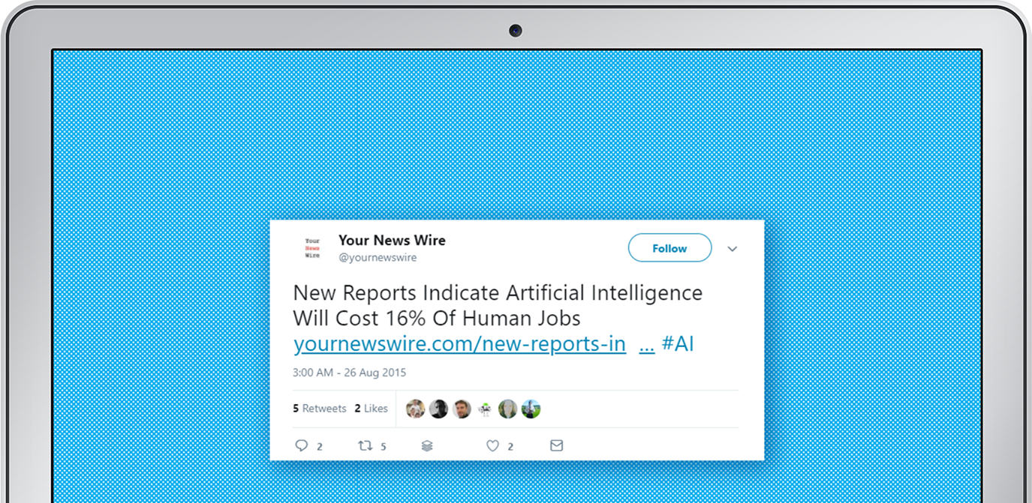
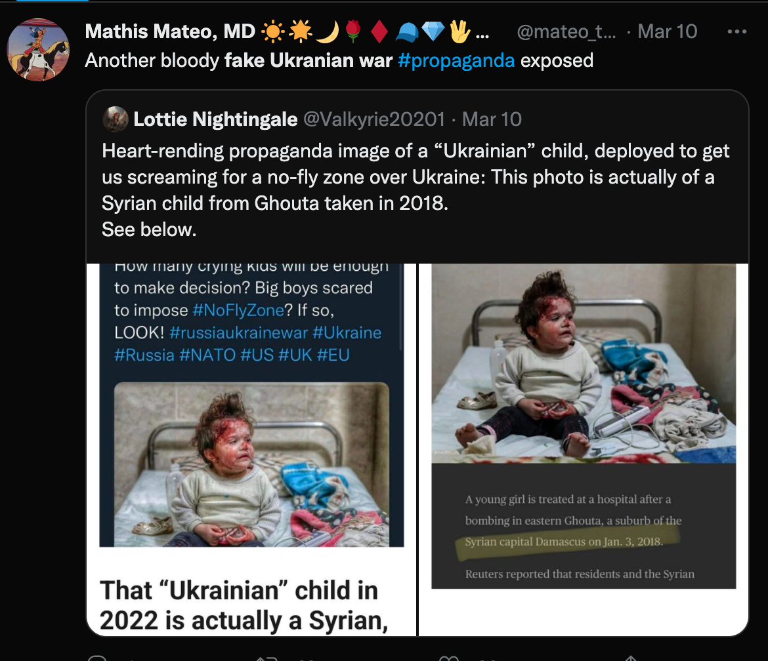
2
Misinformation
Disinformation
Malinformation
Is this an example of disinformation, misinformation or malinformation?

Slide 15
2
False images being spread online create the impression that Russia’s attack of Ukraine is fake.
This leads more people to spread the false idea that the war and humanitarian crisis in Ukraine are fake. This could be very dangerous because it could make people hostile to Ukrainian refugees in the UK.
Misinformation
Notes:
More information - ‘Ukraine invasion: False claims the war is a hoax go viral’: https://www.bbc.co.uk/news/60589965

Slide 16
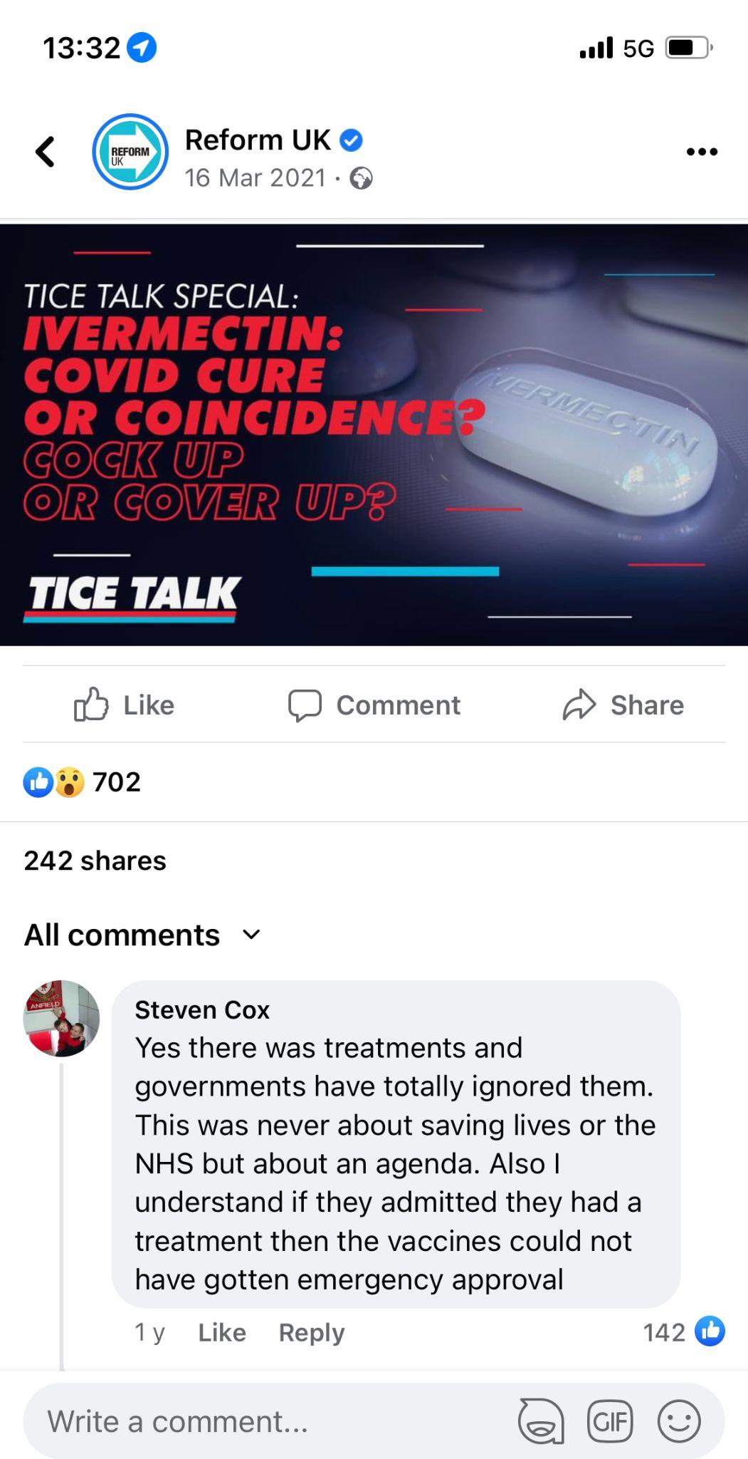
Misinformation
Disinformation
Malinformation
3
Is this an example of disinformation, misinformation or malinformation?

Slide 17
3
Disinformation
Ivermectin - ‘the Covid miracle drug’ is a myth created by social media and false science. Social media influencers and anti-vax campaigners constructed the idea that Ivermectin could miraculously heal severe Covid cases. It was based on some unreliable studies that have been universally condemned.
This is now widely known, but some groups continue to circulate this disinformation to provoke distrust and fear in the public health response and the vaccines.
Notes:
Source - ‘Ivermectin: How false science created a Covid 'miracle' drug’: https://www.bbc.co.uk/news/health-58170809

Slide 18
You will start to see more of these types of warnings - but are they enough?

Slide 19
Who do you think should be held responsible for the spread of false information online?
The individuals? The owners of the news sites or social media platforms? The government?
A mixture?

Slide 20
Social Media sites are gradually being held accountable for malicious and false content on their platforms
‘Social media companies cannot hide behind the claim of being merely a ‘platform’ and maintain that they have no responsibility themselves in regulating the content of their sites. [...] Our Interim Report recommended that clear legal liabilities should be established for tech companies to act against harmful or illegal content on their sites. There is now an urgent need to establish independent regulation. We believe that a compulsory Code of Ethics should be established, overseen by an independent regulator, setting out what constitutes harmful content.’
Source – UK House of Commons’ Digital, Culture, Media and Sport Committee, Disinformation and ‘fake news’: Final Report, Eighth Report of Session 2017–19, 14 February 2019

Slide 21
Thank you!
For more information contact the GLA Social Integration Team
elisabeth.pop@london.gov.uk
london.gov.uk

