Slide 1
Your City
Lesson 3 | Voting and Elections

Slide 3
ACTIVITY
Vote with your feet

Slide 4
DISCUSS
Why is voting important?

Slide 5
Types of electoral systems
The main types of election systems used in the UK are:
First Past the Post (FPTP)
Alternative Vote (AV)
Proportional Representation (PR)

Slide 6
First Past the Post
Pro | Cons
Usually allows parties to form a government on their own | The number of votes cast for a party in general elections is not accurately reflected in the number of seats won
Fringe parties unlikely to get elected | Hard for small parties to gain seats
 | Can encourage tactical voting
Voters put a cross next to one or more candidates (one in general elections, multiple in local elections).
Where is it used? In the UK, the US and India.
The London Assembly is London's local government. It is made of 25 Assembly Members who keep a check on what the Mayor is doing, publish findings and recommendations to investigations and make proposals to the Mayor.
11 Assembly Members are elected to represent London as a whole. 14 London Assembly Members - who represent a constituency made of two or more London boroughs -
are elected using FPTP.

Slide 7
Proportional Representation (PR)
Pro | Cons
The number of seats directly reflects the number of votes cast for each party | Consensus politics isn’t always what voters want
Every vote counts | Gridlock - It can take longer for coalitions and minority governments to reach decisions.
Less tactical voting | Politicians could prioritise local issues, to get re-elected, over national compromise
Voters put a cross next to their chosen party. Votes are counted in each region and seats are given to parties in direct proportion to their vote share. So, if a party gets 40% of the vote in a region, they will have 40% of the available seats.
Where is it used? It is used for electing the UK’s Members of the European Parliament (MEPs) and in other European countries for their national parliaments, such as Denmark, Austria and Spain.

Slide 8
Alternative Vote (AV)
Pro | Cons
The aim of securing more than 50% of the local vote means MPs work harder to earn and keep voter support. | AV is a "losers' charter" where the candidate who comes second or third in first preferences can actually be elected.
No wasted votes | Some votes count more than others - If you give your first preference to a mainstream party, your other choices might not be counted, but if you give first preference to a small party who gets knocked out, your other preferences will count.
Less tactical voting
Reduces negative campaigning
Voters rank candidates in order of preference. If more than half the voters have the same favourite candidate, that candidate wins. If nobody gets half of first preference votes, the candidate who came last is removed and their second choices are allocated. This is repeated until one candidate has over half the votes.
Where is it used? To elect the majority of chairs of select committees in the House of Commons and for the election of the Lord Speaker and in by-elections for hereditary Peers.
The London Mayoral election uses the Supplementary Vote system, which is similar to AV - you get to mark on the ballot paper your first and second choice. The Mayor of London has the power to make decisions about: arts and culture, economic development, the environment, fire and safety, policing, transport, regeneration.

Slide 9
Registering to vote
To vote in the UK, you must be registered
You can register when you’re 16!
If you don’t register in advance of the election, you cannot vote.
In some countries (like Belgium and Australia), it is a legal requirement to vote – though you can mark on the ballot that you abstain or spoil the ballot.
In some countries, voter registration is an “automatic” system, meaning that everyone is automatically registered to vote, unless you specifically choose to un-register yourself.
The system to register to vote recently changed in the UK. Now, each person is required to register to vote individually, rather than by household.

Slide 10
Registering to vote
Voting is not obligatory in the UK. It is a right but there is no punishment if you do not vote.
But registering to vote is mandatory. You can be fined if you repeatedly refuse to register.
Remember, you need to register at your new address every time you move house.
You can register online: www.gov.uk/register-to-vote
You can also register by post: to find out how, get in touch with your local Electoral Registration Office via https://www.gov.uk/get-on-electoral-register.

Slide 11
To vote in the UK you must be registered and be:
18 years of age or over on polling day in England, Wales and Northern Ireland and 16 or older to vote in some Scottish elections
a British, Irish or qualifying Commonwealth citizen (then you can vote in all elections)
a European citizen (although you can vote in local and regional elections only)
a resident at an address in the UK (or a UK citizen living abroad who has been registered to vote in the UK in the last 15 years) and
not be legally excluded from voting
Note: Due to the UK leaving the EU (Brexit), the voting rights of EU nationals might change. For up to date info visit
https://www.gov.uk/elections-in-the-uk

Slide 12
Types of elections in the UK:
UK general election
Devolved Parliaments and Assembly elections
Regional and Local elections

Slide 13
General Elections
In general elections, you vote for a Member of Parliament (MP) to represent you in the House of Commons.
These elections are meant to take place every 5 years
You vote in your constituency (local area)
MPs are elected using the First Past the Post system. You vote once for a candidate in your constituency and the candidate with the most votes becomes your MP. The party with the most MPs in Parliament forms the government and its leader becomes the Prime Minister.

Slide 14
Members of Parliament
Sit in the House of Commons (the elected House in Parliament)
Split their time between working in Parliament and in their constituency
Many MPs also sit on committees, which analyse policy issues in depth, e.g. Education Committee, Defence Committee.
Whilst Parliament is sitting, MPs: – Raise issues affecting their constituents – Debate, amend and vote on new laws – Deal with national issues, such as: tax, abortion laws, transport and housing
legislation, foreign policy.

Slide 15
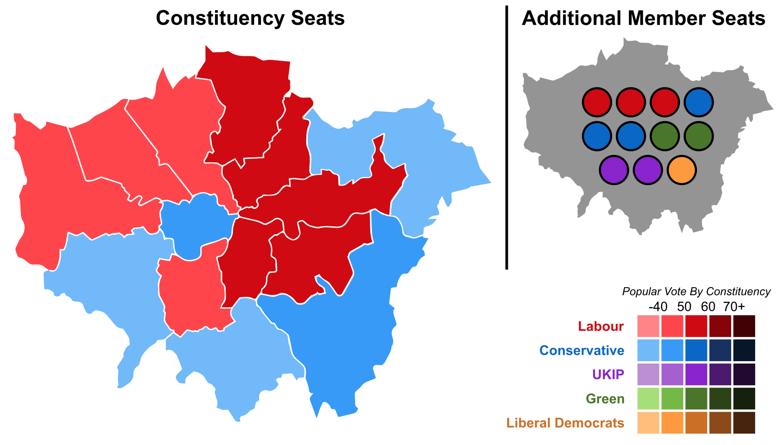
London elections
The London Assembly is London's local government. It is made of 25 Assembly Members who hold the Mayor and his team to account.
The Assembly Members are elected using the
additional members system of proportion
representation. This mixes first past the post and
proportional representation. Each voter casts two
votes. One for a candidate standing in a super – constituency (covering 2 or more boroughs), and a vote for a party list member standing for
the whole region.
14 Assembly constituency members are elected
via FPTP and 11 London-wide Members using
proportional representation.
This is the result of the 2016 London Assembly elections.

Slide 16
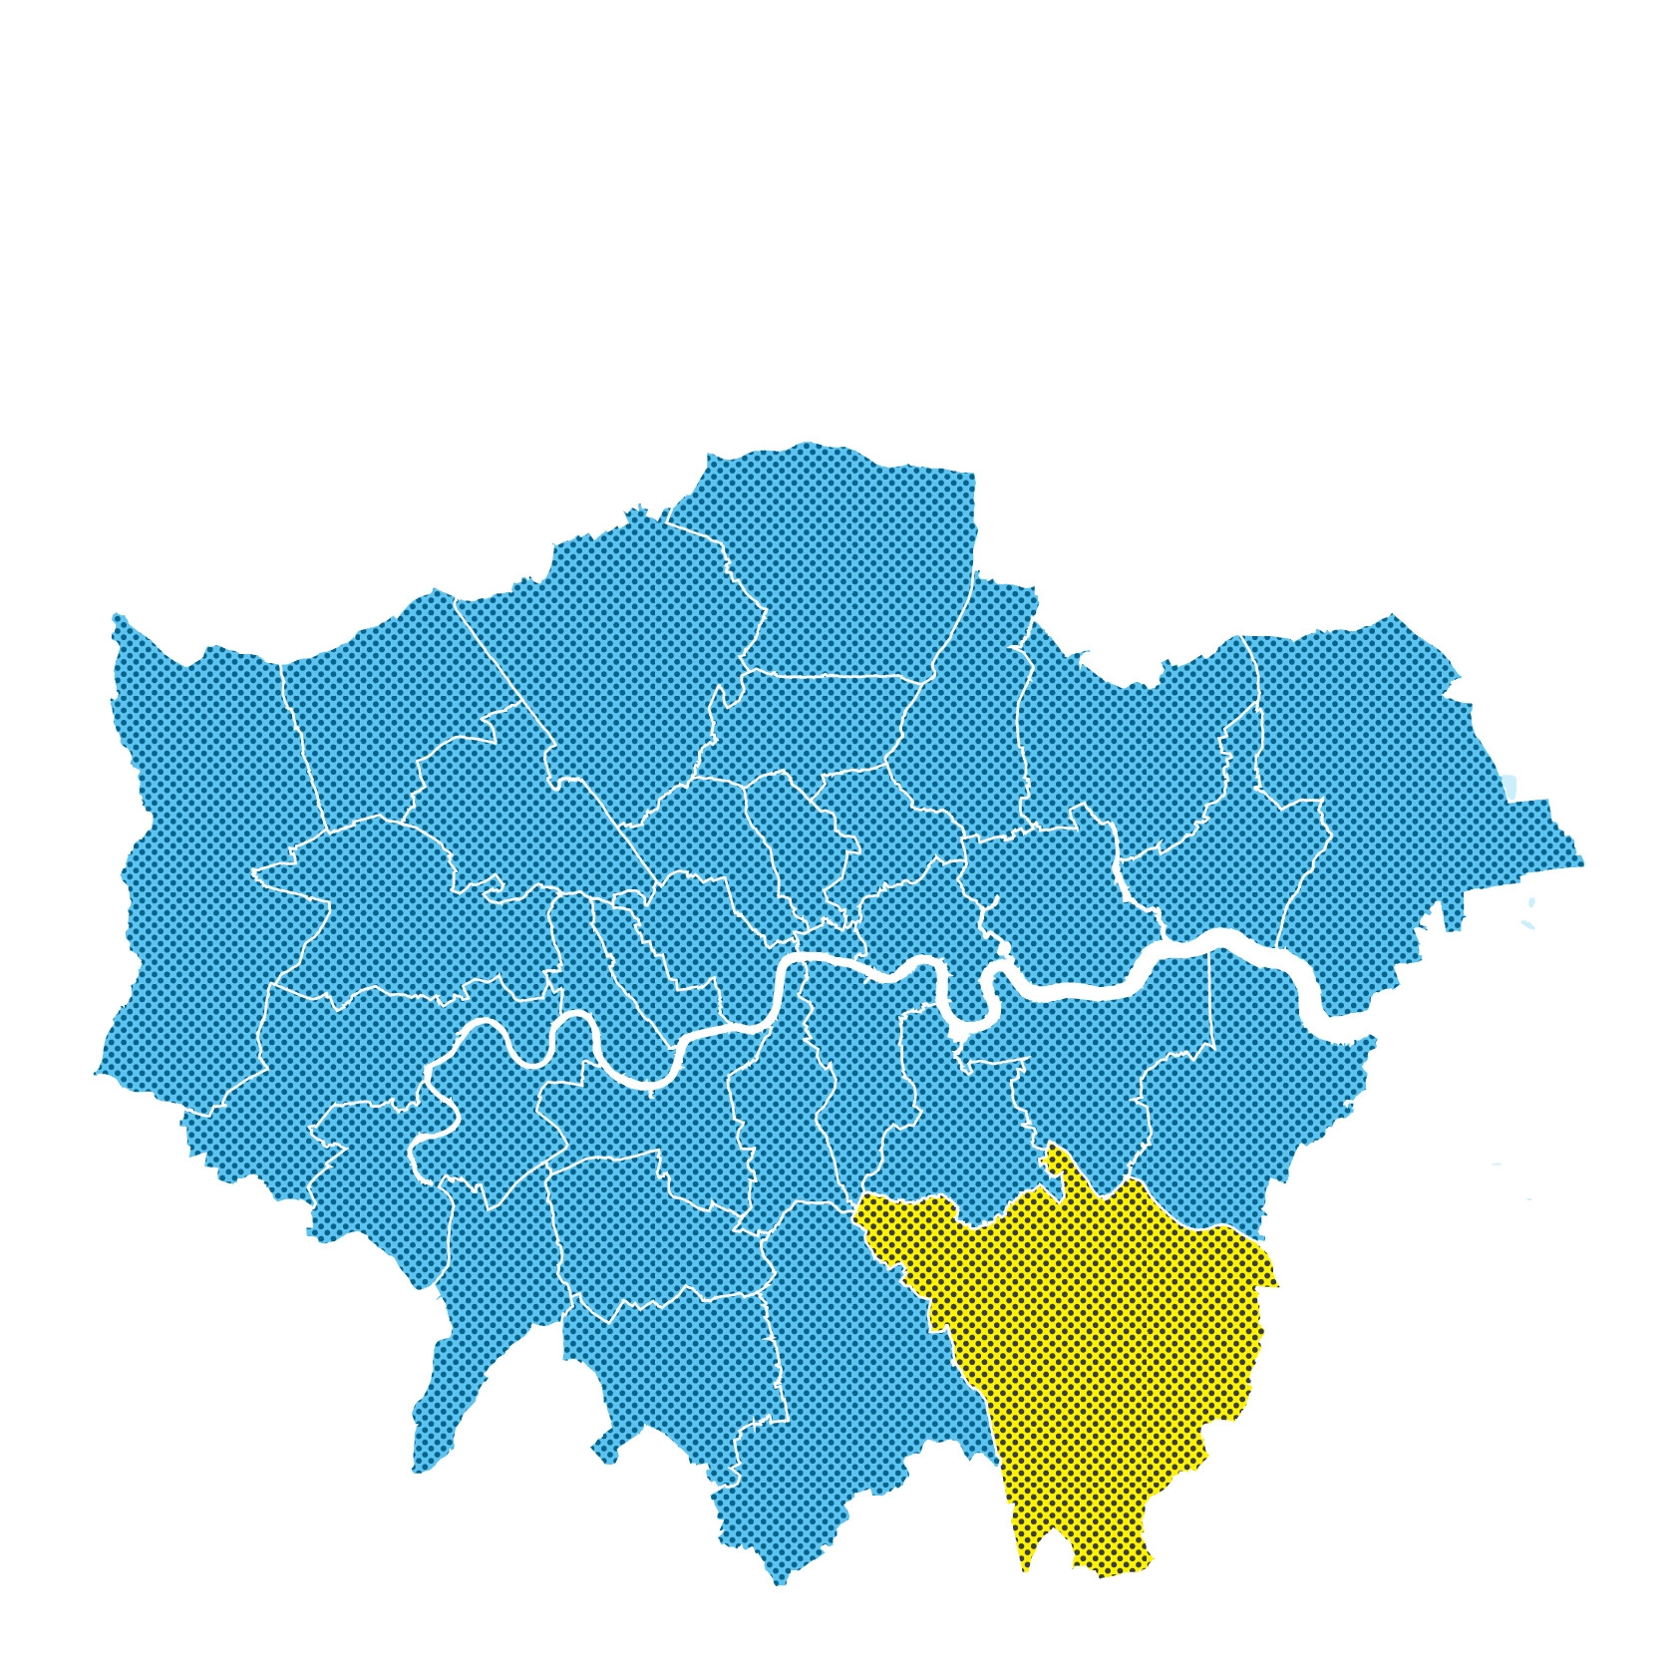
Local elections
In local elections, you vote for councillors –
the politicians who represent you in your local council.
Local government councillors are elected using the First Past the Post system. You vote for one or more candidates in your local area (ward) and the candidates with the most votes win. Often you will vote for around three councillors per ward.

Slide 17
Local councillors
Councillors are usually members of political parties, but can also run as independents
They represent people in their local area (ward)
They debate local issues in council chambers
They act as a bridge between the community and local council
Councillors deal with local issues, including: libraries, youth services, council housing, rubbish collection, local environment, social care and public health.

Slide 18
Voter turnout
Voter turnout in the UK is low, but is rising again
In the 2017 general election, 68.7% of those who were registered to vote, voted
This is not the same as the total number of people eligible to vote because some people don’t register
If you don’t vote, you can’t have a say and decide who will make decisions on your behalf

Slide 19
Do young people vote?

Slide 20
Thank you
For more information contact the GLA Social Integration Team SocialIntergrationPSO@london.gov.uk
london.gov.uk

