Slide 1
Your city
Lesson 5 | Media

Slide 2
Guess the fake

Slide 3
Guess the fake

Slide 4
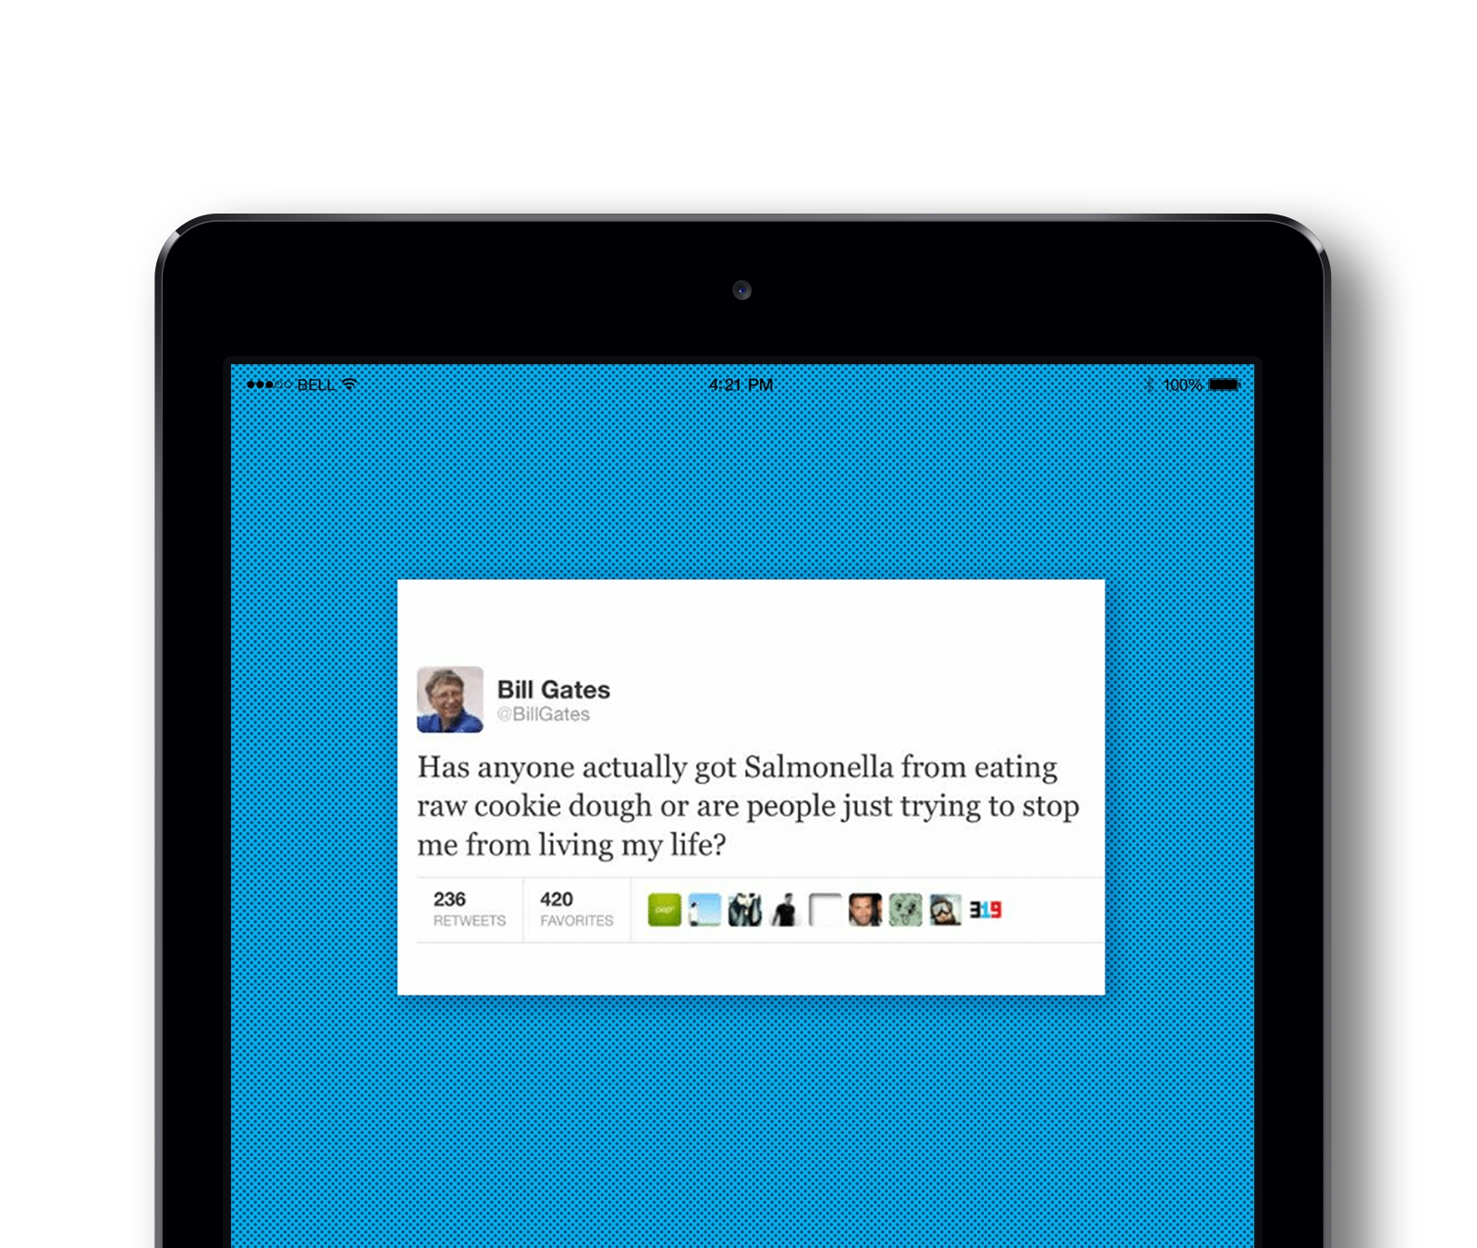
Guess the fake

Slide 5
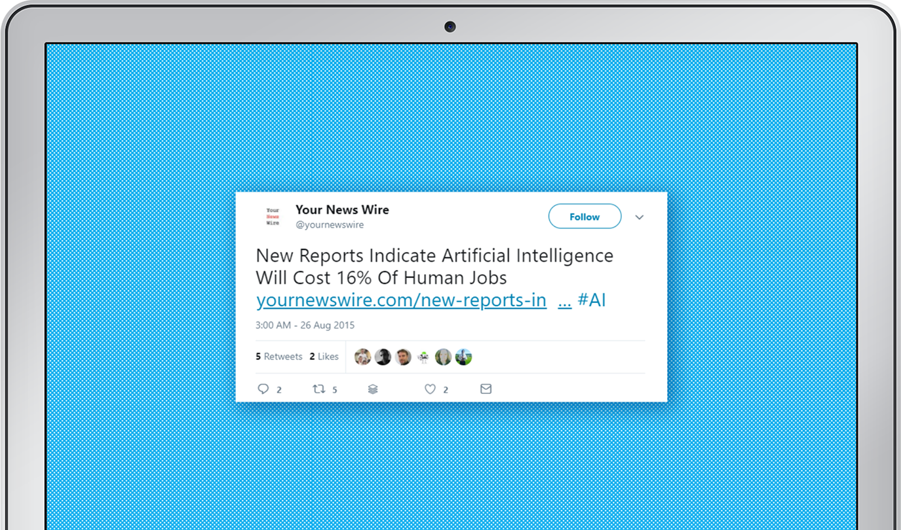
Guess the fake

Slide 6
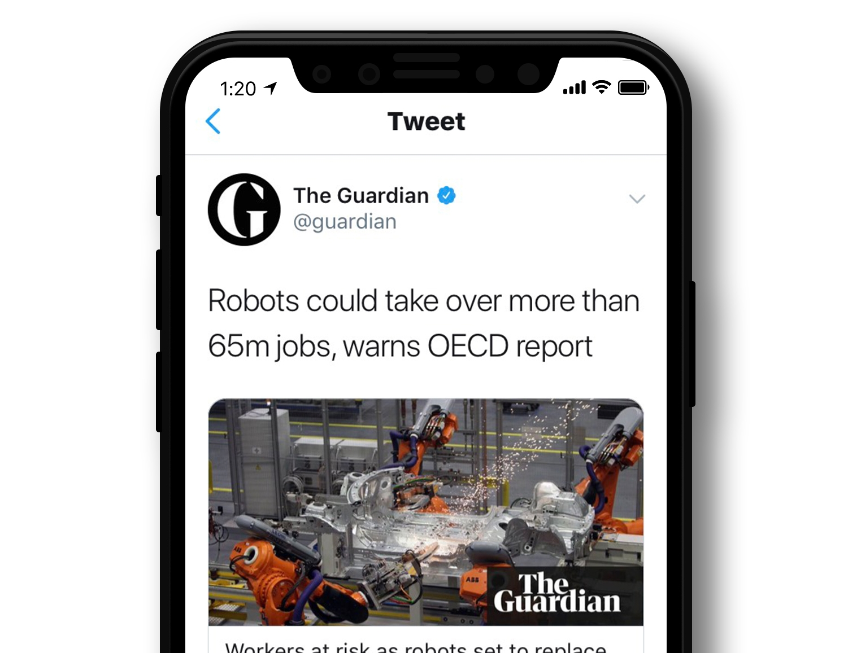
Guess the fake

Slide 7
Guess the fake

Slide 8
Guess the fake

Slide 9
Guess the fake

Slide 10
DISCUSS
How can you tell what is real and what is fake?

Slide 11
LOOK OUT
Things to look out for when checking news
Date
Byline (author)
Quotes
Web-domain
Purpose – What are they trying to do?
Source
Does the image look legit?

Slide 12
LOOK OUT
Things to look out for when checking news
Emotions – do they rile you up or make you sad – make you want to share it?
Do they use excessive punctuation AND CAPS???!!!
Your own biases – do you WANT to believe it?
Do they claim to hold a secret that the mainstream media is keeping from you?

Slide 13
How can you check a news item?
Check the story in other, reputable publications
Check other articles from that source
Background check the author (social media use etc)
Check if the source has made corrections previously (good) or just deleted articles (bad)
Check quotes and see if they’ve been taken out of context or entirely fabricated
Do an image search
Fact-checking websites: fullfact.org politifact.com snopes.com hoaxeye.com tineye.com

Slide 14
Politics and the media
Headlines
Language – the way they choose to report a story, how they describe things, the angle they take
Choice of images
Choice of stories
What is the relationship between politics and the media?
How do they influence one another?

Slide 15
Newspaper analysis
Look at:
Language
Images
What are they trying to make you feel?
What impression do they want to leave you with?
How effective is it?
Think about:
Do you think the media should be biased?
Do you think there’s a way to make it less biased?
In groups or alone, choose a newspaper and pick a story Can you tell their political stance from reading the story?

Slide 16
ACTIVITY
Create your own London news site
Pick:
Site name
Target audience
London-wide or borough-centred?
Focus – celebrity gossip, politics, business?
Position on the political spectrum?

Slide 17
Thank you
For more information contact the GLA Social Integration Team SocialIntergrationPSO@london.gov.uk
london.gov.uk

