Slide 1
Your city
Lesson 1 | Introduction

Slide 2
DISCUSS
What comes to mind
when you hear the
word ‘politics’?

Slide 3
ACTIVITY
How can you link the following pictures to politics?

Slide 4


Slide 5


Slide 6
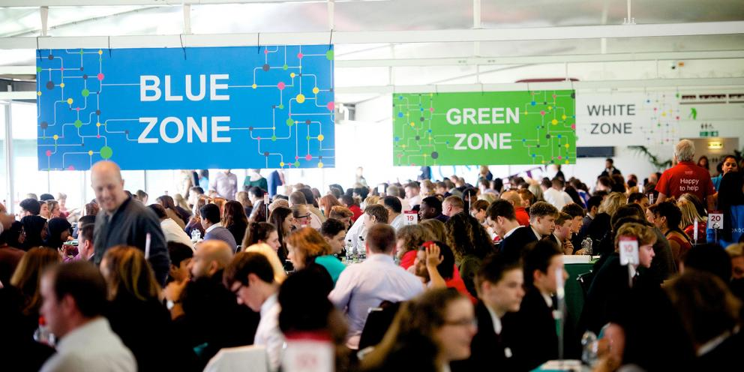

Slide 7


Slide 8
Thank you
For more information contact the
GLA Social Integration Team
SocialIntergrationPSO@london.gov.uk
london.gov.uk

