Slide 1
Your city
Lesson 6 | Activism

Slide 2
DISCUSS
What do you take
for granted?
How do you think that was achieved?

Slide 3



Some things we
take for granted…
Voting
Same sex marriage
Legal abortion
Human rights
Equality laws
School for all children
Free health care
…and much more!

Slide 4


What is activism?
1
2
Activism can be small
or it can be big
The best campaigns combine
both small and large methods:
Small
Talking to your friends
and family, teachers, starting a school petition, writing letters
Big
Protest marches, films, music, occupations,
strikes, adverts, celebrity endorsements

Slide 5
DISCUSS
Can you think of
any different types
of activism?

Slide 6

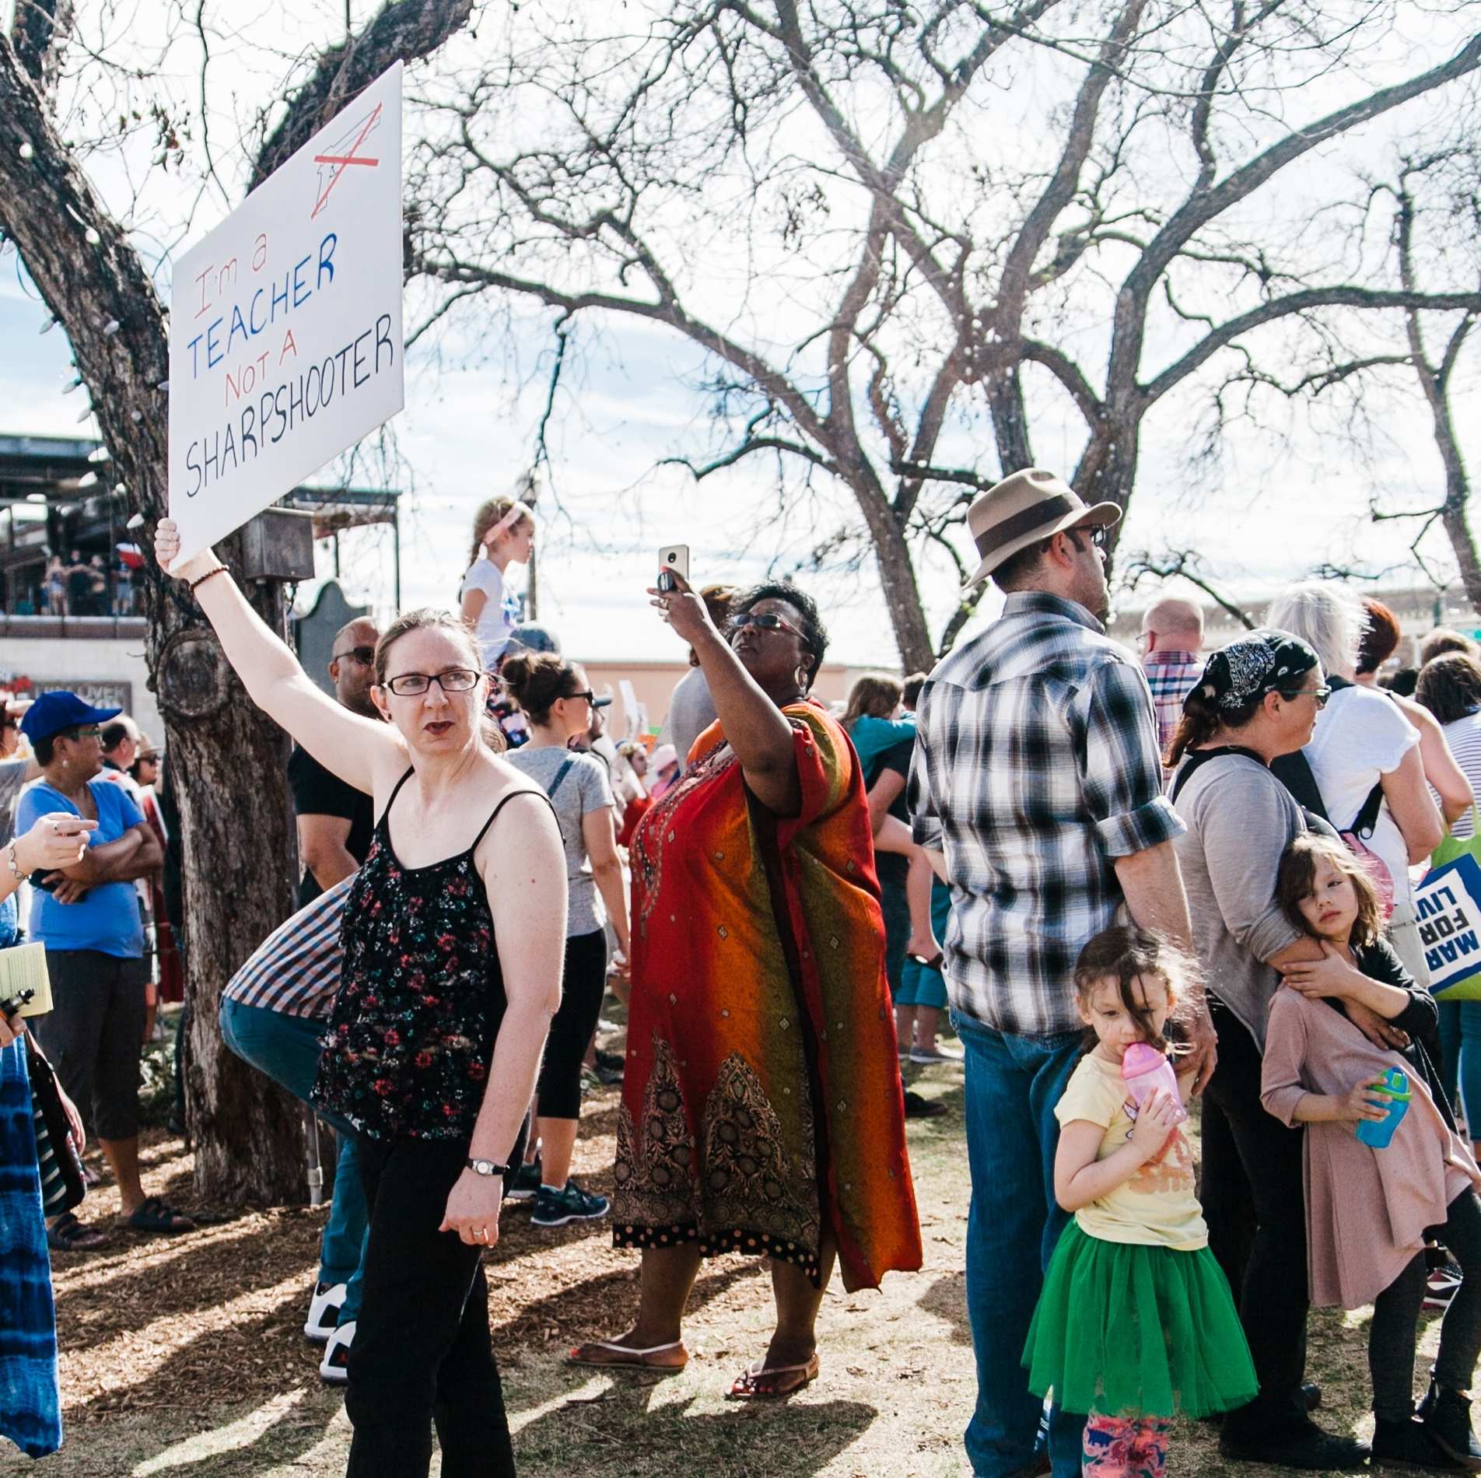
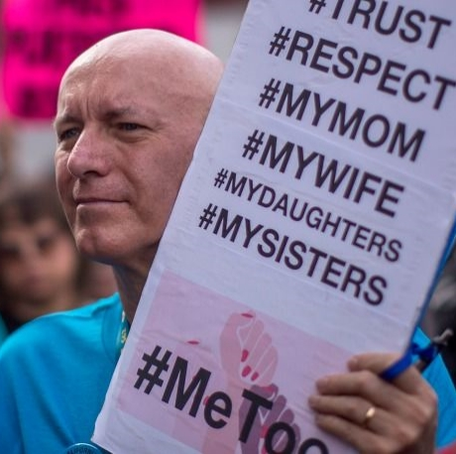
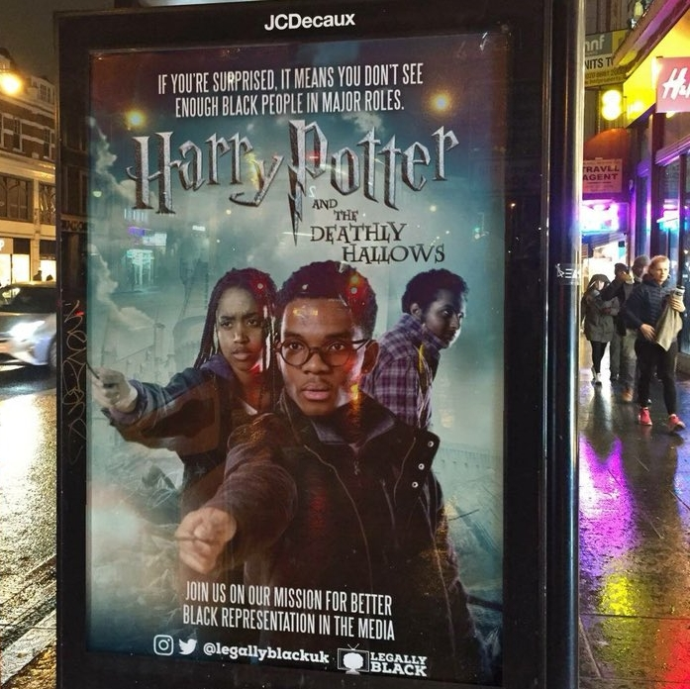
Can you think of any
more examples of activism?
Historic or recent? Local,
national, international?

Slide 7
Focus: FreePeriods
Period poverty campaign started by 18 year
old Amika George in 2017. It supports
girls in UK who can’t afford menstrual
products and so are missing school.
Launched petition on change.org
(ANYONE can start a petition here)
asking the UK government to give free menstrual products to girls who receive
free school meals
Celebrity support
Blog
Compiles research and articles
Tweets and other social media
Helped people write to their MPs
Gave TEDxTalk
Organised protest in Parliament square – YouTube star Tanya Burr spoke
Fundraises for and coordinates work
of charities, for example Bloody Good Period (provides menstrual supplies to refugees
and those who can't afford them) and freedom4girls (offer environmentally
friendly products and educate globally)
Interview with Amika
Amika’s TEDx Talk

Slide 8
Video links
Emma Gonzalez –
March for our lives speech
View video
Question Time –
Letter to Prime Minister
View video
Black Lives Matter video
View video
Out in Sport video –
Gareth Thomas on coming
out to his teammates
View video
Hollyoaks –
Don’t filter feeling mental health
View video

Slide 9
ACTIVITY
Now it’s your turn
to build a campaign!
Think of an injustice or something you think is wrong or unfair in your society/school/life
What would you like to change?
How could you change it?
What type of activism could you use?
Action plan: what steps do you need to take to put this into place? Who could you contact who could help you?

Slide 10
Thank you
For more information contact the
GLA Social Integration Team
SocialIntergrationPSO@london.gov.uk
london.gov.uk

