Slide 1
Your City
Lesson 4 | Global Citizenship

Slide 2
Global Institutions
International Monetary Fund (IMF) –
An organisation of 189 countries working
to foster global monetary cooperation and trade. The IMF’s primary purposeis to ensure the stability of the international monetary system.
United Nations (UN) – An international organisation formed in 1945. It aims to increase political and economic cooperation among its member countries, keep peace throughout the world and build cooperation among nations on major global issues.
The European Union (EU) – A political union of European countries who work
in cooperation to set and follow standards and regulations, with the aim of reaching common goals including peace, progress, freedom, diversity and security. Britain joined the EU in January 1973, but
decided to leave it following a referendum in June 2016.

Slide 3
Discuss
Migration:
Why would anyone leave the place they were born?
Migration
the movement of a person or people from one country, locality, place of residence, etc. to settle in another

Slide 4
Words matter:
Migrant
Immigrant
Emigrant
Asylum-seeker
Refugee
EU migrant
Forced migration
Economic migrant
Expat
International student
Stateless person

Slide 5
Discuss
New Beginnings
What kind of welcome would you expect? (accommodation, language classes, orientation)
if you were a student
if you came here for a job
if you moved here with your family
if you left a conflict zone
What is the one thing that you would bring with you? What is the first thing you would do
when you arrive in a new place?

Slide 6
How has migration
shaped London?
It also applied to Romani Gypsies who had slowly migrated across Europe from northern India over several centuries and whose nomadic way of life was seen as a threat.
The mass immigration between 1750 and 1900 was a result of Britain’s wealth and power, achieved by the exploitation of the world’s resources and its people through imperial expansion, the slave trade and industrialisation.
The 20th and 21st centuries simultaneously saw unprecedented movement of populations, and increasing restriction on those migrations.
In Britain it was the 1905 Aliens Act which introduced immigration controls.
Runnymede Trust – Our Migration Story
By the time the Romans invaded Britain in the year 43, it was already a land of many cultures and languages, made up of people from North Africa, Syria, the Balkans and Scandinavia.
For over a century the Tudors ran a strong centralised monarchy in which it was dangerous to be ‘the other’. This applied at different times to both Protestants and Catholics, when their faith conflicted with the monarch of the time.

Slide 7
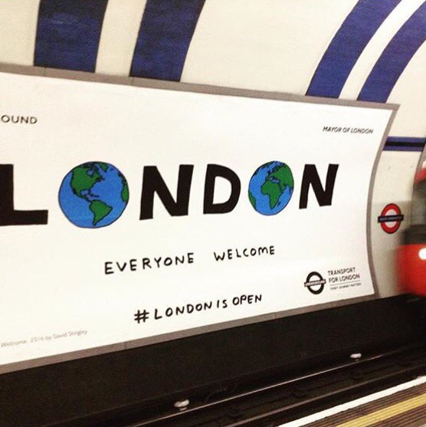
Celebrating London’s cultural diversity
#LondonIsOpen
The London Is Open campaign launched
in 2016 following the result of the Brexit referendum. It reassures Londoners that
despite the result, London would remain
open, diverse and vibrant.
The campaign celebrates London’s
continued openness, strength and diversity
and tries to reassure Londoners that their
voices and experiences matter and will
continue to be valued.

Slide 8
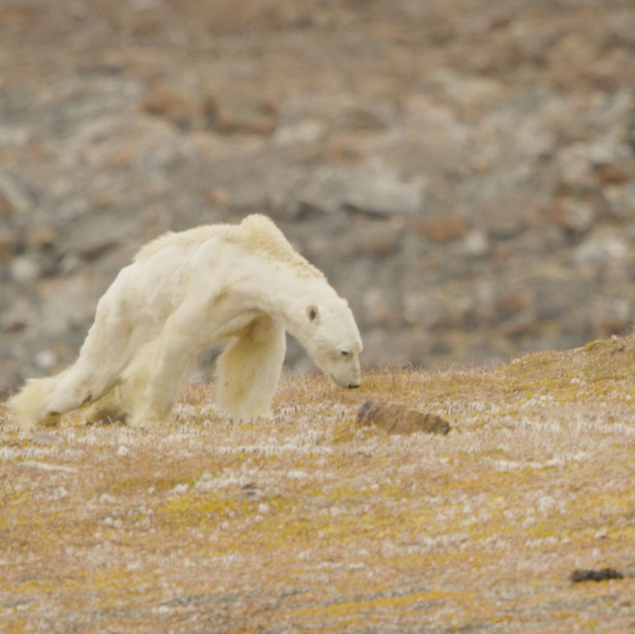
Place image here
Climate Emergency
What is the Climate Emergency ?
The climate emergency relates to climate change experienced around the globe.
Climate change is any significant, long-term change in the expected patterns of average weather over a significant period of time.

Slide 9
What is the impact of the climate emergency?
Average global temperatures have risen
every decade since the 1970s, and the
10 warmest years on record have all
occurred since 1997 (Greenpeace)
This is causing extreme weather events
to become more common
The increase in global temperature is also causing glaciers, permafrost and sea ice
to disappear
The devastating effects are not just felt across our environment but can be seen causing problems for wildlife
At current rates, by 2050 we’ll have more plastic than fish in our oceans (World Economic Forum)

Slide 10
Discuss
Which places across the globe are most affected?

Slide 11
How does the climate emergency affect London?
London may be particularly sensitive to
a rise in temperature because of the
urban heat island effect.
London is exposed to far greater potential damage from flooding than any other urban area in the UK. This is due to the value of its assets and the fact that a significant proportion of London lies within the floodplain of the River Thames and its tributaries.
London is one of the driest capital cities in
the world, with available water resources
per head of population similar to that of
Israel. Climate change could reduce the amount of water available and increase demand in hot periods.

Slide 12
London is a world leader in climate action
with a diverse concentration of businesses, NGOs and academic institutions working
with governments and communities to
develop and deliver solutions.
The Mayor of London’s first London Climate Action Week took place in July 2019 and focused on:
community action and business leadership on climate
clean energy and energy efficiency
adaptation and resilience
low emission transport
London’s role in driving UK and international climate leadership

Slide 13
What is the Paris Climate Agreement?
(12 December 2015)
The deal originally united almost all countries
in the world in a single agreement on tackling
the climate emergency. Recently, the US
decided to withdraw.
The fact that nearly 200 countries reached consensus is regarded by many observers
as an achievement in itself and has been
hailed as ‘historic’.
The main aim of the Paris Climate Agreement
is to limit global warming to well below 2C, or 1.5C if possible. An increase beyond that will
be irreversible and cause a catastrophic
chain reaction.
It also aims to:
Adopt green energy sources
Cut down on greenhouse gas emissions
Limit the rise of global temperatures

Slide 14
Discuss
Currently, few countries are adhering to the Paris Climate Agreement. What measures should countries actually put in place to
address the climate emergency?
What should the consequences be for
countries that are not taking steps?
Should we only look at countries that
currently have high CO2 levels, or also
in a historical context?
What are you and your family doing to limit
your carbon footprint?

Slide 15
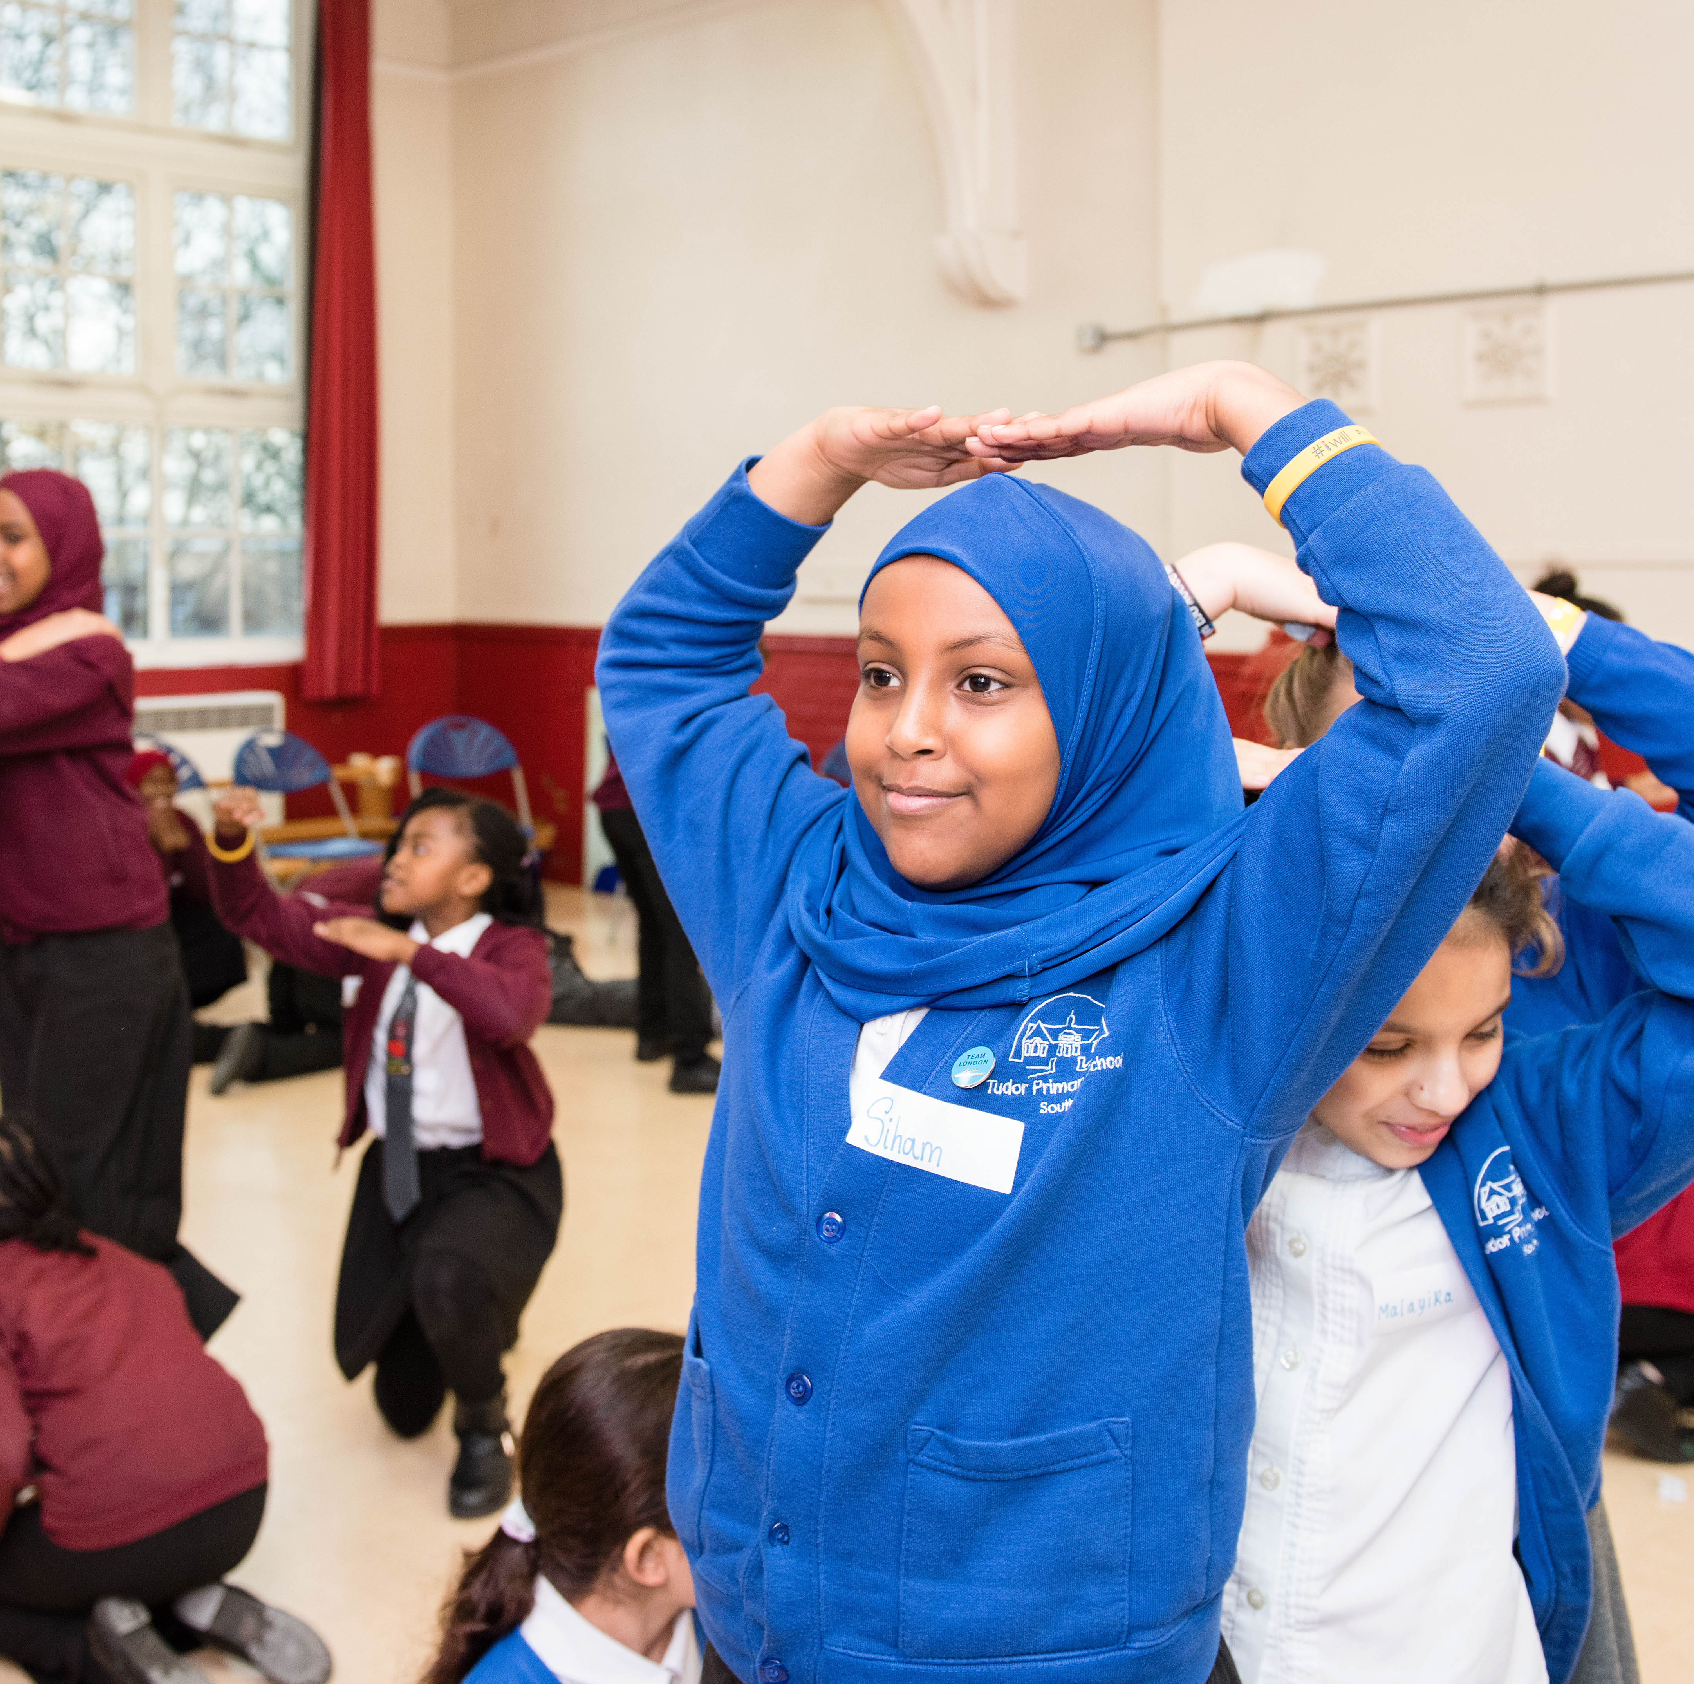
Inequalities
Legal, social and cultural situations in which personal characteristics (like gender, faith, race, ability, sexual orientation) determine different access to rights, opportunities and dignity for individuals.
Inequalities can be expressed in assumption
of stereotypical social and cultural roles, lack of social mobility, unfair pay or opportunities
in work, an infrastructure that does not
support different bodied people. They can
be individual, institutional or structural.

Slide 16
Gender Inequality
Period poverty: Millions of people across
the world do not have access to proper sanitation. This makes it harder for women
and young girls to manage their periods
safely and with dignity. Some do not have
access to proper menstrual materials, which
can increase physical health risks. In some countries, like rural Nepal, menstruating
women are seen as impure by their community and banished to huts during their cycles.
Access to education: Free access to
education is a universal human right. It doesn’t just improve the skills and personal development of individuals, it also benefits the progress of whole communities and countries. According to the UN, 265 million or 10 per cent of the world’s children do not have access to education due to poverty, lack of state support, cultural norms or ongoing conflict.

Slide 17
Gender Inequality
Violence against women and girls:
Across the globe, by virtue of their birth or gender re-assignation, women experience
female infanticide (termination of pregnancies
if the foetus is female), rape as a weapon of
war, female genital mutilation, domestic
abuse, physical assault, sexual exploitation
and child marriage.
For example, The Mothers of Srebrenica
are a group of survivors who want to raise awareness
about the genocide and mass rape that took place during the war in Bosnia.
Equal pay: Women are often paid less than men, and black and minority ethnic groups (BAME) are often paid less than white groups. In London there is a 16.7% difference between men and women and more than 20% between white employees and BAME groups.
At the current rate, the global pay gap between men and women will take 202 years to close.
https://www.youtube.com/watch?v=byq-EH9cR00

Slide 18
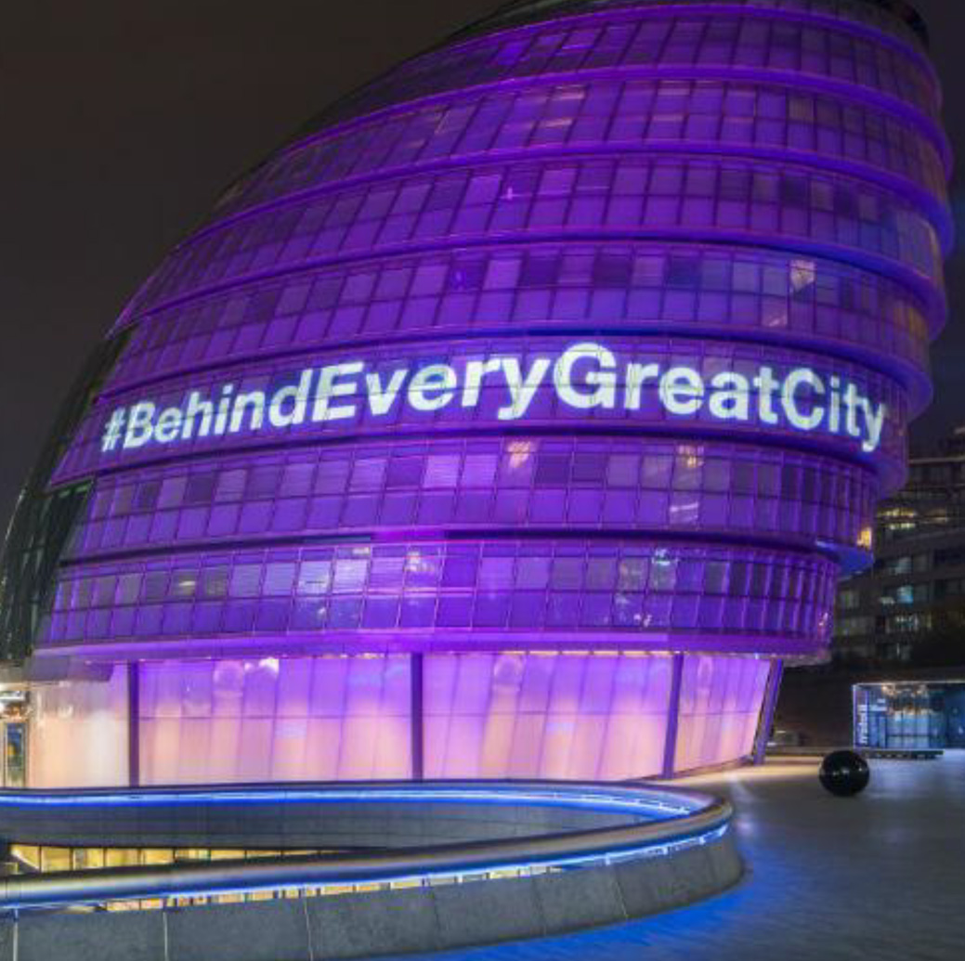
#BehindEveryGreatCity
This campaign had the aim of championing
the fact that it is the achievements and contributions of women, from all walks of
life, which make cities like London great.
It coincided with the 100 year anniversary
of the 1918 Representation of the People
Act, which gave some women the vote,
and was introduced thanks to the
campaigning of suffragists and suffragettes.

Slide 19
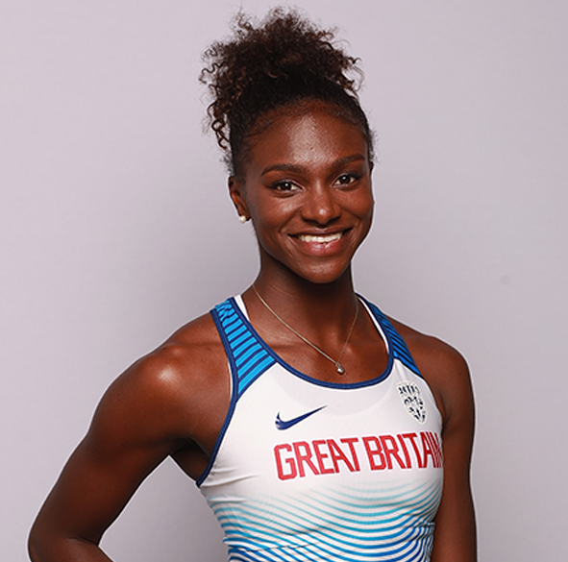
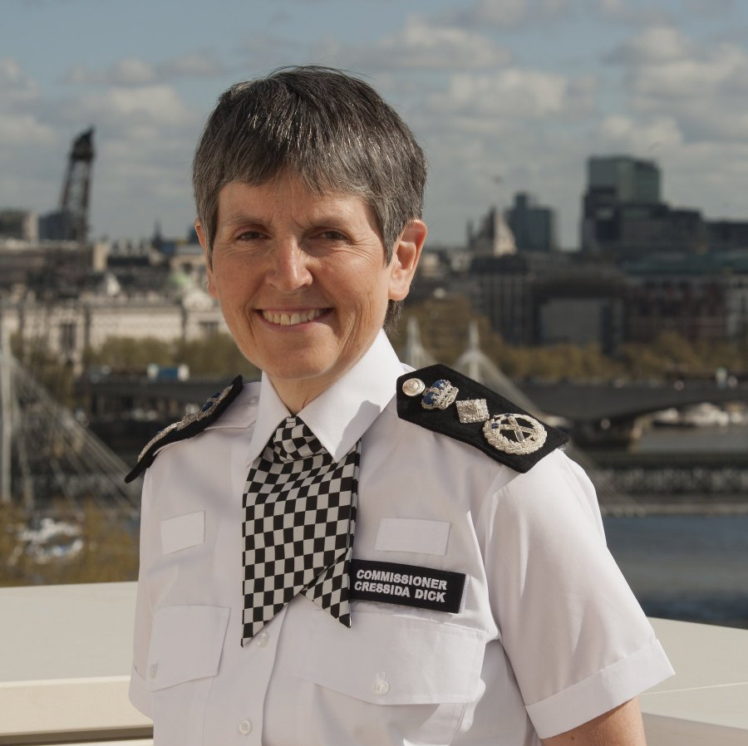
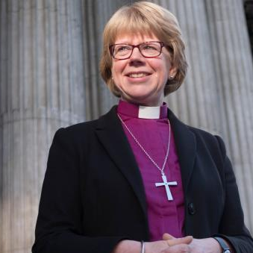
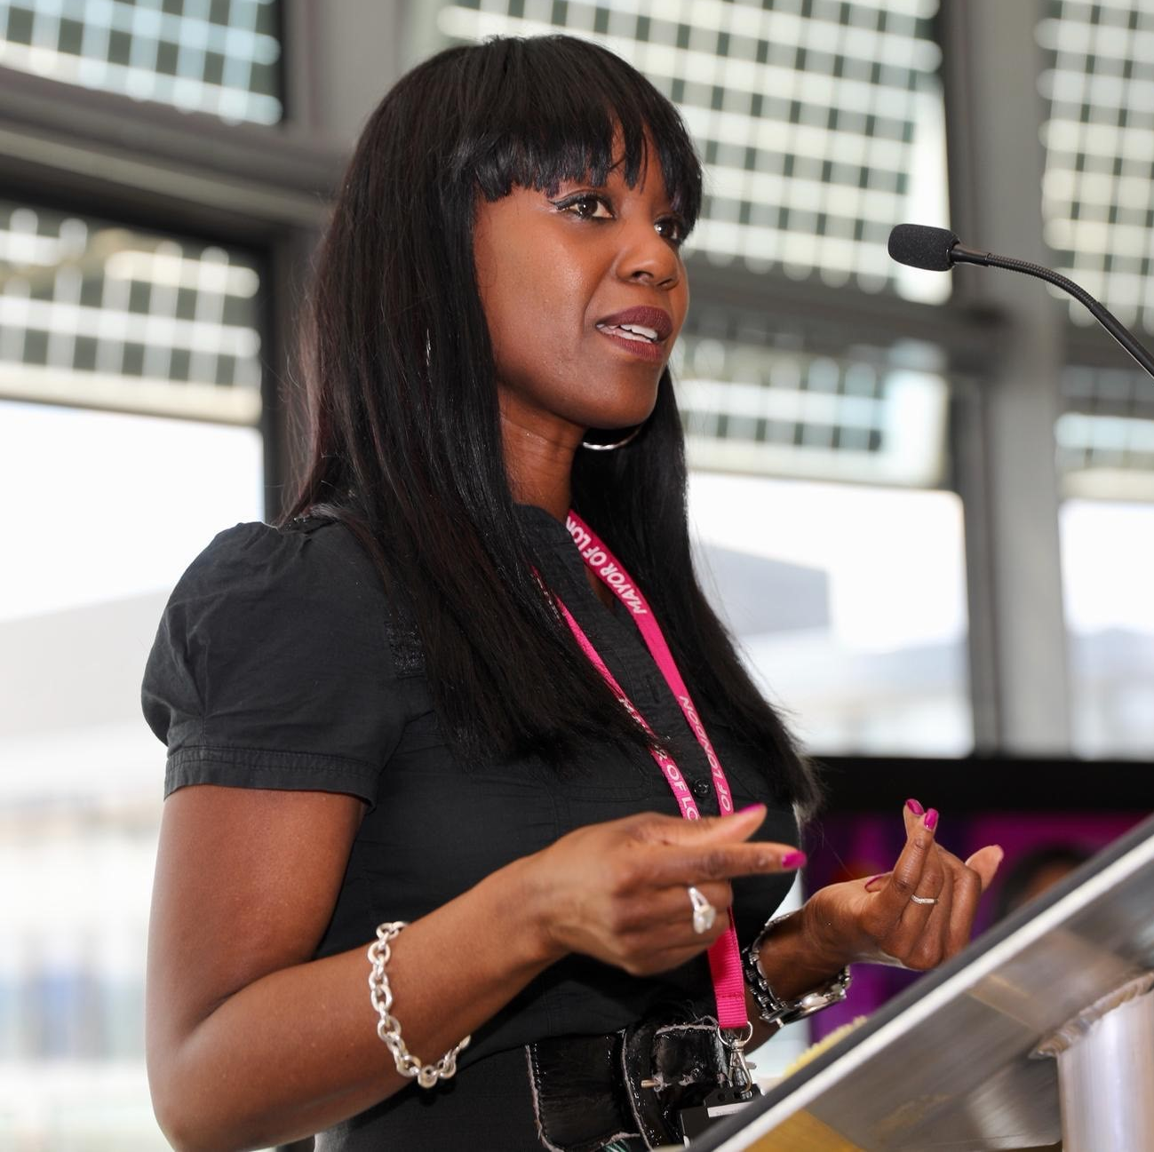
ACTIVITY
Who are they?

Slide 20
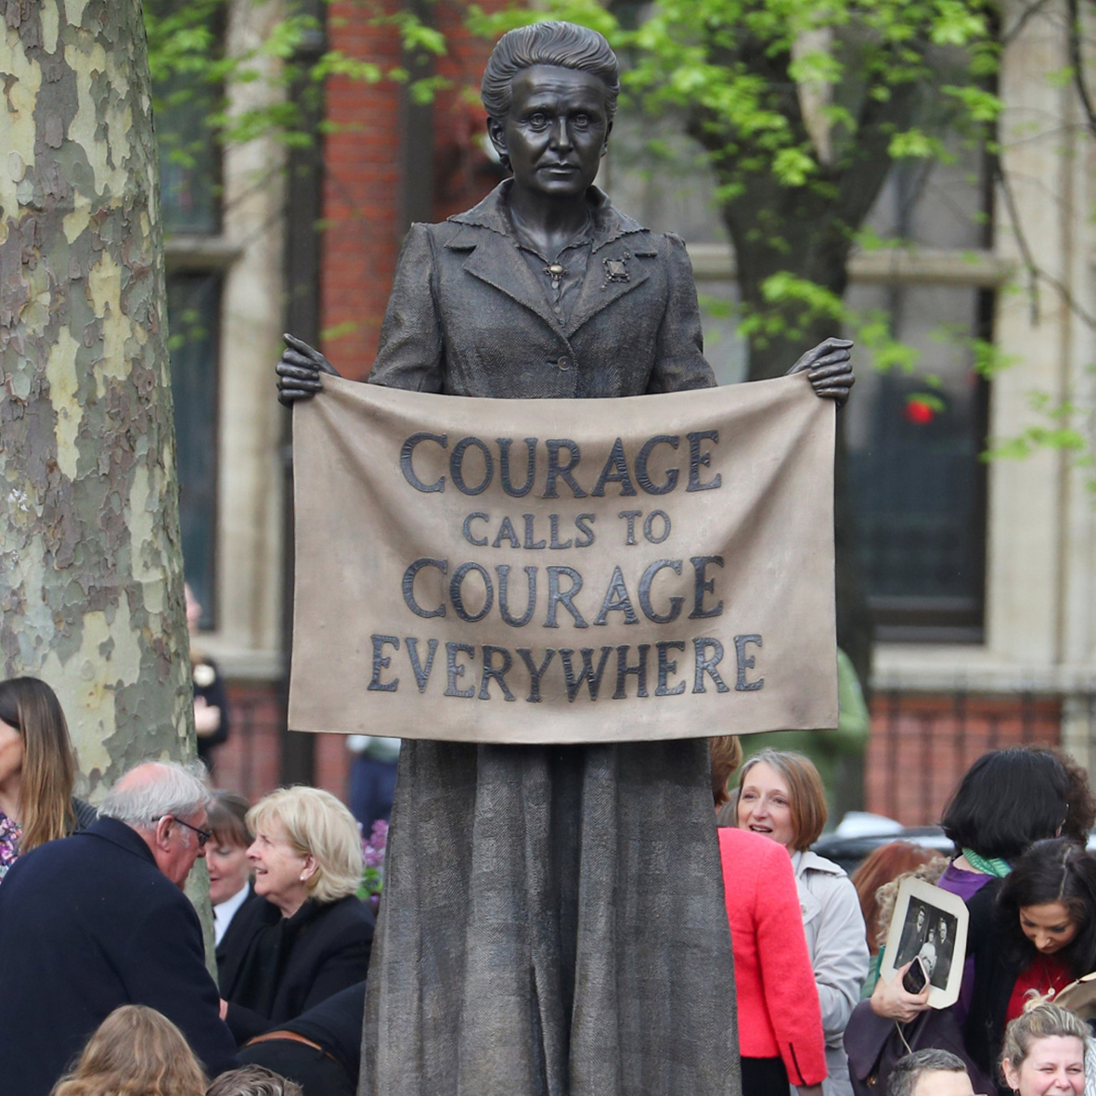
Improving representation
in London
One way to tackle gender inequality is
through representation. On 24th April 2018,
the first female statue was unveiled in Parliament Square – that of suffragist leader Millicent Fawcett.
Millicent Garrett Fawcett (1847 –1929) was a leading suffragist and campaigner for equal rights for women. She led the biggest suffrage organisation, the non-violent (NUWSS) from 1890 –1919 and played a key role in gaining some women the right to vote.

Slide 21
Discuss
Do you think Parliament should be 50:50 in order to tackle gender inequality?
Are you interested in working in politics?
Are you registered to vote? Why do you think it matters?
Do you know of any female politicians?
In the UK or elsewhere?

Slide 22
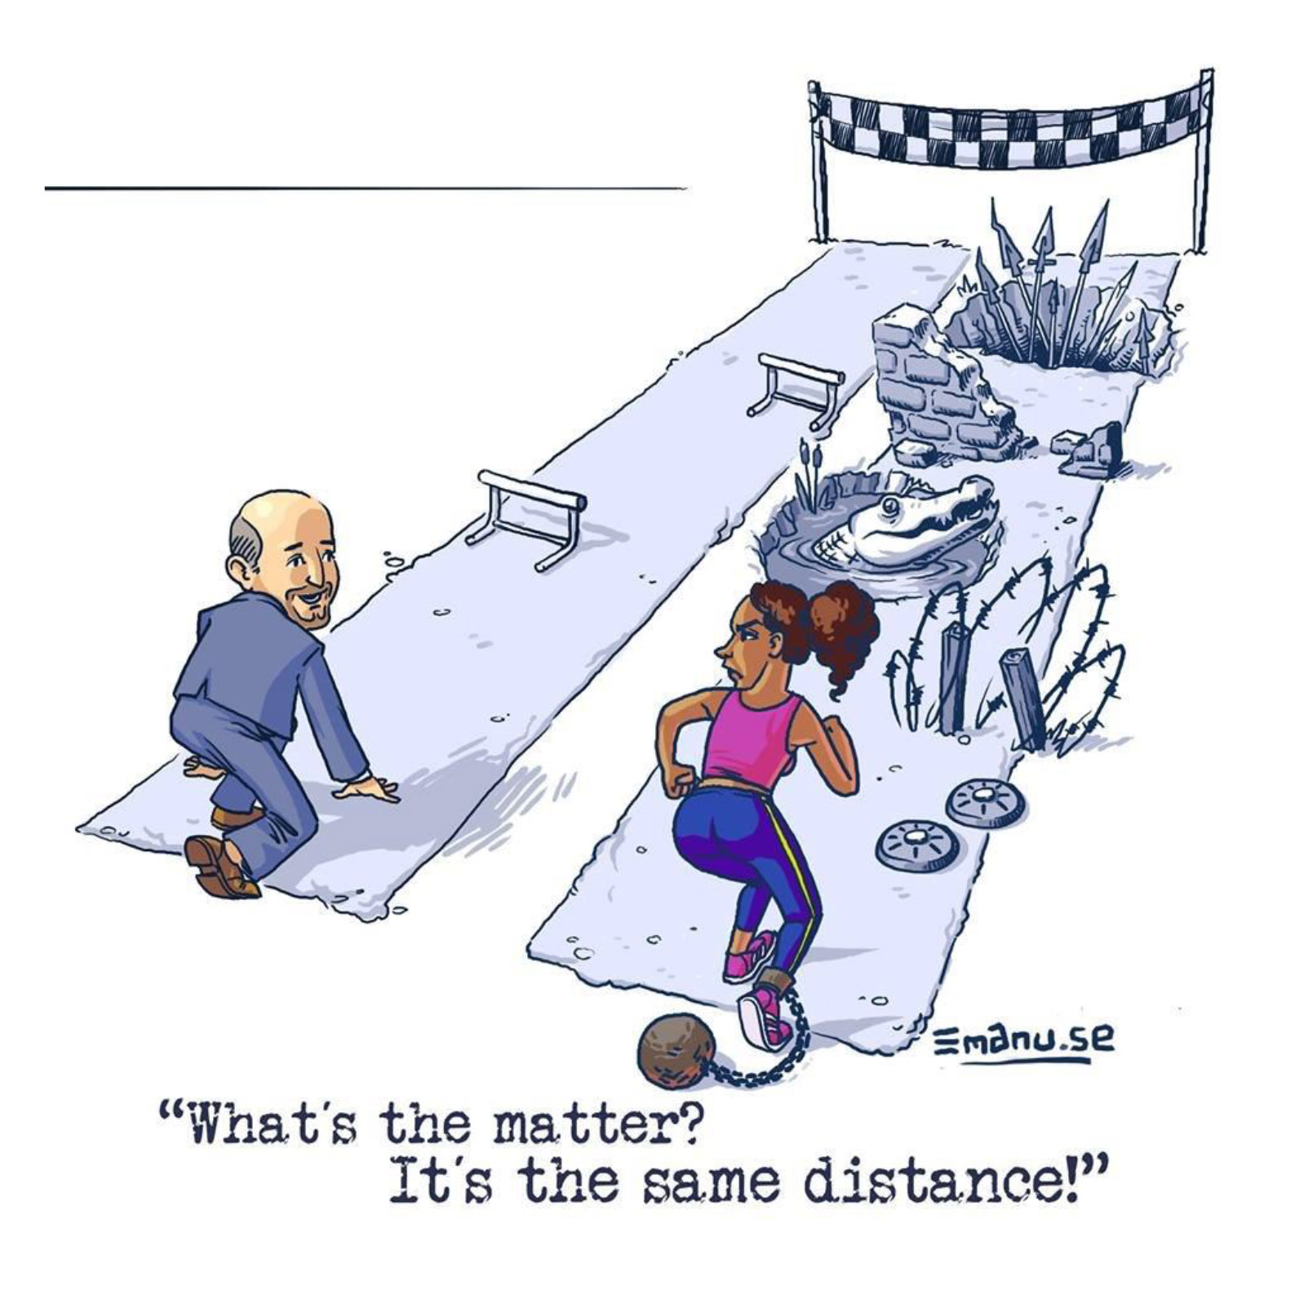
Structural inequality
Privilege is a right or advantage that some people might have by virtue of their place of birth, gender, ethnic or faith background, social class, physical or mental ability, sexual identity.
These privileges can then be reinforced by
individuals, institutions or structures of power,
like the state. Acknowledging someone starts
from a position of privilege or is advantaged
through life is the starting point to ensure
equality, inclusion and representation and to
address prejudice and discrimination.

Slide 23
ACTIVITY
Play the ‘Privilege’ Game

Slide 24
Thank you
For more information contact the
GLA Social Integration Team
SocialIntergrationPSO@london.gov.uk
london.gov.uk

