Slide 1



No Vote, No Voice!
Democracy doesn’t end at the ballot box, it starts there.
Funded by the Greater London Authority, City Hall, Kamal Churchie Way, London, E16 1ZE

Slide 2
In this session we will explore the following questions:
What are your civic rights?
What are your democratic rights?
How can you register to vote? And what does voting look like?
How can you follow, write or talk to the person who is voted in (elected representative)?

Slide 3
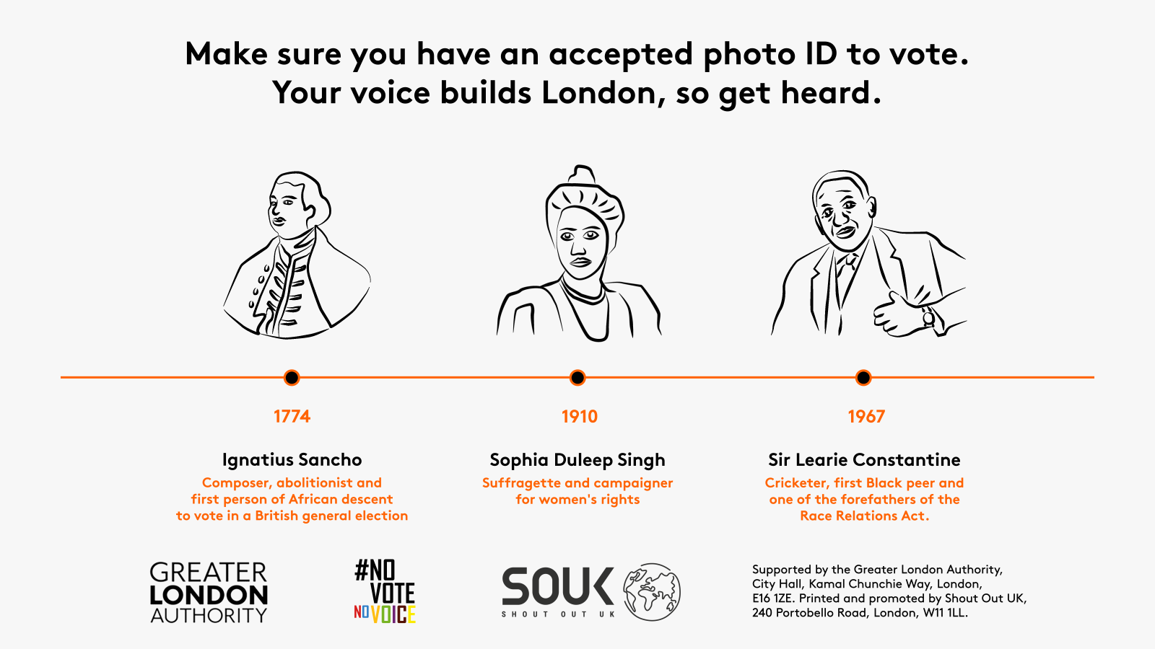
Why is it important to know your rights? How have rights changed?

Slide 4
Let’s look at some rights!
Put your hand up if you, or someone you know, has used this right…

Slide 5


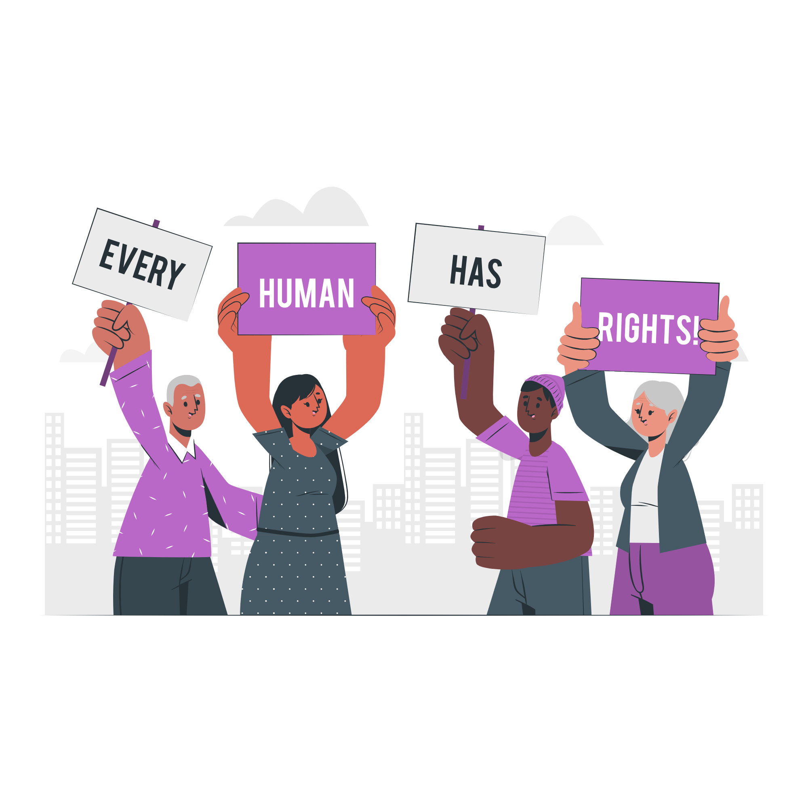
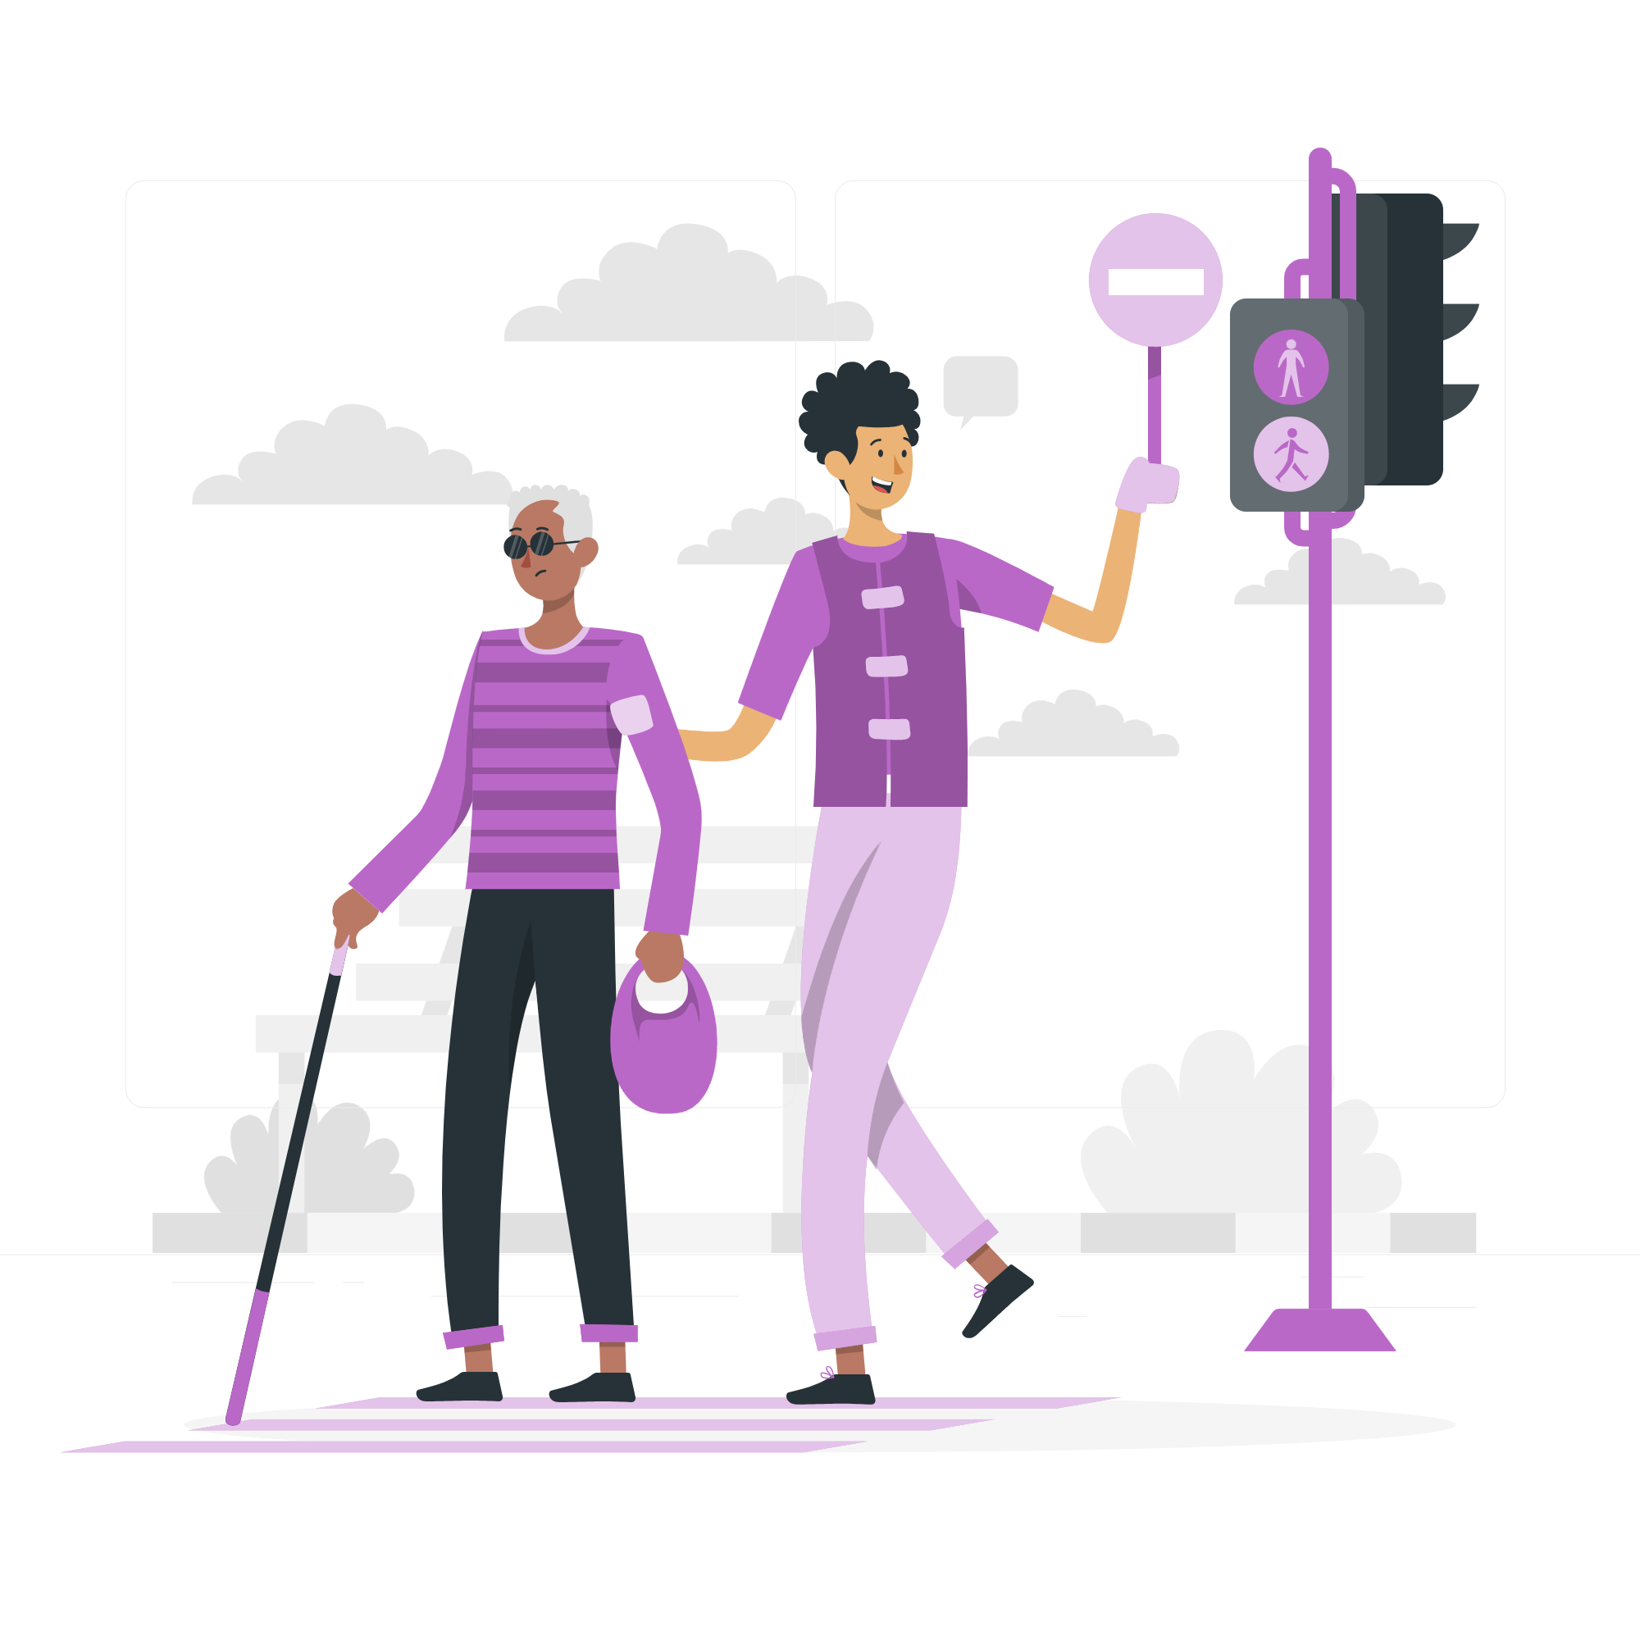
These are part of our Civic Rights:
Starting or signing petitions
Community organising
Taking part in peaceful, legal protest
Volunteering

Slide 6



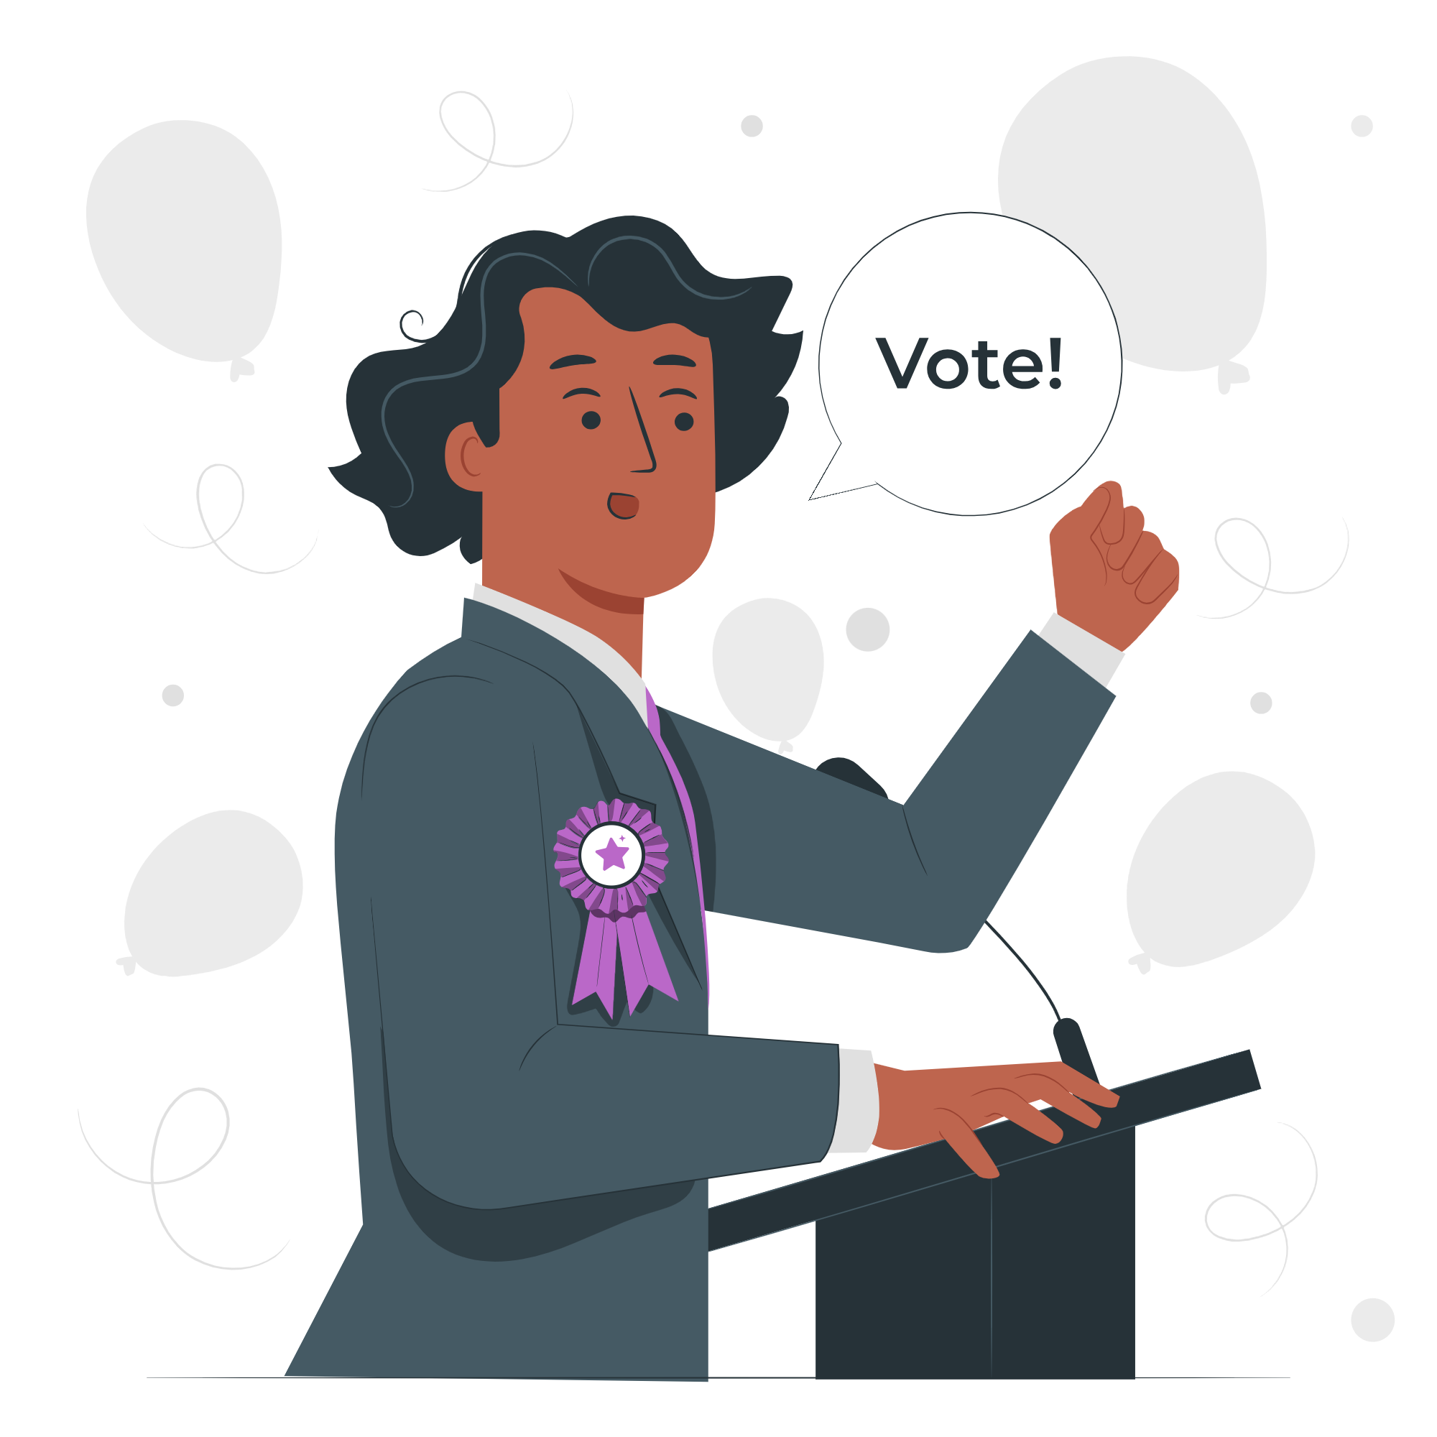
These are part of our Democratic Rights:
Registering to vote
Taking part in citizens’ assemblies
Voting in elections
Standing for election

Slide 7

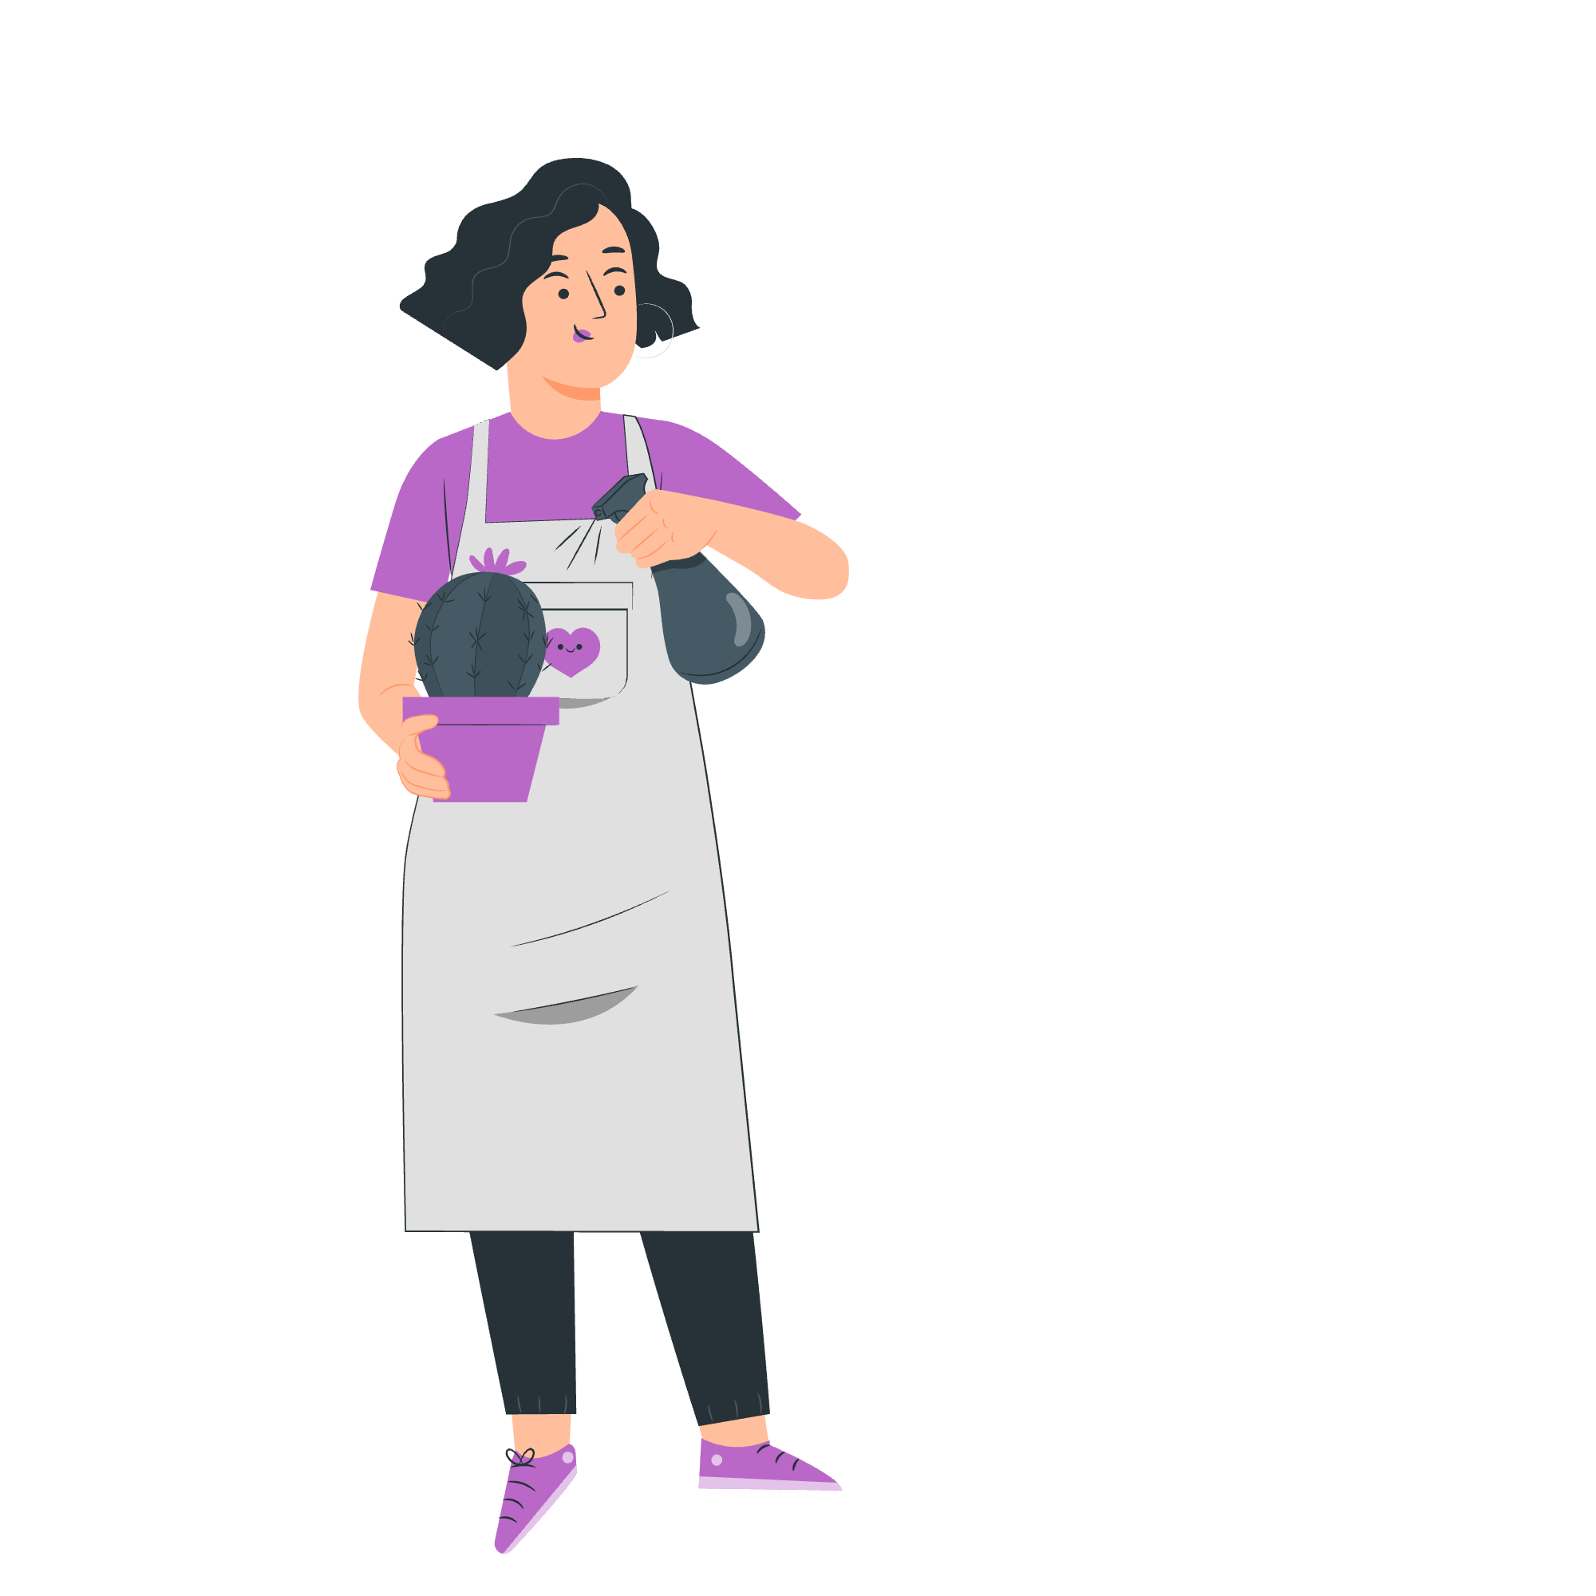
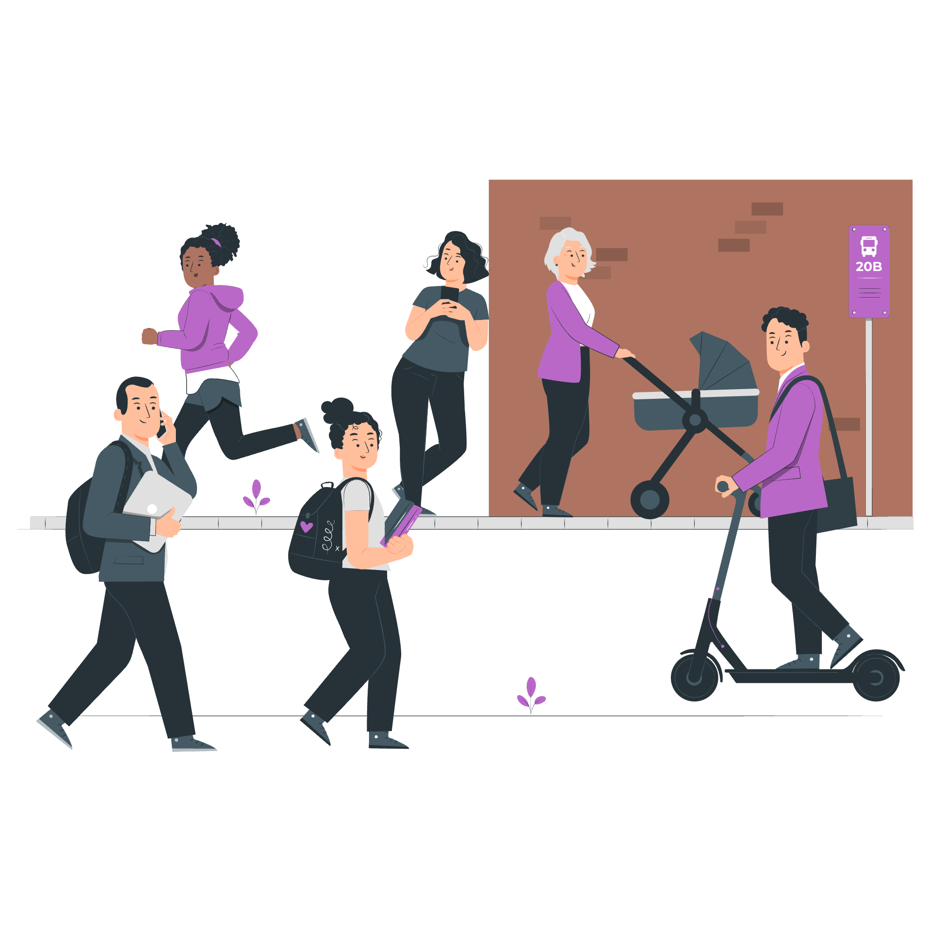
Why do people use their democratic and civic rights?
To gain knowledge and skills
To make a difference
To build stronger communities

Slide 8
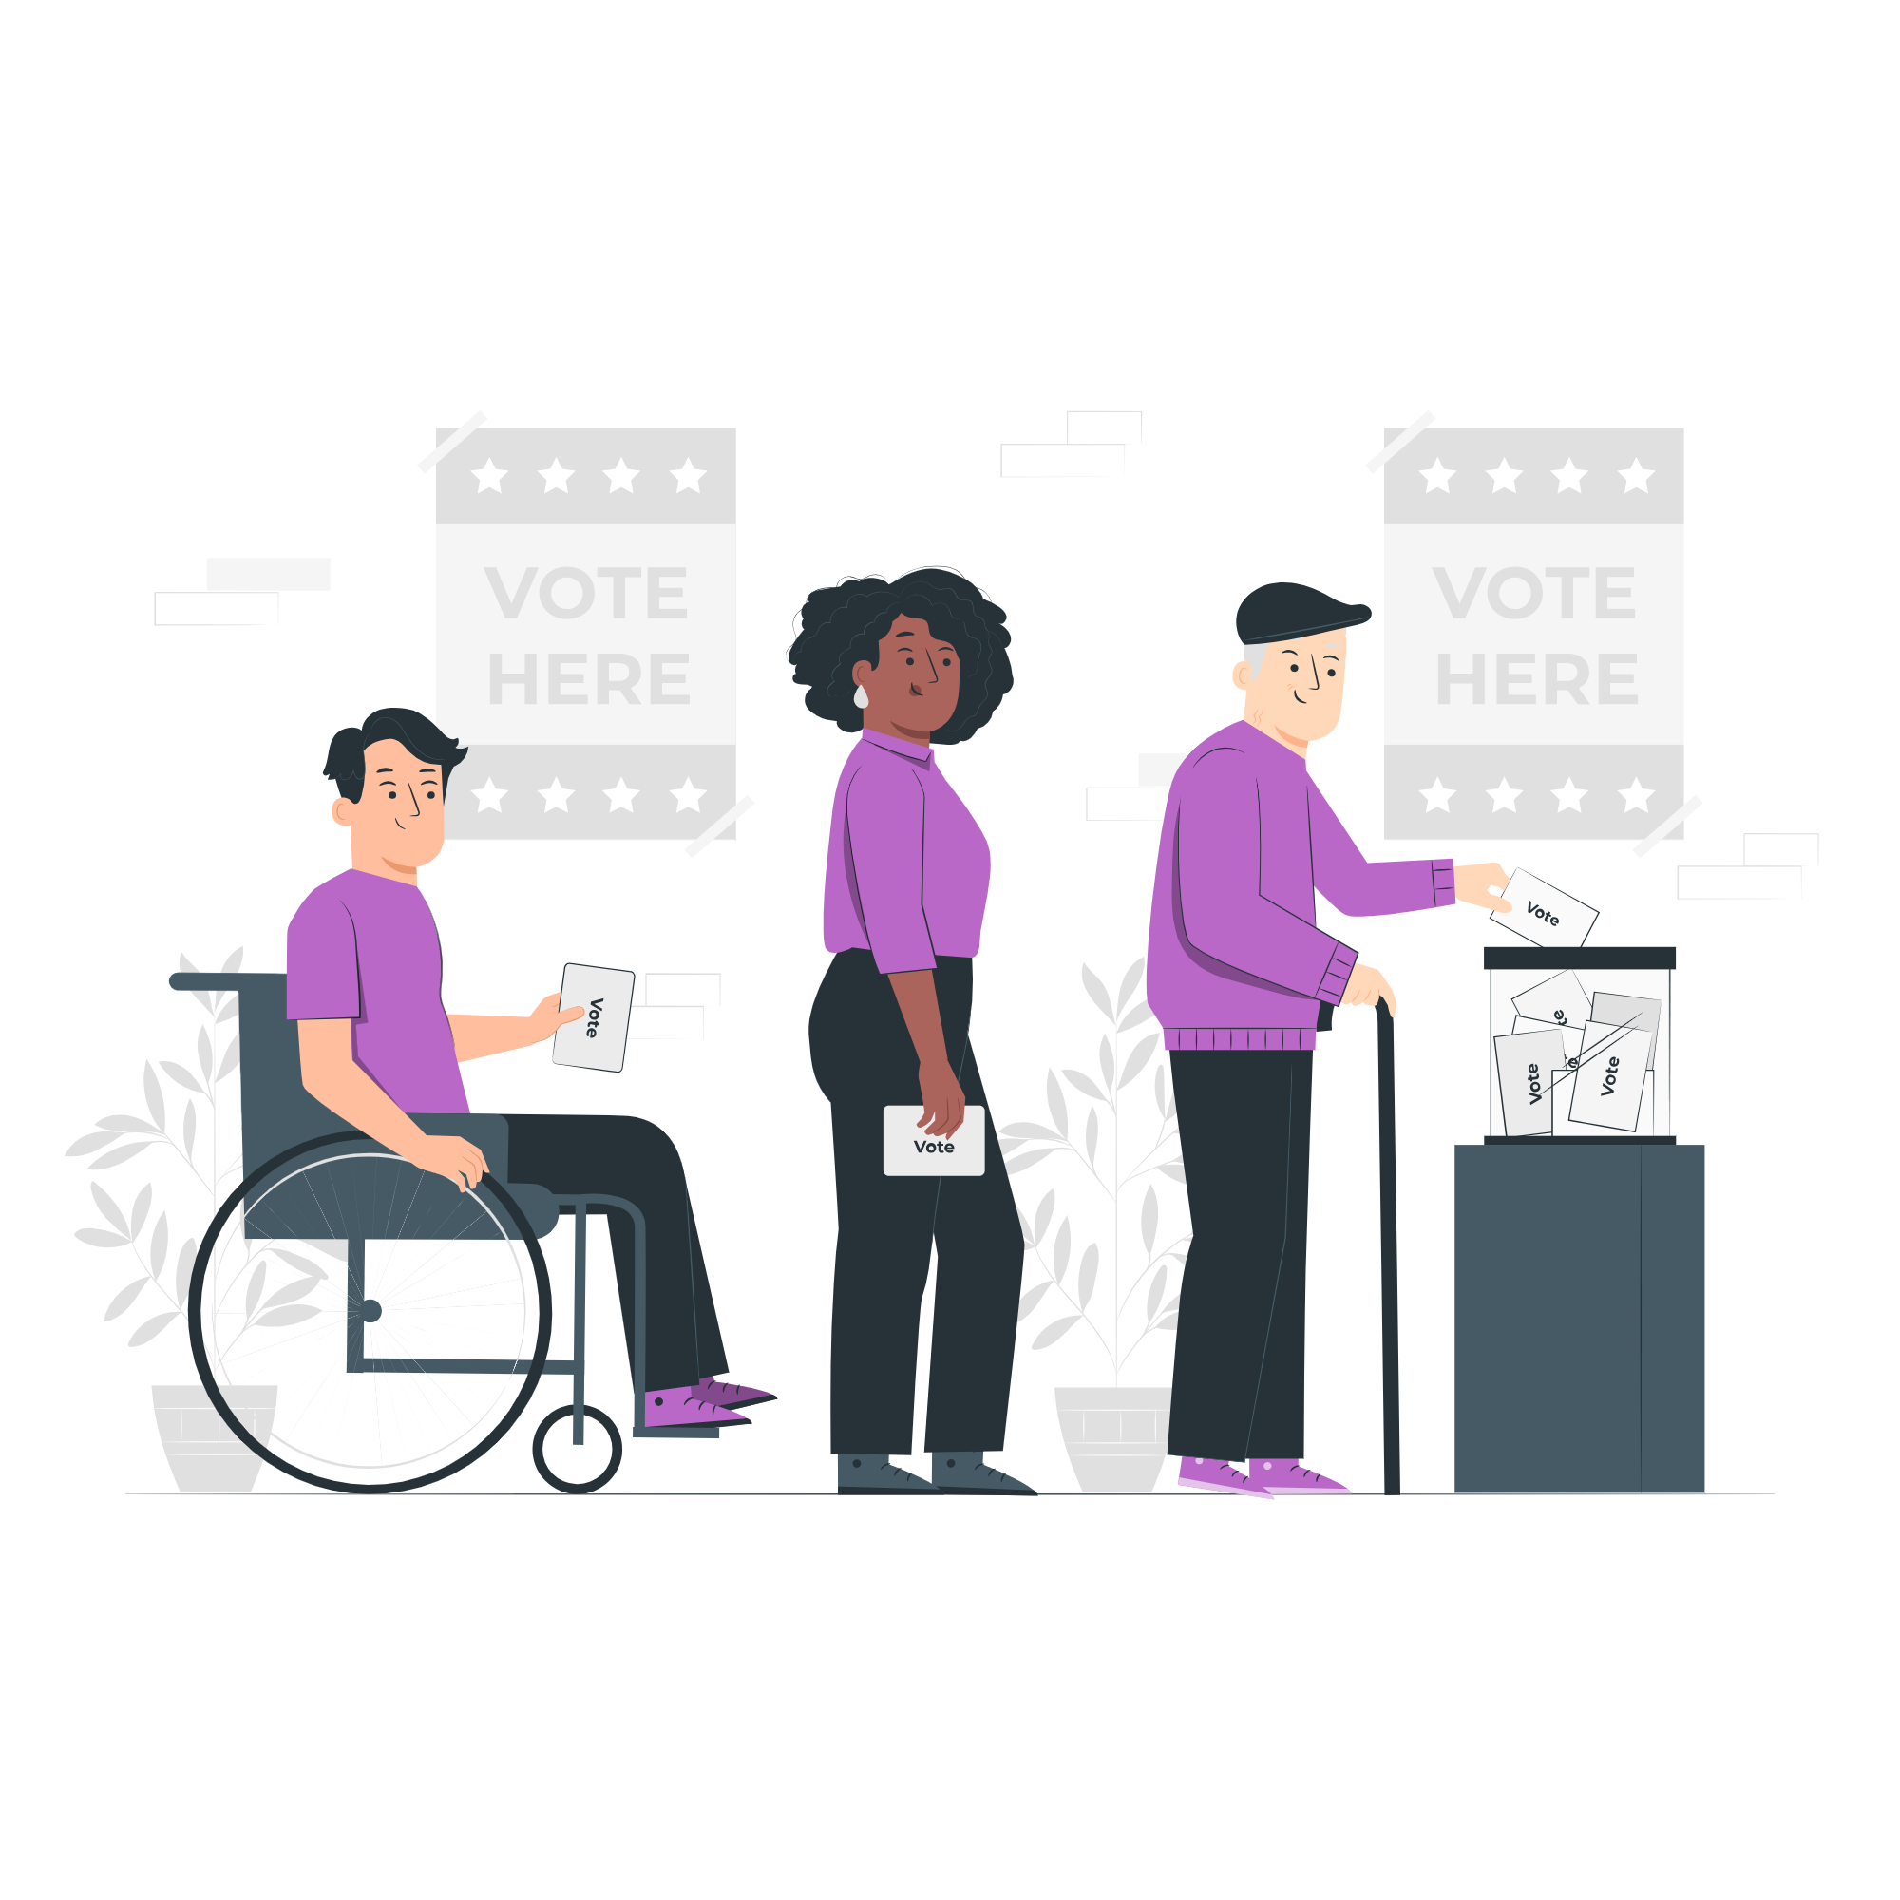
Let’s zoom in on voting:
What do you know about voting?

Slide 9
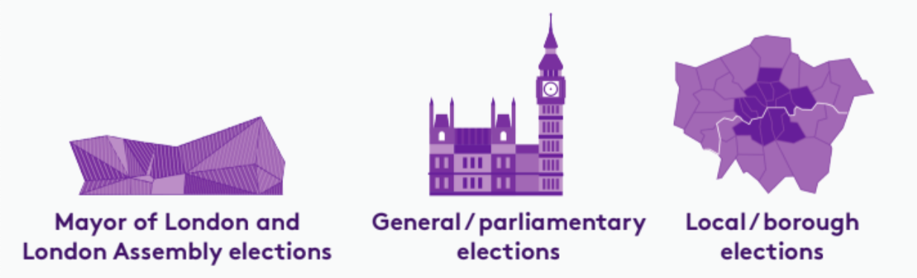
Who do you vote for?
There are three types of election in London:

Slide 10
Which London residents are eligible to vote in these elections?
 | Mayor of London and London Assembly | General / parliamentary | Local / borough
Must be at least 18 years of age | ✅ | ✅ | ✅
British or Irish citizens | ✅ | ✅ | ✅
Qualifying Commonwealth citizens | ✅ | ✅ | ✅
Qualifying EU citizens or EU citizens with retained rights | ✅ | ❌ | ✅
For further information on eligibility, head to electoralcommission.org.uk

Slide 11

How can you have your voice heard in the voting system?
1
To register to vote, head to gov.uk/register-to-vote
Notes:
Please note that a young person’s Oyster or student ID are NOT accepted forms of ID to vote in person.

Slide 12


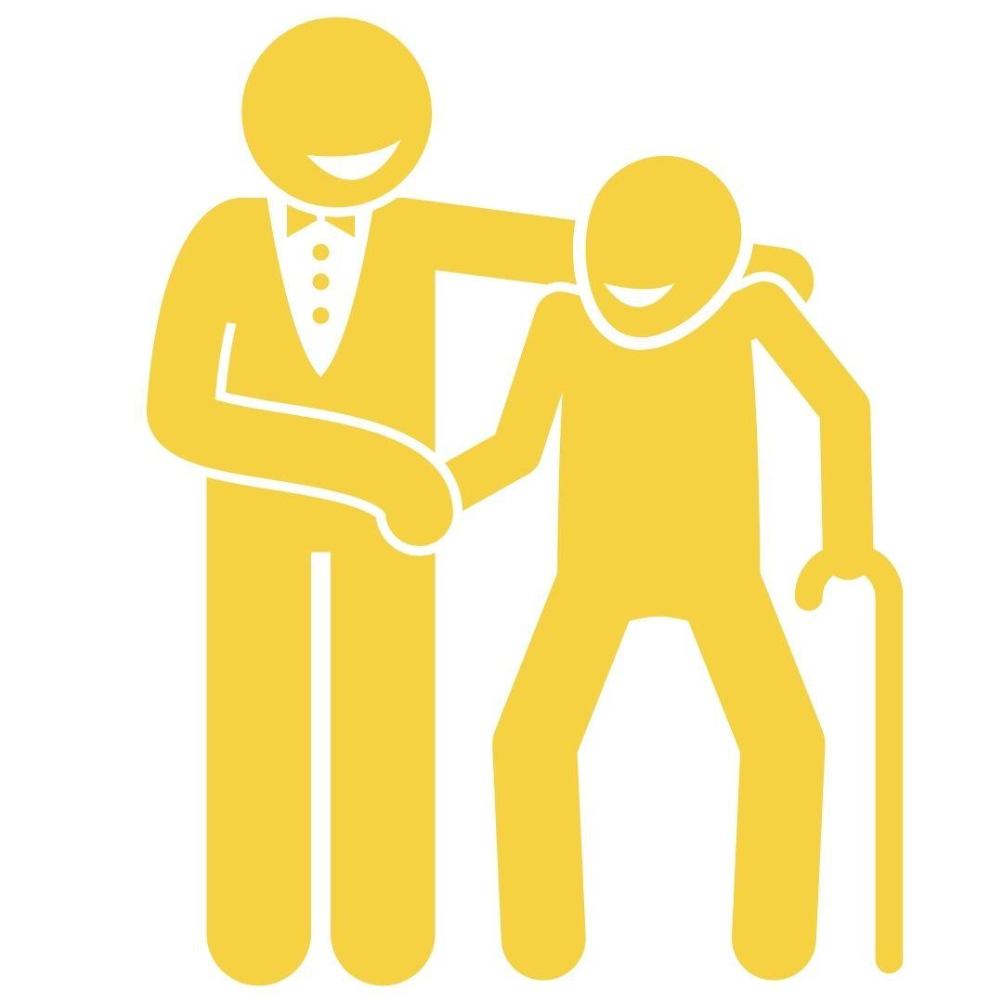
How can you have your voice heard in the voting system?
2
You can vote in:
In person
By post
By proxy
This means that on election (voting) day you go to your local polling station, show your photo Voter ID and cast your vote.
This means that before election (voting) day you are sent papers for you to vote at home. To vote, you must follow the instructions and post your vote before the deadline.
This means that before election (voting) day you have chosen someone to vote in person instead of you. You trust this individual to vote for the person you wish.
Notes:
Please note that a young person’s Oyster or student ID are NOT accepted forms of ID to vote in person.

Slide 13
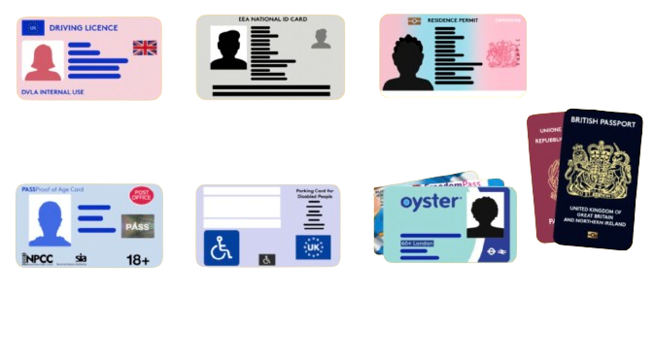
How can you have your voice heard in the voting system?
3
You need an accepted form of ID to vote in person
These include, but are not limited to:
UK, Channel Islands or EEA driving licence
UK, commonwealth
or EEA passport
Blue Badge scheme card
Notes:
Please note that a young person’s Oyster or student ID are NOT accepted forms of ID to vote in person.

Slide 14
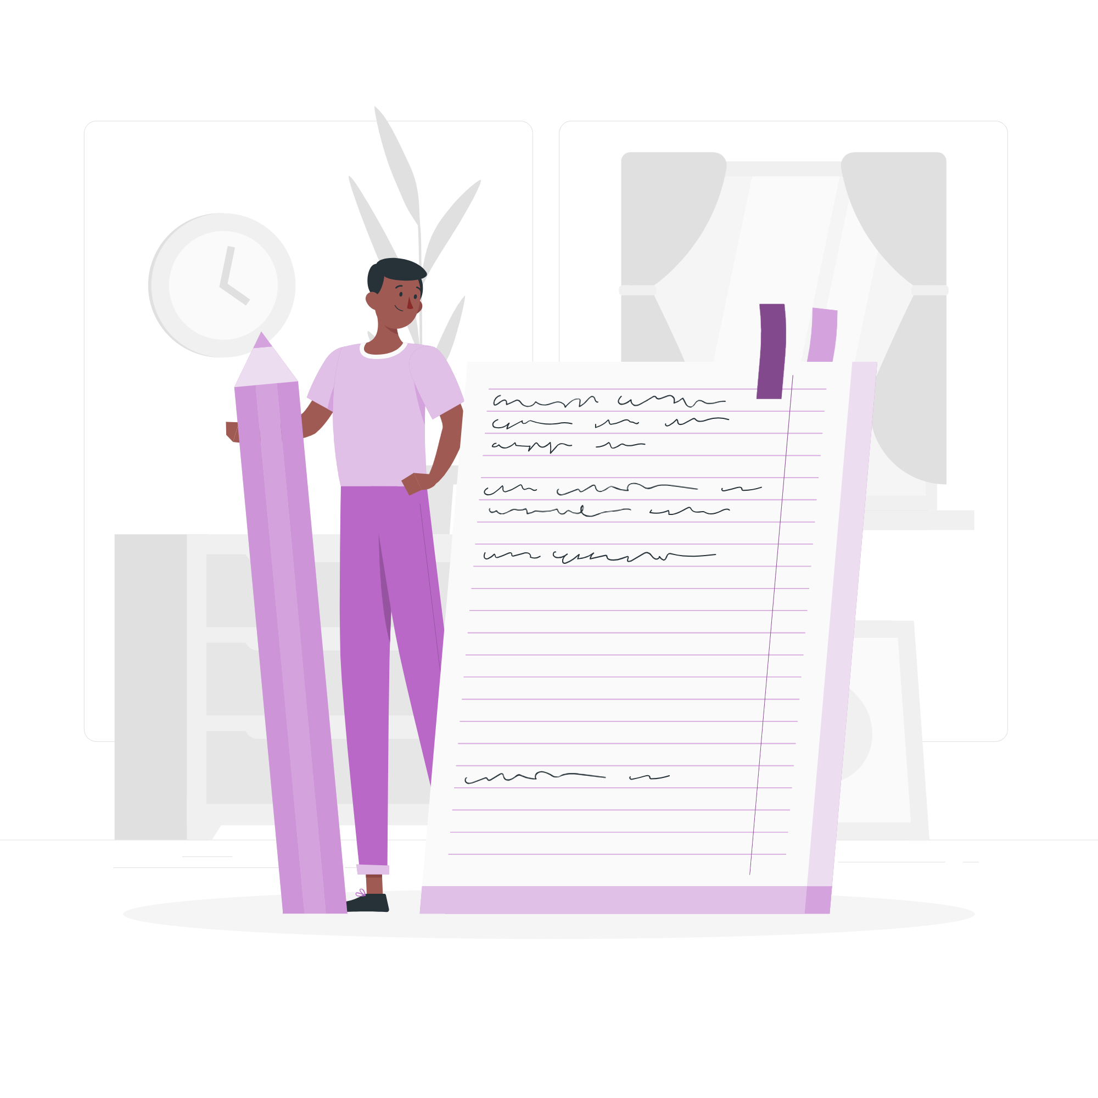


How can you follow, talk or meet the people you vote for
(elected representative)?
Follow what they say and how they vote!
Write to them!
Talking to them!
This link shows you what is said/voted for: Hansard
This link shows you how: WriteToThem
Some representatives have days and times you can visit!
Notes:
Important to note that whether you are eligible to vote or not, you can participate in these ways of engagement.

Slide 15
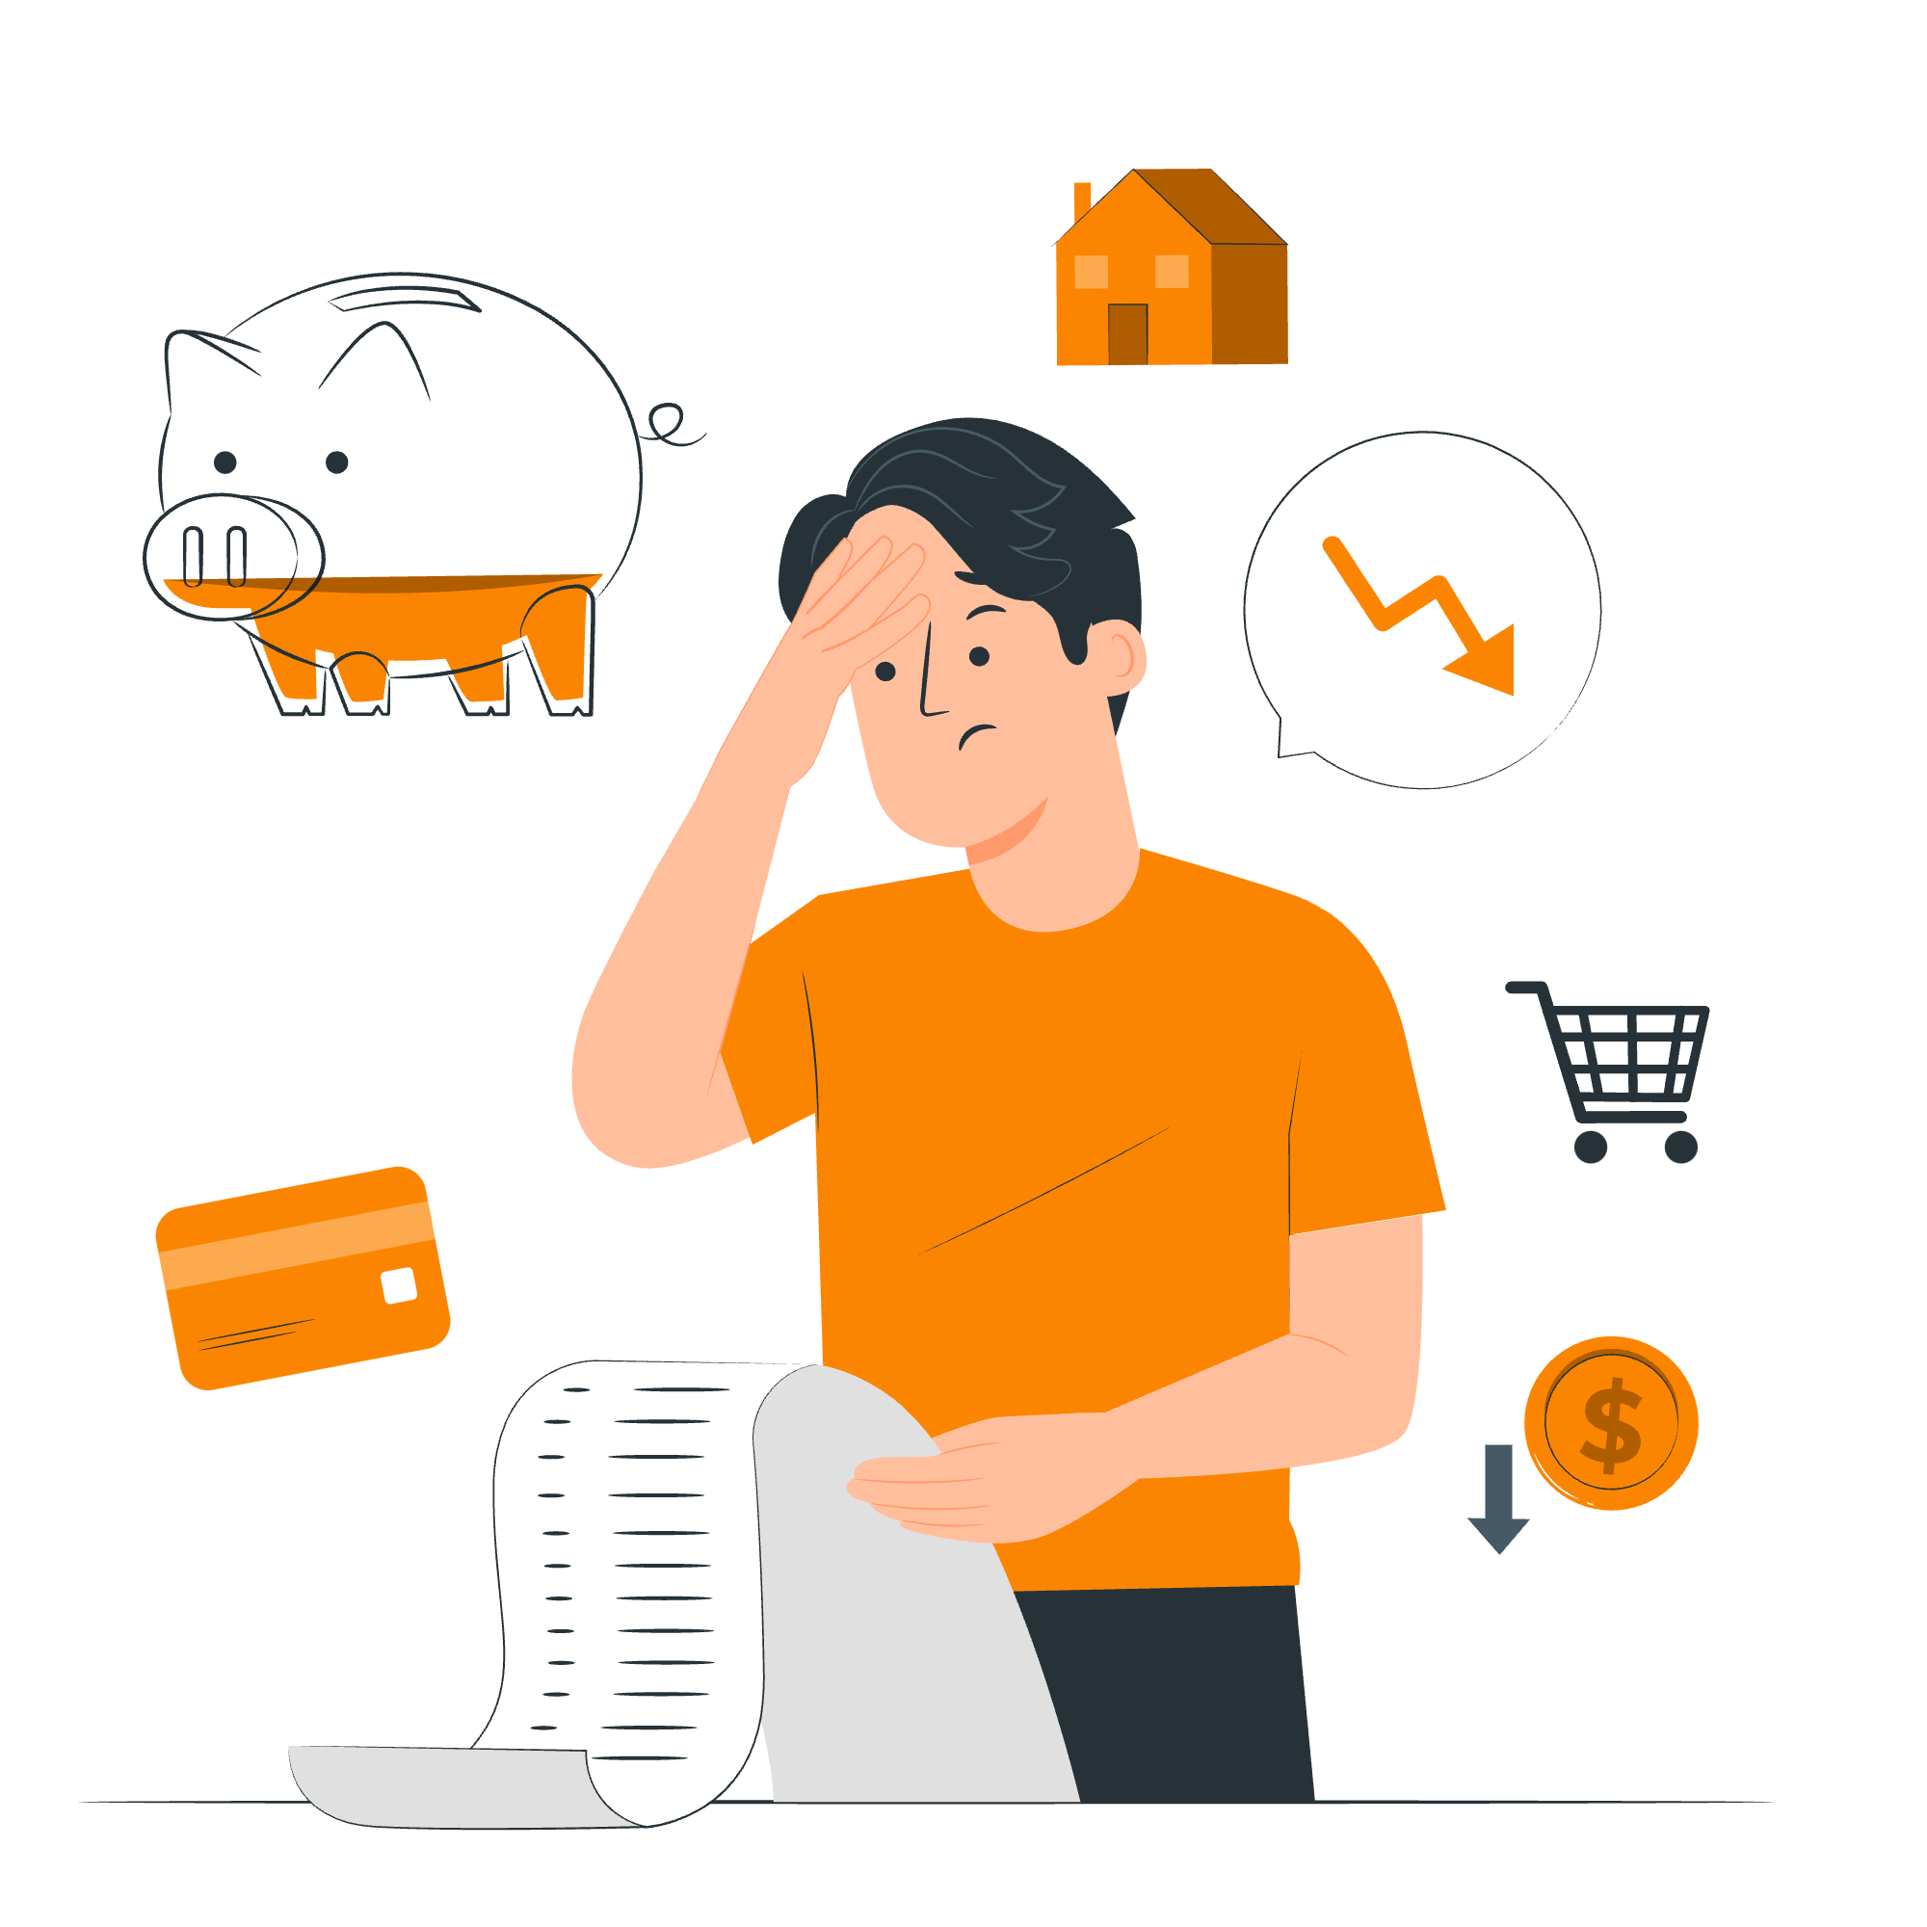


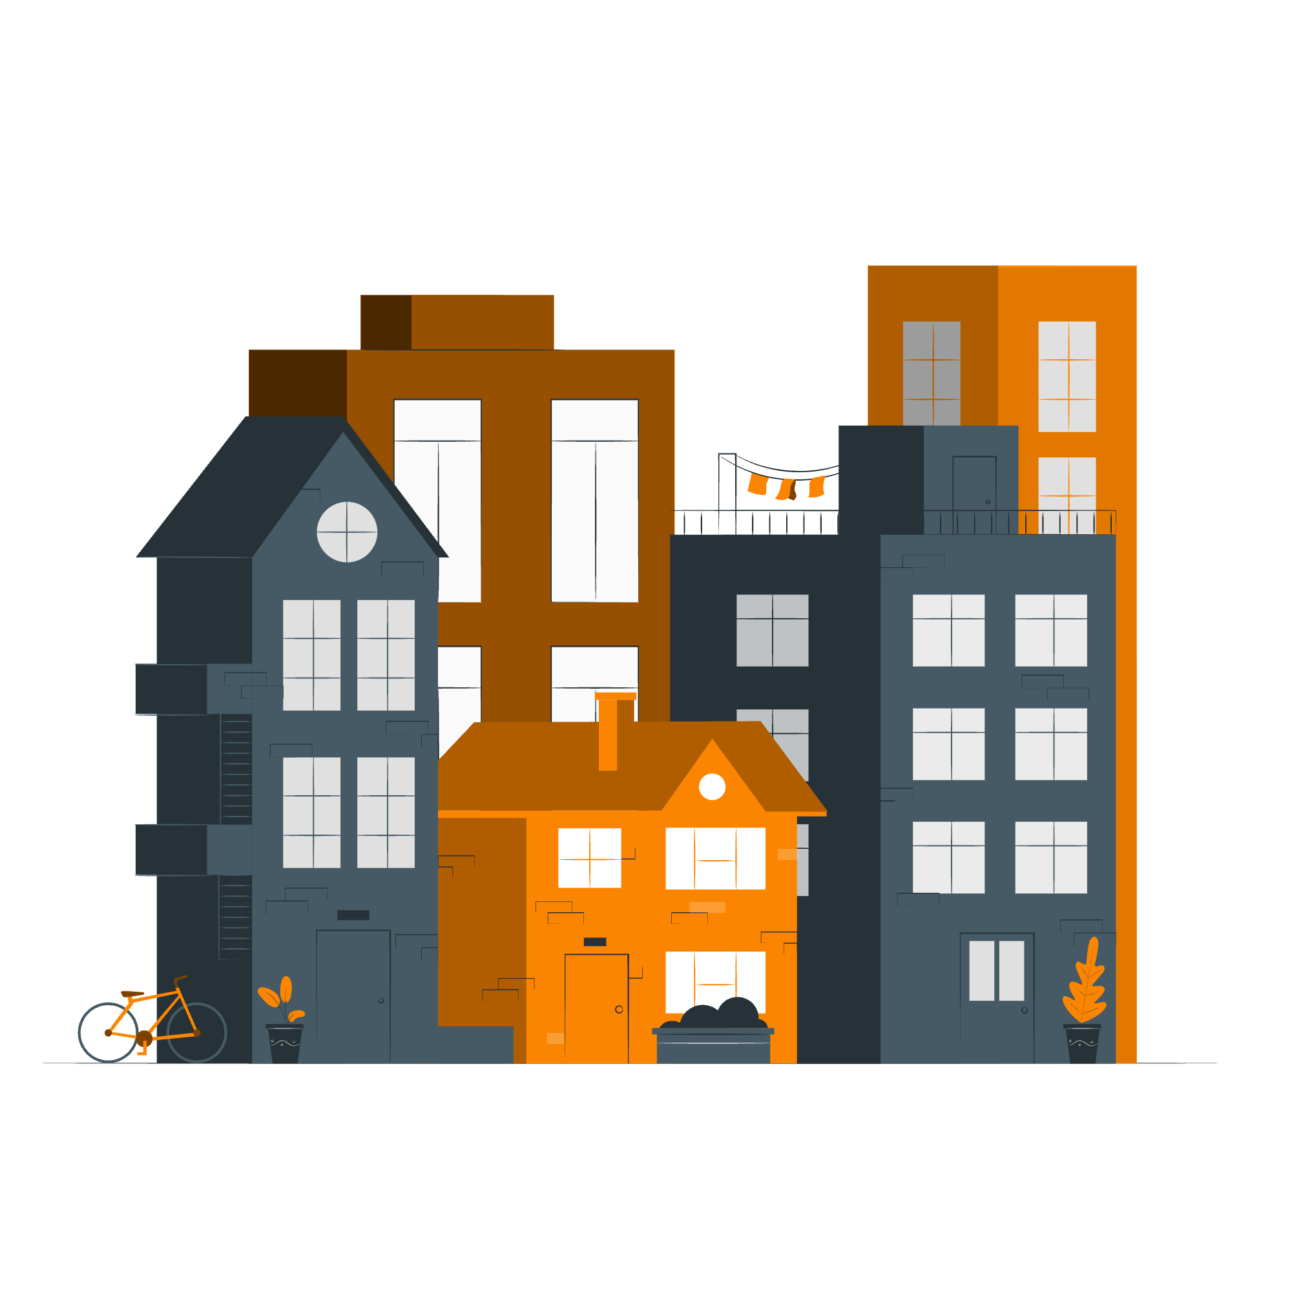
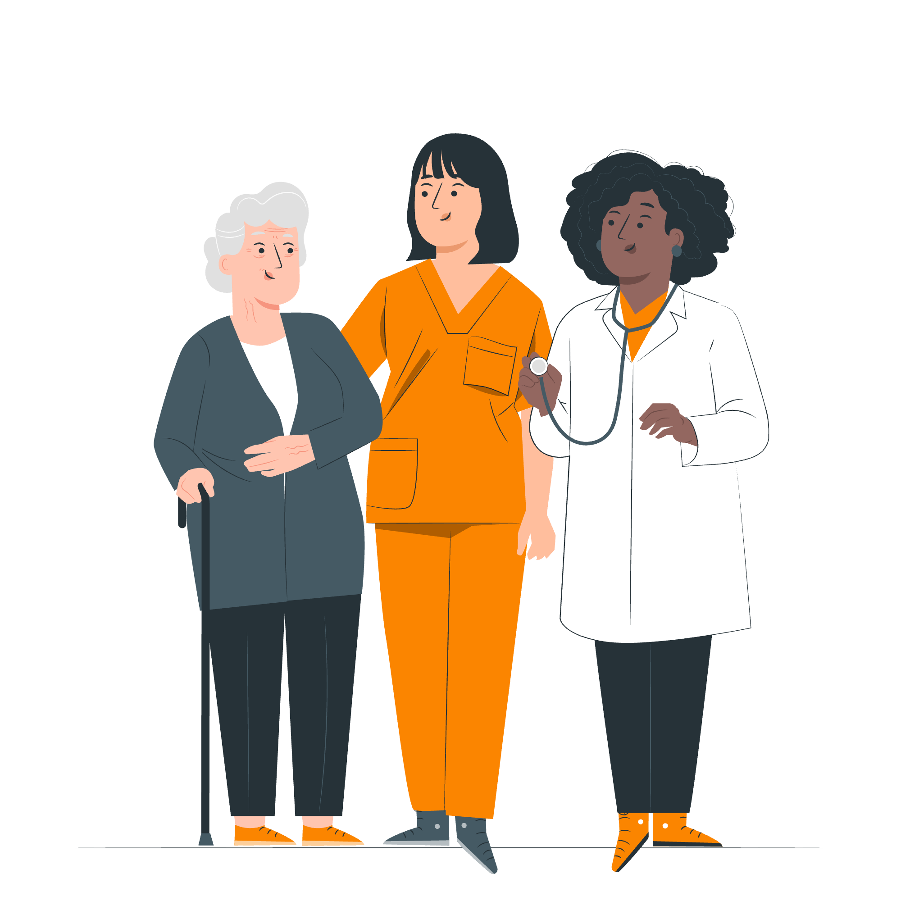
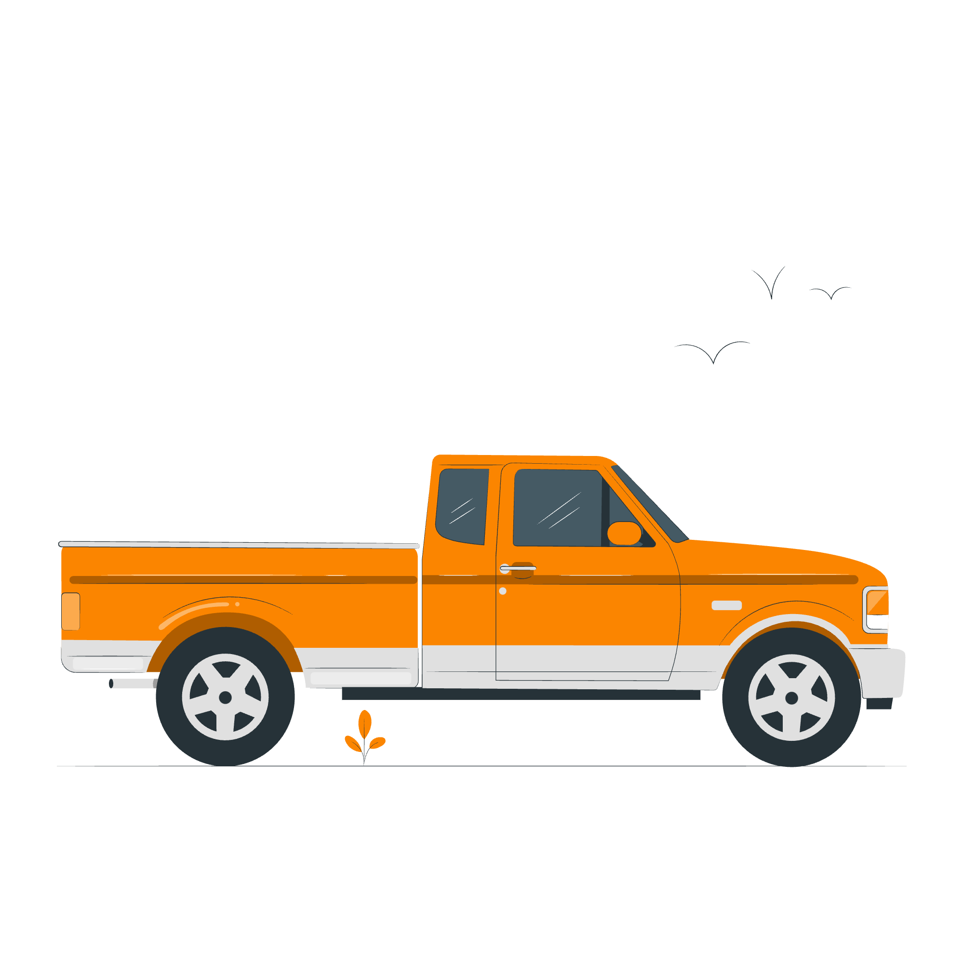
The environment
The economy
Education
What issues do you think are most important?
Healthcare
Transport
Housing

Slide 16
1. Decide an issue you want to write to your representative about.
Dear [representative name],
I am writing to you today to express my [concern/ support] for [explain issue].
The reason I believe this is because [explain your reasoning].
I urge you to [ask them to take a specific action].
Thank you for your time and consideration on this important matter.
Yours sincerely,
[Your name]
2. Find your representatives’ contact details: WriteToThem
3. Write to them about the issue that matters to you! You can use the writing frame to guide you.
4. Send your letter/ email!

Slide 17

Your voice matters, make sure it gets heard!
Check out the GLA democracy Hub registertovote.london to:
Find more information on your civic and democratic rights
Find comprehensive FAQs and WhatsApp chatbot (+44 7908820136)
Find information in different languages

Slide 18

Thank You!
For more information contact the
GLA Democratic Participation Team at: democracy@london.gov.uk
Funded by the Greater London Authority, City Hall, Kamal Churchie Way, London, E16 1ZE

