Slide 1
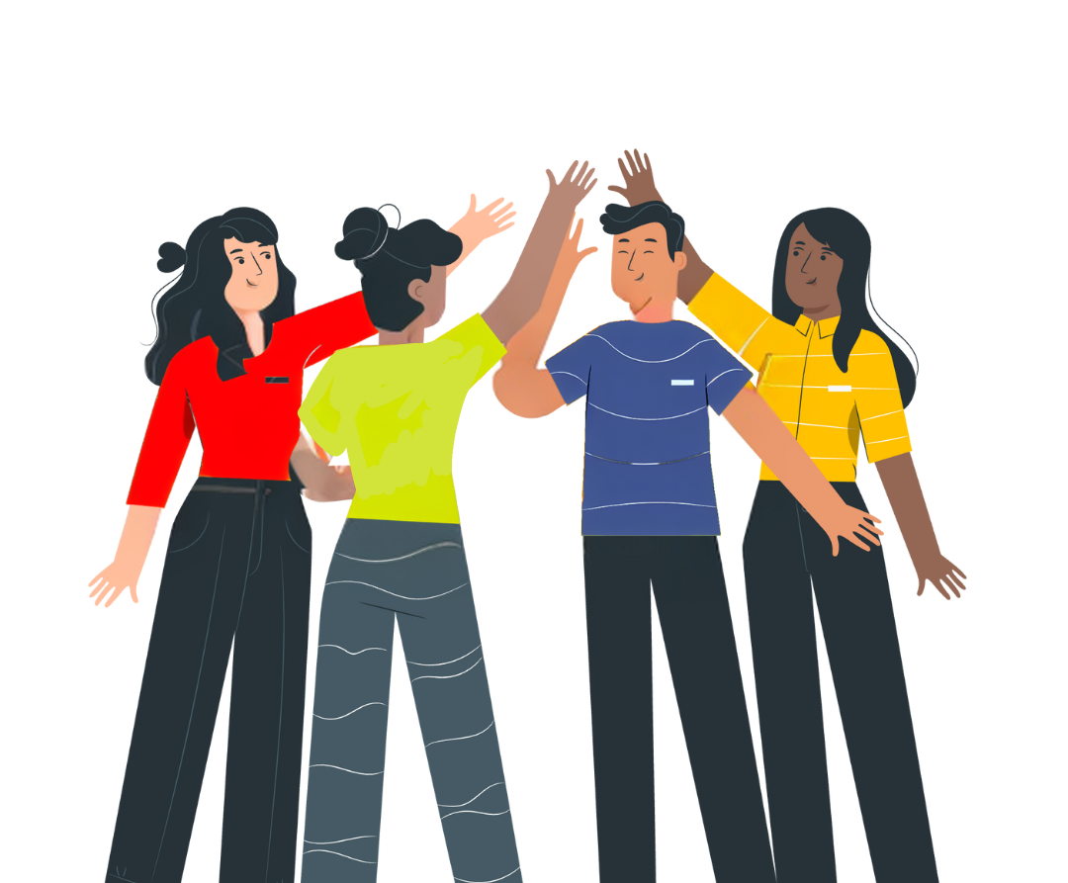


No Vote, No Voice!
Democracy doesn’t end at the ballot box, it starts there.
Funded by the Greater London Authority, City Hall, Kamal Churchie Way, London, E16 1ZE

Slide 2
In this session we will explore the following questions:
What are your civic rights?
What are your democratic rights?
How can you register to vote? And what does voting look like?
How can you follow, write or talk to the person who is voted in (elected representative)?

Slide 3
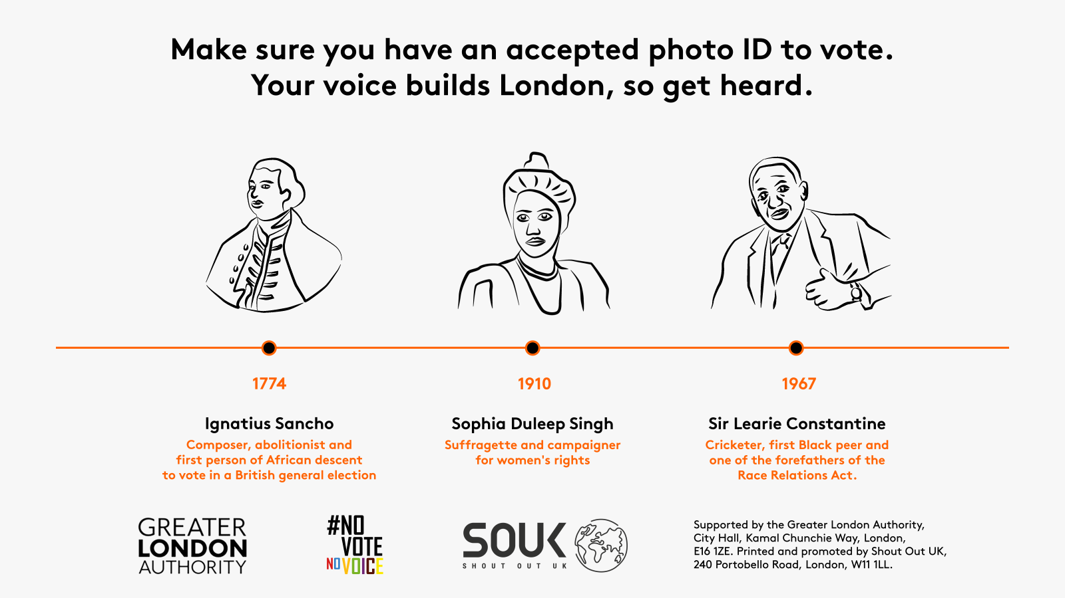
Why is it important to know your rights? How have rights changed?

Slide 4
Let’s look at some rights!
Put your hand up if you, or someone you know, has used this right…

Slide 5



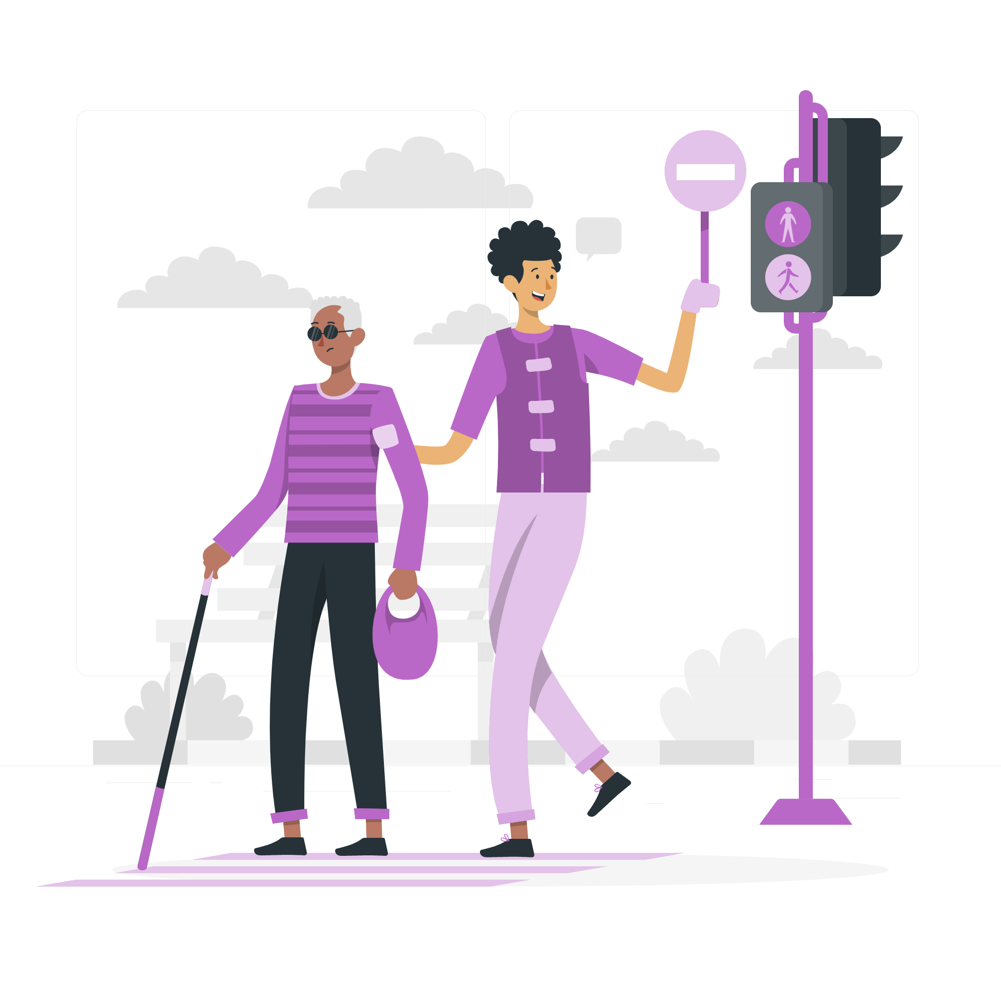
These are part of our Civic Rights:
Starting or signing petitions
Community organising
Taking part in peaceful, legal protest
Volunteering

Slide 6


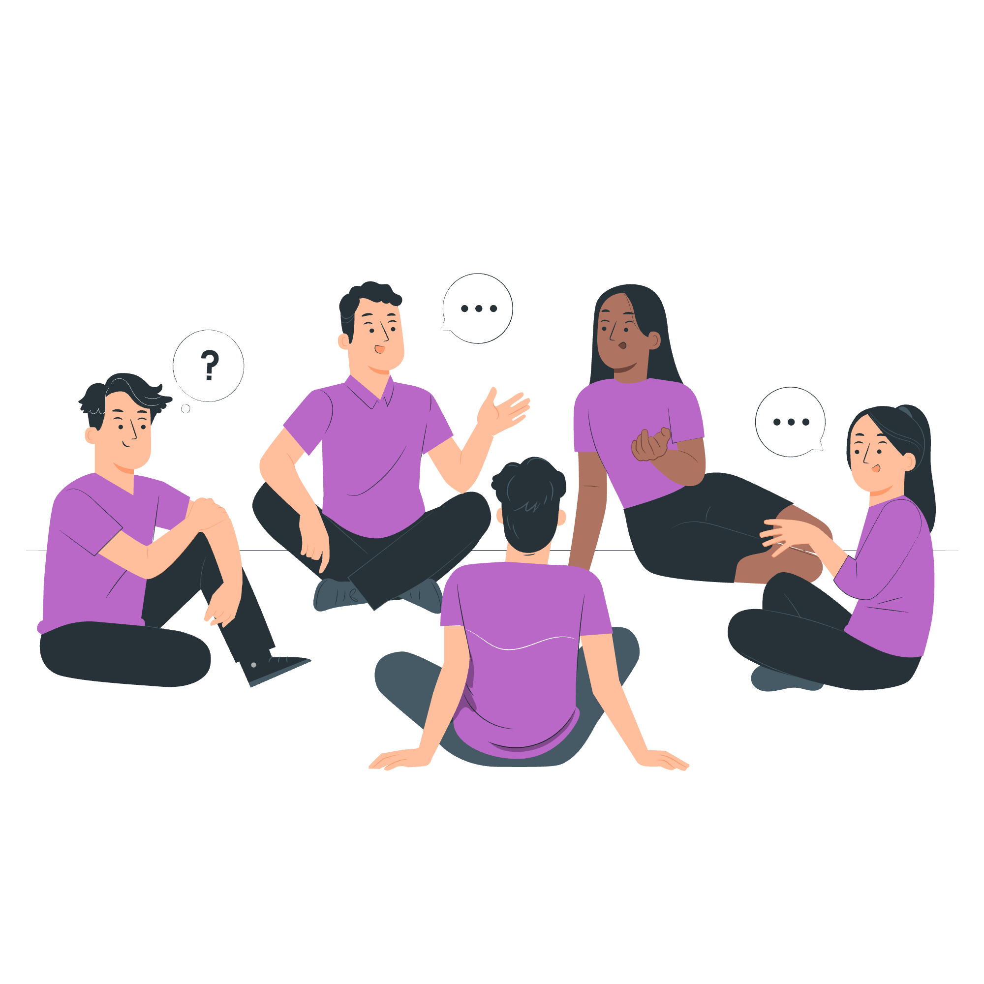
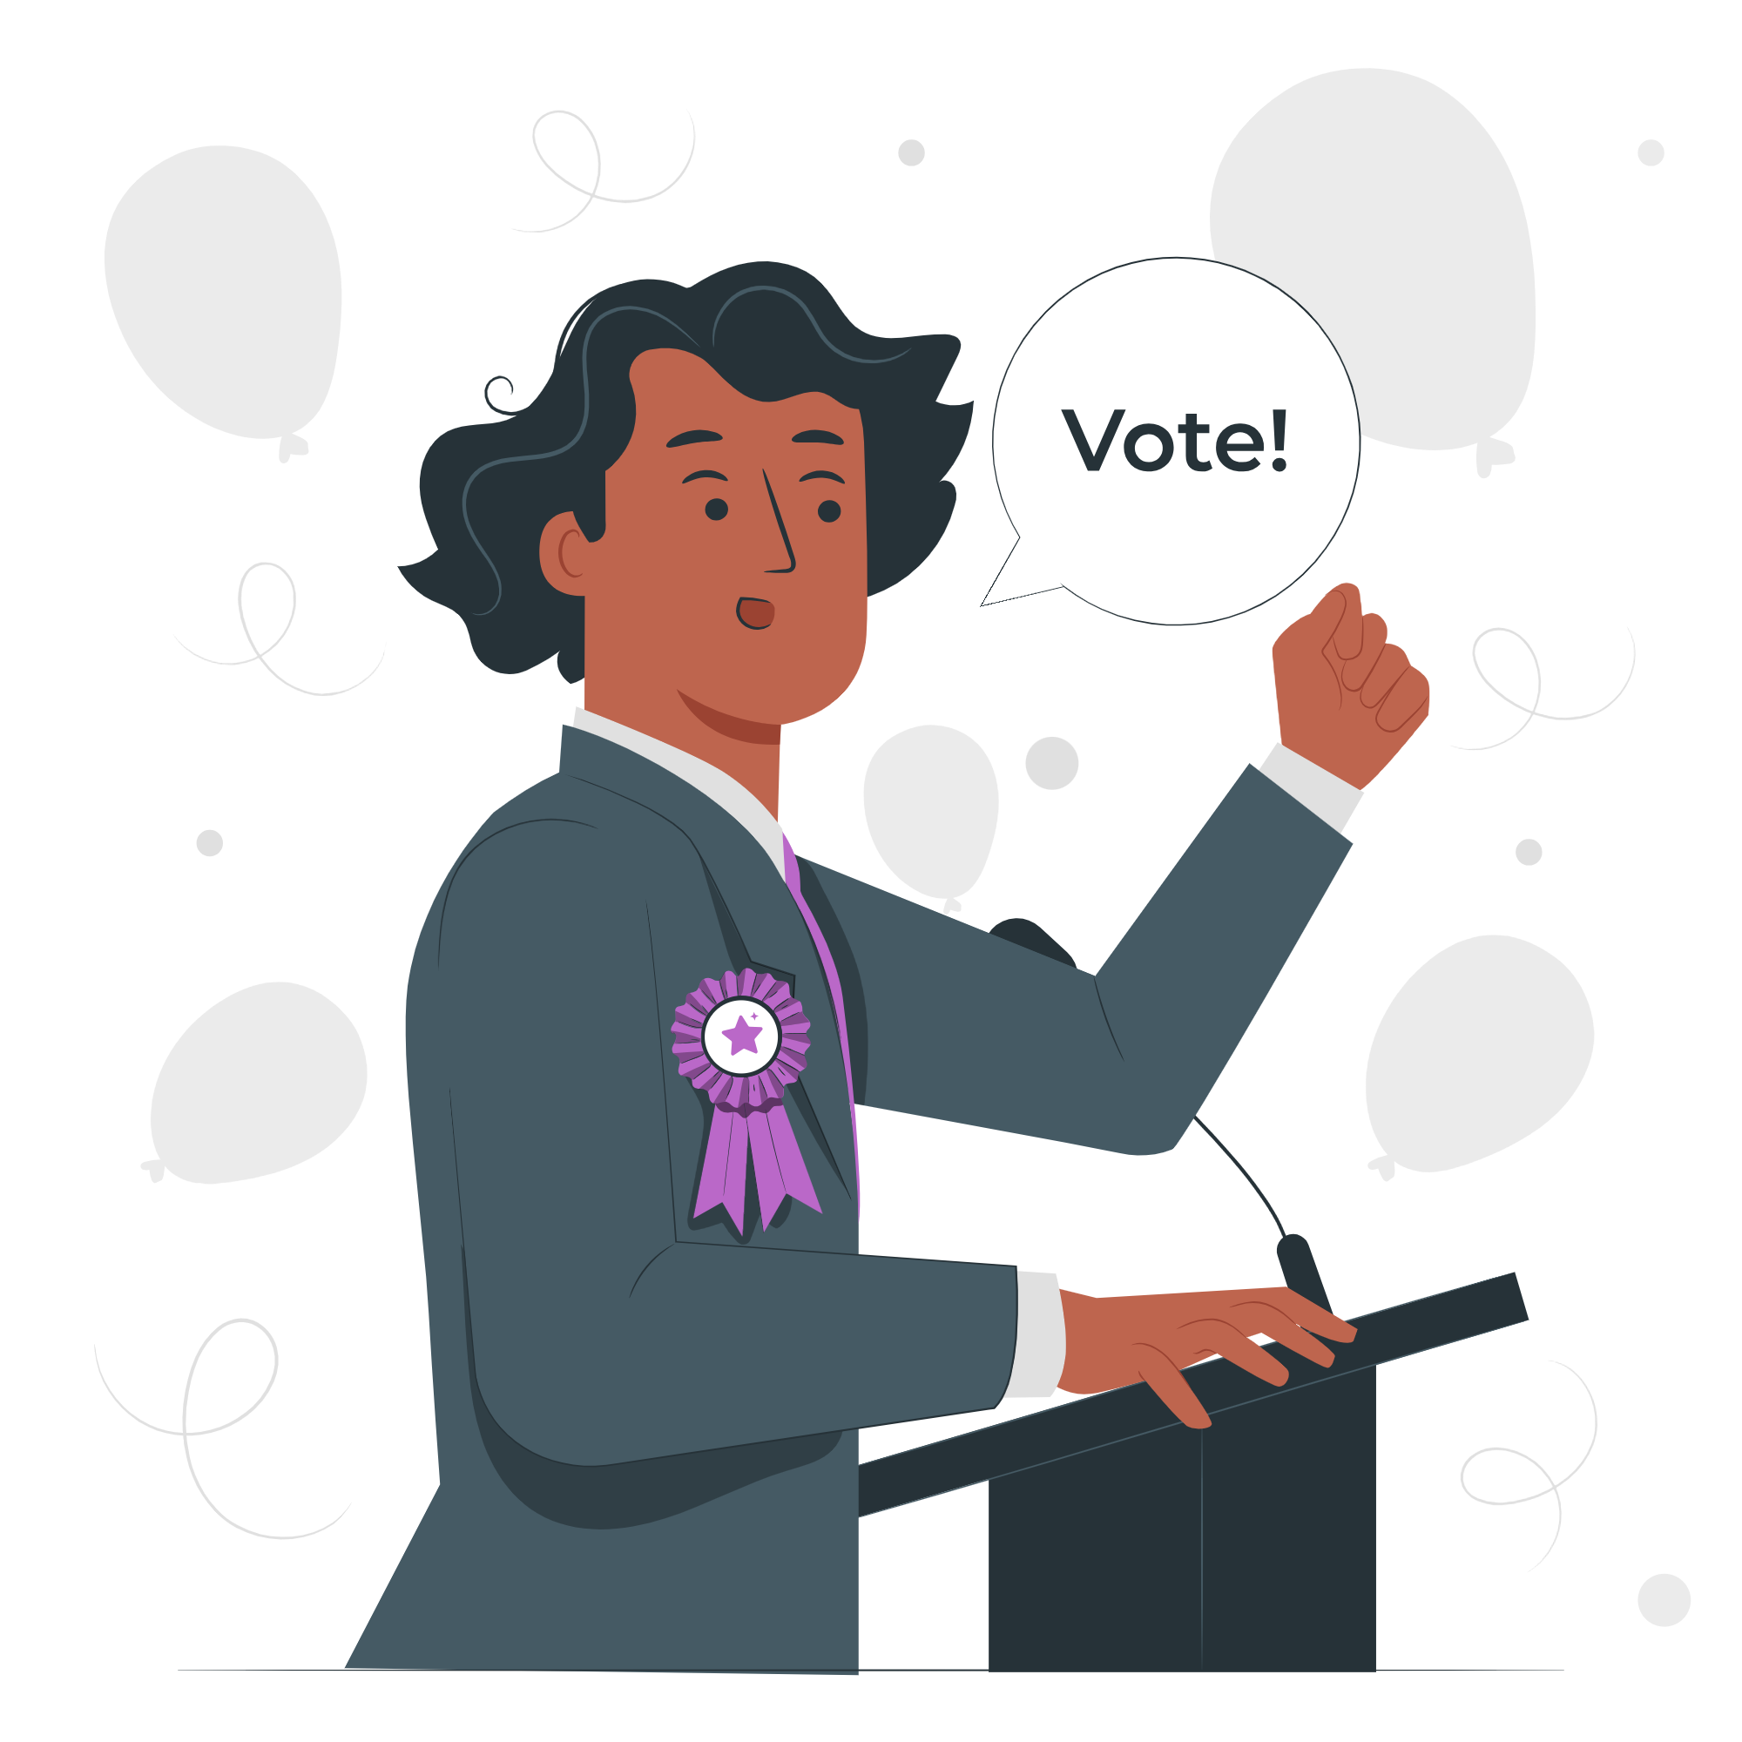
These are part of our Democratic Rights:
Registering to vote
Taking part in citizens’ assemblies
Voting in elections
Standing for election

Slide 7

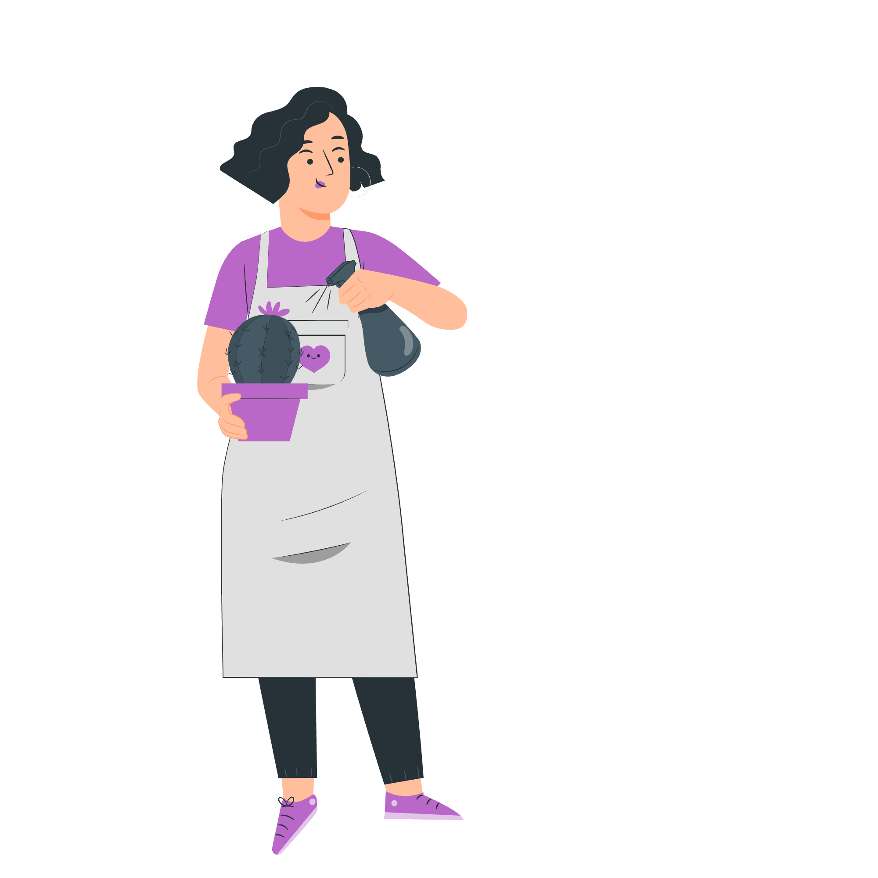
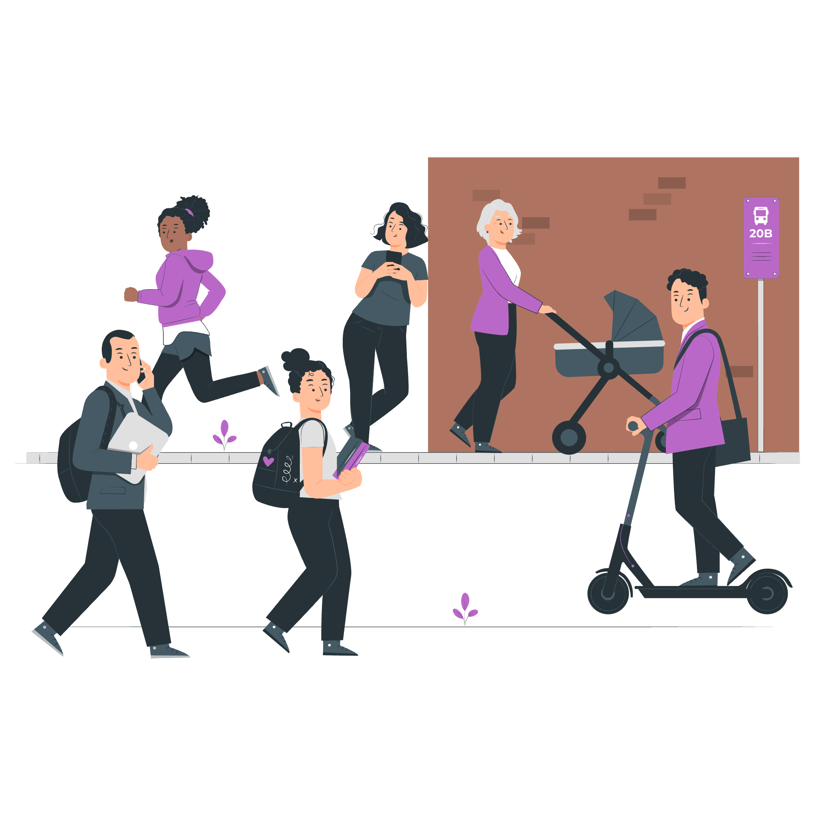
Why do people use their democratic and civic rights?
To gain knowledge and skills
To make a difference
To build stronger communities

Slide 8
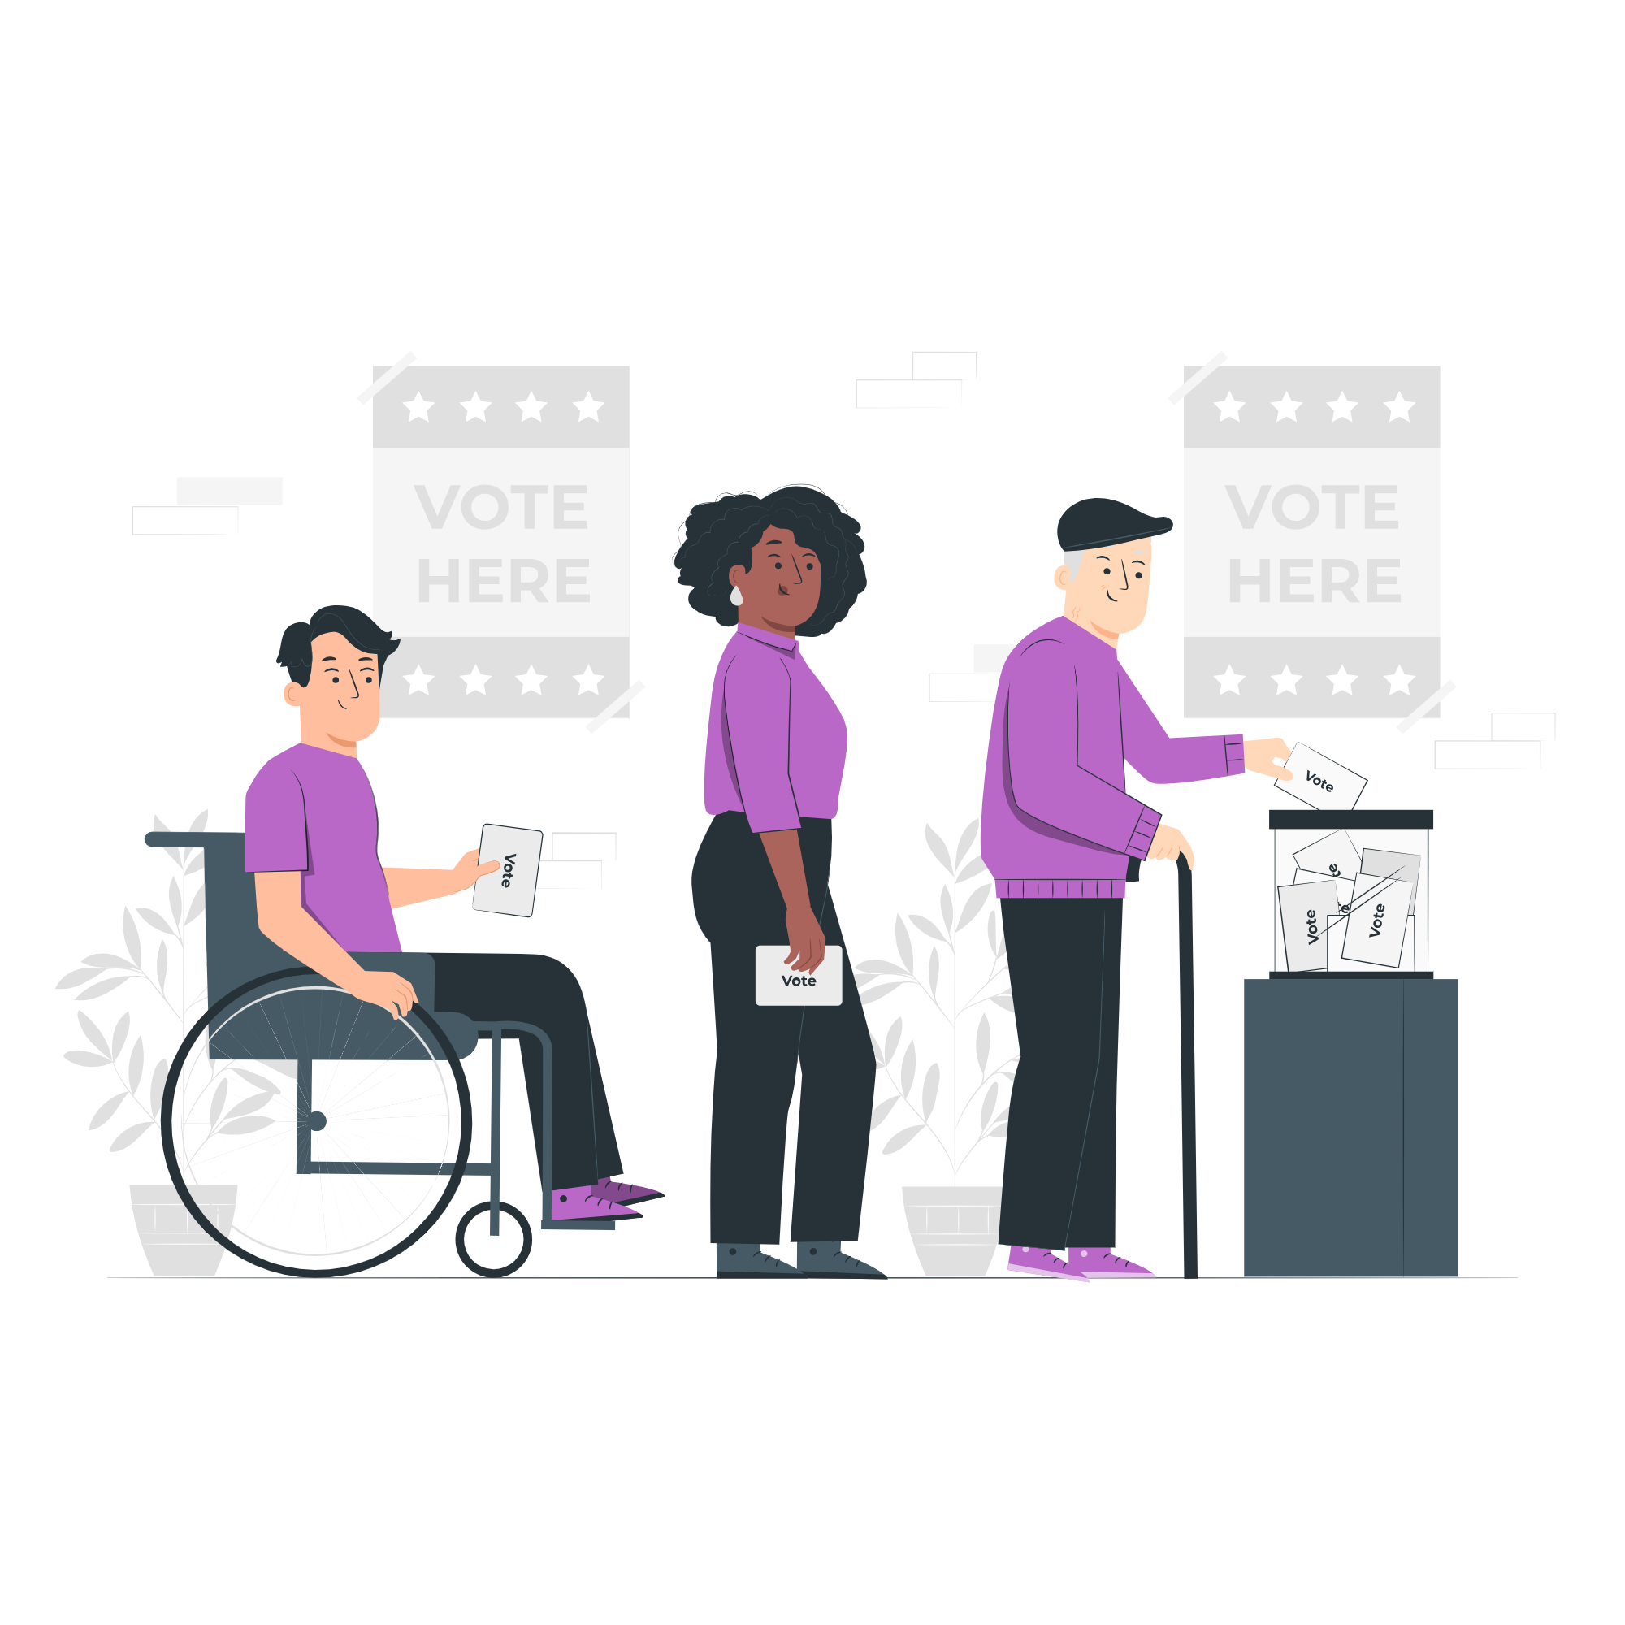
Let’s zoom in on voting:
What do you know about voting?

Slide 9
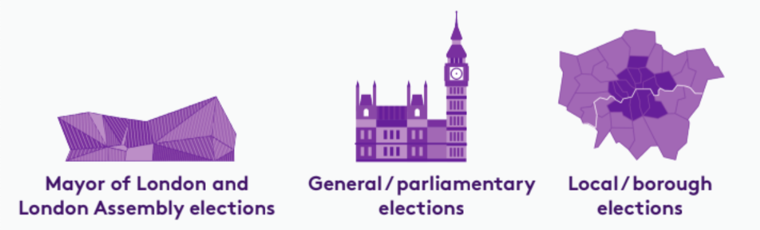
Who do you vote for?
There are three types of election in London:

Slide 10
Which London residents are eligible to vote in these elections?
 | Mayor of London and London Assembly | General / parliamentary | Local / borough
Must be at least 18 years of age | ✅ | ✅ | ✅
British or Irish citizens | ✅ | ✅ | ✅
Qualifying Commonwealth citizens | ✅ | ✅ | ✅
Qualifying EU citizens or EU citizens with retained rights | ✅ | ❌ | ✅
For further information on eligibility, head to electoralcommission.org.uk

Slide 11
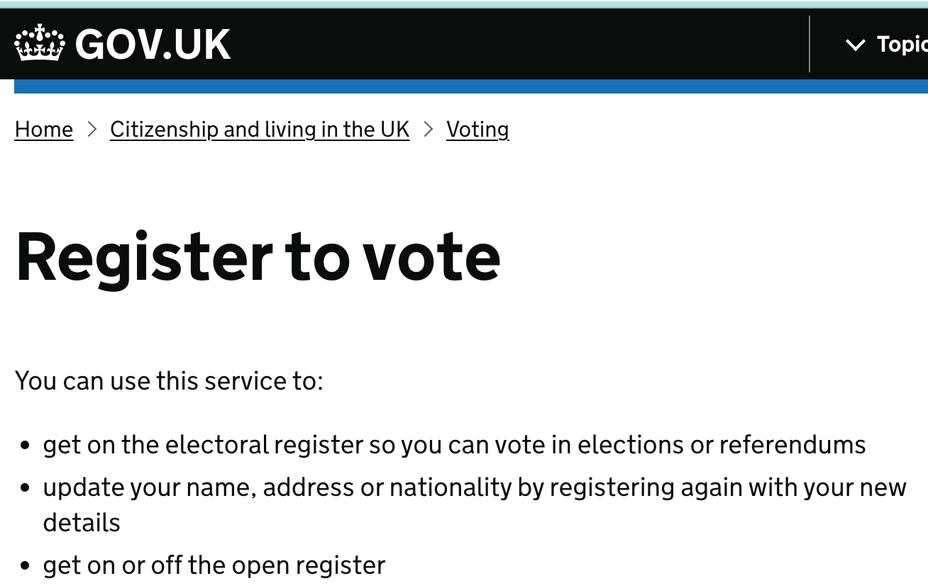
Time to register!
STEP 1:
Go to www.gov.uk/register-to-vote
(Try to have your National Insurance number handy)

Slide 12
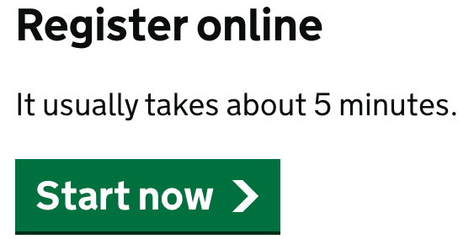
Time to register!
STEP 2:
Click the Start now button and complete the registration process!

Slide 13


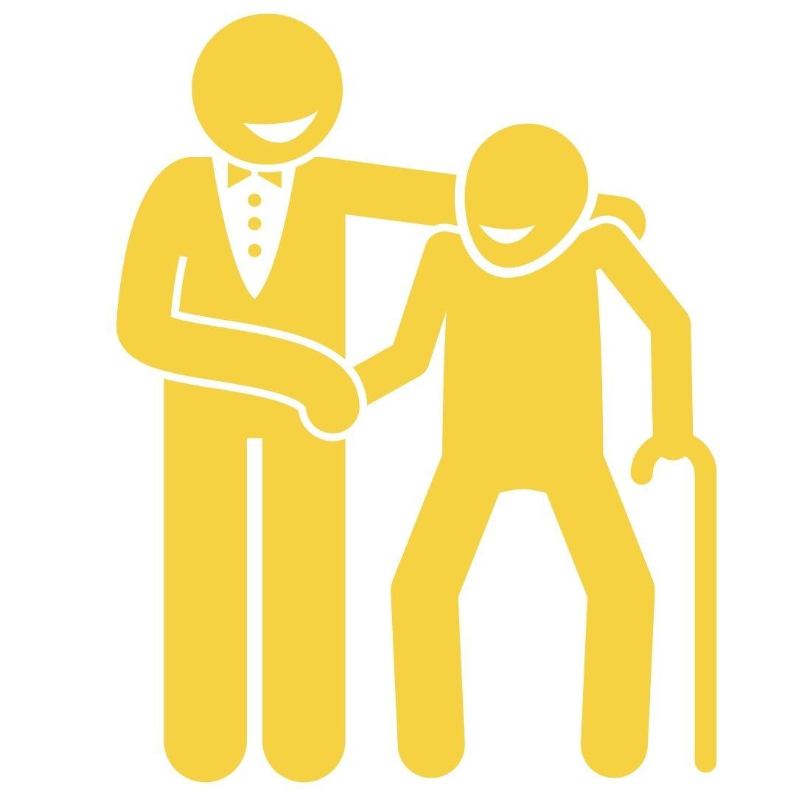
How do you vote?
In person
By post
By proxy

Slide 14
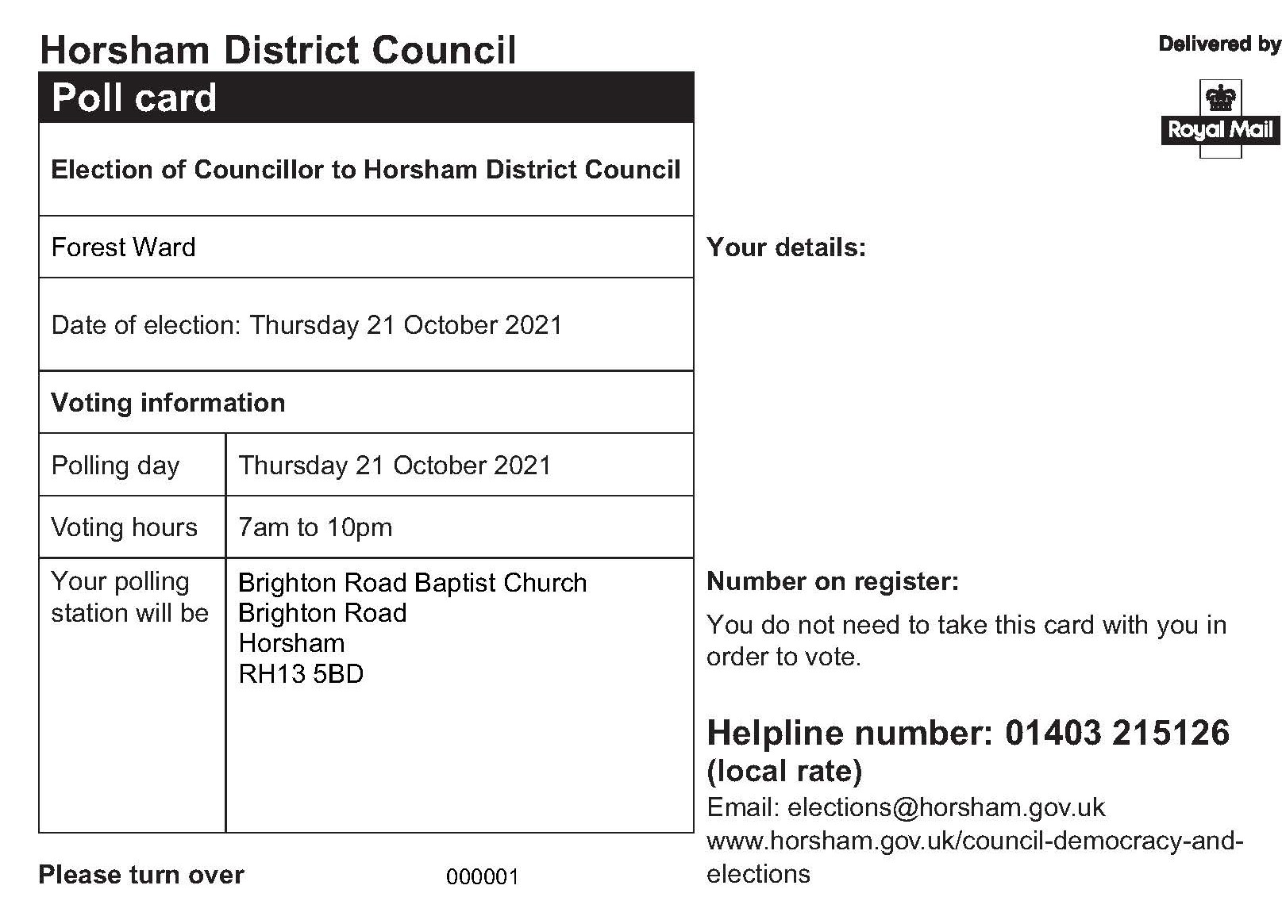
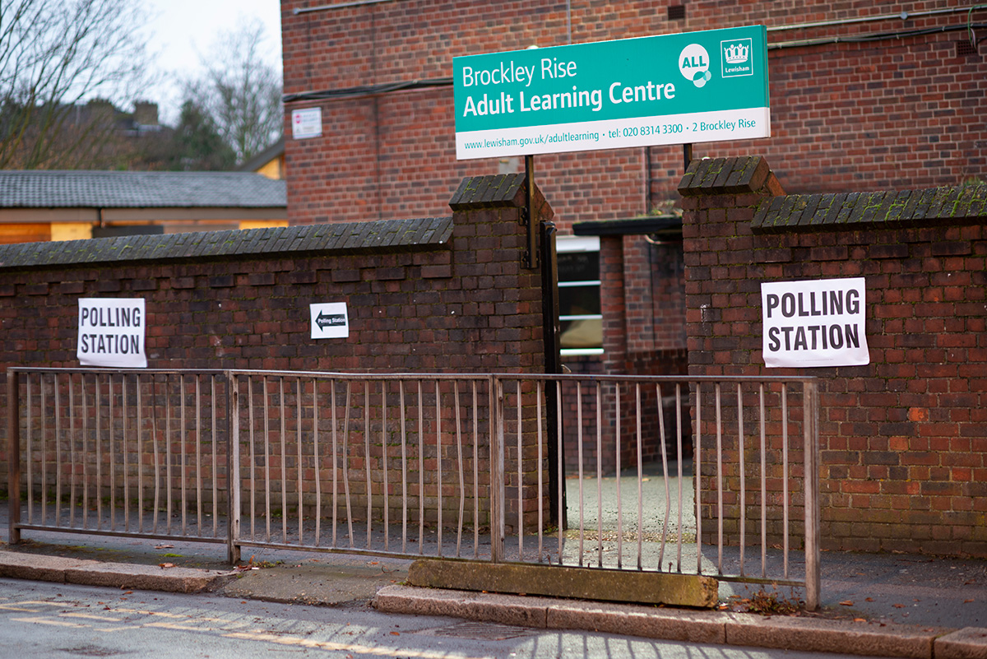
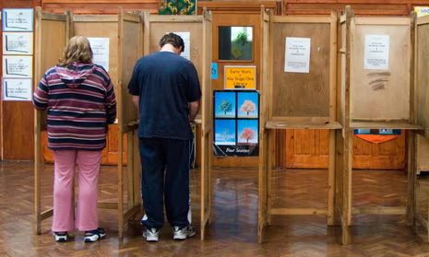
How do I vote in person?
You are sent a polling card to your house.
The card will tell you where your local polling station is and the date and time you can vote.
You go to the polling station with your ID
You vote by writing an X next to the name of the person you want to vote for.

Slide 15
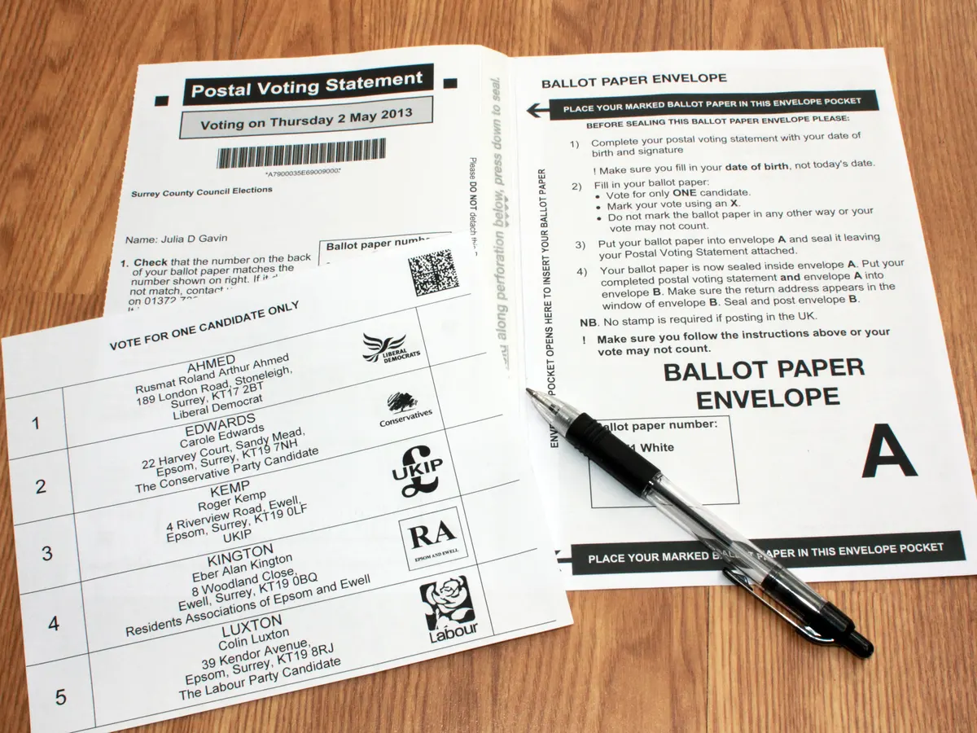
How do I vote by post?
You apply to vote by post more than two weeks before voting day (election day)
You receive your ballot (voting paper) in the post.
You write an X next to the person you want to vote for.
You send your vote in the post.

Slide 16

How do I vote by proxy?
If you can’t vote in person, or by post, you can choose someone trustworthy to vote for you.
You need to apply for a proxy vote online
You tell your proxy (the person you chose) who you want them to vote for, on your behalf
Your proxy will go to the polling station to vote for you (they will need to bring their own photo ID)

Slide 17
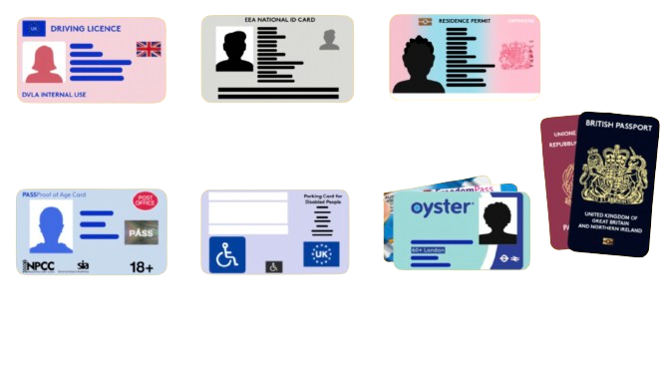

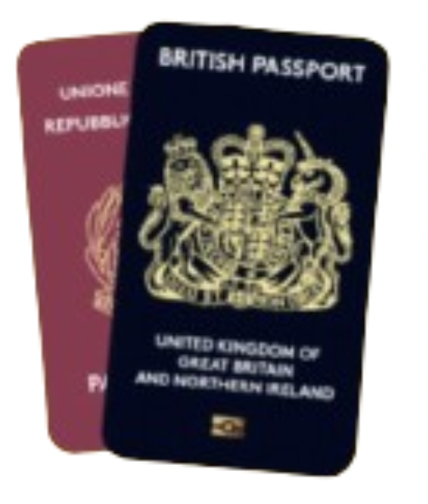
What are some accepted forms of ID?
UK, Channel Islands or EEA driving licence
National identity card issued by an EEA state
Biometric immigration document
PASS card issued by the National Proof of Age Standards Scheme bearing the PASS hologram
Blue Badge scheme card
60+ Oyster photocard or a Freedom Pass
UK, commonwealth
or EEA passport

Slide 18

What if I don’t have an accepted form of ID?
You can apply for a free Voter Authority Certificate if:
You do not have an accepted form of photo ID
You no longer look like the photo on your ID
The name on your photo ID is different to the
name on the electoral register
Funded by the Greater London Authority, City Hall, Kamal Churchie Way, London, E16 1ZE

Slide 19
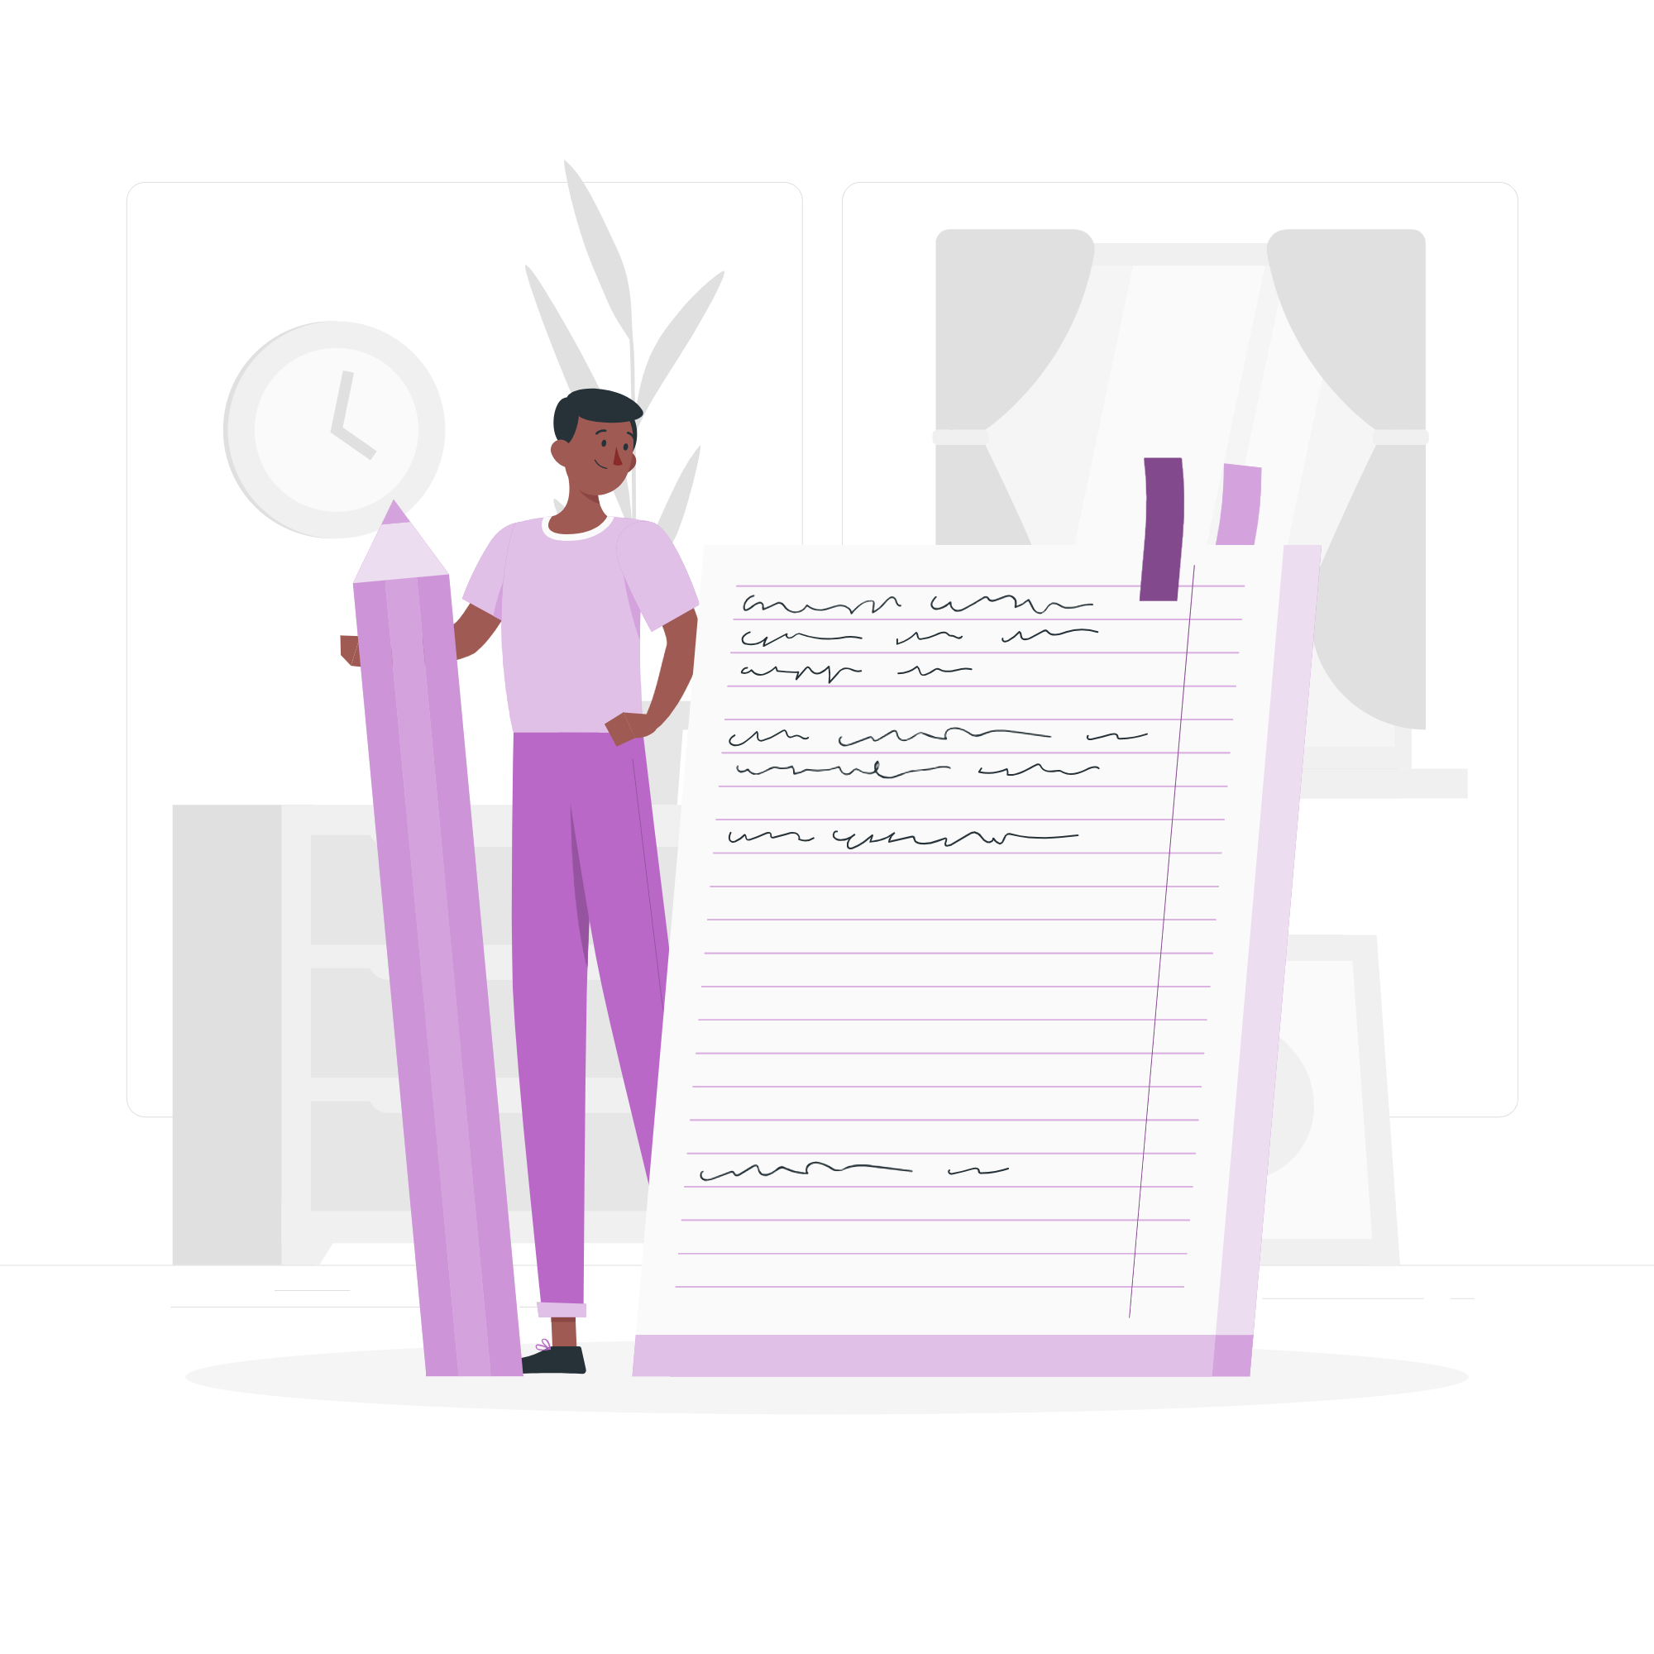


How can you follow, talk or meet the people you vote for
(elected representative)?
Follow what they say and how they vote!
Write to them!
Talking to them!
This link shows you what is said/voted for: Hansard
This link shows you how: WriteToThem
Some representatives have days and times you can visit!
Notes:
Important to note that whether you are eligible to vote or not, you can participate in these ways of engagement.

Slide 20
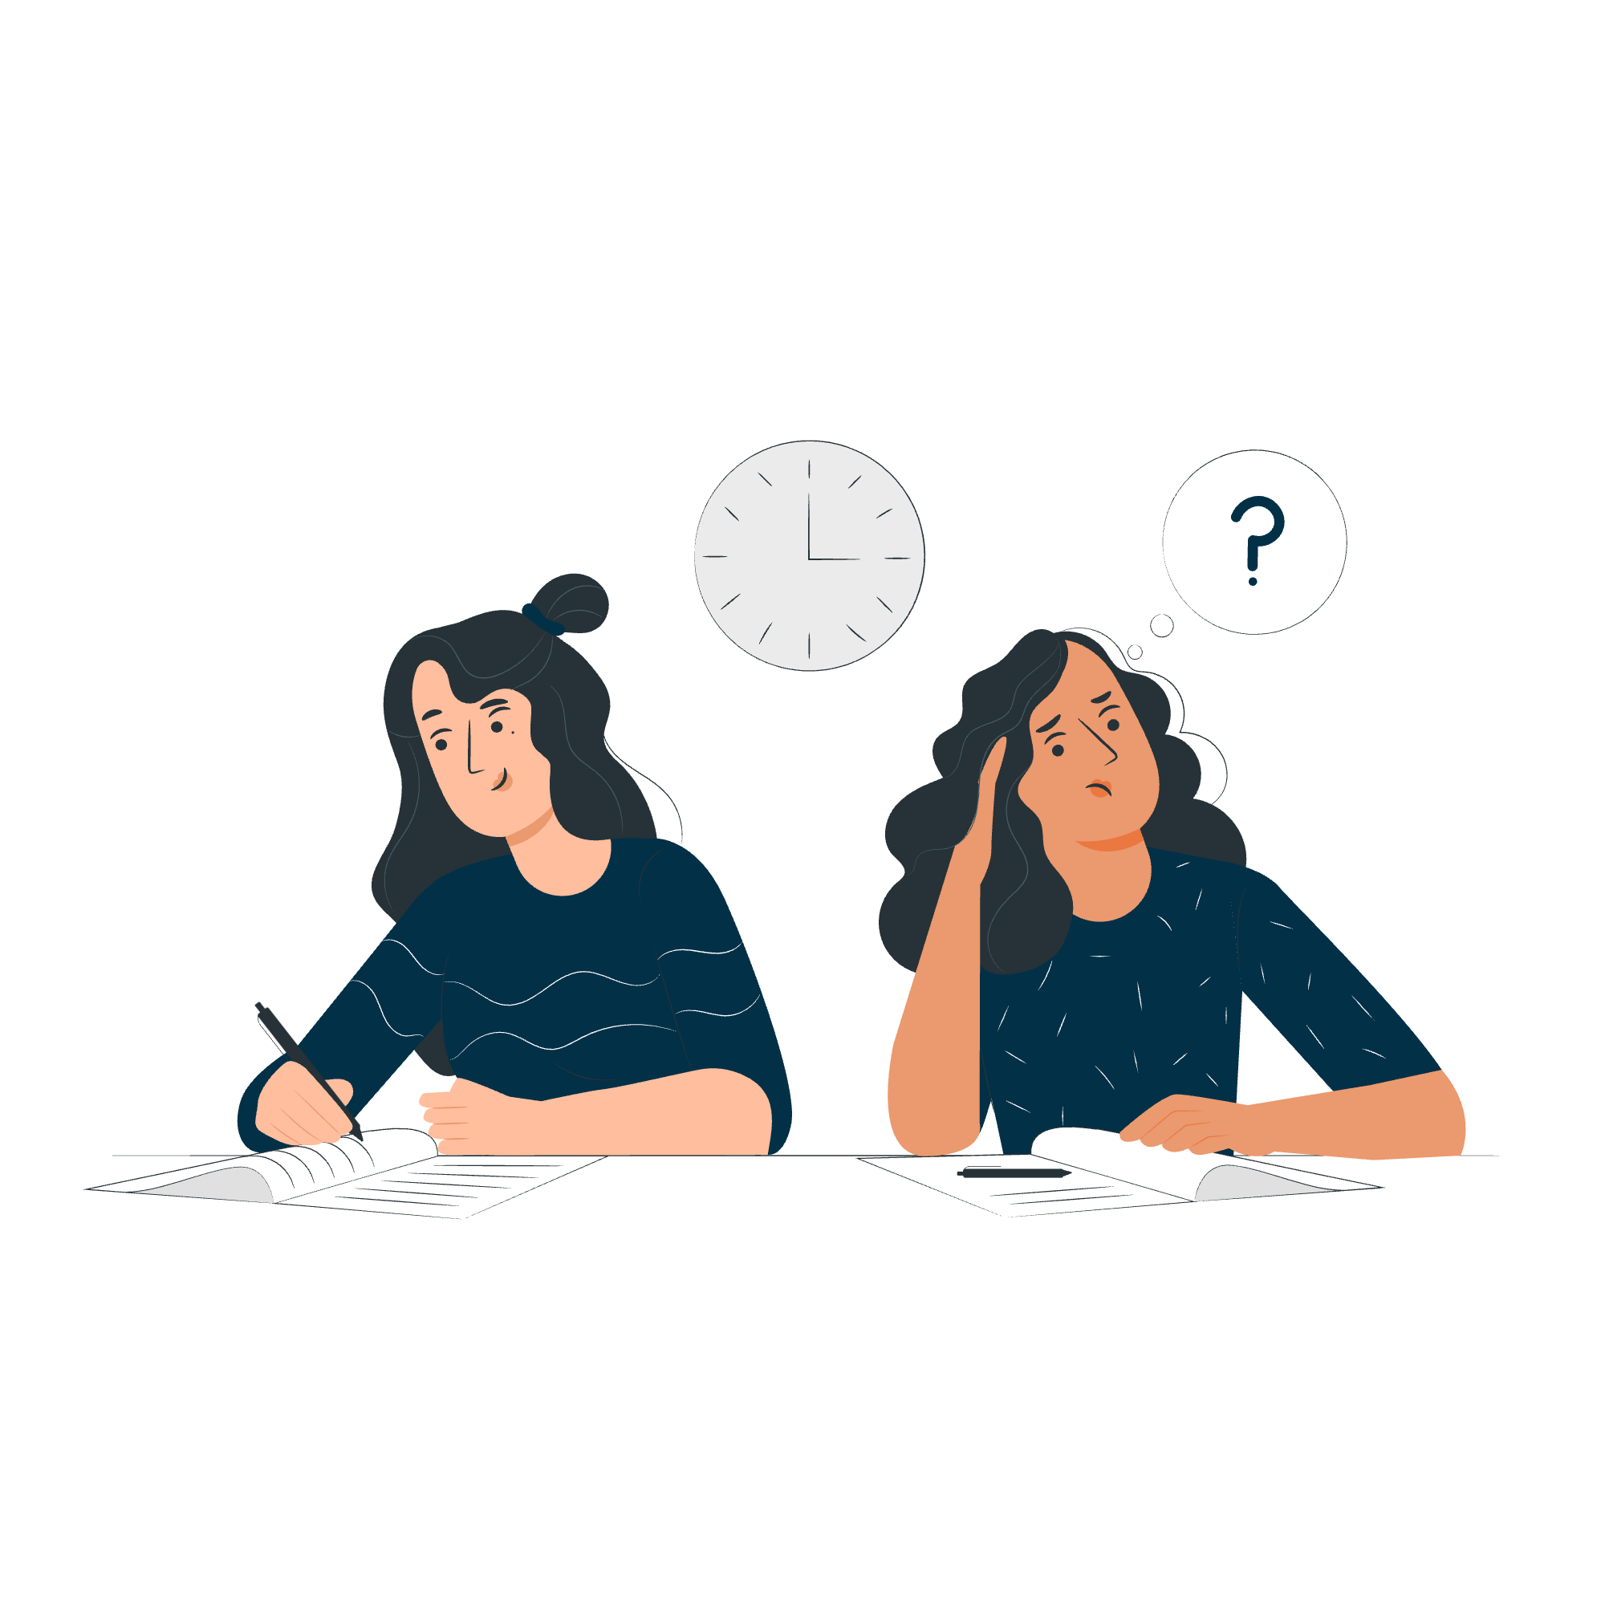
Democracy Mini Quiz!

Slide 21
True or False: I can find information on WhatsApp about voting in London.
True
False

Slide 22
True or False: I can find information on WhatsApp about voting in London.
True
False
In fact, there are two ways to get information on WhatsApp!
For personalised support on voting and translated guidance, you can use the GLA’s Whatsapp Chatbot. Just send a message to +44 7908 820136.
To get general updates and resources related to civic and democratic rights, follow the GLA and SOUK’s #NoVoteNoVoice Whatsapp Channel.

Slide 23
True or False: You can write to the person who has been voted in (elected representative).
True
False
Funded by the Greater London Authority, City Hall, Kamal Churchie Way, London, E16 1ZE

Slide 24
True or False: You can write to the person who has been voted in (elected representative).
True
False
Yes! You can find the email address of your MP, and any elected representative on WriteToThem.com

Slide 25
True or False: the debates in parliament are private (secret).
True
False

Slide 26
True or False: the debates in parliament are private (secret).
True
False
You can find transcripts and voting records from parliament on Hansard.

Slide 27
True or False: you can vote through different ways.
True
False

Slide 28
True or False: you can vote through different ways.
True
False
You need to register to vote first at www.gov.uk/register-to-vote .
Once you have registered, you can vote in person, by post or by proxy.

Slide 29
True or False: the only way to find out who your candidates are for upcoming elections is through leaflets delivered to your address.
True
False

Slide 30
True or False: the only way to find out who your candidates are is through leaflets delivered to your address.
True
False
You can find out which candidates are standing in your area at any time by checking WhoCanIVoteFor

Slide 31
True or False: if you don’t own an accepted form of photo ID you cannot vote in person.
True
False

Slide 32
True or False: if you don’t own an accepted form of photo ID you cannot vote in person.
True
False
Be prepared - if you don’t have an accepted form of photo ID, you can apply for a Voter Authority Certificate! These are free, valid for 10 years, and have no gender marker.
Apply here: gov.uk/apply-for-photo-id-voter-authority-certificate

Slide 33

Your voice matters, make sure it gets heard!
Check out the GLA democracy Hub registertovote.london to:
Find more information on your civic and democratic rights
Find comprehensive FAQs and WhatsApp chatbot (+44 7908820136)
Find information in different languages

Slide 34

Thank You!
For more information contact the
GLA Democratic Participation Team at: democracy@london.gov.uk
Funded by the Greater London Authority, City Hall, Kamal Churchie Way, London, E16 1ZE

