Slide 1
LONDON
Lesson | ACTIVE CITIZENSHIP

Slide 2
What are the aims of this session?
Today we will:
Identify what an Active Citizen is
Identify what a Community is
Explain and create a Social Action plan
Present your Social Action plan to your peers

Slide 3
Animation Video: Active Citizenship
LVRW 2022 animation : https://drive.google.com/drive/folders/12W1F9L7gGVTiVPiyADSlctC1Ddde_sKb

Slide 4
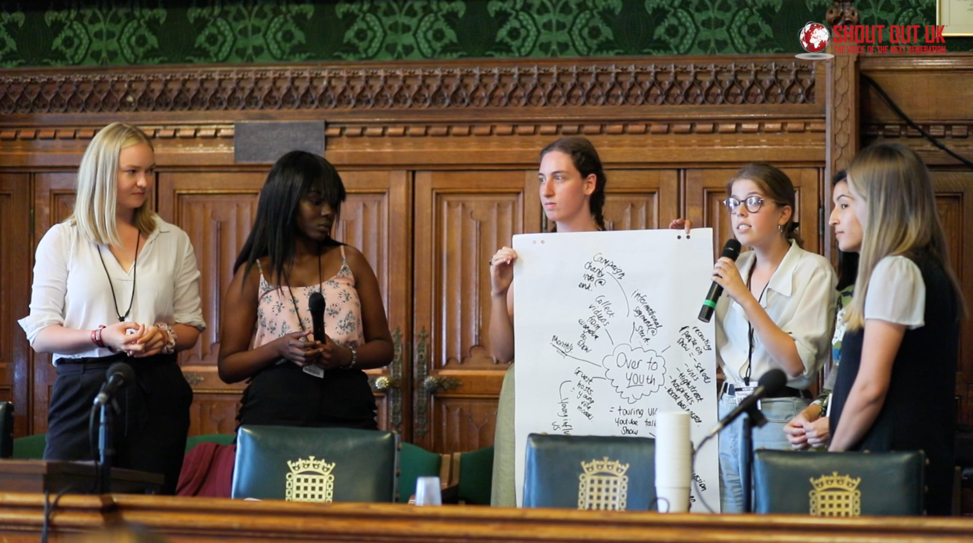
Active Citizens don't wait around for change to happen…
Active Citizens are regular people who feel inspired. They are residents who feel motivated and empowered to make a difference through their voice and their actions.
This means that Londoners, irrespective of their background, nationality or immigration status, who have the belief, the passion, the experience and the know-how to make sure ideas come to life and benefit others, can be active citizens and residents.

Slide 5
DISCUSS
In groups or pairs discuss what a social action is.
Can you outline an example of social action?

Slide 6
Social Action is….
Social action is about people coming together to help improve their lives and solve the problems that are important in their communities.

Slide 7
Running a voter registration event at your school
Playing video games to raise money for MIND (mental health charity)
Social action can be categorised through:
Campaigning
Work in an organised and active way towards a particular goal, typically a democratic or social one
Fundraising
Seek to generate financial support for a charity or cause
Volunteering
Any activity that involves spending time, unpaid, doing something that aims to help the community, a cause or individual
Cooking meals for people experiencing homelessness

Slide 8
Idea
Making a difference
In groups, plan out ONE type of social action you are going to undertake.
Step 1: Figure out if you are going to run a campaign, fundraise for an issue or volunteer for your local community.
Step 2: What issue do you plan on tackling?
Step 3: Present your idea back to the class.

Slide 9
Place image here
Community focus:
Does your plan tackle a London issue?
Community is a collection of people who share a common identity, values, interests, customs or territory and meet their basic physical and social needs through regular interaction with one another.
E.g. your street, your neighbourhood, your borough, London, your ethnic or faith community, your sports club, your community centre, etc.

Slide 10
Appreciative inquiry
Write down….
What makes you proud to live in London?
What would you like to see in London in 5 years’ time?

Slide 11
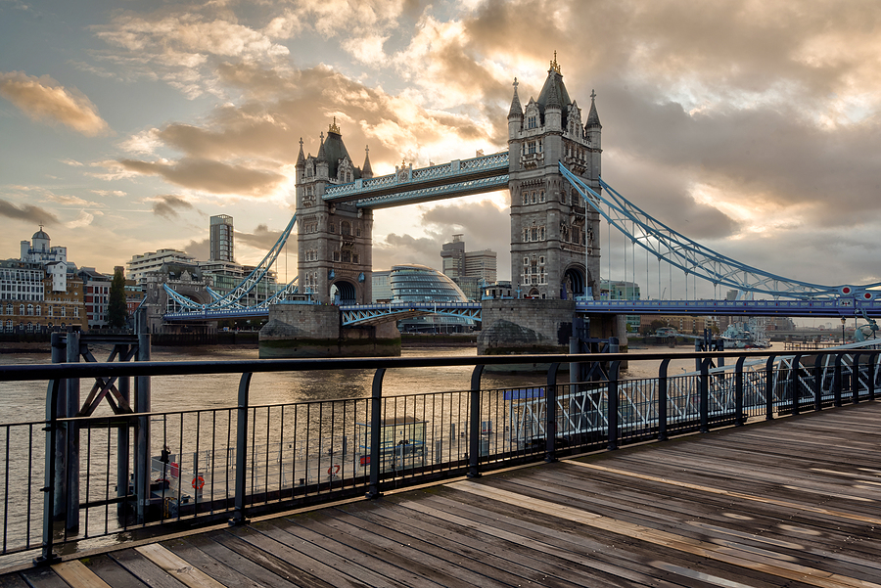
Focusing on London Challenges:
Increase in cost of living
Women’s safety
Homelessness and temporary accommodation
Notes:
Source: https://www.centreforlondon.org/

Slide 12
Our streets now:
Our Streets Now is a youth-led campaign to tackle the issue of public sexual harassment (PSH) through two routes:
Legislation: a petition to introduce specific legislation to make PSH a reportable offence. The petition was launched in April 2019 and now has nearly a quarter of a million signatures.
Cultural change: Our Schools Now provides resources for schools and organisations to tackle PSH.
Notes:
Source: https://www.cypnow.co.uk/best%20practice/article/sisters-launch-campaign-for-law-change-to-tackle-public-sexual-harassment

Slide 13
Making a difference
Go back to your original plan and see if you need to update and include a community element.
You may be able to tackle the issue, but you will want to think about how you can do this locally and collectively.

Slide 14
Make sure you do your research…
It is important to do some research before you start your social action to find out:
Whether the social action is actually necessary
Who it impacts and how
What else, if anything has been done about it
Who has the power to bring about change

Slide 15
Research
Find that statistic
Using a computer, tablet or book find a statistic that proves your social action issue needs to be addressed.
Think about:
The geographic location that the statistic can be applied to
Data sets from the statistic (How did the source come up with that statistic and can the data be broken down in further detail?)

Slide 16
Social Action Idea: The heart of your project: What is the difference that you are making? | Partners: Who is going to help you deliver your activities? | Delivery: What activities are you going to do to make a difference? | Raising awareness: How will you get the word out about the issue and your plan? Social Media, leaflet making, creating a petition? | People: Who are the people that benefit from your social action?
 | Resources: What resources do you have and what might you need? (A physical space, a particular game, any equipment?)
Social Action Delivery: How will you do this? Through a campaign, fundraising or volunteering? |  |  |  | Unique Point: How is your social action different to other charities, or activities?
The social action model is a template that you can use to plan and refine different aspects of your project or idea.

Slide 17
Present your Social Action Plan.
In your groups come together and present your idea following the social action model template.

Slide 18
Thank you
For more information contact the GLA Social Integration Team elisabeth.pop@london.gov.uk
london.gov.uk

